Slide 1
新年，新發展！
New year,
New development!
房正豪牧師
Pastor Fang

Slide 2
1. 先要有
“神國度”的看見！
Possess the vision of "God’s Kingdom"!

Slide 3
2020 我愛我家，同心建造
I love my family. Build up with one mind!

Slide 4
使徒行傳 10:1-2
1 在恺撒利亚有一个人名叫哥尼流，是“意大利营”的百夫长。
2 他是个虔诚人，他和全家都敬畏神，多多周济百姓，常常祷告神。

Slide 5
Acts 10:1-2
1 At Caesarea there was a man named Cornelius, a centurion in what was known as the Italian Regiment.
2 He and all his family were devout and God-fearing; he gave generously to those in need and prayed to God regularly.

Slide 6
使徒行傳 10:9-16
9 第二天，他们行路将近那城，彼得约在午正上房顶去祷告。
10 觉得饿了，想要吃。那家的人正预备饭的时候，彼得魂游象外，

Slide 7
11 看见天开了，有一物降下，好像一块大布，系着四角，缒在地上，
12 里面有地上各样四足的走兽和昆虫，并天上的飞鸟。

Slide 8
13 又有声音向他说：“彼得，起来，宰了吃！” 14 彼得却说：“主啊，这是不可的！凡俗物和不洁净的物，我从来没有吃过。”

Slide 9
15 第二次有声音向他说：“神所洁净的，你不可当做俗物。”
16 这样一连三次，那物随即收回天上去了。

Slide 10
Acts 10:9-16
9 About noon the following day as they were on their journey and approaching the city, Peter went up on the roof to pray.
10 He became hungry and wanted something to eat, and while the meal was being prepared, he fell into a trance.

Slide 11
11 He saw heaven opened and something like a large sheet being let down to earth by its four corners.
12 It contained all kinds of four-footed animals, as well as reptiles and birds. 13 Then a voice told him, “Get up, Peter. Kill and eat.”

Slide 12
14 “Surely not, Lord!” Peter replied. “I have never eaten anything impure or unclean.”
15 The voice spoke to him a second time, “Do not call anything impure that God has made clean.”
16 This happened three times, and immediately the sheet was taken back to heaven.

Slide 13
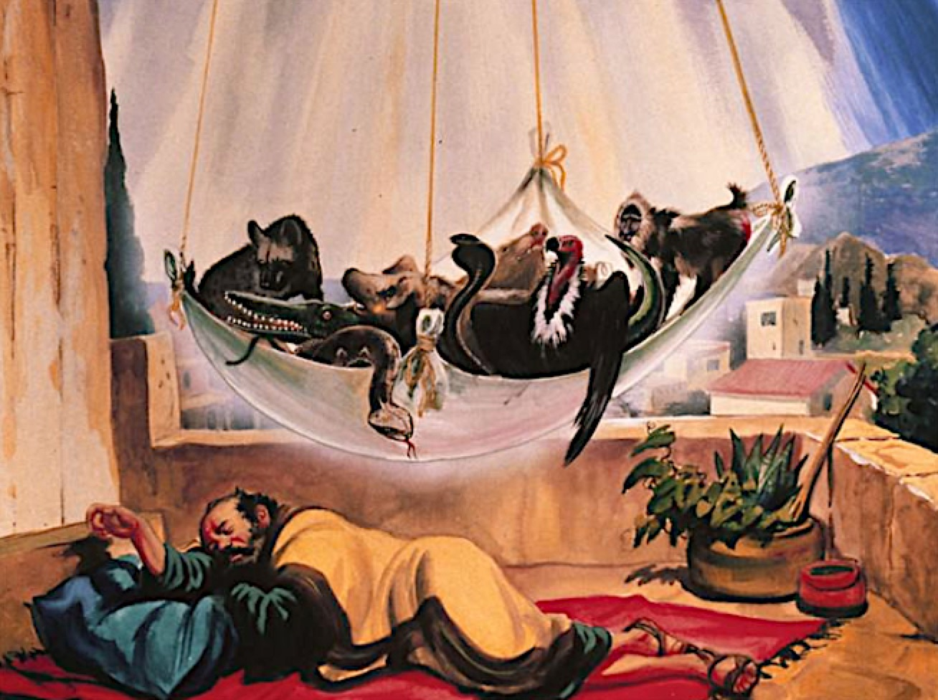

Slide 14
使徒行傳 10:15
第二次有声音向他说：
神所洁净的，你不可当做俗物。
The voice spoke to him a second time, “Do not call anything impure that God has made clean.

Slide 15
2. 要突破自己的成见，学习顺服神带领。
Overcome prejudice, Learn to Obey God’s guidance.

Slide 16
要全力發展小組功能Grow cell groups with all we have
關懷、查經、活動
Caring, Bible study and Activities

Slide 18
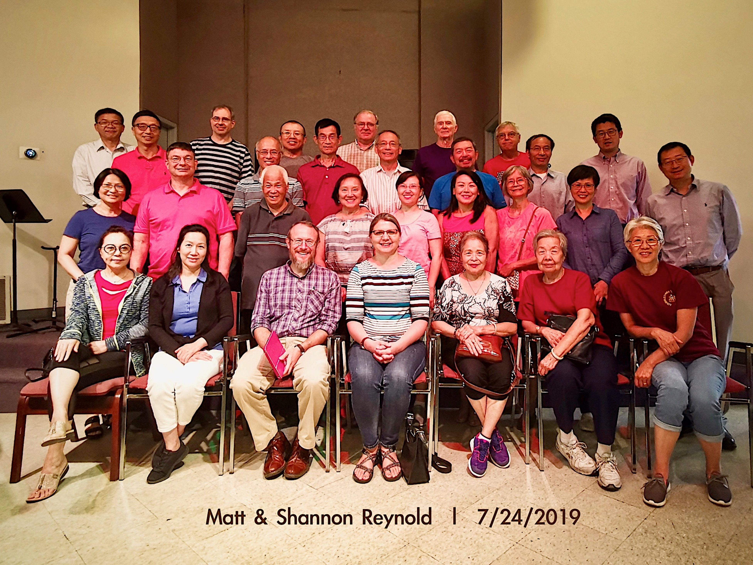

Slide 19
罗马书 Romans 12:11
殷勤不可懒惰；
要心里火热，
常常服侍主。
Never be lacking in zeal,
but keep your spiritual fervor,
serving the Lord.

Slide 20
為主大發熱心！
Be Enthusiastic for God!

Slide 21
新年操練四個字
Four resolution words for the New Year
聖、勇、專、誠
Sanctification, Courageous, Faithfulness, Honesty

Slide 22
1. 聖潔 Holy
帖撒罗尼迦前书 1 Thessalonians 4:7
神召我们本不是要我们沾染污秽，乃是要我们成为圣洁。
For God did not call us to be impure, but to live a holy life.

Slide 23
2.勇敢 Courageous
教會要勇於突破現況
Church needs to have courage to break through current circumstances.

Slide 24
3.专一 Faithfulness
立志专心跟从主
Faithfulness: Commitment in following God

Slide 25
民数记 14: 24
唯独我的仆人迦勒，因他另有一个心志，专一跟从我，我就把他领进他所去过的那地。他的后裔也必得那地为业。

Slide 26
Numbers 14: 24
But because my servant Caleb has a different spirit and follows me wholeheartedly, I will bring him into the land he went to, and his descendants will inherit it.

Slide 27
4.诚实 Honesty
做人要誠信，
做事要實在
Be Honest and Be Real

Slide 28
新年新發展
New Year New Beginning
1.要先看見“神的國度”
Have Vision of “God's Kingdom”

Slide 29
2.還要突破成見，
願意順服神
Overcome prejudice,
Obey God

Slide 30
3.立志操練
Commit to practice
聖潔、勇敢、專一、誠實
Sanctification, Courageous, Faithfulness, Honesty

