Slide 1
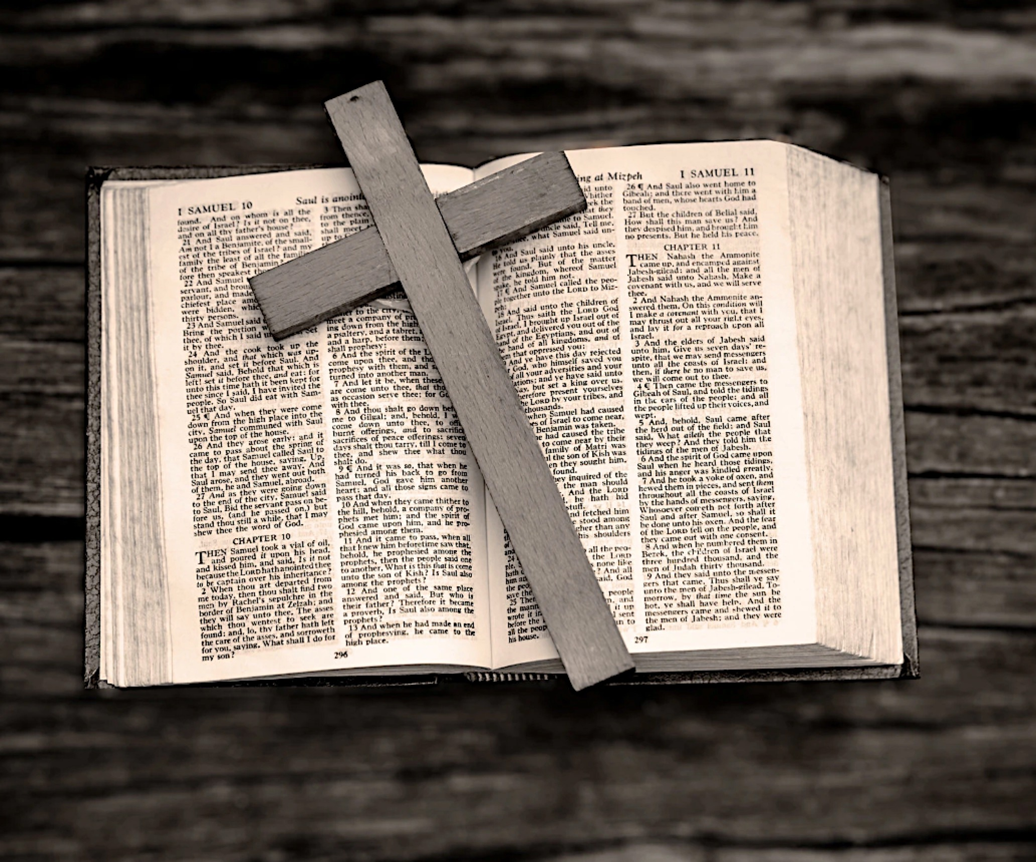
末世警鐘！預備主再來！
Apocalyptic bell, prepare the Lord to come again!
房正豪牧師

Slide 2
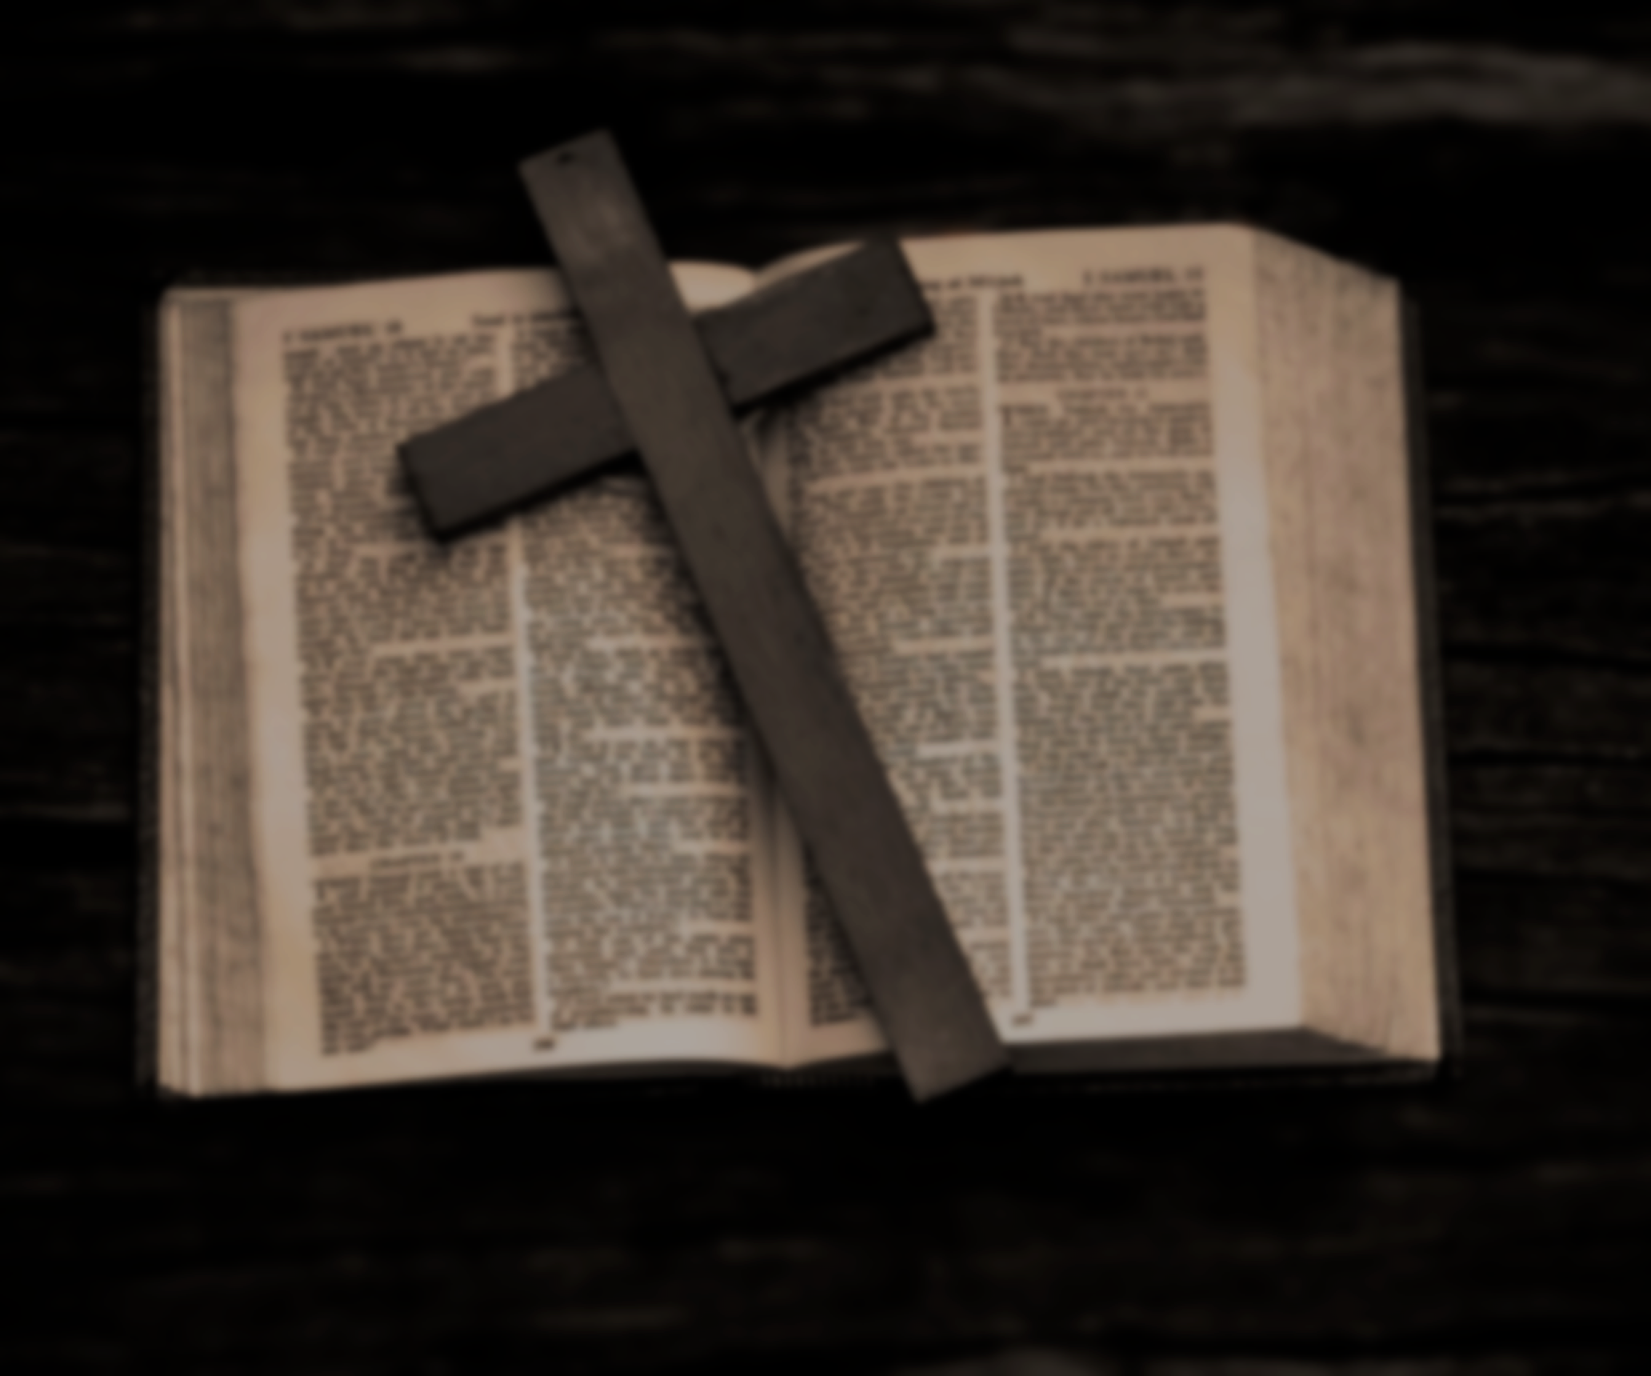
历代志下 6: 27
求你在天上垂听，赦免你仆人和你民以色列的罪，将当行的善道指教他们，且降雨在你的地，就是你赐给你民为业之地。

Slide 3
2 Chronicles 6: 27
then hear from heaven and forgive the sin of your servants, your people Israel. Teach them the right way to live, and send rain on the land you gave your people for an inheritance.

Slide 4
历代志下 6: 28-30
28 “国中若有饥荒、瘟疫、旱风、霉烂、蝗虫、蚂蚱，或有仇敌犯境围困城邑，无论遭遇什么灾祸疾病，

Slide 5
29 你的民以色列，或是众人，或是一人，自觉灾祸甚苦，向这殿举手，无论祈求什么，祷告什么，

Slide 6
30 求你从天上你的居所垂听赦免。你是知道人心的，要照各人所行的待他们唯有你知道世人的心

Slide 7
2 Chronicles 6: 28-30
28 “When famine or plague comes to the land, or blight or mildew, locusts or grasshoppers, or when enemies besiege them in any of their cities, whatever disaster or disease may come,

Slide 8
29 and when a prayer or plea is made by anyone among your people Israel—being aware of their afflictions and pains, and spreading out their hands toward this temple—

Slide 9
30 then hear from heaven, your dwelling place. Forgive, and deal with everyone according to all they do, since you know their hearts (for you alone know the human heart),

Slide 10
历代志下 7: 12-14
12 夜间，耶和华向所罗门显现，对他说：“我已听了你的祷告，也选择这地方作为祭祀我的殿宇。

Slide 11
13 我若使天闭塞不下雨，或使蝗虫吃这地的出产，或使瘟疫流行在我民中，

Slide 12
14 这称为我名下的子民，若是自卑，祷告，寻求我的面，转离他们的恶行，我必从天上垂听，赦免他们的罪，医治他们的地。

Slide 13
2 Chronicles 7: 12-14
12 the Lord appeared to him at night and said:“I have heard your prayer and have chosen this place for myself as a temple for sacrifices.

Slide 14
13 “When I shut up the heavens so that there is no rain, or command locusts to devour the land or send a plague among my people, heaven, and I will forgive their sin and will heal their land.

Slide 15
14 if my people, who are called by my name, will humble themselves and pray and seek my face and turn from their wicked ways, then I will hear from heaven, and I will forgive their sin and will heal their land.

Slide 16
13 我若使天闭塞不下雨，或使蝗虫吃这地的出产，或使瘟疫流行在我民中，
13 “When I shut up the heavens so that there is no rain, or command locusts to devour the land or send a plague among my people, heaven, and I will forgive their sin and will heal their land.

Slide 17
自卑、禱告，
尋求神轉離我們的惡行。
Inferiority, pray for God to turn away from our evil deeds.

Slide 18
垂听、赦免、医治！
Listen, forgive, and healing!

Slide 19
彼得后书 3: 9
主所应许的尚未成就，有人以为他是耽延，其实不是耽延，乃是宽容你们，不愿有一人沉沦，乃愿人人都悔改。

Slide 20
2 Peter 3: 9
The Lord is not slow in keeping his promise, as some understand slowness. Instead he is patient with you, not wanting anyone to perish, but everyone to come to repentance.

Slide 21
末世的现象有三点：
1. 不法的事增多。
2. 假基督，假先知的出现。
3. 教会将要受到逼迫。

Slide 22
以赛亚书 41: 10
你不要害怕，因为我与你同在；不要惊惶，因为我是你的神。我必坚固你，我必帮助你，我必用我公义的右手扶持你。

Slide 23
Isaiah 41: 10
So do not fear, for I am with you;
do not be dismayed, for I am your God.
I will strengthen you and help you;
I will uphold you with my righteous right hand.

Slide 24
提摩太后书 1: 7
因为神赐给我们不是胆怯的心，乃是刚强、仁爱、谨守的心。

Slide 25
2 Timothy 1:7
For the Spirit God gave us does not make us timid, but gives us power, love and self-discipline.

Slide 26
预备自己有三点：
1. 增强属灵的分辨力！
2. 坚守内心圣洁的生活！
絕不能給罪留破口。
3. 寻找机会，传扬福音！

Slide 27
箴言 Proverbs 4: 23
你要保守你心，胜过保守一切，因为一生的果效是由心发出。Above all else, guard your heart, for everything you do flows from it.

Slide 28
启示录记载的災難将要发生。
The disaster recorded in Revelation is about to happen.

Slide 29
提摩太后书 2 Timothy 4: 7
那美好的仗我已经打过了，
当跑的路我已经跑尽了，
所信的道我已经守住了。
I have fought the good fight, I have finished the race, I have kept the faith.

Slide 30
末世警鐘！預備主再來！
Apocalyptic bell, prepare the Lord to come again!

Slide 31
末世的现象有三点：
There are three things in the last days:
不法的事增多。
Unlawful things increased.

Slide 32
2. 假基督，假先知的出现。
The appearance of false Christ, false prophet.
3. 教会将要受到逼迫。
The church is about to be persecuted.

Slide 33
预备自己有三点：
Prepare yourself for three things:
增强属灵的分辨力！
Enhance spiritual discrimination!

Slide 34
2. 坚守内心圣洁的生活！
Stick to a holy life inside!
絕不能給罪留破口。
There must be no breach of sin
3. 寻找机会，传扬福音！
Find Opportunities and Preach the Gospel!

