Slide 1
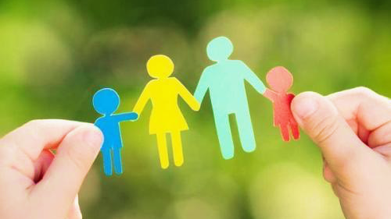

現代父母甘苦談
Joys & Pains of Modern Parenting
房正豪牧師

Slide 2

提摩太后书 1:5-7
5 想到你心里无伪之信，这信是先在你外祖母罗以和你母亲友尼基心里的，我深信也在你的心里。
6 为此我提醒你，使你将神借我按手所给你的恩赐再如火挑旺起来。

Slide 3
提摩太后书 1:5-7
7 因为神赐给我们不是胆怯的心，乃是刚强、仁爱、谨守的心。

Slide 4
2 Timothy 1:5-7
5 I am reminded of your sincere faith, which first lived in your grandmother Lois and in your mother Eunice and, I am persuaded, now lives in you also.
6 For this reason I remind you to fan into flame the gift of God, which is in you through the laying on of my hands.

Slide 5
2 Timothy 1:5-7
7 For the Spirit God gave us does not make us timid, but gives us power, love and self-discipline.

Slide 6
父母當看重“屬靈的傳承” Parents must Place Emphasis on their Spiritual Legacy

Slide 7
箴言 Proverbs 22:6
教养孩童，使他走当行的道，
就是到老他也不偏离。
Start children off on the way they should go, and even when they are old they will not turn from it.

Slide 8
尊主為大!
Magnify the Lord!

Slide 9
以赛亚书 Isaiah 66:13
母亲怎样安慰儿子，我就照样安慰你们，你们也必因耶路撒冷得安慰。
As a mother comforts her child, so will I comfort you; and you will be comforted over Jerusalem.

Slide 10
申命记 Deuteronomy 5:10
爱我守我诫命的，我必向他们发慈爱，直到千代。 but showing love to a thousand generations of those who love me and keep my commandments.

Slide 11
以弗所书 6:1-3
1 你们做儿女的，要在主里听从父母，这是理所当然的。
2,3 要孝敬父母，使你得福，在世长寿。”这是第一条带应许的诫命。

Slide 12
Ephesians 6:1-3
1 Children, obey your parents in the Lord, for this is right.
2 “Honor your father and mother”—which is the first commandment with a promise—
3 “so that it may go well with you and that you may enjoy long life on the earth.”

Slide 13
彼得前书 1 Peter 5:7
你们要将一切的忧虑卸给神，因为他顾念你们。
Cast all your anxiety on him because he cares for you.

Slide 14
有主要懂的去“靠主” Depend on the Lord

Slide 15
關鍵在“信靠順服”主The Key is to
“Trust and Obey”God

Slide 16
以弗所书 Ephesians 6:4
你们做父亲的，不要惹儿女的气，只要照着主的教训和警戒养育他们。
Fathers, do not exasperate your children; instead, bring them up in the training and instruction of the Lord.

Slide 17
信息四重點
4 Points of the Message
1. 父母当看重属灵的传承。
Parents must Place Emphasis on their Spiritual Legacy.
2. 儿女当孝顺父母。
Children Must Obey their Parents.

Slide 18
3. 我们要学习真正的交托给主。We must Learn to Commit Ourselves to the Lord.
4. 父母要给孩子成长的空间。Parents must Allow their Children Room to Grow.

