Slide 1
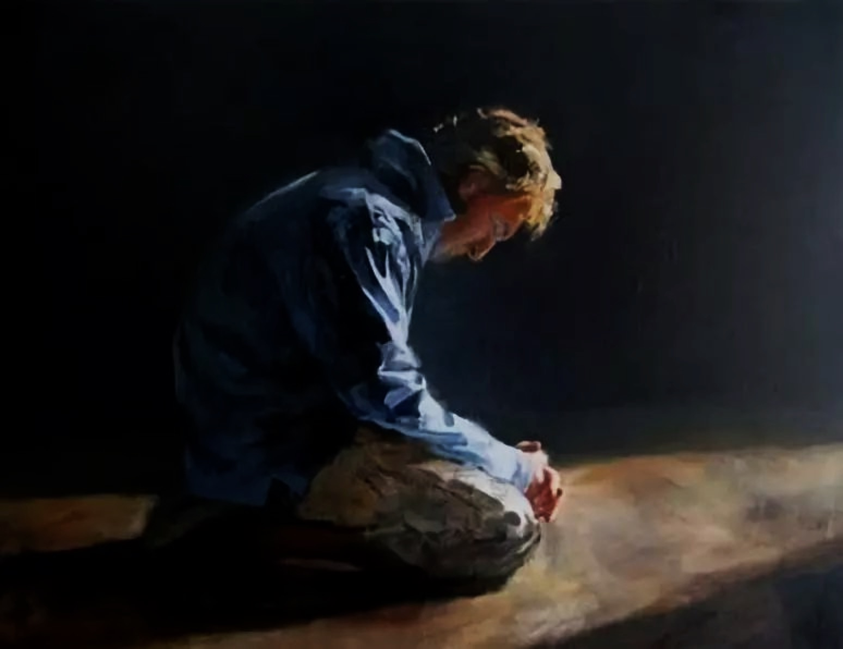
真心悔改，忠心事奉。
True Repentance, Faithful Service.
房正豪牧師

Slide 2
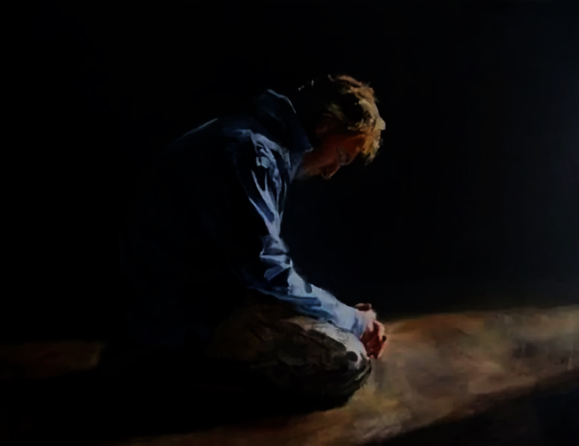
撒 母 耳 記 1 Samuel 上 5:1-4
1 非利士人将神的约柜从以便以谢抬到亚实突。
2 非利士人将神的约柜抬进大衮庙，放在大衮的旁边。
3 次日清早，亚实突人起来，见大衮仆倒在耶和华的约柜前，脸伏于地，就把大衮仍立在原处。

Slide 3
撒 母 耳 記 1 Samuel 上 5:1-4
4 又次日清早起来，见大衮仆倒在耶和华的约柜前，脸伏于地，并且大衮的头和两手都在门槛上折断，只剩下大衮的残体。

Slide 4
撒 母 耳 記 1 Samuel 上 5:1-4
1 After the Philistines had captured the ark of God, they took it from Ebenezer to Ashdod.
2 Then they carried the ark into Dagon’s temple and set it beside Dagon.
3 When the people of Ashdod rose early the next day, there was Dagon, fallen on his face on the ground before the ark of the Lord! They took Dagon and put him back in his place.

Slide 5
撒 母 耳 記 1 Samuel 上 5:1-4
4 But the following morning when they rose, there was Dagon, fallen on his face on the ground before the ark of the Lord! His head and hands had been broken off and were lying on the threshold; only his body remained.

Slide 6
順神者昌，逆神者亡。
Obedience brings Thrive, but those who Disobey will be Cursed.

Slide 7
撒 母 耳 記 1 Samuel 上 7:2
2 约柜在基列耶琳许久。过了二十年，以色列全家都倾向耶和华。
2 The ark remained at Kiriath Jearim a long time—twenty years in all. Then all the people of Israel turned back to the Lord.

Slide 8
撒 母 耳 記 1 Samuel 上 7:3-4
3 撒母耳对以色列全家说：“你们若一心归顺耶和华，就要把外邦的神和亚斯她录从你们中间除掉，专心归向耶和华，单单地侍奉他，他必救你们脱离非利士人的手。”
4 以色列人就除掉诸巴力和亚斯她录，单单地侍奉耶和华。

Slide 9
撒 母 耳 記 1 Samuel 上 7:3-4
3 So Samuel said to all the Israelites, “If you are returning to the Lord with all your hearts, then rid yourselves of the foreign gods and the Ashtoreths and commit yourselves to the Lord and serve him only, and he will deliver you out of the hand of the Philistines.”

Slide 10
撒 母 耳 記 1 Samuel 上 7:3-4
4 So the Israelites put away their Baals and Ashtoreths, and served the Lord only.

Slide 11
神是聖潔的神，
所以神的兒女也要聖潔。
God is Holy, therefore His Children must also be Holy.

Slide 12
我们要做到三件事 The 3 Must Do
1：大家一定要真心的悔改！
    We must Truly Repent!
2：大家必须除掉所有的偶像！
    We must Get Rid of all Idols!
3：大家必须单单来敬拜独一真神！
    We Must Worship the One True God!

Slide 13
每人只有一位爸爸，
照樣只有一位和我們有關係的神。
Each of Us has One Father,
in the same way there is only One God who Establishes a Relationship with Us.

Slide 14
撒 母 耳 記 1 Samuel 上 7:4-6
4 以色列人就除掉诸巴力和亚斯她录，单单地侍奉耶和华。
5 撒母耳说：“要使以色列众人聚集在米斯巴，我好为你们祷告耶和华。”

Slide 15
撒 母 耳 記 1 Samuel 上 7:4-6
6 他们就聚集在米斯巴，打水浇在耶和华面前，当日禁食，说：“我们得罪了耶和华！”于是撒母耳在米斯巴审判以色列人。

Slide 16
撒 母 耳 記 1 Samuel 上 7:4-6
4 So the Israelites put away their Baals and Ashtoreths, and served the Lord only.
5 Then Samuel said, “Assemble all Israel at Mizpah, and I will intercede with the Lord for you.”

Slide 17
撒 母 耳 記 1 Samuel 上 7:4-6
6 When they had assembled at Mizpah, they drew water and poured it out before the Lord. On that day they fasted and there they confessed, “We have sinned against the Lord.” Now Samuel was serving as leader of Israel at Mizpah.

Slide 18
詩 篇 Psalm 34:18
18 耶和华靠近伤心的人，拯救灵性痛悔的人。
18 The Lord is close to the brokenhearted and saves those who are crushed in spirit.

Slide 19


Slide 20
撒 母 耳 記 1 Samuel 上 7:3b
3 专 心 归 向 耶 和 华 ， 单 单 地 事 奉 他 。 他 必 救 你 们 脱 离 非 利 士 人 的 手 。
3 Commit yourselves to the Lord and serve him only, and he will deliver you out of the hand of the Philistines.”

Slide 21
所以我们需要思想五个问题
Let Us Ponders over these 5 Questions
1：我们侍奉神的动机是什么？
    What is the Motive behind our Serving God?
2：我们是用什么样的态度来侍奉神？
    What is our Attitude towards Serving God?
3：侍奉的人需要什么样的装备？
    How must We be Equipped to Serve God?

Slide 22
4：在教会里如何与别人搭配侍奉？
    How do We Work Together with Others to Serve God?
5：什么叫本位的事奉？
    How do We set the Standard for Serving?

Slide 24
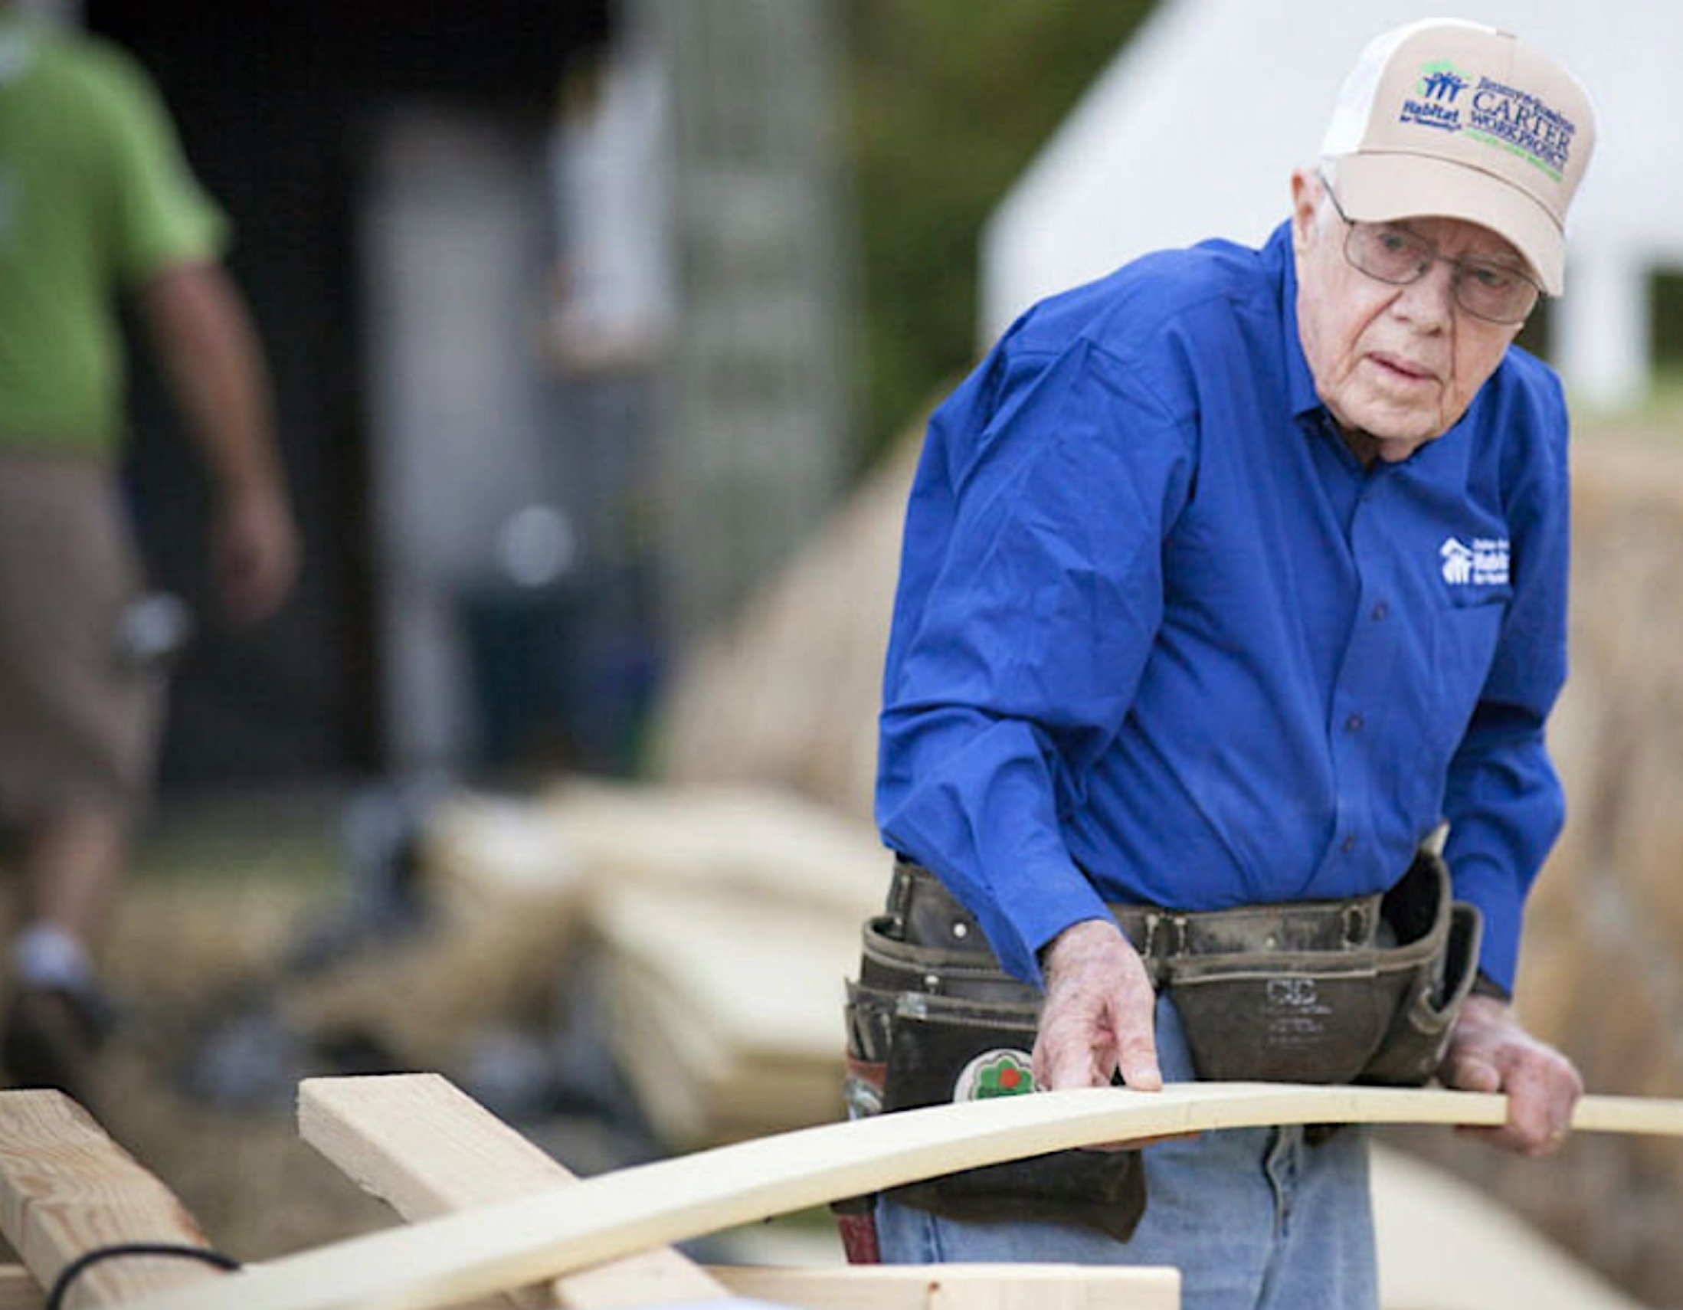
President Jimmy Carter

Slide 25
歌 羅 西 書 Colossians 3:23
23 无论做什么，都要从心里做，像是给主做的，不是给人做的。
23 Whatever you do, work at it with all your heart, as working for the Lord, not for human masters,

Slide 26
真心的悔改与忠心的侍奉！有五个重点
5 Aspects of True Repentance,
and Faithful Service
1：我们事奉的动机是什么？报答主恩！
    What is the Motive behind our Serving God? The Answer is to Reciprocate for His Grace!
2：我们用什么态度来侍奉神？谦卑顺服！
    What is our Attitude towards Serving God? With Humility & Obedience!

Slide 27
3：侍奉的人所需要的装备？真理和生命两方面
    How must We be Equipped? With Truth & Life
4：如何与别人搭配？爱与包容！
    How do We Work Together with Others? With Love & Acceptance!
5：什么叫本位事奉？认真工作和圣洁生活！
    How do We set the Standard for Serving? Serve Whole-heartedly & Live Righteously!

