Slide 1
互相款待，不發怨言 Offer hospitality to one another without grumbling.

Slide 2
7 万物的结局近了，所以你们要谨慎自守，警醒祷告。 8 最要紧的是彼此切实相爱，因为爱能遮掩许多的罪。 9 你们要互相款待，不发怨言。10 各人要照所得的恩赐彼此服侍，做神百般恩赐的好管家。
彼得前書 4:7-10

Slide 3
7 The end of all things is near. Therefore be alert and of sober mindso that you may pray. 8 Above all, love each other deeply, because love covers over a multitude of sins. 9 Offer hospitality to one another without grumbling. 10 Each of you should use whatever gift you have received to serve others, as faithful stewards of God’s grace in its various forms.
1 Peter 4:7-10

Slide 4
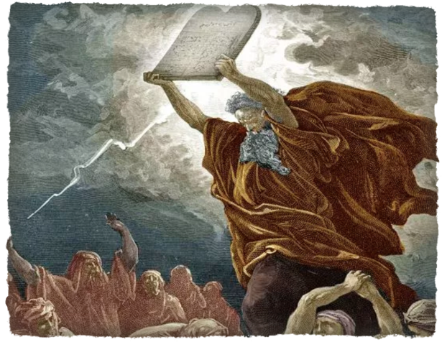
1.怨言是信心不夠的表現
Grumbling displays a lack of faith.

Slide 5
哥林多前书 1 Corinthians 10:10
你们也不要发怨言，像他们有发怨言的，就被灭命的所灭。
And do not grumble, as some of them did—and were killed by the destroying angel.

Slide 6
抱怨的民族 Complaining nation

Slide 7
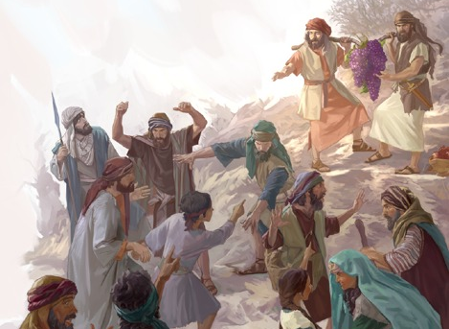

Slide 9
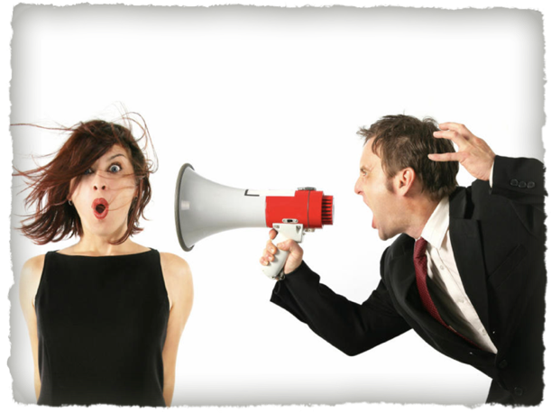
2.怨言起爭論
Grumbling triggers arguments.
一種傳染病 A contagious disease

Slide 10
腓立比书 Philippians 2:14
凡所行的，都不要发怨言、起争论，
Do everything without grumbling or arguing,

Slide 11
3.怨言招神怒 Grumbling brings God’s wrath.
招審判 Bring God’s judgment

Slide 12
雅各书 James 5:9
弟兄们，你们不要彼此埋怨，免得受审判。看哪，审判的主站在门前了！
Don’t grumble against one another, brothers and sisters, or you will be judged. The Judge is standing at the door!

Slide 13
使徒保羅勸戒教會遠避五樣罪
The Apostle Paul exhorts the church to stay away from five sins.
1.貪戀惡事 Lust after evil things
2.拜偶像 Worship false god
3.行姦淫 Commit sexual immorality
4.試探主 Test the Lord
5.發怨言 Grumble against each other

Slide 14
4.怨言無愛心 Grumbling shows a lack of love.
遠離愛 心Away from love

Slide 15
彼得前书 1 Peter 4:8-9
8 最要紧的是彼此切实相爱，因为爱能遮掩许多的罪。 9 你们要互相款待，不发怨言。
8 Above all, love each other deeply, because love covers over a multitude of sins. 9 Offer hospitality to one another without grumbling.

Slide 16
發怨言四結果
Four consequences of grumbling
1.信心不夠的表現。
Display a lack of faith
2.怨言起爭論。
Trigger arguments
3.怨言招神怒。
Bring God’s wrath
4.怨言無愛心。
Show a lack of love

Slide 17
如何面對發怨言的人How to face people who grumble

Slide 18
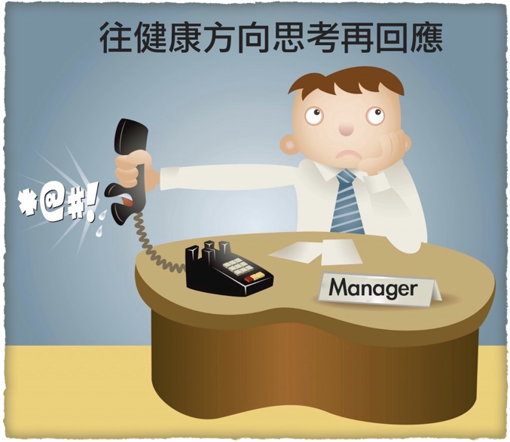
Think positively first and then respond

Slide 19
以赛亚书 Isaiah 43:19
“看哪，我要做一件新事，如今要发现，你们岂不知道吗？我必在旷野开道路，在沙漠开江河。
See, I am doing a new thing! Now it springs up; do you not perceive it? I am making a way in the wilderness and streams in the wasteland.

Slide 20
如何不發怨言 How to not grumble

Slide 21
1.常說感謝的話。 Often say thank you 2.多數算神的恩典。 Often count God’s blessing 3.選擇饒恕？ Choose forgiveness
如何不發怨言
How to not grumble

Slide 22
帖撒罗尼迦前书 1 Thessalonians 5:16-18
16 要常常喜乐， 17 不住地祷告， 18 凡事谢恩，因为这是神在基督耶稣里向你们所定的旨意。
16 Rejoice always, 17 pray continually, 18 give thanks in all circumstances; for this is God’s will for you in Christ Jesus.

Slide 23
1.角度，為教會還是為自己？ Which perspective? For church or self? 2.對事不對人。 It is nothing personal. 3.自己能否協助？ Can I help? 4.為他或事工禱告。 Pray for people and ministry
發言前四種思考
Four thoughts before speaking

Slide 24
箴言 Proverbs 25 :11
Like apples of gold in settings of silver is a ruling rightly given.

Slide 25
立 志 30 天不抱怨，每天說一句好話。
Commit 30 days for not complaining
Say a good word every day.

Slide 26
以弗所书 Ephesians 4：29b
只要随事说造就人的好话，
叫听见的人得益处。
but only what is helpful for building others up according to their needs, that it may benefit those who listen.

