Slide 1
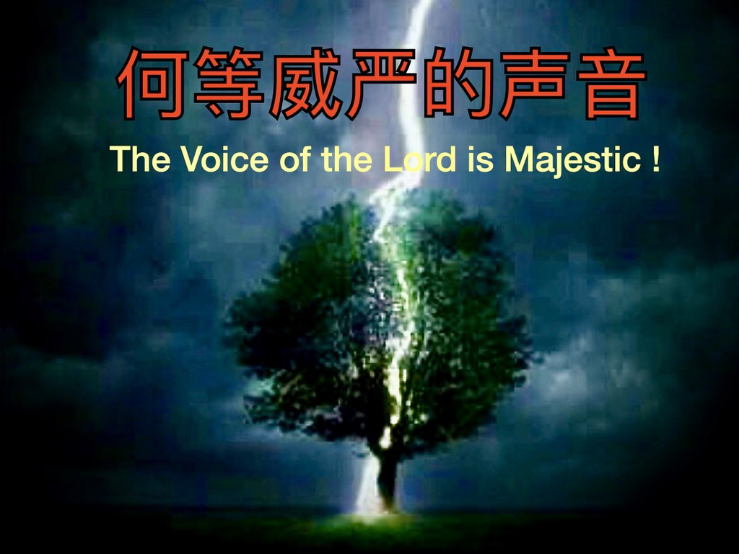
房正豪牧師

Slide 2
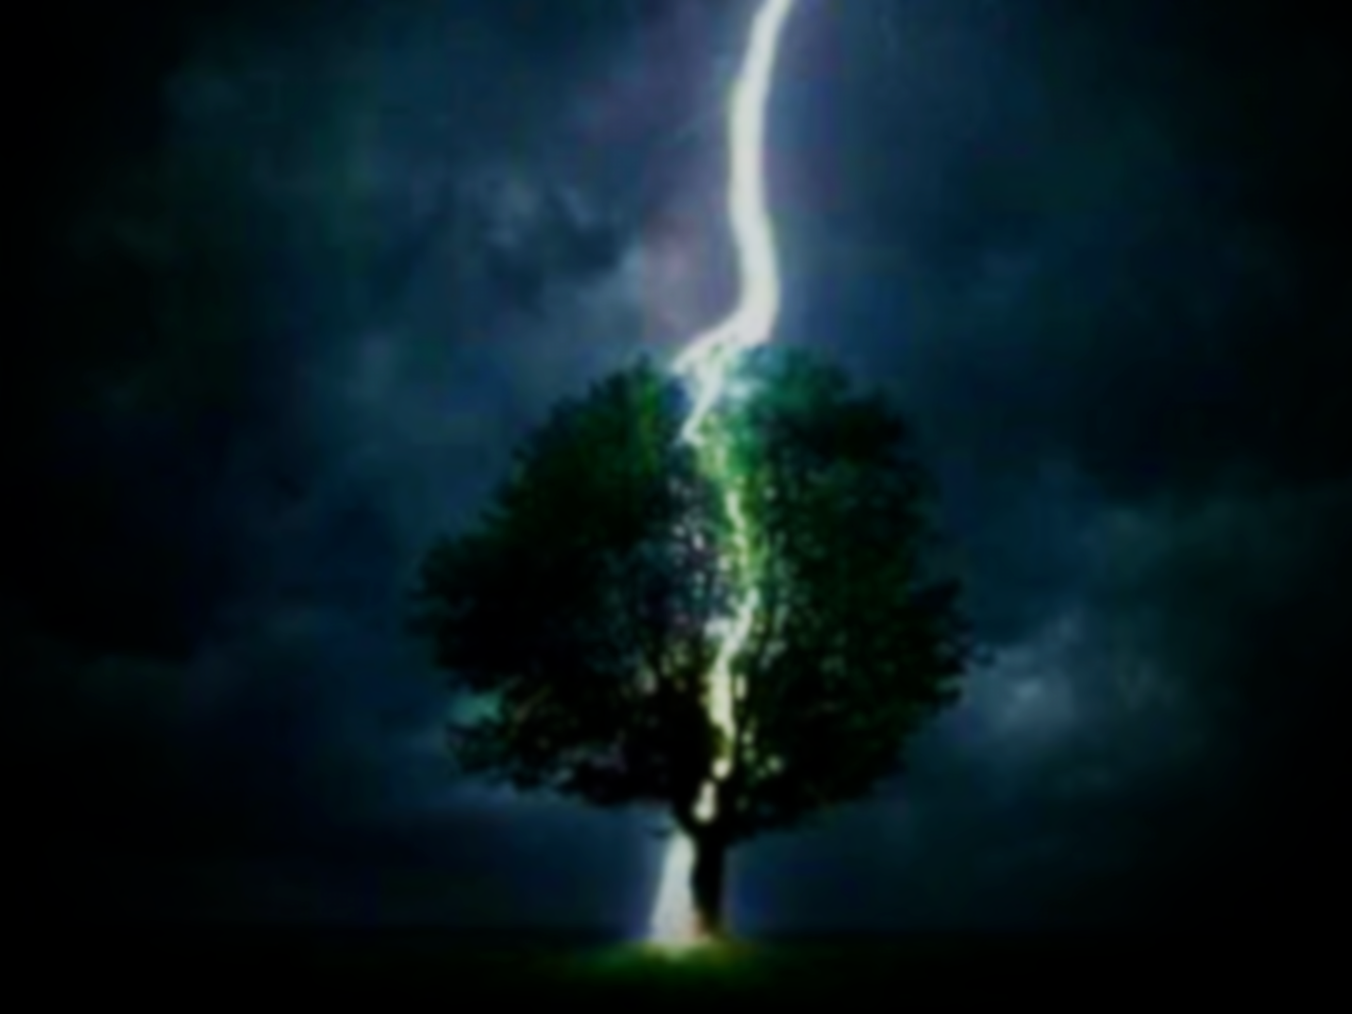
诗篇 29:1-2
1 神的众子啊，你们要将荣耀、能力归给耶和华，归给耶和华！
2 要将耶和华的名所当得的荣耀归给他，以圣洁的[a]装饰敬拜耶和华！

Slide 3
Psalm 29:1-2
1 Ascribe to the Lord, you heavenly beings; ascribe to the Lord glory and strength.
2 Ascribe to the Lord the glory due his name; worship the Lord wearing holy attire.

Slide 4
以赛亚书 Isaiah 42 :8
8 我是耶和华，这是我的名。我必不将我的荣耀归给假神，也不将我的称赞归给雕刻的偶像。
8 I, the Lord, am the one, and I won’t give my name and glory to another, nor my praise to idols.

Slide 5
诗篇 Psalm 29:1-2
2 要将耶和华的名所当得的荣耀归给他，以圣洁的[a]装饰敬拜耶和华！
2 Ascribe to the Lord the glory due his name; worship the Lord wearing holy attire.

Slide 6
圣洁就是内在的庄重自洁
Holiness is Solemn Cleansing of your Inner-Self

Slide 7
诗篇 29:3-5
3 耶和华的声音发在水上，荣耀的神打雷，耶和华打雷在大水之上。
4 耶和华的声音大有能力，耶和华的声音满有威严。
5 耶和华的声音震破香柏树，耶和华震碎黎巴嫩的香柏树。

Slide 8
Psalm 29:3-5
3 The voice of the Lord was heard[a] above the waters;
the God of glory thundered;
the Lord was heard over many waters.

Slide 9
4 The voice of the Lord is powerful;
the voice of the Lord is majestic.
5 The voice of the Lord snaps the cedars;
the Lord snaps the cedars of Lebanon.

Slide 10
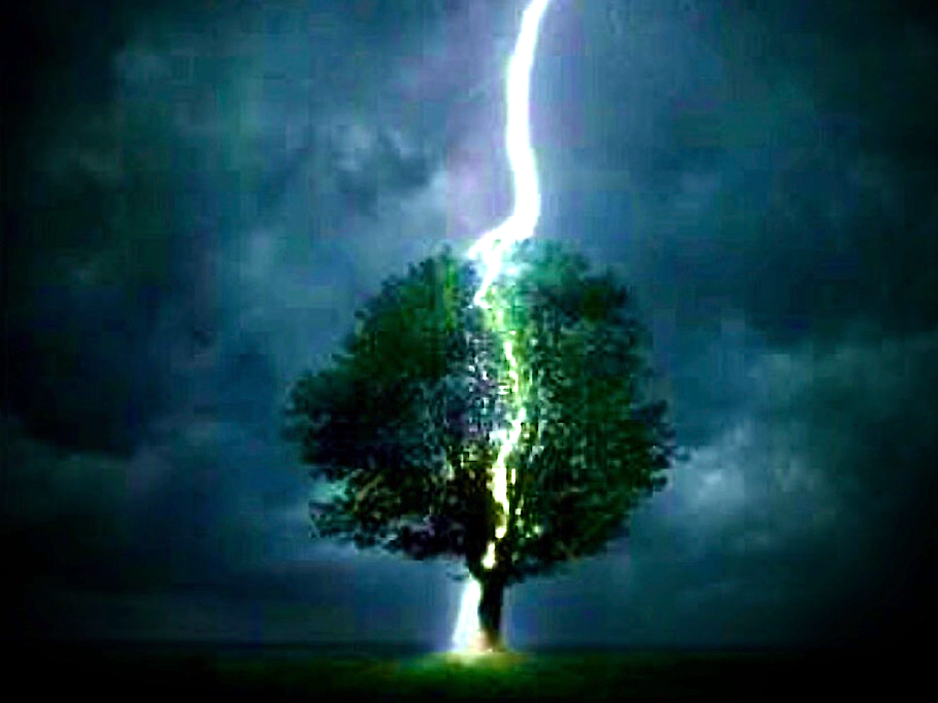
God of Wealth

Slide 11
诗篇 Psalm 29:6-7
6 他也使之跳跃如牛犊，使黎巴嫩和西连跳跃如野牛犊。
7 耶和华的声音使火焰分岔。

Slide 12
诗篇 Psalm 29:6-7
6 He makes them stagger like a calf,
even Lebanon and Sirion like a young wild ox.
7 The voice of the Lord shoots out flashes of fire.

Slide 13
诗篇 Psalm 29:8-9
8 耶和华的声音震动旷野，耶和华震动加低斯的旷野。
9 耶和华的声音惊动母鹿落胎，树木也脱落净光。凡在他殿中的，都称说他的荣耀。

Slide 14
诗篇 Psalm 29:8-9
8 The voice of the Lord shakes the wilderness; the voice of the Lord shakes the wilderness of Kadesh.
9 The voice of the Lord causes deer to give birth, and strips the forest bare. In his Temple all of them shout, “Glory!”

Slide 15
希伯来书 Hebrews 12:26-29
26 当时他的声音震动了地，但如今他应许说：“再一次我不单要震动地，还要震动天。”
27 这再一次的话，是指明被震动的，就是受造之物都要挪去，使那不被震动的常存。

Slide 16
28 所以，我们既得了不能震动的国，就当感恩，照神所喜悦的，用虔诚、敬畏的心侍奉神，
29 因为我们的神乃是烈火。

Slide 17
希伯来书 Hebrews 12:26-29
26 At that time his voice shook the earth, but now he has promised, “Once more I will shake not only the earth but also heaven.”

Slide 18
27 The expression “once more” signifies the removal of what can be shaken, that is, what he has made, so that what cannot be shaken may remain.

Slide 19
28 Therefore, since we are receiving a kingdom that cannot be shaken, let us be thankful and worship God in reverence and fear in a way that pleases him.
29 For “our God is an all-consuming fire.”

Slide 20
约翰福音 John 10:27-28
27 我的羊听我的声音，我也认识他们，他们也跟着我。
28 我又赐给他们永生，他们永不灭亡，谁也不能从我手里把他们夺去。

Slide 21
约翰福音 John 10:27-28
27 My sheep hear my voice. I know them, and they follow me.
28 I give them eternal life, they’ll never be lost, and no one will snatch them out of my hand.

Slide 22
诗篇 Psalm 29:10-11
10 洪水泛滥之时，耶和华坐着为王；耶和华坐着为王，直到永远。
11 耶和华必赐力量给他的百姓，耶和华必赐平安的福给他的百姓。

Slide 23
诗篇 Psalm 29:10-11
10 The Lord sat enthroned over the flood, and the Lord sits as king forever.
11 The Lord will give strength to his people; the Lord will bless his people with peace.

Slide 24
启示录 Revelation 21:3-5
3 我听见有大声音从宝座出来说：“看哪，神的帐幕在人间！他要与人同住，他们要做他的子民，神要亲自与他们同在，做他们的神。

Slide 25
4 神要擦去他们一切的眼泪，不再有死亡，也不再有悲哀、哭号、疼痛，因为以前的事都过去了。”
5 坐宝座的说：“看哪，我将一切都更新了！”又说：“你要写上，因这些话是可信的，是真实的。”

Slide 26
启示录 Revelation 21:3-5
3 I heard a loud voice from the throne say, “See, the tent of God is among humans! He will make his home with them, and they will be his people. God himself will be with them, and he will be their God.

Slide 27
4 He will wipe every tear from their eyes. There won’t be death anymore. There won’t be any grief, crying, or pain, because the first things have disappeared.”

Slide 28
5 The one sitting on the throne said, “See, I am making all things new!”
He said, “Write this: ‘These words are trustworthy and true.’”

