Slide 1
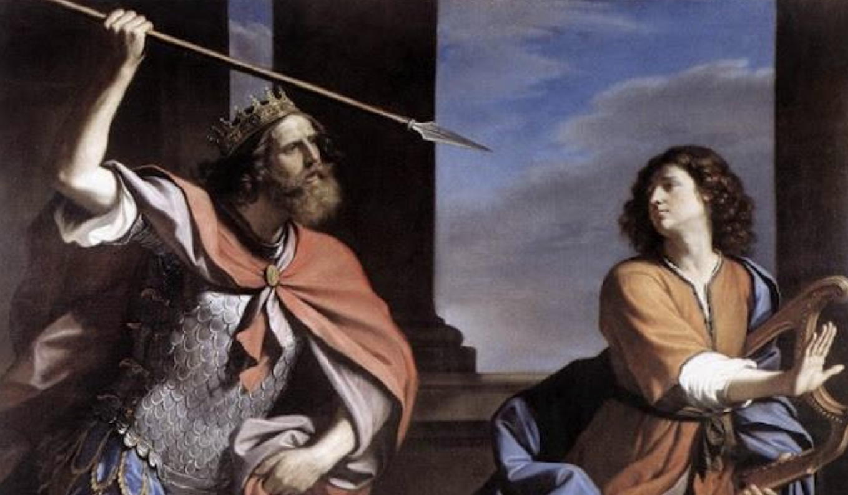
如何得勝嫉妒？
How to win over the jealousy?

Slide 2
撒母耳记上 18: 6-9
6 大卫打死了那非利士人，同众人回来的时候，妇女们从以色列各城里出来，欢欢喜喜，打鼓击磬，歌唱跳舞，迎接扫罗王。 7 众妇女舞蹈唱和，说：“扫罗杀死千千，大卫杀死万万。”

Slide 3
撒母耳记上 18: 6-9
8 扫罗甚发怒，不喜悦这话，就说：“将万万归大卫，千千归我，只剩下王位没有给他了！” 9 从这日起，扫罗就怒视大卫。

Slide 4
1 Samuel 18: 6-9
6 When the men were returning home after David had killed the Philistine, the women came out from all the towns of Israel to meet King Saul with singing and dancing, with joyful songs and with timbrels and lyres.

Slide 5
1 Samuel 18: 6-9
7 As they danced, they sang:
“Saul has slain his thousands,
and David his tens of thousands.”
8 Saul was very angry; this refrain displeased him greatly. “They have credited David with

Slide 6
1 Samuel 18: 6-9
tens of thousands,” he thought, “but me with only thousands. What more can he get but the kingdom?” 9 And from that time on Saul kept a close eye on David.

Slide 7
撒母耳记上 18: 8
8 扫罗甚发怒，不喜悦这话，就说：“将万万归大卫，千千归我，只剩下王位没有给他了！”

Slide 8
1 Samuel 18: 8
8 Saul was very angry; this refrain displeased him greatly. “They have credited David with tens of thousands,” he thought, “but me with only thousands. What more can he get but the kingdom?”

Slide 9
和自己比一比
Compare yourself to yourself
1.今天的我比昨天更溫柔嗎？
Today am I more tender and gentle than I was yesterday?
2.明天我比今天更愛主耶穌嗎？
Tomorrow will I love our lord Jesus more than I do today?

Slide 10
使徒行传 9:26-27
26 扫罗到了耶路撒冷，想与门徒结交，他们却都怕他，不信他是门徒。

Slide 11
使徒行传 9:26-27
27 唯有巴拿巴接待他，领去见使徒，把他在路上怎么看见主，主怎么向他说话，他在大马士革怎么奉耶稣的名放胆传道，都述说出来。

Slide 12
Acts 9:26-27
26 When he came to Jerusalem, he tried to join the disciples, but they were all afraid of him, not believing that he really was a disciple. 27 But Barnabas took him and brought him to the apostles.

Slide 13
Acts 9:26-27
He told them how Saul on his journey had seen the Lord and that the Lord had spoken to him, and how in Damascus he had preached fearlessly in the name of Jesus.

Slide 14
巴拿巴不但不嫉妒保羅，
Not only Barnabas was
never jealous toward Paul,
而且幫助保羅成為領袖。
He also helped Paul
become the leader.

Slide 15
雅各书 James 1:9
9 卑微的弟兄升高，就该喜乐；
9 Believers in humble circumstances ought to take pride in their high position.

Slide 16
如何消除嫉妒？
How to eliminate the jealousy?
1.求神的愛充滿我，
使我心胸寬大。
Lord, I pray, please fill me with your love, bless me with a big and gentle heart.

Slide 17
2.明白“現階段”
神給我的是最合適我的。
Truly understand that whatever God gives to me now, it is the most suitable for me at this moment.

Slide 18
約瑟一生三個階段
Three stages of Joseph's life
彩衣、囚衣、宰相衣。
Colorful clothing,
Prisoner's clothing,
Primary Minister's clothing.

Slide 19
在每一階段
我都要堅持信靠神。
Every step of my life,
I want to be faithful and trust in God.

Slide 20
我要決心去掉生命的雜質，
I determine to get rid of the impurities of my life.
裝進聖靈所結的果子。
Put in the fruit of the
Holy spirit.

Slide 21
節制口裡說出的話！
Control the words coming out from my mouth.
節制口裡所吃進的食物！
Control the food coming into my mouth.

Slide 22
活出真理！
Live in the truth!
真理要生活化！
Truth needs to be applied to daily life!

Slide 23
如何消除嫉妒？
How to eliminate the jealousy?
1.求神的愛充滿我，
使我心胸寬大。
Lord, I pray, please fill me with your love, bless me with a big and gentle heart.

Slide 24
2.明白“現階段”
神給我的是最合適我的。
Truly understand that whatever God gives to me now, it is the most suitable for me at this moment.

