Slide 1
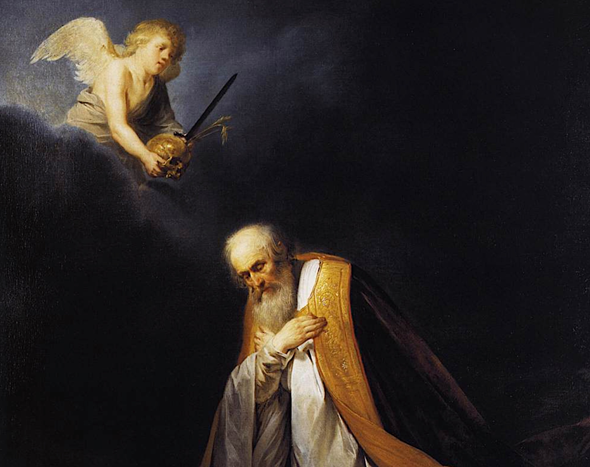
從大衛學功課
Lessons from David
房正豪牧師

Slide 2
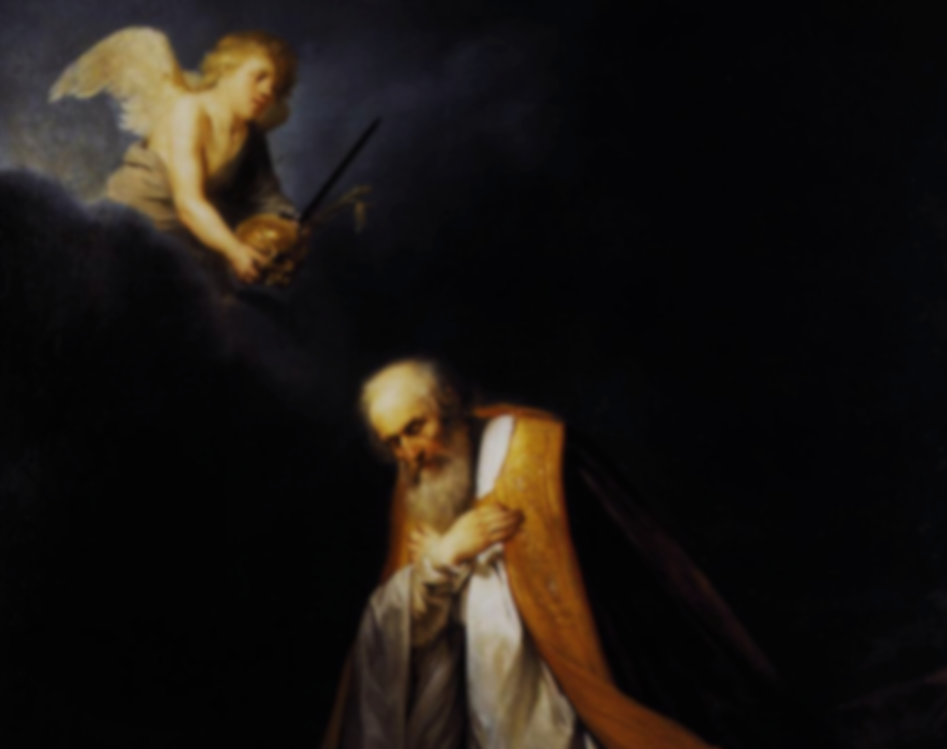
撒母耳记上 24: 1-7
1 扫罗追赶非利士人回来，有人告诉他说，大卫在隐基底的旷野。 2 扫罗就从以色列人中挑选三千精兵，率领他们往野羊的磐石去，寻索大卫和跟随他的人。 3 到了路旁的羊圈，在那里有洞，扫罗进去大解。

Slide 3
大卫和跟随他的人正藏在洞里的深处。 4 跟随的人对大卫说：“耶和华曾应许你说：‘我要将你的仇敌交在你手里，你可以任意待他。’如今时候到了！”大卫就起来，悄悄地割下扫罗外袍的衣襟。

Slide 4
5 随后大卫心中自责，因为割下扫罗的衣襟， 6 对跟随他的人说：“我的主乃是耶和华的受膏者，我在耶和华面前万不敢伸手害他，因他是耶和华的受膏者。” 7 大卫用这话拦住跟随他的人，不容他们起来害扫罗。扫罗起来，从洞里出去行路。

Slide 5
1 Samuel 24: 1-7
1 After Saul returned from pursuing the Philistines, he was told, “David is in the Desert of En Gedi.”
2 So Saul took three thousand able young men from all Israel and set out to look for David and his men near the Crags of the Wild Goats.

Slide 6
3 He came to the sheep pens along the way; a cave was there, and Saul went in to relieve himself. David and his men were far back in the cave. 4 The men said, “This is the day the Lord spoke of when he said[b] to you, ‘I will give your enemy into your

Slide 7
hands for you to deal with as you wish.’” Then David crept up unnoticed and cut off a corner of Saul’s robe.
5 Afterward, David was conscience-stricken for having cut off a corner of his robe.
6 He said to his men, “The Lord forbid that I should

Slide 8
do such a thing to my master,
the Lord’s anointed, or lay my hand on him; for he is the anointed of the Lord.”
7 With these words David sharply rebuked his men and did not allow them to attack Saul. And Saul left the cave and went his way.

Slide 9
撒母耳记上 24: 6
6 对跟随他的人说：“我的主乃是耶和华的受膏者，我在耶和华面前万不敢伸手害他，因他是耶和华的受膏者。”

Slide 10
1 Samuel 24: 6
6 He said to his men, “The Lord forbid that I should do such a thing to my master,
the Lord’s anointed, or lay my hand on him; for he is the anointed of the Lord.”

Slide 11
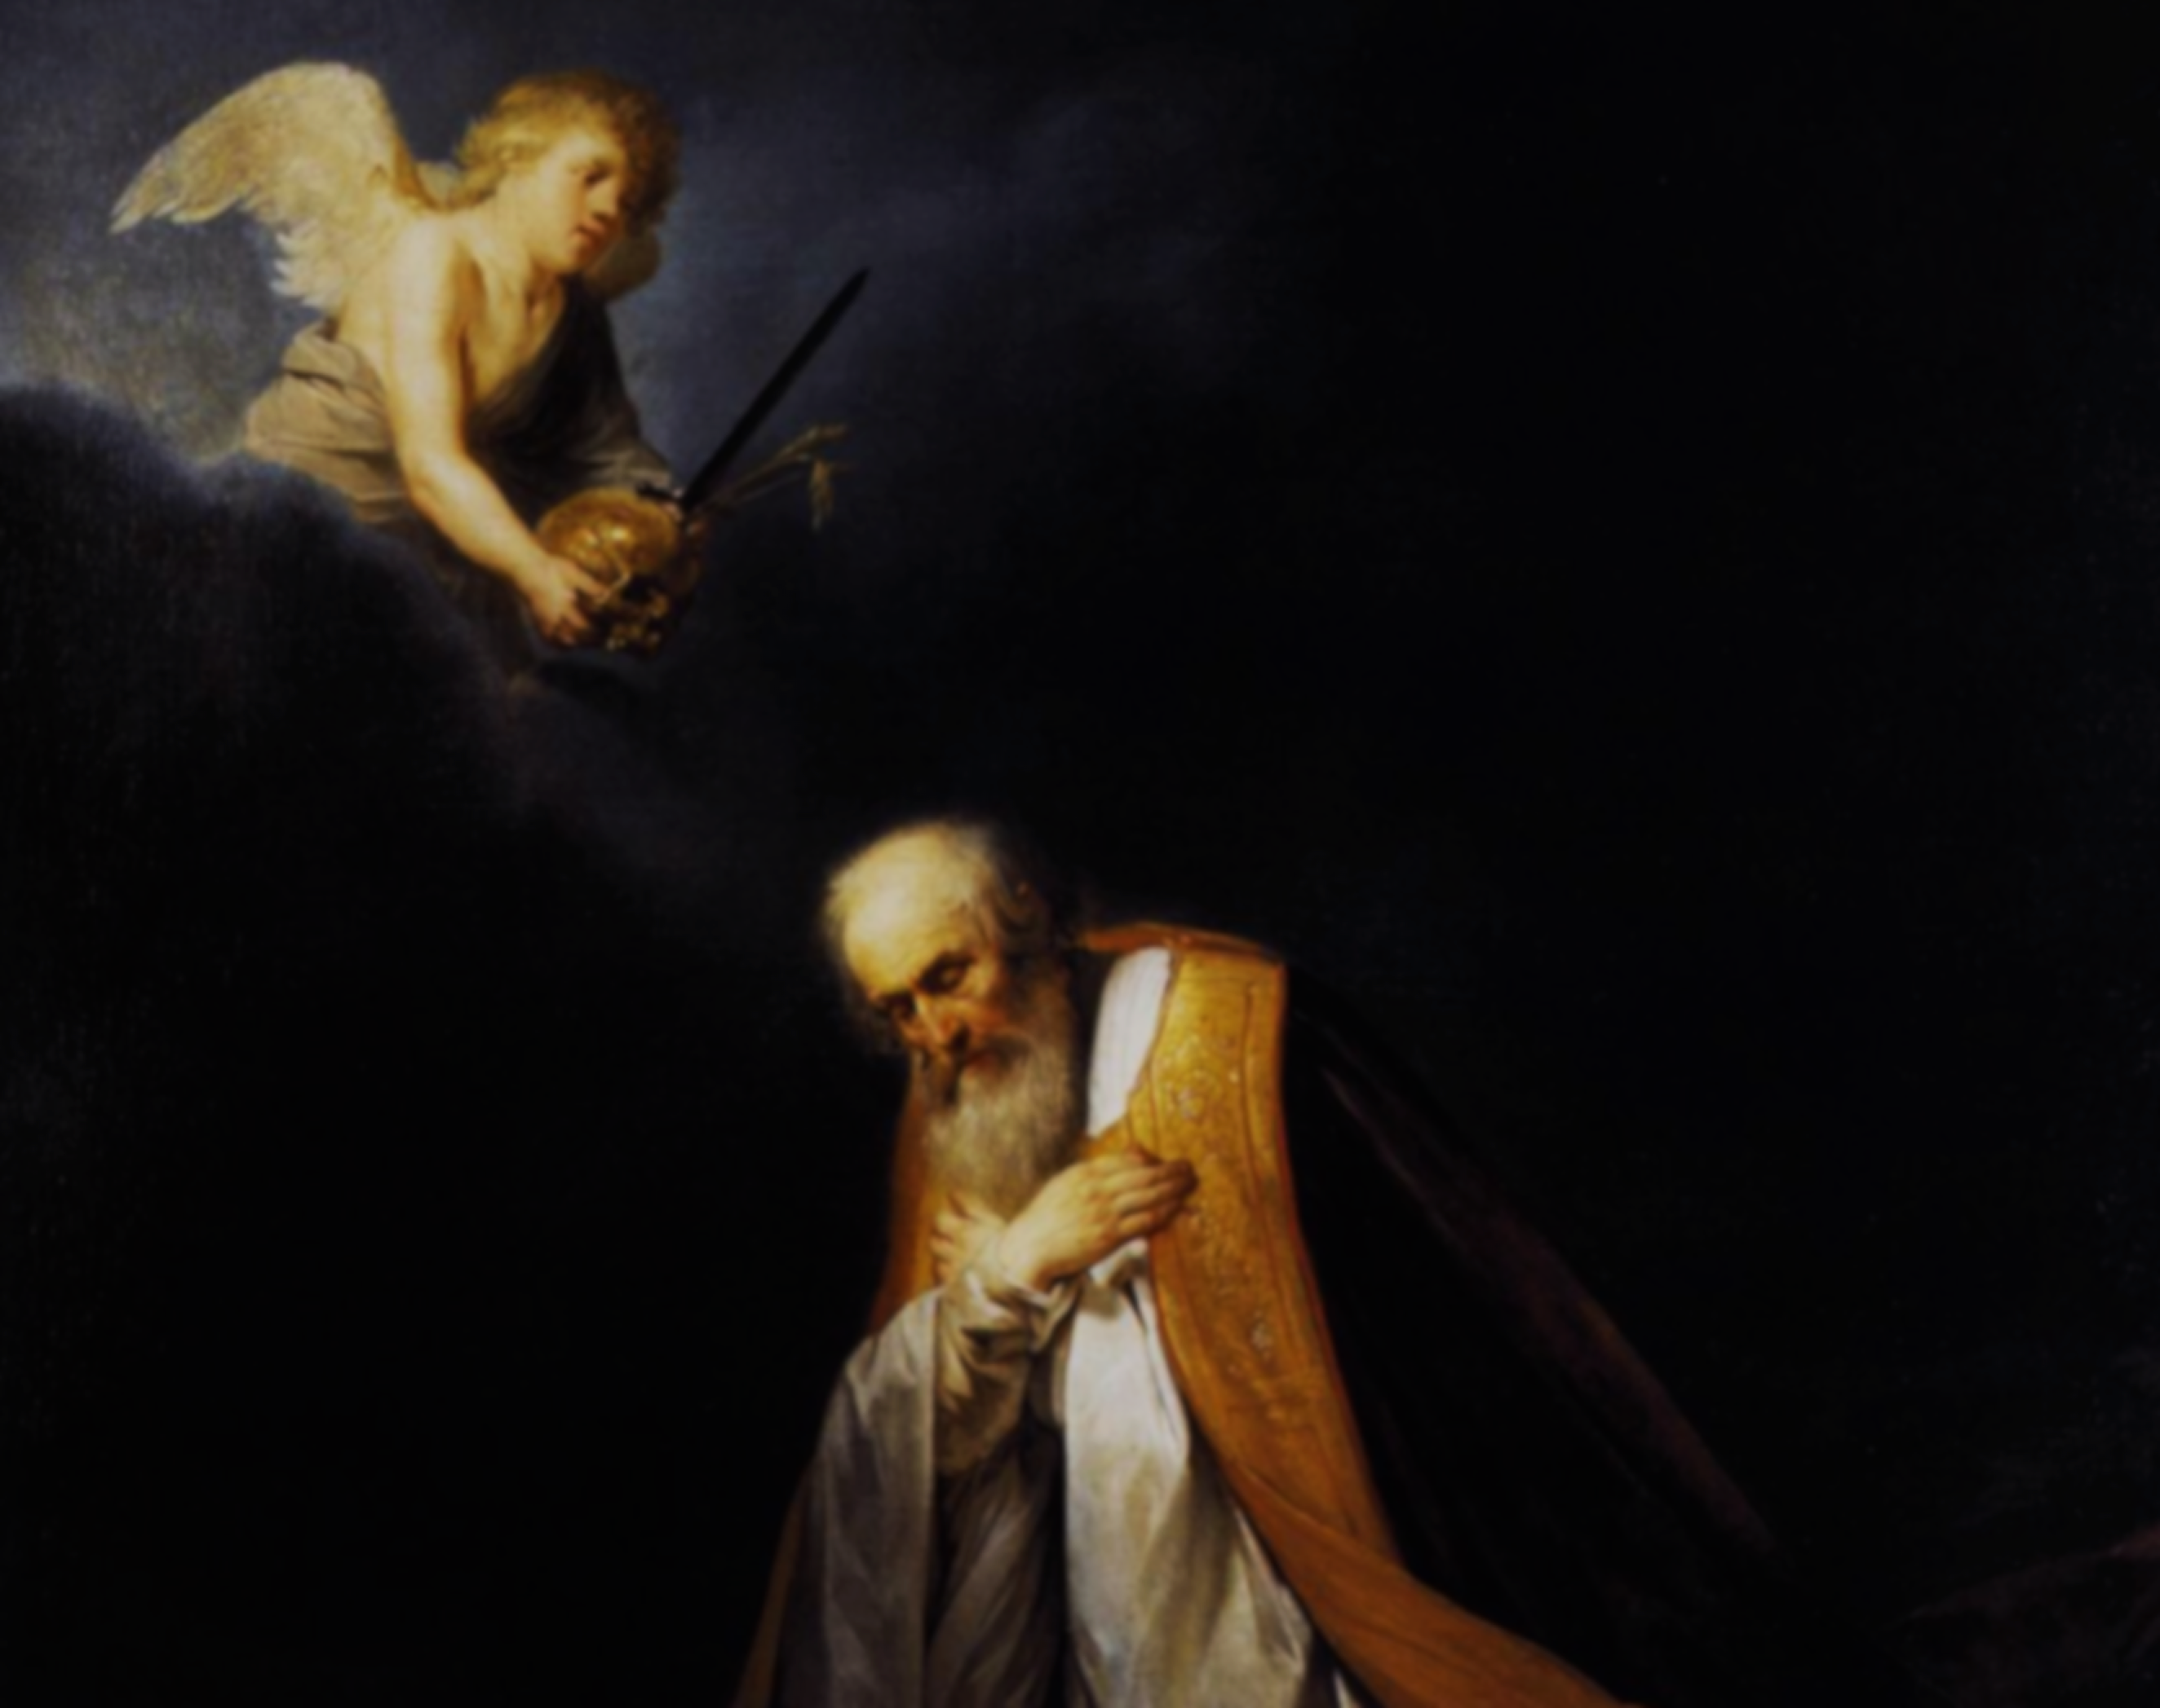
學習敬畏神的主權！
Learning to Respect God’s Sovereignty

Slide 12
深信神會把最合適的給我
Trusting God to Provide my Best

Slide 13
加拉太書 Galatians 6: 7
7 不要自欺，神是轻慢不得的。人种的是什么，收的也是什么。
Do not be deceived: God cannot be mocked. A man reaps what he sows.

Slide 14
箴言 2:1-5
1 我儿，你若领受我的言语，存记我的命令， 2 侧耳听智慧，专心求聪明， 3 呼求明哲，扬声求聪明， 4 寻找她如寻找银子，搜求她如搜求隐藏的珍宝， 5 你就明白敬畏耶和华，得以认识神

Slide 15
Proverbs 2:1-5
1 My son, if you accept my words and store up my commands within you,
2 turning your ear to wisdom and applying your heart to understanding—
3 indeed, if you call out for insight and cry aloud for

Slide 16
understanding,
4 and if you look for it as for silver and search for it as for hidden treasure,
5 then you will understand the fear of the Lord and find the knowledge of God.

Slide 17
撒母耳记上 24: 8-12
8 随后大卫也起来，从洞里出去，呼叫扫罗说：“我主！我王！”扫罗回头观看，大卫就屈身，脸伏于地下拜。
9 大卫对扫罗说：“你为何听信人的谗言，说大卫想要害你呢？

Slide 18
10 今日你亲眼看见在洞中，耶和华将你交在我手里。有人叫我杀你，我却爱惜你，说：‘我不敢伸手害我的主，因为他是耶和华的受膏者。’ 11 我父啊，看看你外袍的衣襟在我手中。我割下你的衣襟，

Slide 19
没有杀你。你由此可以知道我没有恶意叛逆你。你虽然猎取我的命，我却没有得罪你。 12 愿耶和华在你我中间判断是非，在你身上为我申冤，我却不亲手加害于你。

Slide 20
1 Samuel 24: 8-12
8 Then David went out of the cave and called out to Saul, “My lord the king!” When Saul looked behind him, David bowed down and prostrated himself with his face to the ground. 9 He said to Saul, “Why do you listen

Slide 21
when men say, ‘David is bent on harming you’? 10 This day you have seen with your own eyes how the Lord delivered you into my hands in the cave. Some urged me to kill you, but I spared you; I said, ‘I will not lay my hand on my lord, because he is the Lord’s anointed.’

Slide 22
11 See, my father, look at this piece of your robe in my hand! I cut off the corner of your robe but did not kill you. See that there is nothing in my hand to indicate that I am guilty of wrongdoing or rebellion. I have not wronged you, but you are hunting me down to take my life.

Slide 23
12 May the Lord judge between you and me. And may the Lord avenge the wrongs you have done to me, but my hand will not touch you.

Slide 24
罗马书 Romans 12:19
19 亲爱的弟兄，不要自己申冤，宁可让步，听凭主怒[b]；因为经上记着：“主说：申冤在我，我必报应。”
Do not take revenge, my dear friends, but leave room for God’s wrath, for it is written: “It is mine to avenge; I will repay,” says the Lord.

Slide 25
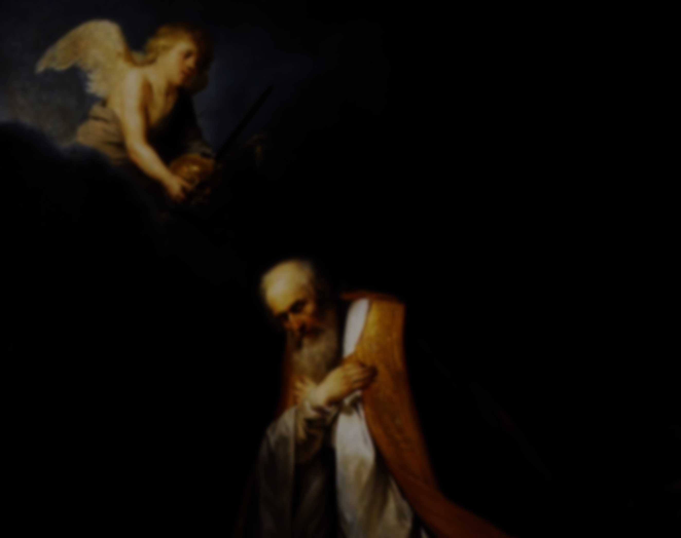
學習大衛的三顆心
3-Fold Lesson from David
1：敬畏神的心：对神的主权存懼心！
Fearing God: Respect His Sovereignty.
2：等候神的心：对神的时间有耐心！
Awaiting God: Patient with His Timing.
3：交托给神的心：对神的公义有信心！
Trusting God: Trust in His Righteousness.

Slide 26
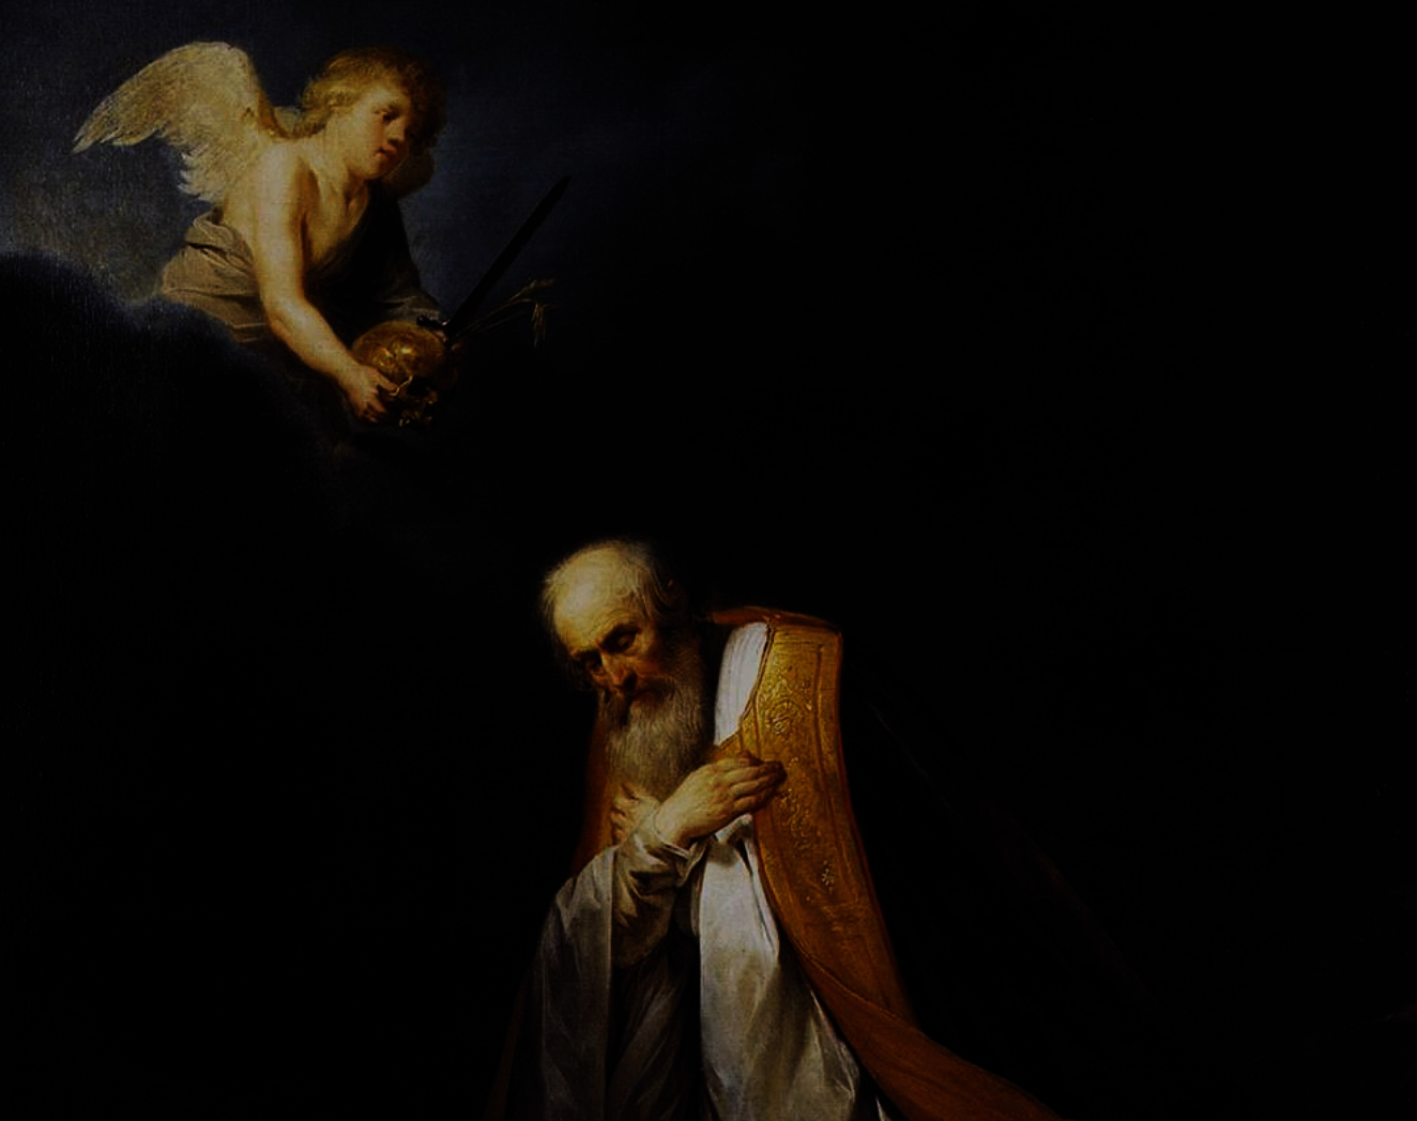
我们当存 懼心、耐心和信心！
Fear God, have Patience
and Trust in Him!
深信神必按着他的恩典来成就。
Trusting God to Accomplish His Will according to His Grace.

