Slide 1
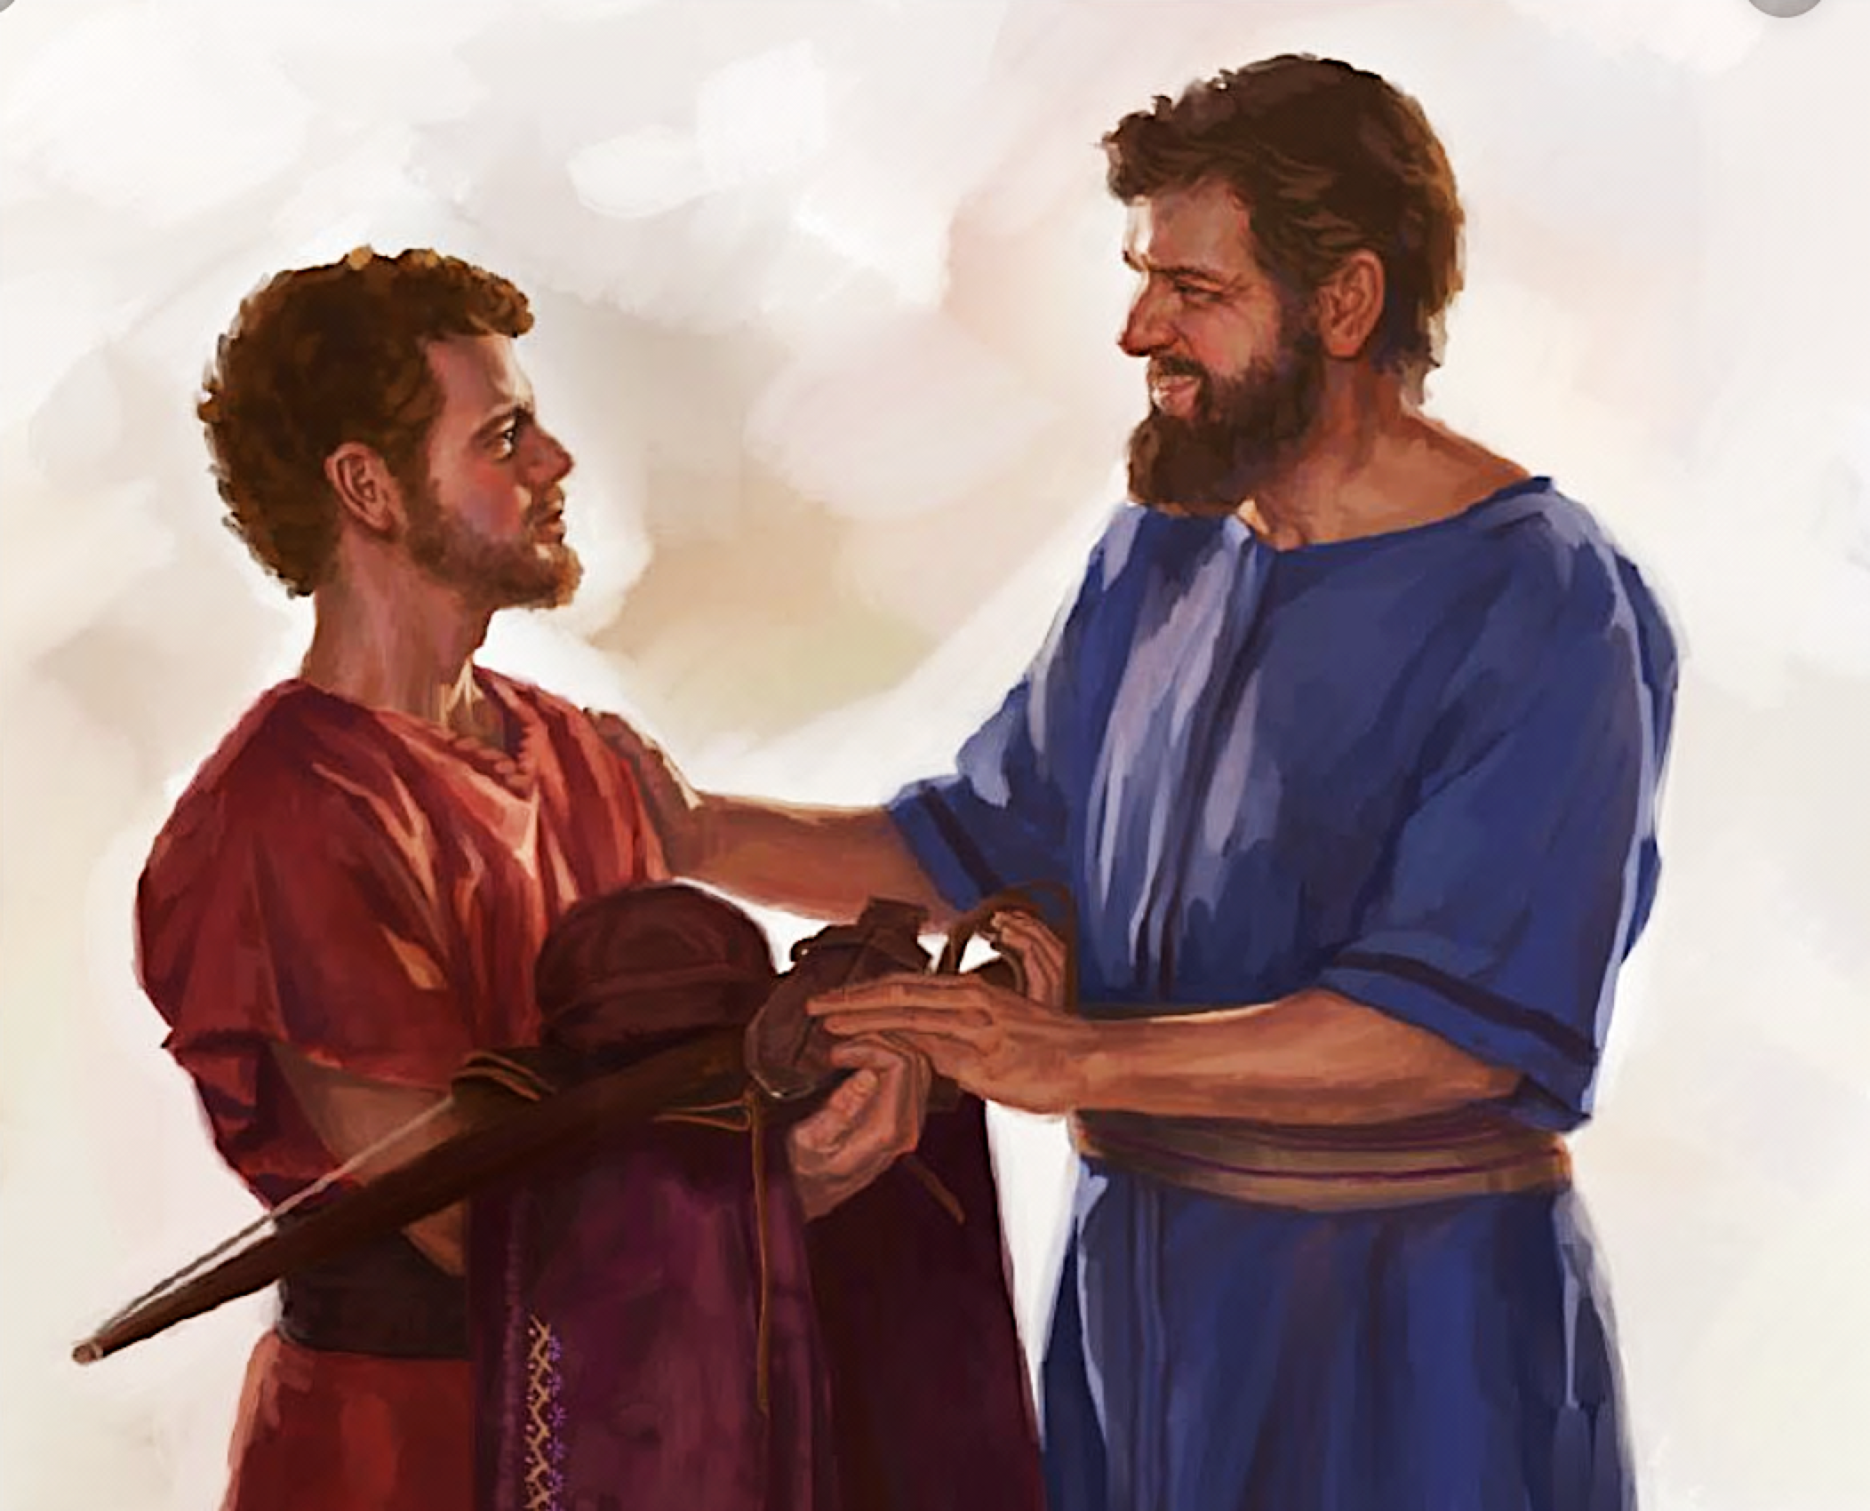
來做好朋友
Becoming a Good Friend
房正豪牧師

Slide 2
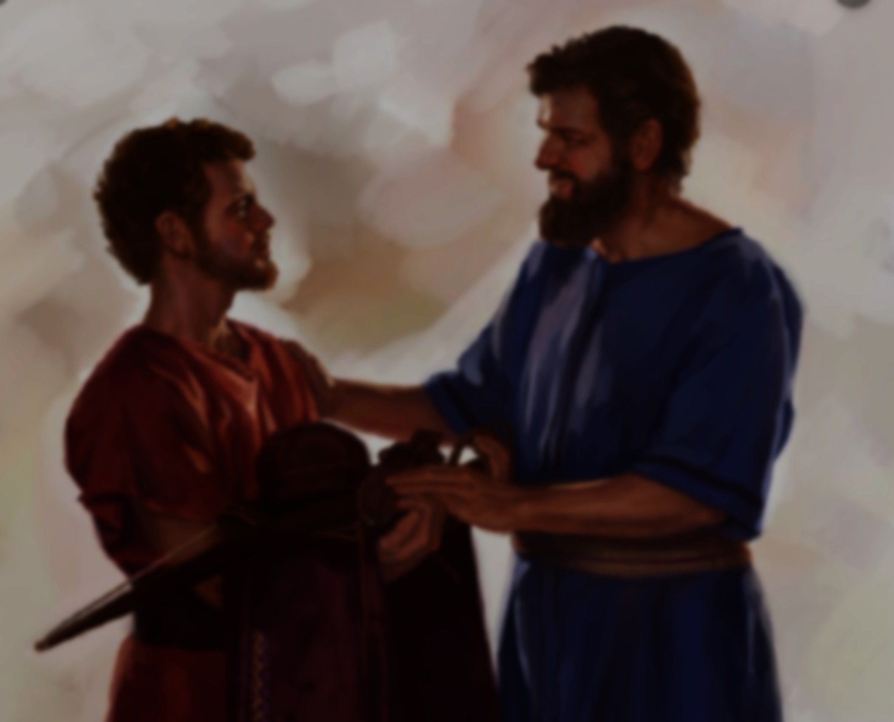
好朋友的意義
肝膽相照，情義相挺。
The meaning of good friends
Be devoted to each other
and show the deepest sincerity

Slide 3
約翰福音 John 15:13
人为朋友舍命，
人的爱心没有比这个大的。Greater love has no one than this: to lay down one’s life for one’s friends.

Slide 4
撒母耳记上 23: 14-18
14 大卫住在旷野的山寨里，常在西弗旷野的山地。扫罗天天寻索大卫，神却不将大卫交在他手里。
15 大卫知道扫罗出来寻索他的命，那时他住在西弗旷野的树林里。 16 扫罗的儿子约拿单起身，往那树林里去见大卫，使他倚靠神得以坚固，

Slide 5
撒母耳记上 23: 14-18
17 对他说：“不要惧怕，我父扫罗的手必不加害于你。你必做以色列的王，我也做你的宰相。这事我父扫罗知道了。”
18 于是二人在耶和华面前立约。大卫仍住在树林里，约拿单回家去了。

Slide 6
1 Samuel 23: 14-18
14 David stayed in the wilderness strongholds and in the hills of the Desert of Ziph. Day after day Saul searched for him, but God did not give David into his hands.
15 While David was at Horesh in the Desert of Ziph, he learned that[a] Saul had come out to take his life.

Slide 7
1 Samuel 23: 14-18
16 And Saul’s son Jonathan went to David at Horesh and helped him find strength in God.
17 “Don’t be afraid,” he said. “My father Saul will not lay a hand on you. You will be king over Israel, and I will be second to you. Even my father Saul knows this.”

Slide 8
1 Samuel 23: 14-18
18 The two of them made a covenant before the Lord. Then Jonathan went home, but David remained at Horesh.

Slide 9
撒母耳记上 1 Samuel 23: 16
扫罗的儿子约拿单起身，往那树林里去见大卫，
使他倚靠神得以坚固，
And Saul’s son Jonathan went to David at Horesh and helped him find strength in God.

Slide 10
撒母耳记上 1 Samuel 23: 17
对他说：“不要惧怕，我父扫罗的手必不加害于你。你必做以色列的王，我也做你的宰相。这事我父扫罗知道了。
And “Don’t be afraid,” he said. “My father Saul will not lay a hand on you. You will be king over Israel, and I will be second to you. Even my father Saul knows this.”

Slide 11
好朋友會，忠言逆耳。
Truth from good friend
seldom sounds pleasant.

Slide 12
诗篇 15:1-2
1 耶和华啊，谁能寄居你的帐幕？谁能住在你的圣山？
2 就是行为正直，做事公义，心里说实话的人。

Slide 13
Psalm 15:1-2
1 Lord, who may dwell in your sacred tent? Who may live on your holy mountain?
2 The one whose walk is blameless,
who does what is righteous,
who speaks the truth from their heart;

Slide 14
撒母耳记上 1 Samuel 23: 18
于是二人在耶和华面前立约。大卫仍住在树林里，约拿单回家去了。
The two of them made a covenant before the Lord. Then Jonathan went home, but David remained at Horesh.

Slide 15
提摩太后书 3:16-17
16 圣经都是神所默示的于教训、督责、使人归正、教导人学义都是有益的，
17 叫属神的人得以完全，预备行各样的善事。

Slide 16
2 Timothy 3:16-17
16 All Scripture is God-breathed and is useful for teaching, rebuking, correcting and training in righteousness, 17 so that the servant of God may be thoroughly equipped for every good work.

Slide 17
要有两个好的心态
Two good attitudes
1：真诚相爱！
Love one another
2：有难同当！
Share misfortune together

Slide 18
活出愛來影響別人。
Live out love to influence others

Slide 19
箴言 Proverbs 17:17
朋友乃时常亲爱，
弟兄为患难而生。
A friend loves at all times,
and a brother is born for a time of adversity.

Slide 20
约翰福音 John 15:14
你们若遵行我所吩咐的，就是我的朋友了。You are my friends if you do what I command.

Slide 21
马太福音 28:18-20
18 耶稣进前来，对他们说：“天上地下所有的权柄都赐给我了。
19 所以你们要去，使万民做我的门徒，奉父、子、圣灵的名给他们施洗

Slide 22
马太福音 28:18-20
20 凡我所吩咐你们的，都教训他们遵守。我就常与你们同在，直到世界的末了。”

Slide 23
Matthew 28:18-20
18 Then Jesus came to them and said, “All authority in heaven and on earth has been given to me.
19 Therefore go and make disciples of all nations, baptizing them in the name of the Father and of the Son and of the Holy Spirit,

Slide 24
Matthew 28:18-20
20 and teaching them to obey everything I have commanded you. And surely I am with you always, to the very end of the age.”

