Slide 1
房正豪牧師

Slide 2
罗马书 Romans 5:1
我们既因信称义，就借着我们的主耶稣基督得与神相和。Therefore, since we have been justified by faith, we have peace with God through our Lord Jesus the Messiah.

Slide 3
因信称义的好处是：
与神和好
The advantage of justification by faith is: Reconciliation with God

Slide 4
1. 祷告：为自己为别人。
Pray: for self and for others
2. 学习：靠主饶恕。
Learn: to forgive by God’s Grace

Slide 5
三个重要的词 (5:2)
Three important words
得：（原文）已经得到，现在正在享受。
A. Gain: (Original) have gained and enjoy it now

Slide 6
B. 进入：（原文）立刻进到神面前。
Access: (Original) access to God immediately

Slide 7
C. 现在所站：（原文）持久不改变的地位。
Stand: (Original) stand in the permanent position

Slide 8
罗马书 Romans 5:3-5
3 不但如此，就是在患难中也是欢欢喜喜的。因为知道患难生忍耐， 4 忍耐生老练，老练生盼望， 5 盼望不至于羞耻，因为所赐给我们的圣灵将神的爱浇灌在我们心里。

Slide 9
罗马书 Romans 5:3-5
3 Not only that, but we also boast in our sufferings, knowing that suffering produces endurance,
4 endurance produces character, and character produces hope.

Slide 10
5 Now this hope does not disappoint us, because God’s love has been poured out into our hearts by the Holy Spirit, who has been given to us.

Slide 11
忍耐
Perseverance
不是向下压
Not pressing down
而是向上放
But relieving upward

Slide 12
老练通达人情世故
Sophisticated and familiar with world

Slide 13
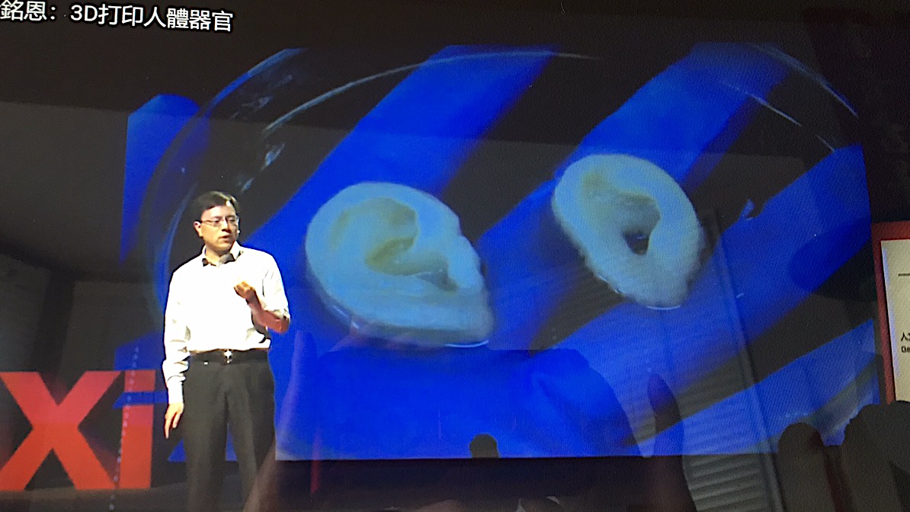

Slide 14
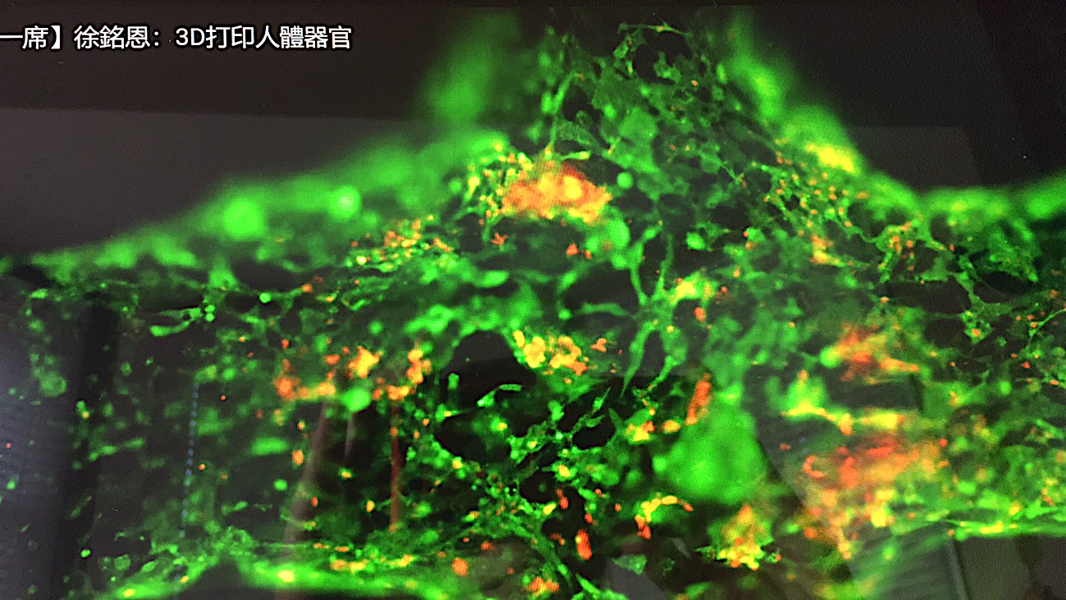

Slide 15
罗马书 Romans 5:5
盼望不至于羞耻，因为所赐给我们的圣灵将神的爱浇灌在我们心里。
Now this hope does not disappoint us, because God’s love has been poured out into our hearts by the Holy Spirit, who has been given to us.

Slide 16
神人同乐！
The joy of God with man

Slide 17
想开心吗？
Want to be happy ?
心要先打开！
Open your heart first !

