Slide 1
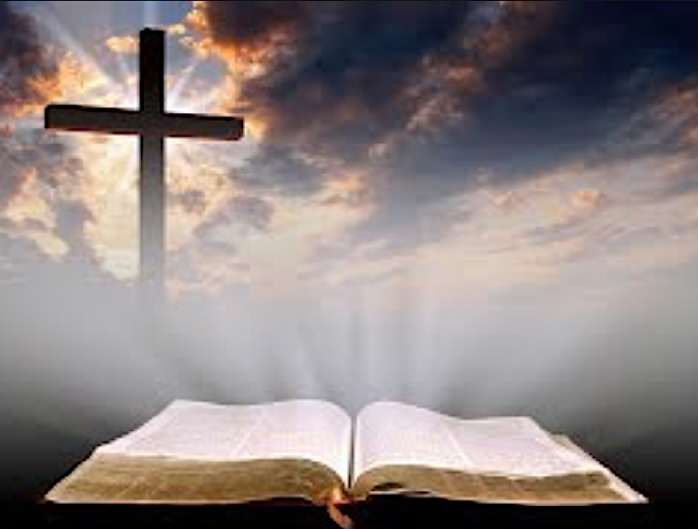
來做大能的勇士
Be a Mighty Warrior
房正豪牧師

Slide 2
使徒行傳Acts
舊約
O.T.
新約
N.T.
使徒行傳 = 聖靈行傳
Acts of the Apostles = Acts of the Holy Spirit

Slide 3
四福音 | 使徒行傳
主角：耶穌 | 主角：聖靈透過使徒做事
對象：猶太人（始） | 對象：外邦人（終）
信息：天國的福音 | 信息：建立主的教會
主題：耶穌是救主 | 主題：彰顯聖靈的作為
使命：接受裝備 | 使命：傳揚福音

Slide 4
The Four Gospels | Acts
Lead Role: Jesus | Lead Role: The Holy Spirit works through the Apostles
Target: Jew (in the Beginning) | Target: Gentiles (in the End)
Message: Good News of the Kingdom of Heaven | Message: Building the Church of the Lord
Theme: Jesus is the Messiah | Theme: To Manifest the Works of the Bible
Mission: Ready to be Equipped | Mission: Ready to Share the Gospel

Slide 5
使徒行傳 1: 1-3
1 提阿非罗啊，我已经作了前书，论到耶稣开头一切所行所教训的，
2 直到他借着圣灵吩咐所拣选的使徒以后，被接上升的日子为止。

Slide 6
使徒行傳 1: 1-3
3 他受害之后，用许多的凭据将自己活活地显给使徒看，四十天之久向他们显现，讲说神国的事。

Slide 7
Acts 1: 1-3
1 In my former book, Theophilus, I wrote about all that Jesus began to do and to teach
2 until the day he was taken up to heaven, after giving instructions through the Holy Spirit to the apostles he had chosen.

Slide 8
Acts 1: 1-3
3 After his suffering, he presented himself to them and gave many convincing proofs that he was alive. He appeared to them over a period of forty days and spoke about the kingdom of God.

Slide 9
主 題:
教會被建立且延伸出去
Theme:
Church being Built & Extending Outward

Slide 10
使徒行傳 1: 4-5
4 耶稣和他们聚集的时候，嘱咐他们说：“不要离开耶路撒冷，要等候父所应许的，就是你们听见我说过的。
5 约翰是用水施洗，但不多几日，你们要受圣灵的洗。”

Slide 11
Acts 1: 4-5
4 On one occasion, while he was eating with them, he gave them this command: “Do not leave Jerusalem, but wait for the gift my Father promised, which you have heard me speak about.

Slide 12
Acts 1: 4-5
5 For John baptized with[a] water, but in a few days you will be baptized with[b] the Holy Spirit.”

Slide 13
聖靈的洗
聖靈的充滿聖靈的澆灌
Baptism of the Holy Spirit
Filled by the Holy Spirit
Spirit of God Poured unto Us

Slide 14
使徒行傳 1: 4
4 耶稣和他们聚集的时候，嘱咐他们说：“不要离开耶路撒冷，要等候父所应许的，就是你们听见我说过的。

Slide 15
Acts 1: 4
4 On one occasion, while he was eating with them, he gave them this command: “Do not leave Jerusalem, but wait for the gift my Father promised, which you have heard me speak about.

Slide 16
使徒行傳 1: 6-8
6 他们聚集的时候，问耶稣说：“主啊，你复兴以色列国就在这时候吗？”
7 耶稣对他们说：“父凭着自己的权柄所定的时候、日期，不是你们可以知道的。

Slide 17
使徒行傳 1: 6-8
8 但圣灵降临在你们身上，你们就必得着能力，并要在耶路撒冷、犹太全地和撒马利亚，直到地极，作我的见证。

Slide 18
Acts 1: 6-8
6 Then they gathered around him and asked him, “Lord, are you at this time going to restore the kingdom to Israel?”

Slide 19
Acts 1: 6-8
7 He said to them: “It is not for you to know the times or dates the Father has set by his own authority.

Slide 20
Acts 1: 6-8
8 But you will receive power when the Holy Spirit comes on you; and you will be my witnesses in Jerusalem, and in all Judea and Samaria, and to the ends of the earth.”

Slide 21
1.降臨: 門徒身上
Descend Upon the Disciples
2.得著: 能力
Power Received
3.作: 主的見證人
Becoming Witnesses of the Lord

Slide 22
你有沒有看重
“主的吩咐”
Do You Pay Attention to the Lord’s Command ?

Slide 23
使徒行傳 4: 12
除他以外，别无拯救，因为在天下人间，没有赐下别的名我们可以靠着得救。”

Slide 24
Acts 4: 12
Salvation is found in no one else, for there is no other name under heaven given to mankind by which we must be saved.”

Slide 25
1：保守等候派
2：社会关怀派
3：现代流行派
4：传统圣乐派
5：糊里糊涂派
6：宣教福音派
The Conservative Group
The Social Care Group
The Modernist Group
The Sacred Music Group
The Disconcerted Group
The Mission-Minded Group

Slide 26
主最喜歡的兩個字
Two Words the Lord Loves Most
去
來
To Go
To Come

Slide 27
撒迦利亚书 4 : 6b
万军之耶和华说：
不是倚靠势力，
不是倚靠才能，乃是倚靠我的灵方能成事。

Slide 28
Zechariah 4 : 6b
‘Not by might nor by power,
but by my Spirit,’ says the Lord Almighty.

Slide 29
口傳、身傳同樣重要！
生命和生活的重要！
Witnessing with Your Voice & Action are Important !
Life & Daily Living Just as Important!

Slide 30
A B C
A: admit
就是承认自己是个罪人。
B: believe
相信耶稣十字架的恩典。
C: confirm
确定自己有得救的却据。

Slide 31
A B C
A: admit
Admit that I am a Sinner.
B: believe
Believe in the Grace Found in the Cross of Jesus Christ.
C: confirm
Confirm that I Have the Proof of Salvation.

Slide 32
抓住機會一起為主作見證
Grasp the Opportunity & Together Let Us Witness
for the Lord.

