Slide 1
Purity in Prayer & Fasting 祷告和禁食的纯洁性
The Disciplined Life
有纪律的人生

Slide 2
What is Prayer? 什么是祷告？
Communication with God
与神相交

Slide 3
What is Fasting? 什么是禁食？
Intentional self-deprivation as an acknowledgement of the need for God
有意的自我剥夺
是承认需要神

Slide 4
Matthew 6:5-9a
And when you pray, you must not be like the hypocrites. For they love to stand and pray in the synagogues and at the street corners, that they may be seen by others. Truly, I say to you, they have received their reward. But when you pray, go into your room and shut the door and pray to your Father who is in secret. And your Father who sees in secret will reward you
你们祷告的时候，不可像那假冒为善的人，爱站在会堂里和十字路口上祷告，故意叫人看见。我实在告诉你们，他们已经得了他们的赏赐。你祷告的时候，要进你的内屋，关上门，祷告你在暗中的父，你父在暗中察看，必然报答你。

Slide 5
Matthew 马太福音 6:5-9a
“And when you pray, do not heap up empty phrases as the Gentiles do, for they think that they will be heard for their many words. Do not be like them, for your Father knows what you need before you ask him. Pray then like this:
你们祷告，不可像外邦人，用许多重复话。他们以为话多了必蒙垂听。你们不可效法他们。因为你们没有祈求以先，你们所需用的，你们的父早已知道了。所以你们祷告，要这样说，

Slide 6
Matthew 马太福音 6:9b-13:16-18
“Our Father in heaven, hallowed be your name. Your kingdom come, your will be done, on earth as it is in heaven. Give us this day our daily bread, and forgive us our debts, as we also have forgiven our debtors. And lead us not into temptation, but deliver us from evil...
我们在天上的父，愿人都尊你的名为圣。愿你的国降临，愿你的旨意行在地上，如同行在天上。我们日用的饮食，今日赐给我们。免我们的债，如同我们免了人的债。不叫我们遇见试探，救我们脱离凶恶，

Slide 7
Matthew 6:9b-13:16-18
“And when you fast, do not look gloomy like the hypocrites, for they disfigure their faces that their fasting may be seen by others. Truly, I say to you, they have received their reward. But when you fast, anoint your head and wash your face, that your fasting may not be seen by others but by your Father who is in secret. And your Father who sees in secret will reward you.
你们禁食的时候，不可像那假冒为善的人，脸上带着愁容。因为他们把脸弄得难看，故意叫人看出他们是禁食。我实在告诉你们，他们已经得了他们的赏赐。你禁食的时候，要梳头洗脸，不叫人看出你禁食来，只叫你暗中的父看见。你父在暗中察看，必然报答你。

Slide 8
What’s the recipe? 食谱是什么？

Slide 9
What’s the recipe? 食谱是什么？

Slide 10
Psalm 诗篇 51:16-17
For you will not delight in sacrifice, or I would give it; you will not be pleased with a burnt offering. The sacrifices of God are a broken spirit; a broken and contrite heart, O God, you will not despise.
你本不喜爱祭物。若喜爱，我就献上。燔祭你也不喜悦。神所要的祭，就是忧伤的灵。神啊，忧伤痛悔的心，你必不轻看。

Slide 11
“Purity of heart is to will one thing.”
“心的纯洁是指愿意做一件事。”
Soren Kierkegaard
索伦·奥贝·齐克果（克尔凯郭尔）

Slide 12
James 雅各书 4:8
...purify your hearts, you double-minded.
心怀二意的人哪，要清洁你们的心。

Slide 13
Secrecy 私密性 v. 5-6

Slide 14
v. 5-6
And when you pray, you must not be like the hypocrites. For they love to stand and pray in the synagogues and at the street corners, that they may be seen by others. Truly, I say to you, they have received their reward.
你们祷告的时候，不可像那假冒为善的人，爱站在会堂里和十字路口上祷告，故意叫人看见。我实在告诉你们，他们已经得了他们的赏赐。

Slide 15
v. 5-6
But when you pray, go into your room and shut the door and pray to your Father who is in secret. And your Father who sees in secret will reward you.
你祷告的时候，要进你的内屋，关上门，祷告你在暗中的父，你父在暗中察看，必然报答你。

Slide 16
Am I praying to God or for others? 我是在向神祷告还是因为别人的原因祷告？
“They have received their reward”
“他们已经得了他们的赏赐。”

Slide 17
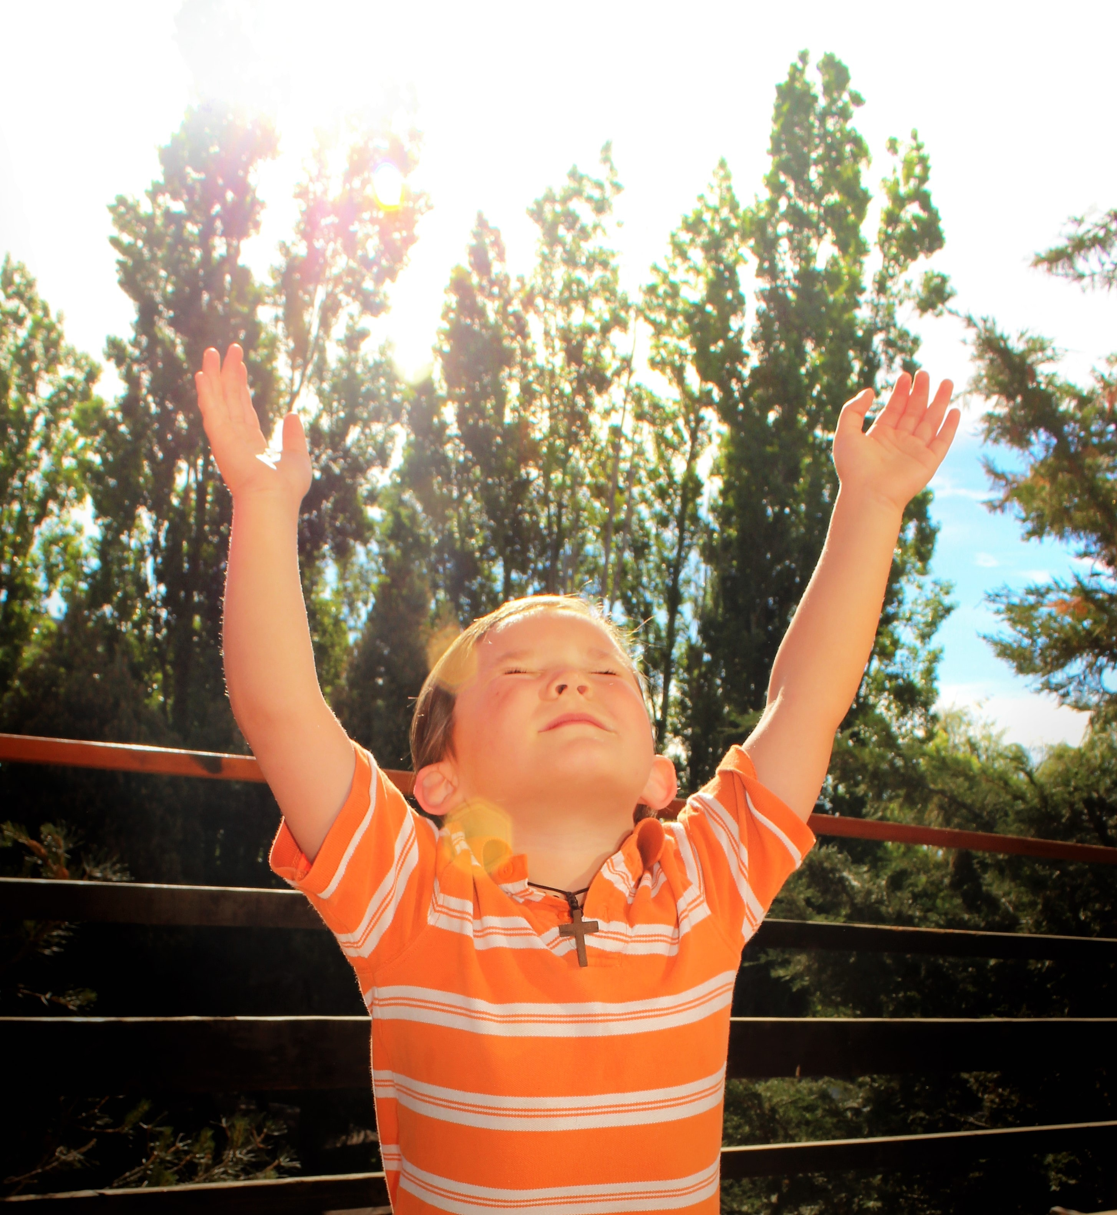
Sincerity
纯粹的态度
v. 16-18

Slide 18
The Hypocrite’s Way 伪君子的方式
Matthew 6:5
Matthew 6:16
And when you pray, you must not be like the hypocrites. For they love to stand and pray in the synagogues and at the street corners, that they may be seen by others. Truly, I say to you, they have received their reward.
你们祷告的时候，不可像那假冒为善的人，爱站在会堂里和十字路口上祷告，故意叫人看见。我实在告诉你们，他们已经得了他们的赏赐。
And when you fast, do not look gloomy like the hypocrites, for they disfigure their faces that their fasting may be seen by others. Truly, I say to you, they have received their reward.
你们禁食的时候，不可像那假冒为善的人，脸上带着愁容。因为他们把脸弄得难看，故意叫人看出他们是禁食。我实在告诉你们，他们已经得了他们的赏赐。

Slide 19
Am I denying myself or gratifying myself in fasting? 我是在禁食中舍己还是在满足自己？

Slide 20
How should the Christian fast? 基督徒应该如何禁食？
V. 17-18
But when you fast, anoint your head and wash your face, that your fasting may not be seen by others but by your Father who is in secret. And your Father who sees in secret will reward you.
你禁食的时候，要梳头洗脸，不叫人看出你禁食来，
只叫你暗中的父看见。你父在暗中察看，必然报答你。

Slide 21
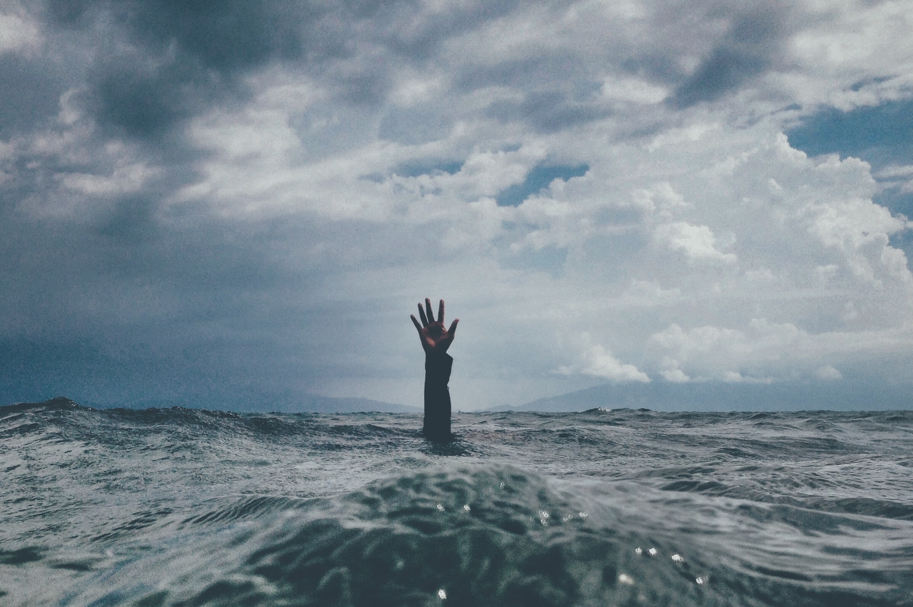
Dependency
依赖性
v. 7-13

Slide 22
“Purity of heart is to will one thing.”
“心的纯洁是指愿意做一件事。”
Soren Kierkegaard
索伦·奥贝·齐克果（克尔凯郭尔）

Slide 23
The Lord’s Prayer 主祷文
Praising God 赞美神
Asking for God’s leadership 求神的带领
Asking for God’s way 求神指点
Asking God to meet our needs 求神满足我们的需要
Asking God for forgiveness祈求神的赦免
Asking God for protection求神保护

Slide 24
Purity in Prayer & Fasting
祷告和禁食的纯洁性
Secrecy 私密性
Sincerity 纯粹的态度
Dependency 依赖性

Slide 25
Practice Prayer & Fasting
操练祷告和禁食

Slide 26
Benefits of Communicating with God 与神相交的益处
It makes us ready to thank and acknowledge God in the blessings we receive. 它使我们准备好在领受祝福中感谢神。
‌It reminds us of the presence of God in our lives and in the world around us. 它提醒我们神在我们的生活和我们周围的世界中同在。
‌It reorients our focus toward God and others. 它将我们的注意力重新聚焦到神和他人身上。
‌It helps us overcome temptation. 它帮助我们战胜诱惑。

Slide 27
Let’s Pray!
我们来祷告！

