Slide 1
辞旧迎新，靠主前行 2022, Waking with the Lord 腓/Phil. 3：1-21

Slide 2
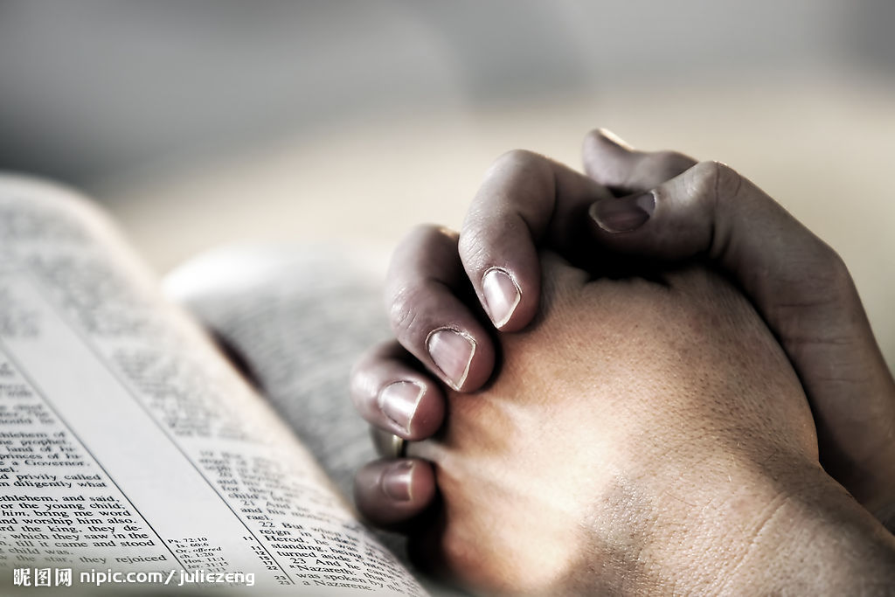
祈祷/Prayer

Slide 3
一、保罗的提醒 /Paul’s warning 3：1-3 1弟兄们，我还有话说，你们要靠主喜乐。我把这话再写给你们，于我并不为难，于你们却是妥当。 2应当防备犬类，防备作恶的，防备妄自行割的。 3因为真受割礼的，乃是我们这以神的灵敬拜，在基督耶稣里夸口，不靠着肉体的。

Slide 4
1Further, my brothers and sisters, rejoice in the Lord! It is no trouble for me to write the same things to you again, and it is a safeguard for you. 2Watch out for those dogs, those evildoers, those mutilators of the flesh. 3For it is we who are the circumcision, we who serve God by his Spirit, who boast in Christ Jesus, and who put no confidence in the flesh.

Slide 5
二、保罗的见证/ Paul’s witness 3：4-6 我第八天受割礼、我是以色列族、便雅悯支派的人、是希伯来人所生的希伯来人．就律法说、我是法利赛人。 就热心说、我是逼迫教会的．就律法上的义说、我是无可指摘的。 腓3：5-6

Slide 6
circumcised on the eighth day, of the people of Israel, of the tribe of Benjamin, a Hebrew of Hebrews; in regard to the law, a Pharisee; as for zeal, persecuting the church; as for righteousness based on the law, faultless. Phil.3：5-6

Slide 7
血统：便雅悯支派的人 Blood: The tribe of Benjamin 身份：罗马公民 Identity: the citizenship of Rome 学历： 受教于迦玛列门下 Education: studied with Gamaliel 信仰 Belief
保
罗
就律法说：我是法利赛人
In regard to the law, a Pharisee
就热心说：我是逼迫教会的
As for zeal, persecuting the church
律法上的义：我是无可指摘的
As for legalistic righteousness, faultless

Slide 8
三、保罗的舍弃与追求/ Paul’s abnegation and pursuit 7-16 15不要爱世界，和世界上的事。人若爱世界，爱父的心就不在他里面了。16因为凡世界上的事，就像肉体的情欲，眼目的情欲，并今生的骄傲，都不是从父来的，乃是从世界来的。17这世界，和其上的情欲，都要过去。惟独遵行神旨意的，是永远常存。 约一 2：15-17

Slide 9
15Do not love the world or anything in the world. If anyone loves the world, love for the Father is not in them. 16For everything in the world – the lust of the flesh, the lust of the eyes, and the pride of life – comes not from the Father but from the world. 17The world and its desires pass away, but whoever does the will of God lives for ever. 1 John 2：15-17

Slide 10
7只是我先前以为与我有益的，我现在因基督都当作有损的。8不但如此，我也将万事当作有损的，因我以认识我主基督耶稣为至宝。我为他已经丢弃万事，看作粪土，为要得着基督。 7But whatever were gains to me I now consider loss for the sake of Christ. 8What is more, I consider everything a loss because of the surpassing worth of knowing Christ Jesus my Lord, for whose sake I have lost all things. I consider them garbage, that I may gain Christ. 腓 /Phil.3：7-8

Slide 11
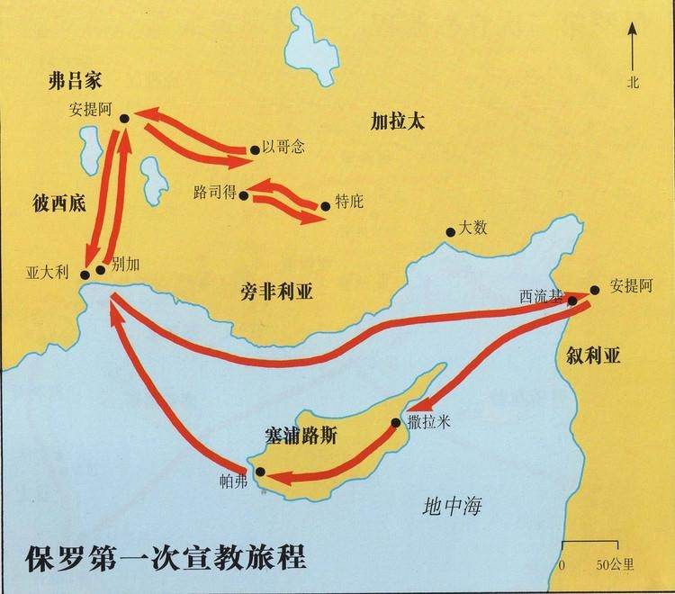

Slide 12
49于是主的道，传遍了那一带地方。50但犹太人挑唆虔敬尊贵的妇女，和城内有名望的人，逼迫保罗，巴拿巴，将他们赶出境外。 徒/Acts 13:49-50
49The word of the Lord spread through the whole region. 50But the Jewish leaders incited the God-fearing women of high standing and the leading men of the city. They stirred up persecution against Paul and Barnabas, and expelled them from their region.

Slide 13
5那时，外邦人和犹太人，并他们的官长，一齐拥上来，要凌辱使徒，用石头打他们。6使徒知道了，就逃往吕高尼的路司得，特庇，两个城，和周围地方去。7在那里传福音。 徒/Acts 14:5-7
5There was a plot afoot among both Gentiles and Jews, together with their leaders, to ill-treat them and stone them. 6But they found out about it and fled to the Lycaonian cities of Lystra and Derbe and to the surrounding country,

Slide 14
19但有些犹太人，从安提阿和以哥念来，挑唆众人，就用石头打保罗，以为他是死了，便拖到城外。20门徒正围着他，他就起来，走进城去。第二天，同巴拿巴往特庇去，21对那城里的人传了福音，使好些人作门徒 徒/Acts 14:19-21
19Then some Jews came from Antioch and Iconium and won the crowd over. They stoned Paul and dragged him outside the city, thinking he was dead. 20But after the disciples had gathered round him, he got up and went back into the city. The next day he and Barnabas left for Derbe.

Slide 15
我们这至暂至轻的苦楚，要为我们成就极重无比永远的荣耀。 17For our light and momentary troubles are achieving for us an eternal glory that far outweighs them all. 林后/2Cor. 4：17 我想现在的苦楚，若比起将来要显于我们的荣耀，就不足介意了。 18 I consider that our present sufferings are not worth comparing with the glory that will be revealed in us. 罗/Rom. 8：18

Slide 16
四、保罗的劝勉/Paul’s exhortation 3：17-21 17弟兄们，你们要一同效法我，也当留意看那些照我们榜样行的人。 18因为有许多人行事，是基督十字架的仇敌。我屡次告诉你们，现在又流泪地告诉你们。 19他们的结局就是沉沦，他们的神就是自己的肚腹，他们以自己的羞辱为荣耀，专以地上的事为念。

Slide 17
19他们的结局就是沉沦，他们的神就是自己的肚腹，他们以自己的羞辱为荣耀，专以地上的事为念。 20我们却是天上的国民。并且等候救主，就是主耶稣基督，从天上降临。 21他要按着那能叫万有归服自己的大能，将我们这卑贱的身体改变形状，和他自己荣耀的身体相似。

Slide 18
17Join together in following my example, brothers and sisters, and just as you have us as a model, keep your eyes on those who live as we do. 18For, as I have often told you before and now tell you again even with tears, many live as enemies of the cross of Christ.

Slide 19
19Their destiny is destruction, their god is their stomach, and their glory is in their shame. Their mind is set on earthly things. Phil. 3:17-19

Slide 20
20But our citizenship is in heaven. And we eagerly await a Saviour from there, the Lord Jesus Christ, 21who, by the power that enables him to bring everything under his control, will transform our lowly bodies so that they will be like his glorious body. Phil. 3:20-21

Slide 21
总结 Summary

Slide 22
“我们既得了清楚的身份和那么多的恩惠，应该想想：可以把什么献给神……庄稼熟了，正等待收割……【神的家不仅需要医学博士和教育专家等等】，也需要家庭主妇，父母、工人、商人……每一个信徒都可以是真正的神国精兵。在世界每一个角落，神都要我们成为他的盐和光……神不是问你能不能，神是问你肯不肯，如果你肯，神就能！”

Slide 23
祈祷 / Prayer

