Slide 1
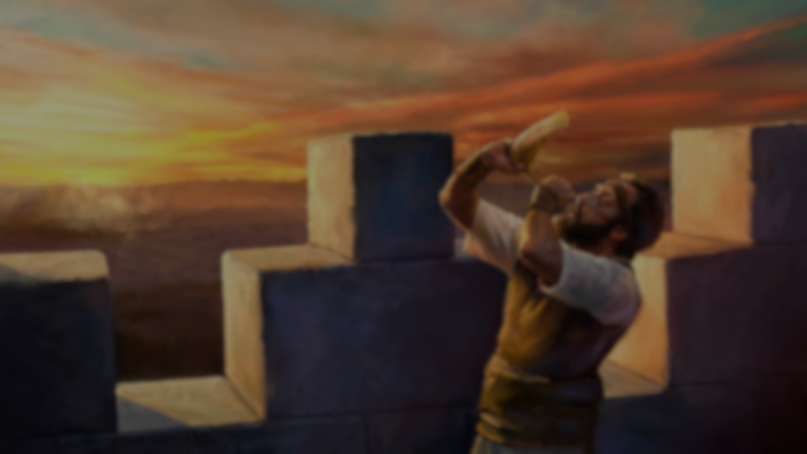
旧约五大部分 O.T.5 Parts
摩西五经
历史书
诗篇智慧书
大先知书
小先知书
Torah
history book
Psalms Wisdom
Great Prophets
Minor Prophets

Slide 2
以西结系列讲道
Ezekiel Sermon Series
天开了！
Heavens opened !
2. 愿顺服！ 付代价！
Be obedient! Comes with a price!
3. 神的警戒！
God’s Warning!

Slide 3
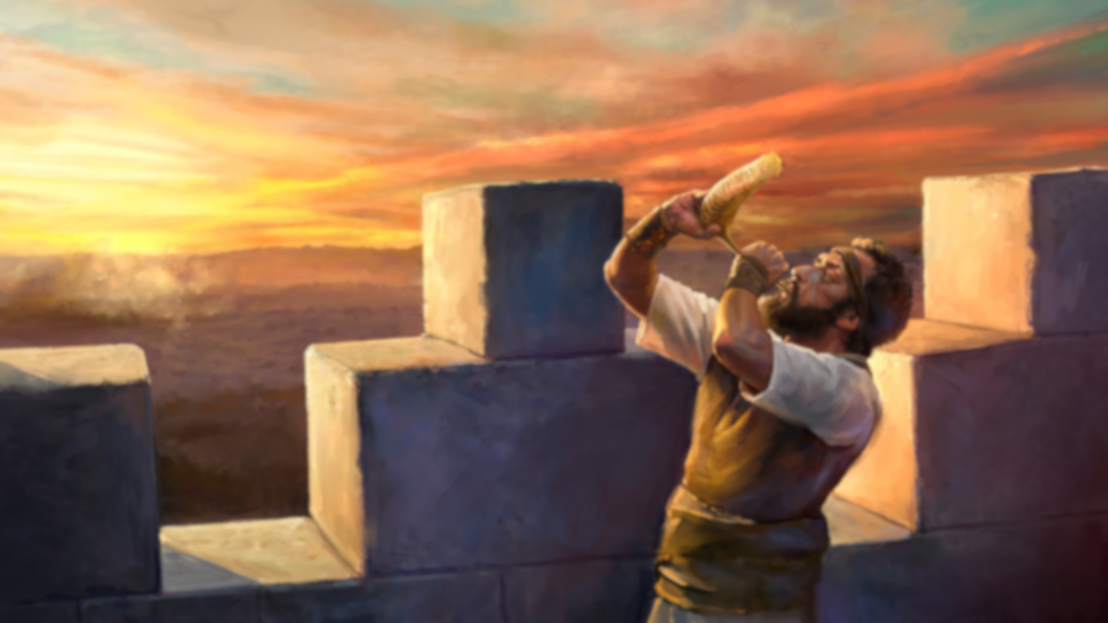
哑口与开口！
Dumb and Speak out!
Rev. Steven Fang 房正豪牧师

Slide 4
以西结书 Ezekiel 3: 22~24
22 耶和华的灵在那里降在我身上。他对我说，你起来往平原去，我要在那里和你说话。
22 The hand of the Lord was on me there, and he said to me, “Get up and go out to the plain, and there I will speak to you.”

Slide 5
23 于是我起来往平原去，不料，耶和华的荣耀正如我在迦巴鲁河边所见的一样，停在那里，我就俯伏于地。
23 So I got up and went out to the plain. And the glory of the Lord was standing there, like the glory I had seen by the Kebar River, and I fell facedown.

Slide 6
24 灵就进入我里面，使我站起来。耶和华对我说，你进房屋去，将门关上。
24 Then the Spirit came into me and raised me to my feet. He spoke to me and said: “Go, shut yourself inside your house.

Slide 7
以西结书 Ezekiel 3: 23
23 于是我起来往平原去，不料，耶和华的荣耀正如我在迦巴鲁河边所见的一样，停在那里，我就俯伏于地。
23 So I got up and went out to the plain. And the glory of the Lord was standing there, like the glory I had seen by the Kebar River, and I fell facedown.

Slide 8
以西结书 Ezekiel 3: 24
24 灵就进入我里面，使我站起来。耶和华对我说，你进房屋去，将门关上。
24 Then the Spirit came into me and raised me to my feet. He spoke to me and said: “Go, shut yourself inside your house.

Slide 9
提摩太后书 2 Timothy 3: 16~17
16 圣经都是神所默示的，于教训，督责，使人归正，教导人学义，都是有益的。
16 All Scripture is God-breathed and is useful for teaching, rebuking, correcting and training in righteousness,
17 叫属神的人得以完全，预备行各样的善事。
17 so that the servant of God may be thoroughly equipped for every good work.

Slide 10
戏剧圣经
Drama Bible
宣读 Read out
聆听 Listen
宣扬 Preach

Slide 11

Drama bible

Slide 12
以西结书 Ezekiel 3: 25~27
25 人子啊，人必用绳索捆绑你，你就不能出去在他们中间来往。
25 And you, son of man, they will tie with ropes; you will be bound so that you cannot go out among the people.

Slide 13
26 我必使你的舌头贴住上膛，以致你哑口，不能作责备他们的人。他们原是悖逆之家。
26 I will make your tongue stick to the roof of your mouth so that you will be silent and unable to rebuke them, for they are a rebellious people.

Slide 14
27 但我对你说话的时候，必使你开口，你就要对他们说，主耶和华如此说。听的可以听，不听的任他不听，因为他们是悖逆之家。
27 But when I speak to you, I will open your mouth and you shall say to them, ‘This is what the Sovereign Lord says.’ Whoever will listen let them listen, and whoever will refuse let them refuse; for they are a rebellious people.

Slide 15
传道书 Ecclesiastes 3: 7
7 撕裂有时，缝补有时。静默有时，言语有时。
7 a time to tear and a time to mend,
a time to be silent and a time to speak,

Slide 16
沈默是金
Silence is Golden

Slide 17
以西结书 Ezekiel 3: 27
27 但我对你说话的时候，必使你开口，你就要对他们说，主耶和华如此说。听的可以听，不听的任他不听，因为他们是悖逆之家。
27 But when I speak to you, I will open your mouth and you shall say to them, ‘This is what the Sovereign Lord says.’ Whoever will listen let them listen, and whoever will refuse let them refuse; for they are a rebellious people

Slide 18
马丁路德说
这就是我的立场！
Martin Luther says
Here I stand!

Slide 19
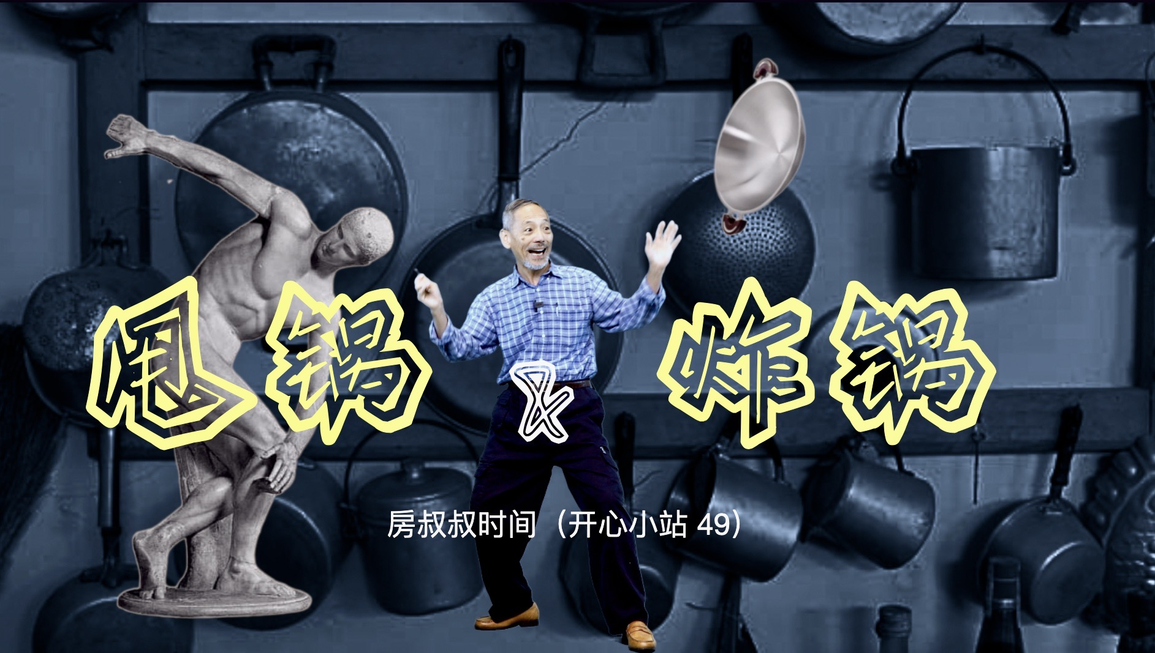

Slide 20
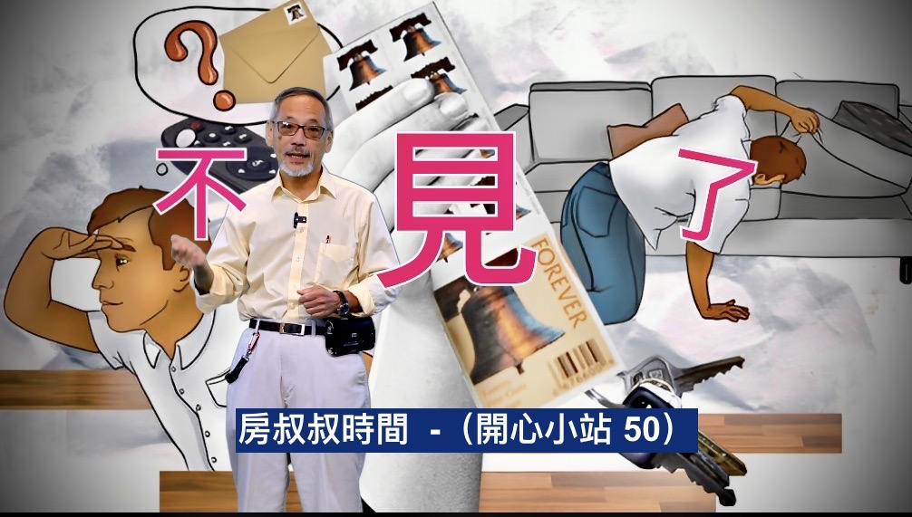

Slide 21
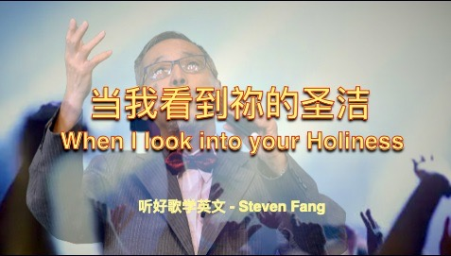

Slide 22
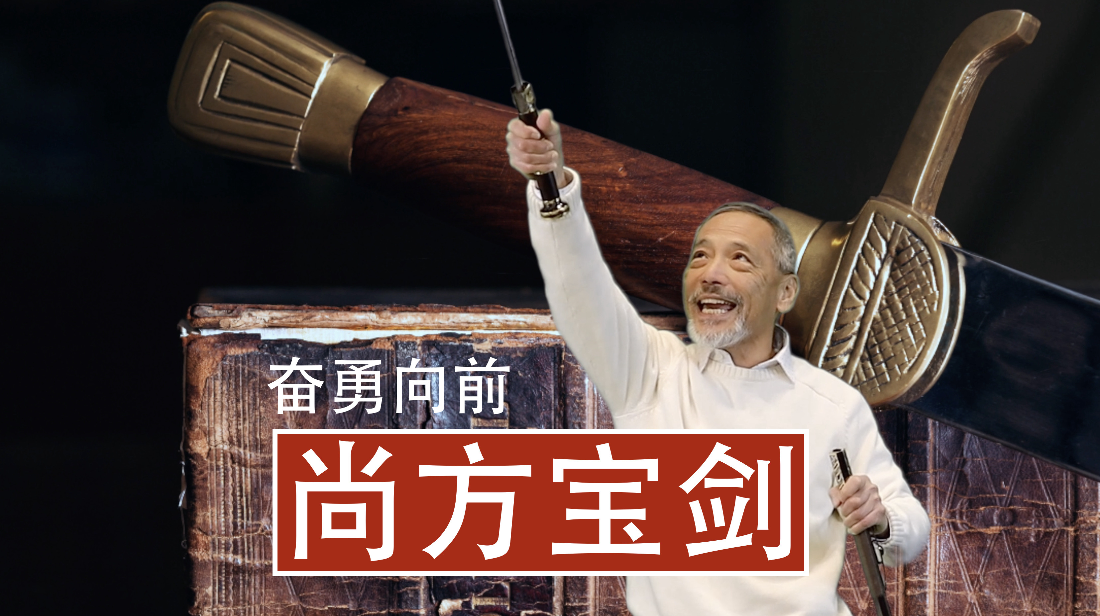

Slide 23

Pray 40 Days for Missionaries

Slide 24
提摩太前书 1 Timothy 2: 1~4
1 我劝你第一要为万人恳求祷告，代求，祝谢。
1 I urge, then, first of all, that petitions, prayers, intercession and thanksgiving be made for all people—
2 为君王和一切在位的也该如此。使我们可以敬虔端正，平安无事的度日。
2 for kings and all those in authority, that we may live peaceful and quiet lives in all godliness and holiness.

Slide 25
3 这是好的，在神我们救主面前可蒙悦纳。
3 This is good, and pleases God our Savior,
4 他愿意万人得救，明白真道。
4 who wants all people to be saved and to come to a knowledge of the truth.

Slide 26
耶利米书 Jeremiah 29: 11~13
11 耶和华说，我知道我向你们所怀的意念是赐平安的意念，不是降灾祸的意念，要叫你们末后有指望。
11 For I know the plans I have for you,” declares the Lord, “plans to prosper you and not to harm you, plans to give you hope and a future.

Slide 27
12 你们要呼求我，祷告我，我就应允你们。
12 Then you will call on me and come and pray to me, and I will listen to you.
13 你们寻求我，若专心寻求我，就必寻见。
13 You will seek me and find me when you seek me with all your heart.

