Slide 1
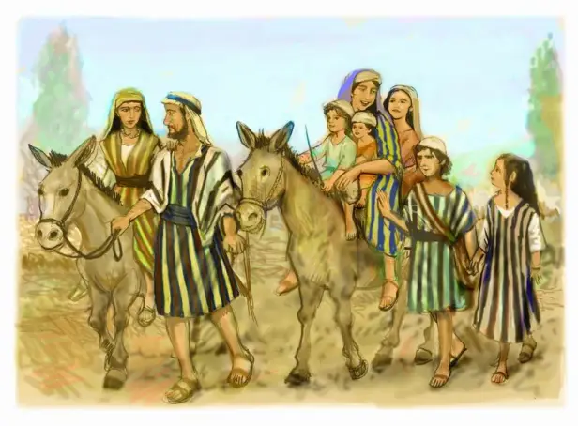
活出的生命见证 Living out the witness of life 撒上 / 1 sam. 1：1-8节

Slide 2
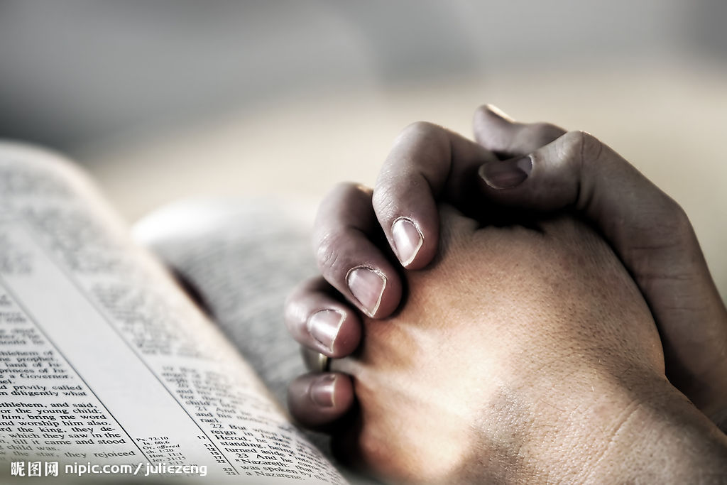
祈祷 / Prayer

Slide 3
一、以利加拿所处的时代和信仰背景 I. The historical and faith background of Elkanah’s time 1、当时的时代背景 1. The historical background of Elkanah’s time

Slide 4
这人每年从本城上到示罗，敬拜祭祀万军之耶和华。在那里有以利的两个儿子何弗尼、非尼哈当耶和华的祭司。 Year after year this man went up from his town to worship and sacrifice to the lord almighty at Shiloh, where Hophni and Phinehas, the two sons of Eli, were priests of the lord. 撒上 / Sam. 1:3

Slide 5
那时没以色列中没有王，各人任意而行。 In those days israel had no king; everyone did as they saw fit. 士 / Jud. 21: 25

Slide 6
耶和华对撒母耳说：“百姓向你说的一切话，你只管依从。因为他们不是厌弃你，乃是厌弃我，不要我作他们的王。 The lord told him: listen to all that the people are saying to you; it is not you they have rejected, but they have rejected me as their king. 撒上 / 1Sam.8:7

Slide 7
你们见亚扪人的王拿辖来攻击你们，就对我说：我们定要一个王治理我们。其实耶和华你们的神是你们的王。 ‘But when you saw that nahash king of the ammonites was moving against you, you said to me, “no, we want a king to rule over us” – even though the lord your god was your king. 撒上 / 1Sam.12:12

Slide 8
1948年，美国最高法院判决在公立学校传福音违宪。 1954年，美国最高法院判决在公立学校分发 《圣经》 违宪 1961年，美国最高法院否决公职人员必须 “宣告相信上帝的存在”。

Slide 9
1962年，美国最高法院取缔全国公立学校的公开祷告。 1963年，美国最高法院判决在公立学校诵读 《圣经》 违宪 1968年，美国最高法院判决在公立学校禁止教进化论违宪 1980年，美国最高法院判决在公立学校悬挂十诫违宪。

Slide 10
1985年，美国最高法院认为在公立学校举行“沉默时刻 ”仪式是变相的祈祷，判决违宪。 1992年，美国最高法院判决在公立学校的毕业典礼上举行祷告仪式违宪。 1997年，美国最高法院判决在公立学校教无神论合法。

Slide 11
2010年，美国威斯康辛州的一个联邦地区法院法官裁定 “全国祈祷日”违宪。 2013年，美国最高法院否决加州第8号 “婚姻只限一男一女 ” 的提案。 2015年，美国最高法院判决同性婚姻合法。

Slide 12
2、当时的信仰背景 2. The faith background of Elkana’s time

Slide 13
这人每年从本城上到示罗，敬拜祭祀万军之耶和华。在那里有以利的两个儿子何弗尼、非尼哈当耶和华的祭司。 3 Year after year this man went up from his town to worship and sacrifice to the lord almighty at Shiloh, where Hophni and Phinehas, the two sons of Eli, were priests of the lord. 撒上 / Sam. 1: 3

Slide 14
以利的两个儿子是恶人，不认识耶和华。这二祭司待百姓是这样的规矩：凡有人献祭，正煮肉的时候，祭司的仆人就来，手拿三齿的叉子，将叉子往罐里，或鼎里，或釜里，或锅里一插，插上来的肉，祭司都取了去。凡上到示罗的以色列人，他们都是这样看待。又在未烧脂油以前，祭司的仆人就来对献祭的人说：

Slide 15
“将肉给祭司，叫他烤吧！他不要煮过的，要生的。”献祭的人若说：“必须先烧脂油，然后你可以随意取肉。”仆人就说：“你立时给我！不然我便抢去。”如此，这二少年人的罪在耶和华面前甚重了，因为他们藐视耶和华的祭物（或作“他们使人厌弃给耶和华献祭”）。 撒上 / 1Sam. 2: 12-17

Slide 16
2：22以利年甚老迈，听见他两个儿子待以色列众人的事，又听见他们与会幕门前伺候的妇人苟合。 撒上 / 1Sam. 2:22

Slide 17
二、富人以利加拿 II. Elkanah was a rich man

Slide 18
以利加拿每逢献祭的日子，将祭肉分给他的妻毗尼拿和毗尼拿所生的儿女。 Whenever the day came for Elkanah to sacrifice, he would give portions of the meat to his wife Peninnah and to all her sons and daughters. 撒上 / Sam. 1: 4

Slide 19
既断了奶，就把孩子带上示罗，到了耶和华的殿，又带了三只公牛，一伊法细面，一皮袋酒。 After he was weaned, she took the boy with her, young as he was, along with a three-year-old bull, an ephah of flour and a skin of wine, and brought him to the house of the Lord at Shiloh. 撒上 / Sam. 1: 24

Slide 20
按摩西律法满了洁净的日子，他们带着孩子上耶路撒冷去，要把他献与主。又要照主的律法上所说，或用一对斑鸠，或用两只雏鸽献祭。 路 / luke 2: 22-24

Slide 21
22 When the time came for the purification rites required by the law of Moses, joseph and Mary took him to Jerusalem to present him to the lord … 24 and to offer a sacrifice in keeping with what is said in the law of the lord: ‘a pair of doves or two young Pigeons’. 路 / luke 2: 22-24

Slide 22
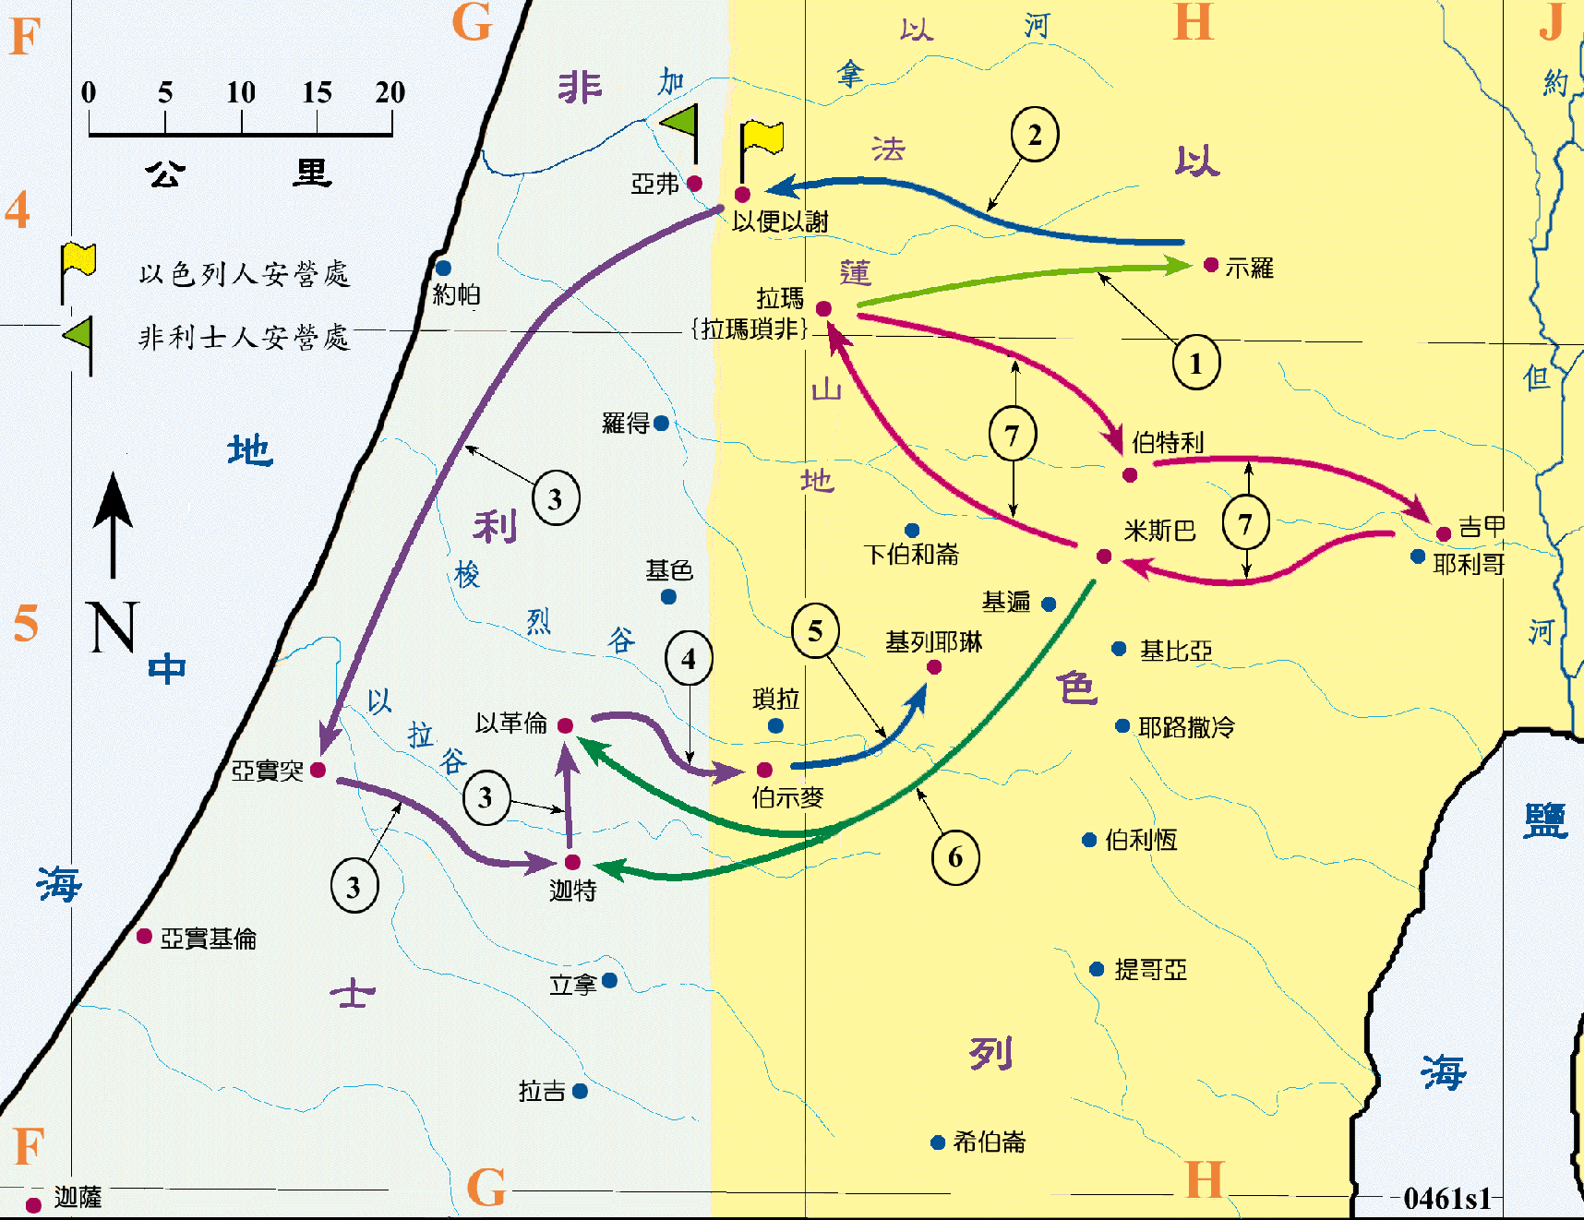

Slide 23
三、以利加拿的家庭 III. The family of Elkanah

Slide 24
以利加拿每逢献祭的日子，将祭肉分给他的妻毗尼拿和毗尼拿所生的儿女。给哈拿的却是双份，因为他爱哈拿。无奈耶和华不使哈拿生育。 撒上 / Sam. 1:4-5

Slide 25
Whenever the day came for Elkanah to sacrifice, he would give portions of the meat to his wife Peninnah and to all her sons and daughters. but to Hannah he gave a double portion because he loved her, and the lord had closed her womb. 撒上 / Sam. 1: 4-5

Slide 26
他母亲每年为他做一件小外袍，同着丈夫上来献年祭的时候带来给他。 Each year his mother made him a little robe and took it to him when she went up with her husband to offer the annual sacrifice. 撒上/ 1Sam. 2: 19

Slide 27
总结 Summary

Slide 28
祈祷 / Prayer

