Slide 1
普通话
广东话
English

Slide 2
What is the greatest challenge presented by technology in your home? 科技在您家中提出的最大挑战是什么？

Slide 3
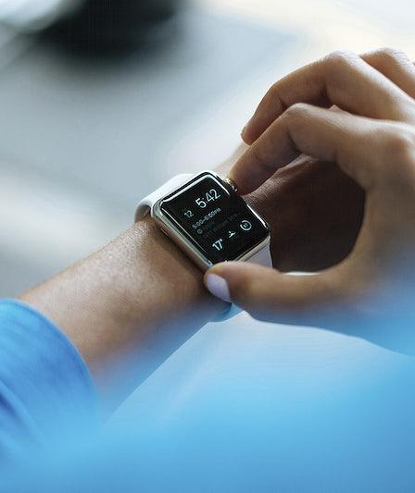
What are the forms of technology used most in your home? 您家中最常使用的科技形式是什么？

Slide 4
DIGITAL 数位
DEVOTION 灵修
I CORINTHIANS 歌林多前书 10:31

Slide 5
USING TECHNOLOGY 运用科技

Slide 6
TECHNOLOGY 科技
Human-made Tools
人造工具

Slide 7
WHAT DOES THE BIBLE SAY ABOUT TECHNOLOGY? 圣经对科技有什么看法？
“Cultivate the earth” “耕耘大地”
Adam & Eve made clothing 亚当夏娃做衣服
Tubal-Cain forged metal tools 土八铁匠锻造金属工具
David used a harp & sling 大卫使用了竖琴和吊索
Architects built the temple 建筑师建造圣殿 Luke was a physician 路加是一名医生
Paul was a tentmaker 保罗是一个帐篷制造者
Jesus was a carpenter 耶稣是一位木匠

Slide 8
WE ARE MADE IN GOD’S IMAGE 我们是照着上帝的形象而造的

Slide 9
“So, whether you eat or drink, or whatever you do, do all to the glory of God.” 所以你们或吃或喝，无论作什么，都要为荣耀神而行。
I CORINTHIANS 歌林多前书 10:31

Slide 10
“innovations [technology] don’t actually raise new questions; they call for greater clarity about old priorities.” “创新 [科技] 实际上并没有提出新问题； 他们呼吁更加明确旧的优先事项。”
— TONY REINKE 托尼·萊因克
GOD, TECHNOLOGY, & THE CHRISTIAN LIFE
上帝、科技和基督徒生活

Slide 11
BIBLICAL PRINCIPLES FOR USING TECHNOLOGY 使用科技的圣经原则

Slide 12
01
SABBATH 安息日
Does technology keep you from experiencing rest?
科技会让你无法休息吗？

Slide 13
BODY AS TEMPLE 身体如同圣殿
02
Does technology lead to physical or mental health problems in your life?
科技是否会导致您生活中的身体或心理健康问题？

Slide 14
SPIRITUAL DISCIPLINES 属灵操练
03
Does technology hinder you from developing spiritual disciplines (Bible study, prayer, meditation, fasting, etc.)
科技是否会阻碍你发展属灵修炼（圣经学习、祈祷、冥想、禁食等）？

Slide 15
04
SLOTHFULNESS 懒惰
Does technology supplement your hard work or does it make you lazier?
科技是对你的辛勤工作的补充还是让你变得更懒惰？

Slide 16
05
BUSYNESS 繁忙
Does technology keep you so focused on accomplishing things that your relationships and wellness suffer?
科技是否让你如此专注于完成你的人际关系和健康受到影响的事情？

Slide 17
ANXIETY AND FEAR 焦虑和恐惧
06
Does technology contribute to anxiety in your life?
科技会导致你生活中的焦虑吗？

Slide 18
LOVE ONE ANOTHER 爱对方
07
Do you use technology to show love to others or do you use it instead of making real sacrifices for others?
您是使用科技向他人表达爱，还是使用它而不是为他人做出真正的牺牲？

Slide 19
GLORIFY GOD IN ALL 荣耀上帝
08
Do the things you do with technology glorify God or glorify yourself?
用科技做的事情是荣耀上帝还是荣耀自己？

Slide 20
09
COVETOUSNESS & VANITY 贪婪与虚荣
Does technology make you less content and more materialistic?
科技会让你变得更少满足，更物质化吗？

Slide 21
IDOLATRY & ENVY 拜偶像和嫉妒
10
Does technology show you things that tempt you to be jealous of others, idolize others, or lust after others?
科技是否向您展示了一些诱使您嫉妒他人、崇拜他人或渴望他人的事物？

Slide 22
TRUTH & INTEGRITY 真实与诚信
11
Does technology lead to a better understanding of the truth or does it add to the confusion?
科技是否会导致更好地理解真相，还是会增加混乱？

Slide 23
How can you use technology
in a Christian way?
您如何以基督教的方式使用科技？

Slide 24
你太专注于你是否可以
你没有停下来思考是否应该

Slide 25
UNDERSTANDING TECHNOLOGY 理解科技

Slide 26
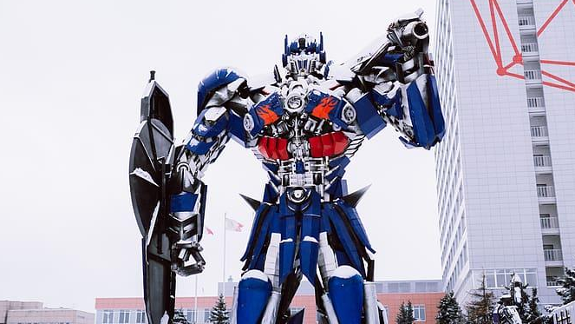
More than meets the eye 不止是眼前一亮
Technology is not neutral, it is good
科技不是中立的，它是好的
Technology should be used for good
科技应该用在好的方面
Technology’s impact goes beyond the ways it is used
科技的影响超出了它的使用方式

Slide 27
Usage:
Calling mom = good use
打电话给妈妈 = 好
Calling names = bad use
直呼名字 = 使用不当
My use of technology
我对科技的使用

Slide 28
Effects:
I can save time
我可以节省时间
I don’t make time for visits
我没有时间去拜访
I sleep poorly
我睡不好觉
Technology’s effect on me
科技对我的影响

Slide 29
What is technology’s effect on you and your household?
科技对您和您的家庭有什么影响？

Slide 30
SUBORDINATING TECHNOLOGY 次要科技

Slide 31
MAKE A PLAN FOR YOUR TECHNOLOGY 为您的科技制定计划

Slide 32
THINGS TO CONSIDER 需考虑的事项
1. Plan your rest
计划你的休息
2. Find others who share a desire to limit tech (be a church community)
寻找其他同样希望限制科技產品的人（成为教会社区）
3. Identify wasted time (Scrolling things, watching things, etc.)
识别浪费的时间（滚动东西、看东西等）
4. Identify where anxiety comes from (personal story)
确定焦虑来自哪里（个人故事）
5. Set boundaries on children’s use of tech and on your own use of tech
为孩子使用科技和你自己使用科技设定界限

Slide 33
What is one step you can take to address the challenge posed by technology in your home? 您可以采取哪些步骤来解决您家中的科技带来的挑战？

