Slide 1
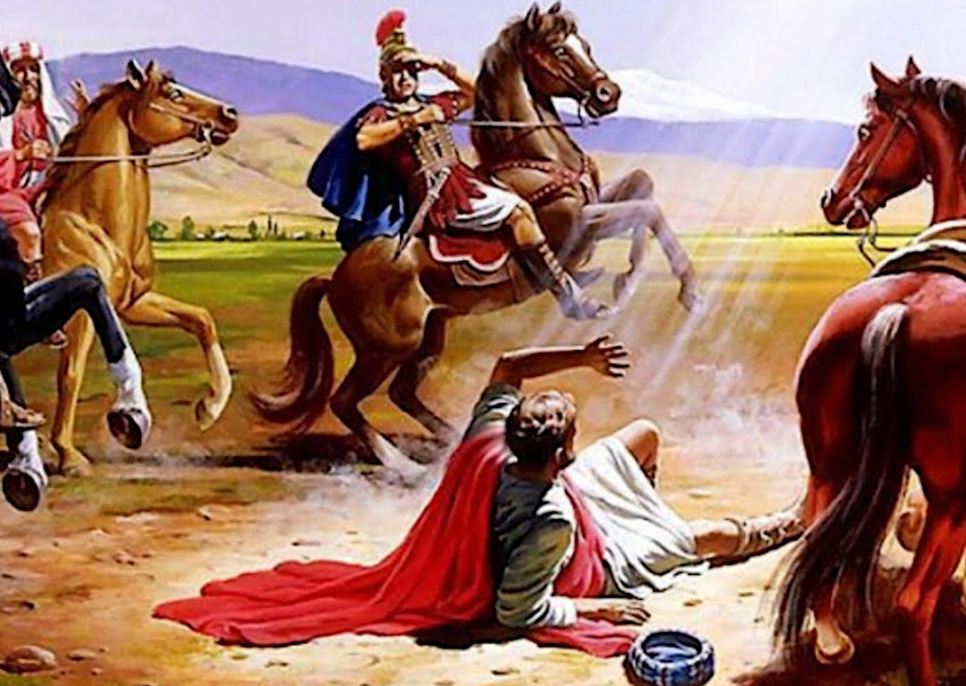
何等美好的改變
What a beautiful change!

Slide 2
使徒行传 9:1-2
1 扫罗仍然向主的门徒口吐威吓凶杀的话，去见大祭司，
2 求文书给大马士革的各会堂，若是找着信奉这道的人，无论男女，都准他捆绑带到耶路撒冷。

Slide 3
Acts 9:1-2
1 Meanwhile, Saul was still breathing out murderous threats against the Lord’s disciples. He went to the high priest
.

Slide 4
Acts 9:1-2
2 and asked him for letters to the synagogues in Damascus, so that if he found any there who belonged to the Way, whether men or women, he might take them as prisoners to Jerusalem.

Slide 5
使徒行传 9:4-5
4 他就仆倒在地，听见有声音对他说：“扫罗，扫罗，你为什么逼迫我？”
5 他说：“主啊，你是谁？”主说：“我就是你所逼迫的耶稣。

Slide 6
Acts 9:4-5
4 He fell to the ground and heard a voice say to him, “Saul, Saul, why do you persecute me?”
5 “Who are you, Lord?” Saul asked.
“I am Jesus, whom you are persecuting,” he replied.

Slide 7
使徒行传 9:6-9
6 起来！进城去，你所当做的事，必有人告诉你。”
7 同行的人站在那里，说不出话来，听见声音，却看不见人。

Slide 8
使徒行传 9:6-9
8 扫罗从地上起来，睁开眼睛，竟不能看见什么。有人拉他的手，领他进了大马士革。
9 三日不能看见，也不吃也不喝。

Slide 9
Acts 9:6-9
6 “Now get up and go into the city, and you will be told what you must do.”
7 The men traveling with Saul stood there speechless; they heard the sound but did not see anyone.

Slide 10
Acts 9:6-9
8 Saul got up from the ground, but when he opened his eyes he could see nothing. So they led him by the hand into Damascus.
9 For three days he was blind, and did not eat or drink anything..

Slide 11
倒下去的是掃羅
站起來變成“保羅”
It was Saul who fell.
He became Paul
after standing up.

Slide 12
上帝問我們的問題？
The questions God has for us
1.我立大地根基的时候
你在哪里？
Where were you when I laid the foundation of the earth?
2.高山中的野山羊什么时候生産，
你知道吗？
Do you know when the mountain goats give birth?

Slide 13
3.谁为海水定界限？
你若是聪明只管说吧？
Who assigned to the sea its limits? Tell me, if you have understanding.

Slide 14
使徒行传 9:10-12
10 当下，在大马士革有一个门徒，名叫亚拿尼亚。主在异象中对他说：“亚拿尼亚！”他说：“主，我在这里。”
11 主对他说：“起来！往直街去，在犹大的家里访问一个大数人，名叫扫罗。他正祷告，

Slide 15
使徒行传 9:10-12
12 又看见了一个人，名叫亚拿尼亚，进来按手在他身上，叫他能看见。”

Slide 16
Acts 9:10-12
10 In Damascus there was a disciple named Ananias. The Lord called to him in a vision, “Ananias!”
“Yes, Lord,” he answered.
11 The Lord told him, “Go to the house of Judas on Straight Street and ask for a man from Tarsus named Saul, for he is praying.

Slide 17
使徒行传 Acts 9:10-12
12 In a vision he has seen a man named Ananias come and place his hands on him to restore his sight.”

Slide 18
Acts 9:10-12
12 又看见了一个人，名叫亚拿尼亚，进来按手在他身上，叫他能看见。”
In a vision he has seen a man named Ananias come and place his hands on him to restore his sight.”

Slide 19
使徒行传 9:15-16
15 主对亚拿尼亚说：“你只管去！他是我所拣选的器皿，要在外邦人和君王并以色列人面前宣扬我的名。
16 我也要指示他，为我的名必须受许多的苦难。”

Slide 20
Acts 9:15-16
15 But the Lord said to Ananias, “Go! This man is my chosen instrument to proclaim my name to the Gentiles and their kings and to the people of Israel.
16 I will show him how much he must suffer for my name.”

Slide 21
三个重点
Three Key Points
1.他成了基督的仆人。
He became a servant of Christ.
2.他成了基督的见证人。
He became a witness to Christ.
3.他成了福音的使者。
He became a messenger of the Gospel.

Slide 22
你做人處事的態度就是
一篇信息！
Your attitude towards people and things is a message.

Slide 23
主是陶匠我們是泥土
The Lord is the potter, and we are the clay.
求主塑造我們成為貴重器皿
May the Lord make us into vessels for honorable use.

