Slide 1
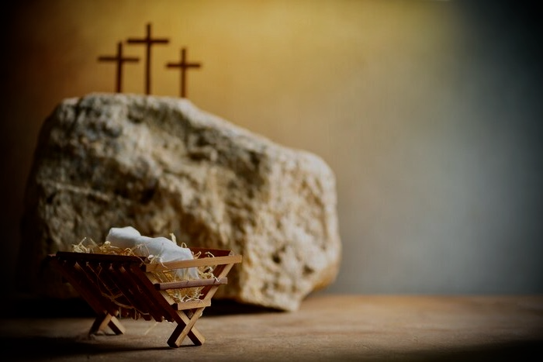
从马槽到十字架的意义 The Meaning of From the Manger to the Cross
房正豪牧师 Rev. Steven Fang

Slide 2
从无限进入有限 From infinite to finite

Slide 3
从尊贵变成卑微 From honor to humble

Slide 4
从永恒进入短暂 from eternity to ephemerality

Slide 5
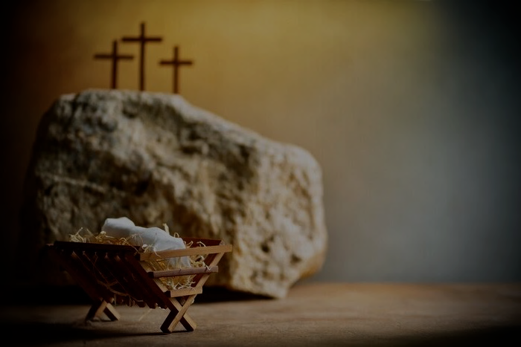
腓利比书 Philippians 2:6-8
6 他本有神的形像，不以自己与神同等为强夺的。
6 Who, being in very nature[a] God, did not consider equality with God something to be used to his own advantage;
7 反倒虚己，取了奴仆的形像，成为人的样式。
7 rather, he made himself nothing
by taking the very nature[b] of a servant,
being made in human likeness.

Slide 6
8 既有人的样子，就自己卑微，存心顺服，以至死，且死在十字架上。
8 And being found in appearance as a man,
he humbled himself
by becoming obedient to death — even death on a cross!

Slide 7
罗马书 Romans 5:6-8
6 因我们还软弱的时候，基督就按所定的日期为罪人死。
6 You see, at just the right time, when we were still powerless, Christ died for the ungodly.
7 为义人死，是少有的，为仁人死，或者有敢作的。
7 Very rarely will anyone die for a righteous person, though for a good person someone might possibly dare to die.

Slide 8
8 惟有基督在我们还作罪人的时候为我们死，神的爱就在此向我们显明了。
8 But God demonstrates his own love for us in this: While we were still sinners, Christ died for us.

Slide 9
因信称义（罗马书主题）
Justification by Faith (Romans Topics)

Slide 10
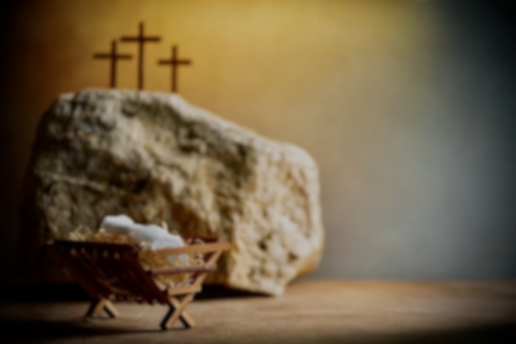
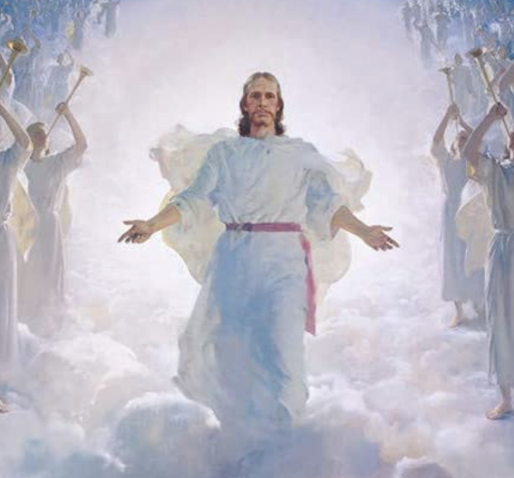
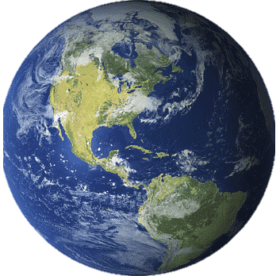
父、子、灵
信主的人

Slide 11
十架下是讽刺的声音 十架上却是句句恩言 under the cross is the voice of sarcasm
On the cross, there are words of Grace

Slide 13
歌林多前书 1 Corinthians 1:18
18 因为十字架的道理，在那灭亡的人为愚拙。在我们得救的人却为神的大能。
18 For the message of the cross is foolishness to those who are perishing, but to us who are being saved it is the power of God.

Slide 15
人生的意义是 在乎和神建立关系！ the meaning of life is
Care about building a relationship with God!

Slide 16
更像耶稣的生命 结出圣灵的果子 life more like jesus
bearing the fruit of the spirit

Slide 17
Word of the year 2022
煤氣燈效應 (Gaslighting)
The act or practice of grossly misleading someone especially for one’s own advantage.
严重误导别人 （为了自己的利益）

Slide 19
从马槽到十字架的意义？ 从出生到死亡的意义？
What does it mean from the manger to the cross?
Meaning from birth to death?

