Slide 1
The Long Game of Discipleship 打门徒训练的持久比赛
2 Timothy /提摩太后 2:1-13

Slide 2
2 Timothy /提摩太后 1:1-13

Slide 3
Play the game of discipleship to win, because you will 全力以赴地为门徒训练竞争， 因为您肯定赢

Slide 4
Invest in the Long Game of Discipleship 投资于长线门徒训练战略

Slide 5
Play Fair 公平竞争

Slide 6
Play to win, because you will 全力以赴地竞争， 因为您肯定赢

Slide 7
Invest in the Long Game of Discipleship 投资于长线门徒训练战略

Slide 8
THE LONG GAME / 长线战略
“what you have heard from me in the presence of many witnesses entrust to faithful men, who will be able to teach others also.” / 你在许多见证人面前听见我所教训的，也要交托那忠心能教导别人的人" (v. 2)
2 Timothy /提摩太后 1:1-18

Slide 9
THE LONG GAME / 长线战略
“what you have heard from me in the presence of many witnesses entrust to faithful men, who will be able to teach others also.” / 你在许多见证人面前听见我所教训的，也要交托那忠心能教导别人的人" (v. 2)
2 Timothy /提摩太后 1:1-18

Slide 10
THE LONG GAME / 长线战略
“what you have heard from me in the presence of many witnesses entrust to faithful men, who will be able to teach others also.” / 你在许多见证人面前听见我所教训的，也要交托那忠心能教导别人的人" (v. 2)
2 Timothy /提摩太后 1:1-18

Slide 11
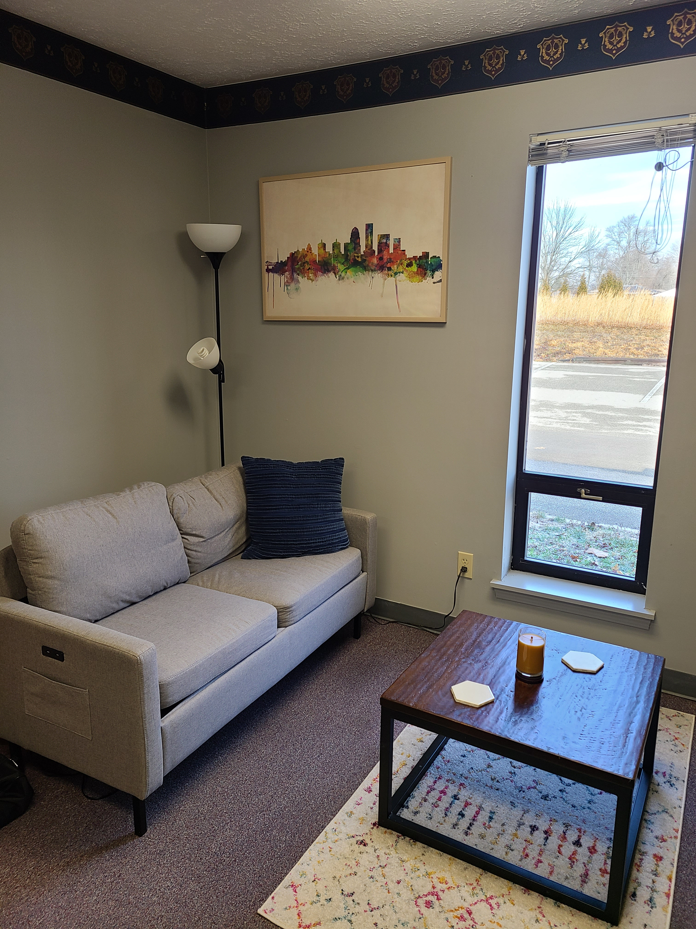

Slide 12
THE LONG GAME / 长线战略
“what you have heard from me in the presence of many witnesses entrust to faithful men, who will be able to teach others also.” / 你在许多见证人面前听见我所教训的，也要交托那忠心能教导别人的人" (v. 2)
2 Timothy /提摩太后 1:1-18

Slide 13
Play Fair 公平竞争

Slide 14
PLAY FAIR / 公平竞争
“An athlete is not crowned unless he competes according to the rules.” / " 人若在场上比武，非按规矩，就不能得冠冕。 " (v. 5) /
2 Timothy /提摩太后 1:1-18

Slide 15
PLAY FAIR / 公平竞争
“… the crown of righteousness, which the Lord, the righteous judge, will award to me on that day, and not only to me but also to all who have loved his appearing.” / "公义的冠冕为我存留，就是按着公义审判的主到了那日要赐给我的；不但赐给我，也赐给凡爱慕他显现的人。 " (v. 5)
2 Timothy /提摩太后 1:1-18

Slide 16
PLAY FAIR / 公平竞争
“An athlete is not crowned unless he competes according to the rules.” / " 人若在场上比武，非按规矩，就不能得冠冕。 " (v. 5) /
2 Timothy /提摩太后 1:1-18

Slide 17
Play to win, because you will 全力以赴地竞争， 因为您肯定赢

Slide 18
PLAY TO WIN / 全力以赴地竞争
“Remember Jesus Christ, risen from the dead” / "你要记念耶稣基督… 他从死里复活" (v. 8)
2 Timothy /提摩太后 1:1-18

Slide 19
PLAY TO WIN / 全力以赴地竞争
“The word of God is not bound” / "神的道却不被捆绑" (v. 9)
“I endure everything for the sake of the elect” / "我为选民凡事忍耐" (v. 10)
“If we have died with him, we will also live with him; if we endure, we will also reign with him;” / "我们若与基督同死，也必与他同活; 我们若能忍耐，也必和他一同作王。" (v. 11-12)
2 Timothy /提摩太后 1:1-18

