Slide 1
房正豪牧师 Rev. Steven Fang

Slide 2
以西结书 Ezekiel 18:1-3
1 耶和华的话又临到我说，
1 The word of the Lord came to me:
2 你们在以色列地怎么用这俗语说父亲吃了酸葡萄，儿子的牙酸倒了呢？
2 “What do you people mean by quoting this proverb about the land of Israel:
“‘The parents eat sour grapes,
and the children’s teeth are set on edge’?

Slide 3
3 主耶和华说，我指着我的永生起誓，你们在以色列中，必不再有用这俗语的因由。
3 “As surely as I live, declares the Sovereign Lord, you will no longer quote this proverb in Israel.

Slide 4
耶利米书 Jeremiah 31:27~30
27 耶和华说，日子将到，我要把人的种和牲畜的种播种在以色列家和犹大家。
27 “The days are coming,” declares the Lord, “when I will plant the kingdoms of Israel and Judah with the offspring of people and of animals.

Slide 5
28 我先前怎样留意将他们拔出，拆毁，毁坏，倾覆，苦害，也必照样留意将他们建立，栽植。这是耶和华说的。
28 Just as I watched over them to uproot and tear down, and to overthrow, destroy and bring disaster, so I will watch over them to build and to plant,” declares the Lord.

Slide 6
29 当那些日子，人不再说，父亲吃了酸葡萄，儿子的牙酸倒了。
29 “In those days people will no longer say,
‘The parents have eaten sour grapes,
and the children’s teeth are set on edge.’
30 但各人必因自己的罪死亡。凡吃酸葡萄的，自己的牙必酸倒。
30 Instead, everyone will die for their own sin; whoever eats sour grapes—their own teeth will be set on edge.

Slide 7
以西结书 Ezekiel 18:4
4 看哪，世人都是属我的。为父的怎样属我，为子的也照样属我。犯罪的，他必死亡。
4 For everyone belongs to me, the parent as well as the child—both alike belong to me. The one who sins is the one who will die.

Slide 8
群体个性 Group Personality
群体中只要一人犯罪
全群都招殃？ As long as one person in the group commits a crime,
Will the entire group suffer?

Slide 9
1. 新约和旧约 “盟约的解释” New Testament and Old Testament
"Interpretation of the Covenant"

Slide 10
2. 新约和旧约 “代表论的解释” New Testament and Old Testament
"Interpretation of the Representationalism"

Slide 11
立约的意义 Significance of covenant
圣经 Bible | 旧约 Old testament | 新约 New testament
立約中保 Mediator | 亚当 Adam | 基督 Christ
立約、責任 Covenant, Responsibility | 守约蒙福，背约受咒诅 Blessed to keep the covenant, cursed to break it. | 基督成全律法，没有咒诅 Christ has fulfilled the law without the curse
约的果效 Fruits of Covenant | 影响全人类 Impact on all of humanity | 因信称义（新人类） Justification by Faith (New Humanity)
约的性质 The Nature of the Covenant | 行为之约，活出要求 Covenant of behavior, live out the requirements | 恩典之约，单靠耶稣十架 The covenant of grace, by Jesus’ Cross alone
约的祝福 Blessing of Covenant | 生命树 Tree of life | 永生 Eternal life

Slide 12
3. 五旬節派释经法是有问题的？ Is Pentecostal Hermeneutics Problematic？

Slide 13
隔代咒诅强调透过内在医治来释放祖先的咒诅是不正确。 Intergenerational Curse Emphasis on releasing ancestral curses through inner healing is incorrect

Slide 15
1. 相信隔代咒诅只会朝
寻找责怪祖先过错方向，
而忽略检讨自己。
Believing in intergenerational curses only leads in the direction of looking for ways to blame ancestors for their faults, while ignoring self-examination.

Slide 16
2. 隔代咒诅脱离耶稣十架救恩的 “完整性”。 The intergenerational curse is separated from the "integrity" of the salvation of Jesus' cross.

Slide 17
约翰福音 John 8:36
36 所以天父的儿子若叫你们自由，你们就真自由了。
36 So if the Son sets you free, you will be free indeed.

Slide 18
加拉太书 Galatians 5:1
1 基督释放了我们，叫我们得以自由，所以要站立得稳，不要再被奴仆的轭挟制。
1 It is for freedom that Christ has set us free. Stand firm, then, and do not let yourselves be burdened again by a yoke of slavery.

Slide 19
以西结书 18：1~20 三段分析（结局） Ezekiel 18:1~20 Three-Paragraph Analysis (Conclusion)
5~9 | 义人敬畏神 The Righteous fear God | 义人必存活 The righteous shall live
10~13 | 义父、恶子 Righteous Father, Wicked Son | 父 Father：存活 Live 子 Son：死亡 Die
14~20 | 恶父、义子 Wicked Father, Righteous Son | 父 Father：死亡 Die 子 Son：存活 Live

Slide 20
(以西结书 Ezekiel 18:21~23)
主题：从恶人到义人 Theme: From the Wicked to the Righteous.

Slide 21
以西结书 Ezekiel 18:21~23
21 恶人若回头离开所作的一切罪恶，谨守我一切的律例，行正直与合理的事，他必定存活，不致死亡。
21 “But if a wicked person turns away from all the sins they have committed and keeps all my decrees and does what is just and right, that person will surely live; they will not die.

Slide 22
22 他所犯的一切罪过都不被记念，因所行的义，他必存活。
22 None of the offenses they have committed will be remembered against them. Because of the righteous things they have done, they will live.

Slide 23
23 主耶和华说，恶人死亡，岂是我喜悦的吗？不是喜悦他回头离开所行的道存活吗？
23 Do I take any pleasure in the death of the wicked? declares the Sovereign Lord. Rather, am I not pleased when they turn from their ways and live?

Slide 24
诗篇 Psalm 34:18
18 耶和华靠近伤心的人，拯救灵性痛悔的人。
18 The Lord is close to the brokenhearted and saves those who are crushed in spirit.

Slide 25
(以西结书 Ezekiel 18:24~26)
主题：从义人到恶人 Theme: From the Righteous to the Wicked.

Slide 26
以西结书 Ezekiel 18:24~26
24 义人若转离义行而作罪孽，照着恶人所行一切可憎的事而行，他岂能存活吗？他所行的一切义都不被记念。他必因所犯的罪，所行的恶死亡。
24 “But if a righteous person turns from their righteousness and commits sin and does the same detestable things the wicked person does, will they live? None of the righteous things that person has done will be remembered. Because of the unfaithfulness they are guilty of and because of the sins they have committed, they will die.

Slide 27
25 你们还说，主的道不公平。以色列家啊，你们当听，我的道岂不公平吗？你们的道岂不是不公平吗？
25 “Yet you say, ‘The way of the Lord is not just.’ Hear, you Israelites: Is my way unjust? Is it not your ways that are unjust?

Slide 28
26 义人若转离义行而作罪孽死亡，他是因所作的罪孽死亡。
26 If a righteous person turns from their righteousness and commits sin, they will die for it; because of the sin they have committed they will die.

Slide 29
以西结书 Ezekiel 18:29~30
29 以色列家还说，主的道不公平。以色列家啊，我的道岂不公平吗？你们的道岂不是不公平吗？
29 Yet the Israelites say, ‘The way of the Lord is not just.’ Are my ways unjust, people of Israel? Is it not your ways that are unjust?

Slide 30
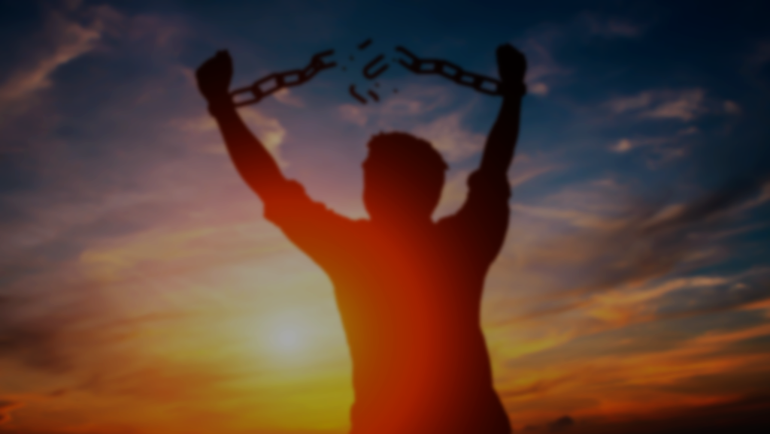
30 所以主耶和华说，以色列家啊，我必按你们各人所行的审判你们。你们当回头离开所犯的一切罪过。这样，罪孽必不使你们败亡。
30 “Therefore, you Israelites, I will judge each of you according to your own ways, declares the Sovereign Lord. Repent! Turn away from all your offenses; then sin will not be your downfall.

