Slide 1
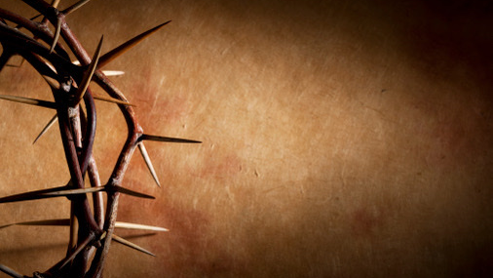
GOOD FRIDAY
纪念耶稣受难礼拜
April 7, 2023

Slide 2
序 乐
Prelude
179 啊！ 圣洁耶稣 Ah, Holy Jesus

Slide 3
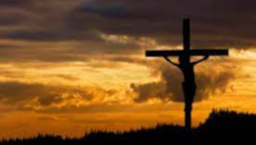
啊！ 圣洁耶稣，祢受如此羞辱， 在审判台前，默默承受寃误， 被敌人憎恶，更被友人辜负，受极大痛苦. Ah, holy Jesus, how have you offended,
that mortal judgment has on You descended?
By foes derided, by Your own rejected, O most afflicted.

Slide 4
为谁的过犯，祢竟受到亏待？ 是我的不义，将祢背弃出卖. 耶稣啊，是我，是我将祢否认，钉祢在十架. Who was the guilty? Who brought this upon You?
It is my treason, Lord, that has undone You.
‘Twas I, Lord Jesus, I it was denied You; I crucified You.

Slide 5
认罪祷告
Confession Prayer

Slide 6
读经 Scripture Reading
路加福音 Luke 23 : 13-25

Slide 7
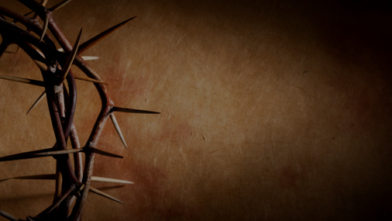
13 彼拉多传齐了祭司长，和官府，并百姓，
14 就对他们说，你们解这人到我这里，说他是诱惑百姓的。看哪，我也曾将你们告他的事，在你们面前审问他，并没有查出他什么罪来。
15 就是希律也是如此，所以把他送回来。可见他没有作什么该死的事。
16,17 故此我要责打他，把他释放了。
18 众人却一齐喊着说，除掉这个人，释放巴拉巴给我们。

Slide 8
19 这巴拉巴是因在城里作乱杀人下在监里的。
20 彼拉多愿意释放耶稣，就又劝解他们。
21 无奈他们喊着说，钉他十字架，钉他十字架
22 彼拉多第三次对他们说，为什么呢？这人作了什么恶事呢？我并没有查出他什么该死的罪来。所以我要责打他，把他释放了。
23 他们大声催逼彼拉多，求他把耶稣钉在十字架上。他们的声音就得了胜，

Slide 9
23 他们大声催逼彼拉多，求他把耶稣钉在十字架上。他们的声音就得了胜，
24 彼拉多这才照他们所求的定案。
25 把他们所求的那作乱杀人下在监里的，释放了。把耶稣交给他们，任凭他们的意思行。

Slide 10
13 Pilate called together the chief priests, the rulers and the people,
14 and said to them, “You brought me this man as one who was inciting the people to rebellion. I have examined him in your presence and have found no basis for your charges against him.
15 Neither has Herod, for he sent him back to us; as you can see, he has done nothing to deserve death.

Slide 11
16 Therefore, I will punish him and then release him.” [17]
18 But the whole crowd shouted, “Away with this man! Release Barabbas to us!”
19 (Barabbas had been thrown into prison for an insurrection in the city, and for murder.)
20 Wanting to release Jesus, Pilate appealed to them again.

Slide 12
21 But they kept shouting, “Crucify him! Crucify him!”
22 For the third time he spoke to them: “Why? What crime has this man committed? I have found in him no grounds for the death penalty. Therefore I will have him punished and then release him.”

Slide 13
23 But with loud shouts they insistently demanded that he be crucified, and their shouts prevailed.
24 So Pilate decided to grant their demand.
25 He released the man who had been thrown into prison for insurrection and murder, the one they asked for, and surrendered Jesus to their will.

Slide 14
奇妙十架 When I survey the Wondrous Cross

Slide 15
每逢思想奇妙十架， 荣耀之主在上悬挂， 富贵荣华看为有损， 从前所夸，今觉鄙下. When I survey the wondrous cross
on which the Prince of glory died;
My richest gain I count but loss,
and pour contempt on all my pride.

Slide 16
求主禁我别有所夸， 但夸我主舍命十架， 从前所慕虚荣宴乐，
今因主血甘尽丢下. Forbid it, Lord, that I should boast,
save in the death of Christ, my God;
All the vain things that charm me most,
I sacrifice them to His blood.

Slide 17
试看其头， 其足， 其手， 慈爱忧愁和血并流， 如此爱， 忧自古焉有？ 荆棘反成荣耀冕旒. See, from His head, His hands, His feet,
sorrow and love flow mingled down.
Did e’er such love and sorrow meet,
or thorns compose so rich a crown?

Slide 18
宇宙万物若归我管， 奉献所有难报主恩， 神圣奇妙主爱深厚， 愿献我命，我身，我心. Were the whole realm of nature mine,
that were a present far too small;
Love so amazing, so divine,
demands my soul, my life, my all.

Slide 19
纪念耶稣 Remembrance of Jesus

Slide 20
1 父啊， 赦免他们.
Father, forgive them.
2 今 日 你 要 同 我 在 乐 园 里 了.
Today you will be with me in paradise.

Slide 21
3 母亲， 看你的儿子.
Dear woman, here is your son.
4 我的神，我的神，为什么离弃我?
My God, my God,
why have you forsaken me?

Slide 22
5 我渴了!
I am thirsty.
6 成了!
It is finished !

Slide 23
7 父阿！我将我的灵魂交在你手里.
Father, into your hands I commit my spirit.

Slide 24
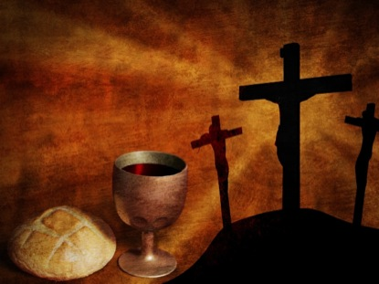
恭守主餐
Communion

Slide 25
领我到髑髏地 Lead Me to Calvary

Slide 26
生命之主愿祢作王，
荣耀都归于祢; 使我莫忘祢荆棘冕; 领我到髑髏地. King of my life, I crown Thee now,
Thine shall the glory be;
lest I forget Thy thorn-crowned brow,
lead me to Calvary.

Slide 27
使我莫忘客西马尼， 莫忘我主痛苦受死， 莫忘我主仁爱慈悲， 领我到髑髏地. Lest I forget Gethsemane;
lest I forget Thine agony;
lest I forget Thy love for me,
lead me to Calvary.

Slide 28
让我看见在祢墓前， 门徒忧伤哭泣; 光明天使看守侍候; 等待救主复活. Show me the tomb where thou was laid,
tenderly mourned and wept;
angels in robes of light arrayed
guarded Thee whilst Thou slept.

Slide 29
使我莫忘客西马尼， 莫忘我主痛苦受死， 莫忘我主仁爱慈悲， 领我到髑髏地. Lest I forget Gethsemane;
lest I forget Thine agony;
lest I forget Thy love for me,
lead me to Calvary.

Slide 30
愿像马利亚清早起， 预备来膏抺祢; 让我看见墓门已开; 领我到髑髏地. Let me like Mary thro’ the gloom,
come with a gift to Thee;
show to me now the empty tomb,
lead me to Calvary.

Slide 31
使我莫忘客西马尼， 莫忘我主痛苦受死， 莫忘我主仁爱慈悲， 领我到髑髏地. Lest I forget Gethsemane;
lest I forget Thine agony;
lest I forget Thy love for me,
lead me to Calvary.

Slide 32
主啊，我甘心又乐意， 背十架跟随祢; 救主苦杯我愿分尝， 因祢为我舍己. May I be willing Lord,
to bear daily my cross for Thee;
even Thy cup of grief to share,
Thou hast borne all for me.

Slide 33
使我莫忘客西马尼， 莫忘我主痛苦受死， 莫忘我主仁爱慈悲， 领我到髑髏地. Lest I forget Gethsemane;
lest I forget Thine agony;
lest I forget Thy love for me,
lead me to Calvary.

Slide 34
祝 祷
Benediction

Slide 35
十架为我荣耀
Near the Cross

Slide 36
求主使我依十架，
在彼有生命水，
由各各他山流下，
白白赦我众罪.
Jesus, keep me near the cross;
there a precious fountain,
free to all, a healing stream,
flows from Calv’ry’s mountain.

Slide 37
十字架， 十字架，
永是我的荣耀！
我众罪都洗清洁，
惟靠耶稣宝血！
In the cross, in the cross,
be my glory ever,
till my raptured soul shall find
rest beyond the river.(X2)

Slide 38
默祷散会 Silent prayer and dismissed

