Slide 1
房正豪牧師
Rev. Steven Fang

Slide 2
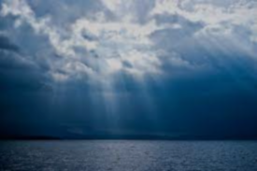
天开了 ➡️ 要看见神的荣耀 Heavens opened
➡️ To see God's glory

Slide 3
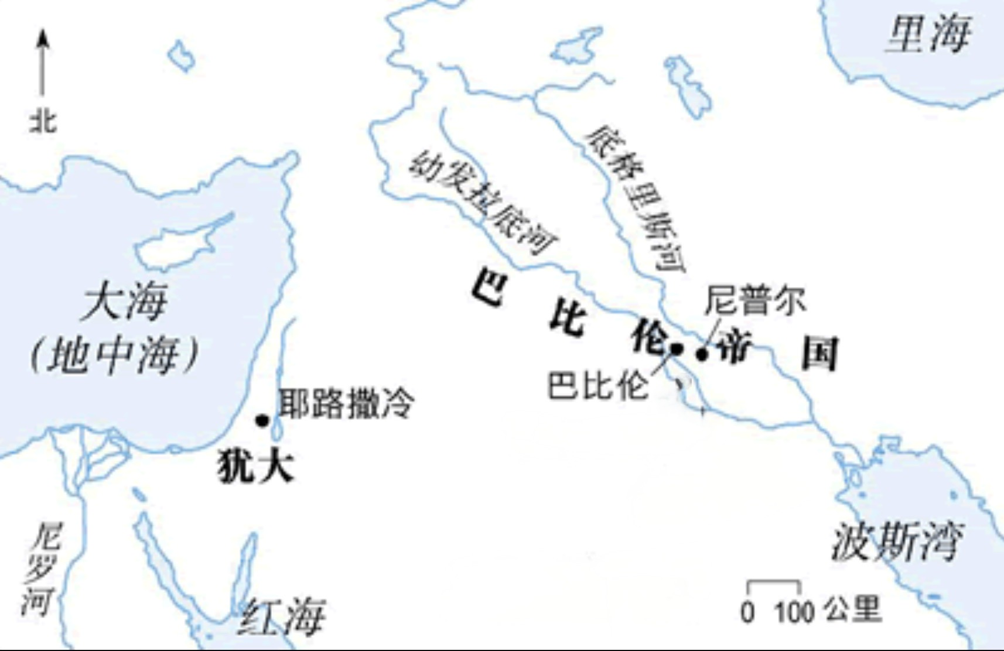
迦巴魯河

Slide 4
春望 Spring View
（唐代诗人杜甫 By Du Fu, poet of Tang Dynasty ） 国破山河在 The country is ruined, though mountains and rivers remain. 城春草木深 In the Spring, the grass and trees flourish in the city. 感时花溅泪 feel sad at that moment like flowers shed tears. 恨别鸟惊心 Hating the separation, birds are fearful at heart.

Slide 5
烽火连三月 The beacons have burnt continuously for three months. 家书抵万金 A letter from home is worth ten-thousand pieces of gold. 白头搔更短 My white hair is even scarcer from scratching. 浑欲不胜簪 And can barely hold a hairpin.

Slide 6
以 西 結 書 Ezekiel 1:1~3
1 当三十年四月初五日，以西结在迦巴鲁河边被掳的人中，天就开了，得见神的异象。
1 In my thirtieth year, in the fourth month on the fifth day, while I was among the exiles by the Kebar River, the heavens were opened and I saw visions of God.
2 正是约雅斤王被掳去第五年四月初五日，
2 On the fifth of the month—it was the fifth year of the exile of King Jehoiachin—

Slide 7
3 在迦勒底人之地，迦巴鲁河边，耶和华的话特特临到布西的儿子祭司以西结。
耶和华的灵降在他身上。
3 the word of the Lord came to Ezekiel the priest, the son of Buzi, by the Kebar River in the land of the Babylonians. There the hand of the Lord was on him.

Slide 8
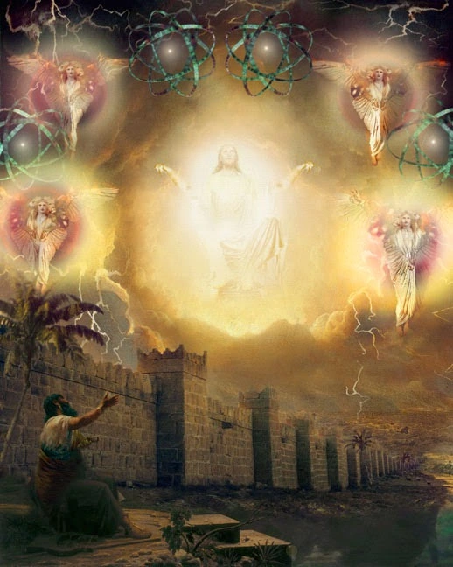
以西结看到四个异象
Ezekiel saw four visions 1. 四个活物
Four living creatures 2. 轮中轮
Wheel in the middle of a wheel 3. 水晶穷苍
Crystal expanse 4. 神荣耀宝座
The Glory of God's Throne

Slide 9
狮子 代表勇猛
Lion represents bravery 牛 代表勤劳
Ox represents hard work 鹰 代表敏捷高腾
Eagle stands for agility 人 代表智慧
Man represents intelligence

Slide 10
天上异象和地上 人类历史大有关系
Heavenly vision has a lot to do with Human history on earth

Slide 11
以 西 結 書 Ezekiel 1:15~21
15 我正观看活物的时候，见活物的脸旁各有一轮在地上。
15 As I looked at the living creatures, I saw a wheel on the ground beside each creature with its four faces.
16 轮的形状和颜色好像水苍玉。四轮都是一个样式，形状和作法好像轮中套轮。
16 This was the appearance and structure of the wheels: They sparkled like chrysolite, and all four looked alike. Each appeared to be made like a wheel intersecting a wheel.

Slide 12
17 轮行走的时候，向四方都能直行，并不掉转。
17 As they moved, they would go in any one of the four directions the creatures faced; the wheels did not change direction as the creatures went.
18 至于轮辋，高而可畏。四个轮辋周围满有眼睛。
18 Their rims were high and awesome, and all four rims were full of eyes all around.

Slide 13
19 活物行走，轮也在旁边行走。活物从地上升，轮也都上升。
19 When the living creatures moved, the wheels beside them moved; and when the living creatures rose from the ground, the wheels also rose.
20 灵往哪里去，活物就往那里去。活物上升，轮也在活物旁边上升，因为活物的灵在轮中。
20 Wherever the spirit would go, they would go, and the wheels would rise along with them, because the spirit of the living creatures was in the wheels.

Slide 14
21 那些行走，这些也行走。那些站住，这些也站住。那些从地上升，轮也在旁边上升，因为活物的灵在轮中。
21 When the creatures moved, they also moved; when the creatures stood still, they also stood still; and when the creatures rose from the ground, the wheels rose along with them, because the spirit of the living creatures was in the wheels.

Slide 15
以 西 結 書 Ezekiel 1:16
16 轮的形状和颜色好像水苍玉。四轮都是一个样式，形状和作法好像轮中套轮。
16 This was the appearance and structure of the wheels: They sparkled like chrysolite, and all four looked alike. Each appeared to be made like a wheel intersecting a wheel.

Slide 16
以 西 結 書 Ezekiel 1:18
18 至于轮辋，高而可畏。四个轮辋周围满有眼睛。
18 Their rims were high and awesome, and all four rims were full of eyes all around.

Slide 17
以 西 結 書 Ezekiel 1:20
20 灵往哪里去，活物就往那里去。活物上升，轮也在活物旁边上升，因为活物的灵在轮中。
20 Wherever the spirit would go, they would go, and the wheels would rise along with them, because the spirit of the living creatures was in the wheels.

Slide 18
以 西 結 書 Ezekiel 1:21
21 那些行走，这些也行走。那些站住，这些也站住。那些从地上升，轮也在旁边上升，因为活物的灵在轮中。
21 When the creatures moved, they also moved; when the creatures stood still, they also stood still; and when the creatures rose from the ground, the wheels rose along with them, because the spirit of the living creatures was in the wheels.

Slide 19
以 西 結 書 Ezekiel 1:22
22 活物的头以上有穹苍的形像，看着像可畏的水晶，铺张在活物的头以上
22 Spread out above the heads of the living creatures was what looked something like an expanse, sparkling like crystal, and awesome.

Slide 20
诗篇 Psalm 8 :3~4
3 我观看你指头所造的天，并你所陈设的月亮星宿，
3 When I consider your heavens, the work of your fingers, the moon and the stars, which you have set in place,
4 便说，人算什么，你竟顾念他。世人算什么，你竟眷顾他。
4 what is man that you are mindful of him, the son of man that you care for him?

Slide 21
以 西 結 書 Ezekiel 1:26~27
26 在他们头以上的穹苍之上有宝座的形像，仿佛蓝宝石。在宝座形像以上有仿佛人的形状。
26 Above the expanse over their heads was what looked like a throne of saphire, and high above on the throne was a figure like that of a man.

Slide 22
27 我见从他腰以上有仿佛光耀的精金，周围都有火的形状，又见从他腰以下有仿佛火的形状，周围也有光辉。
27 I saw that from what appeared to be his waist up he looked like glowing metal, as if full of fire, and that from there down he looked like fire; and brilliant light surrounded him.

Slide 23
以 西 結 書 Ezekiel 1:28
28 下雨的日子，云中虹的形状怎样，周围光辉的形状也是怎样。这就是耶和华荣耀的形像。我一看见就俯伏在地，又听见一位说话的声音。
28 Like the appearance of a rainbow in the clouds on a rainy day, so was the radiance around him.

Slide 24
以 西 結 書 Ezekiel 2:1
1 他对我说，人子啊，你站起来，我要和你说话。
1 He said to me, “Son of man, stand up on your feet and I will speak to you.”

Slide 25
西敏小要理问答 Westminster Shorter Catechism
问题：人活着目的是什么？
Question: What is the purpose of human life? 回答：人活着目的是为荣耀神！并永远享受神！
Answer: The purpose of man‘s life is to glorify God! And enjoy God forever!

Slide 26
歌 林 多 前 書 1 Corinthians 10:31
31 所以你们或吃或喝，无论作什么，都要为荣耀神而行。
31 So whether you eat or drink or whatever you do, do it all for the glory of God.

Slide 27
荣耀三重意义
The three-fold meaning of glory
1. 荣耀表示 “有份量”
Glory means "weight" 2. 荣耀表达 “去衡量”
Glory expression "to measure"

Slide 28
赞美ㄧ神 ：表达人对神的尊崇
Doxology : Expressing Human Reverence for God Doxo 是从荣耀这词演绎来 Doxo is derived from the word glory

Slide 29
Orthodoxy 后半的 doxy
Suffix doxy = opinion 和前 Orth 合起来的意思
Prefix Orth= regular 就是：同样的意见（信仰） Orthodoxy =the same opinion (Belief)

Slide 30
荣耀第三重意义 The third meaning of glory
3. 表達 “光輝”（只限用在神身上）
Expressing "Brightness"
(Only for God)

Slide 31
以 西 結 書 Ezekiel 1:28
28 下雨的日子，云中虹的形状怎样，周围光辉的形状也是怎样。这就是耶和华荣耀的形像。我一看见就俯伏在地，又听见一位说话的声音。
28 Like the appearance of a rainbow in the clouds on a rainy day, so was the radiance around him.

Slide 32
神永恒计划的三路线
The Three Lines of God's Eternal Plan
救赎红线： 主的十字架。
Red Line of Redemption: The Cross of the Lord.
国度紫线：君王永掌权。
Purple Line of Kingdom: The king reigns forever.
荣耀金线：金光灿烂的荣耀永屬神！
Golden Line of Glory: The Glory be to God!

Slide 33
我们当多作 “荣神益人” 的事
We should do more to
"Honor God and benefit man"

