Slide 1
透過父愛體貼天父的心
Through father’s love to know
Our Heavenly Father’s heart
房正豪牧師

Slide 2
詩篇 Psalm 102:13
父亲怎样怜恤他的儿女，
耶和华也怎样怜恤敬畏他的人。
As a father has compassion on
his children, so the Lord has
compassion on those
who fear him;

Slide 3
1.教導孩子，
因為天父也教導我們。
Teach children because for Heavenly Father teaches us.

Slide 4
箴言 Proverbs 22:6
教养孩童，使他走当行的道，
就是到老他也不偏离。
Start children off on the way they should go,
and even when they are old they will not turn from it.

Slide 5
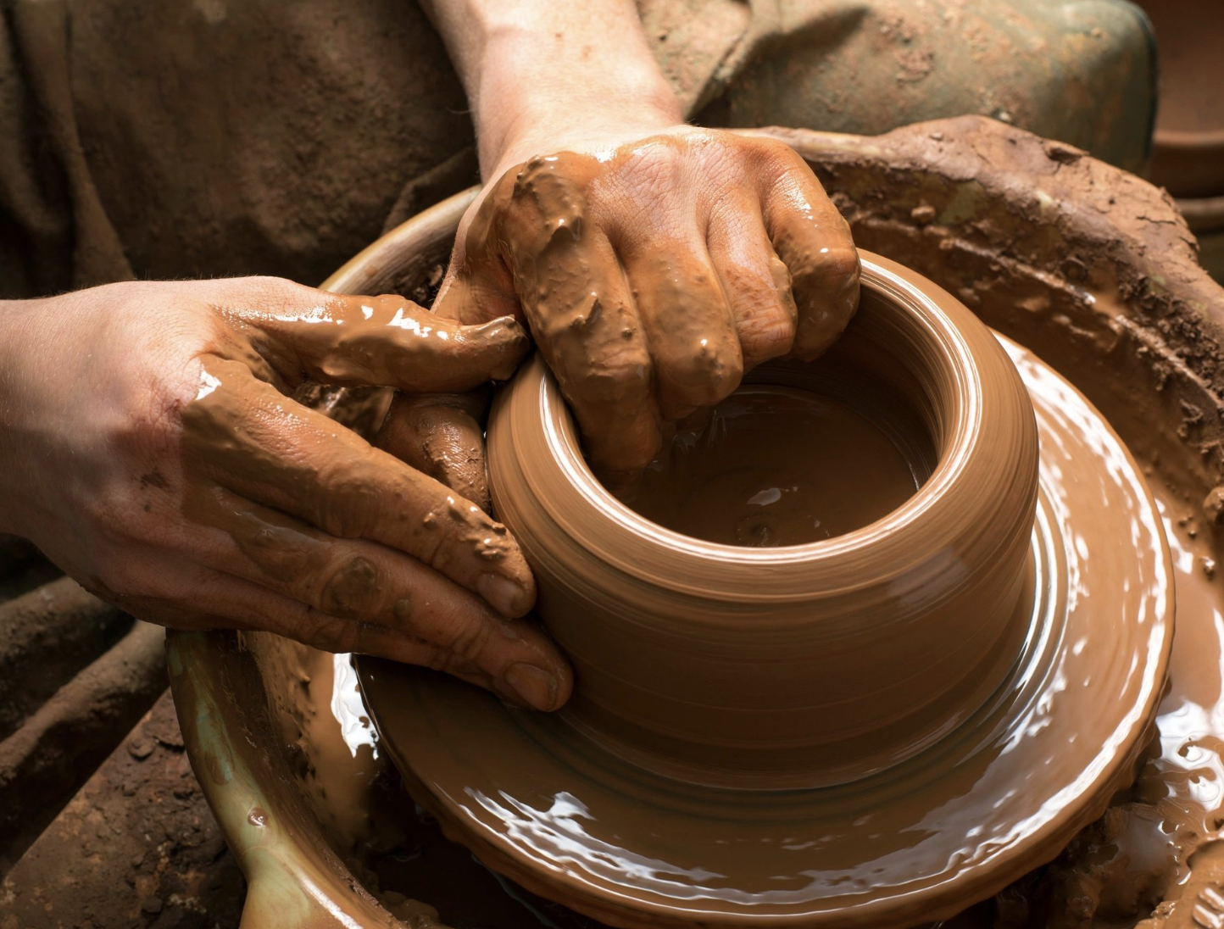

Slide 6
2.接納孩子，
因為天父也接納我們。
Accept our children because our Heavenly Father accepts us.

Slide 7
哥林多前書 1 Corinthians 13:4a
愛是恆久忍耐又有恩慈。
Love is patient, love is kind.

Slide 8
3.兒女當孝敬父母，
我們也理當尊榮天父。
Children should honor their fathers as we should glorify our Heavenly Father .

Slide 9
出埃及記 Exodus 20:12
“当孝敬父母，使你的日子在耶和华你神所赐你的地上得以长久。
“Honor your father and your mother, so that you may live long in the land the Lord your God is giving you.

Slide 10
1.教導孩子，因為天父也教導我們。
Teach children because for Heavenly Father teaches us.
2.接納孩子，因為天父也接納我們。
Accept our children because our Heavenly Father accepts us.
3.兒女當孝敬父母，我們也理當尊榮天父。
Children should honor their fathers as we should glorify our Heavenly Father .

