Slide 1
震撼人心的信息
What a Shocking Message to the Heart
房正豪牧師

Slide 2
使徒行傳 2: 22-24
22 以色列人哪，请听我的话：神借着拿撒勒人耶稣在你们中间施行异能、奇事、神迹，将他证明出来，这是你们自己知道的。

Slide 3
使徒行傳 2: 22-24
23 他既按着神的定旨、先见被交于人，你们就借着无法之人的手，把他钉在十字架上杀了。 24 神却将死的痛苦解释了，叫他复活，因为他原不能被死拘禁。

Slide 4
Acts 2: 22-24
22 “Fellow Israelites, listen to this: Jesus of Nazareth was a man accredited by God to you by miracles, wonders and signs, which God did among you through him, as you yourselves know.

Slide 5
Acts 2: 22-24
23 This man was handed over to you by God’s deliberate plan and foreknowledge; and you, with the help of wicked men,[d] put him to death by nailing him to the cross.

Slide 6
Acts 2: 22-24
24 But God raised him from the dead, freeing him from the agony of death, because it was impossible for death to keep its hold on him.

Slide 7
使徒行傳 2: 24
24 神却将死的痛苦解释了，叫他复活，因为他原不能被死拘禁。
24 But God raised him from the dead, freeing him from the agony of death, because it was impossible for death to keep its hold on him.

Slide 8
耶穌復活和我有什麼關係？
What has the Resurrection of Jesus to do with Me?
你的答案是？
What is your answer?

Slide 9
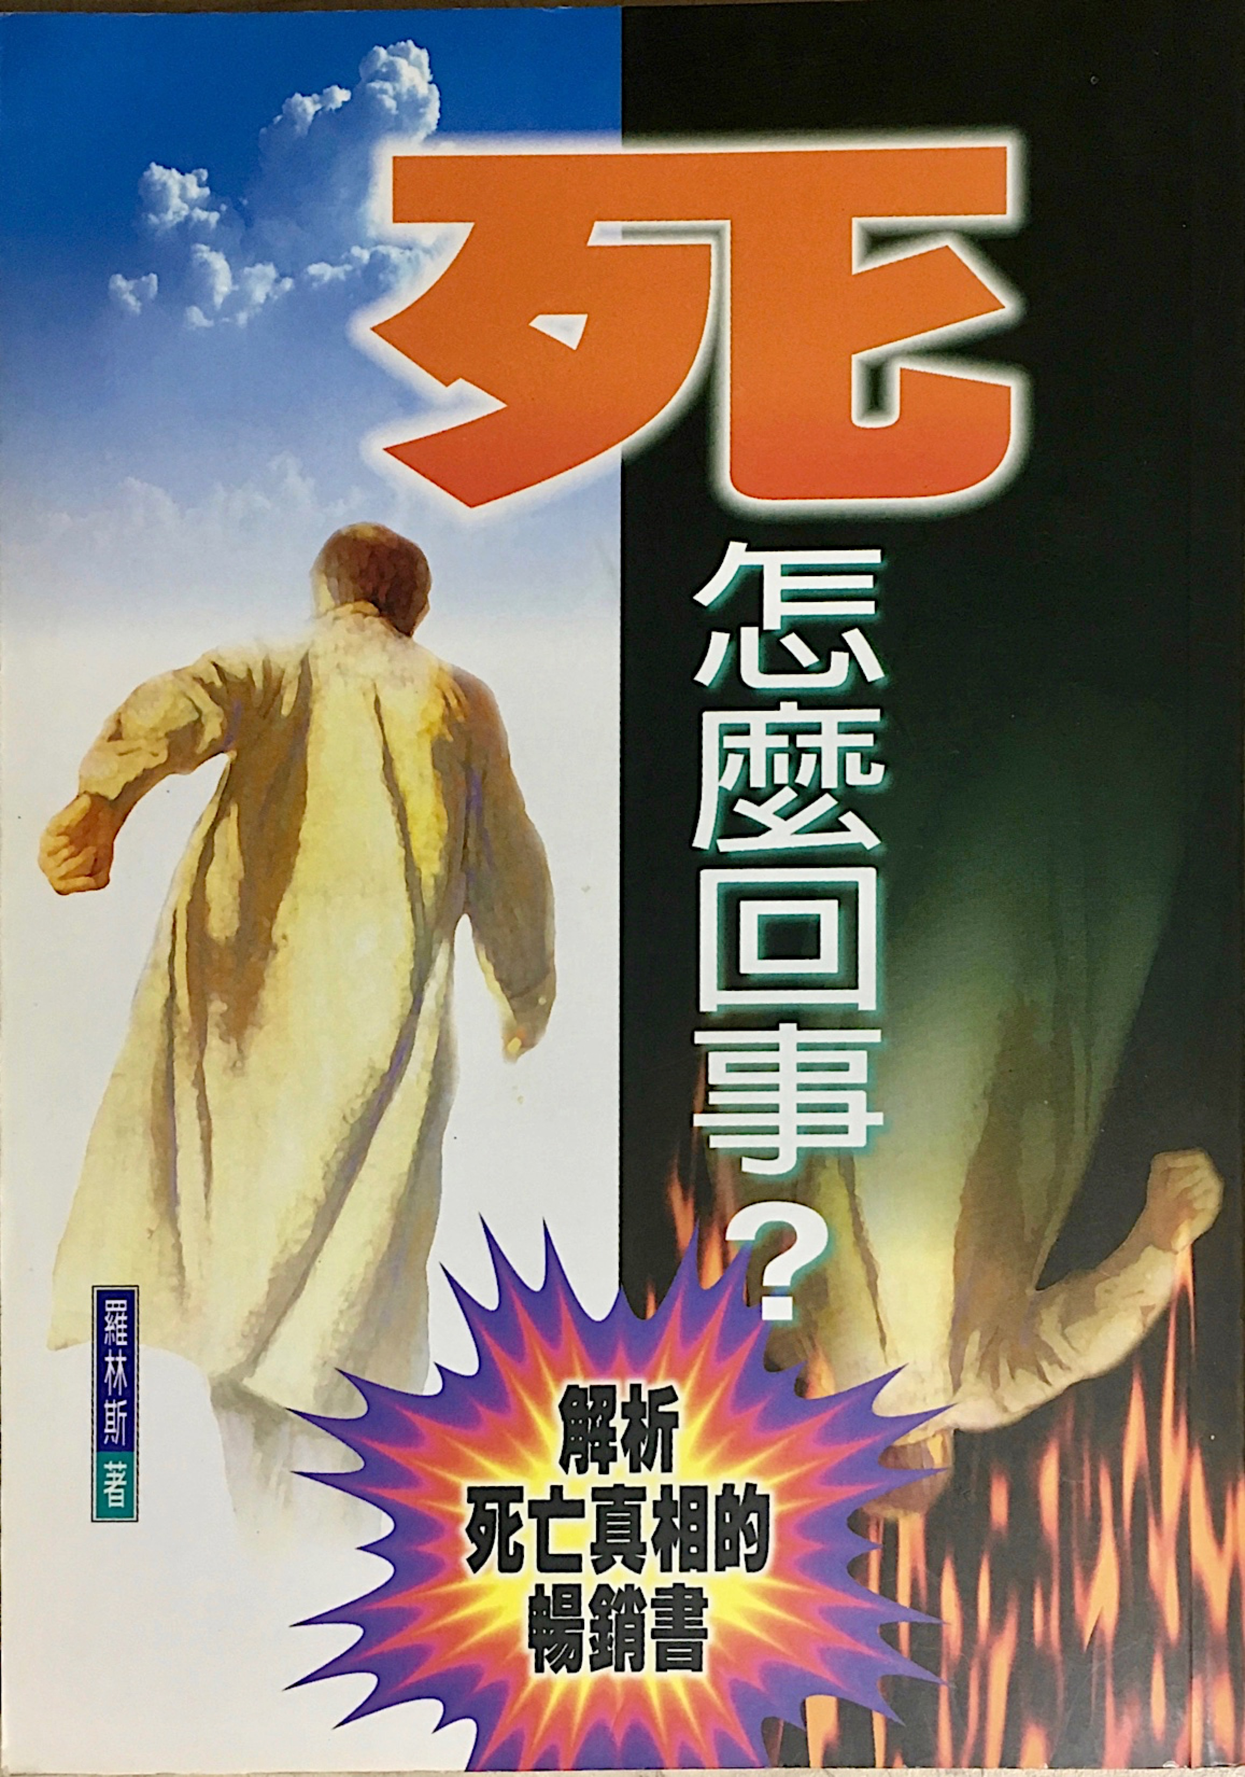
What is death?

Slide 10
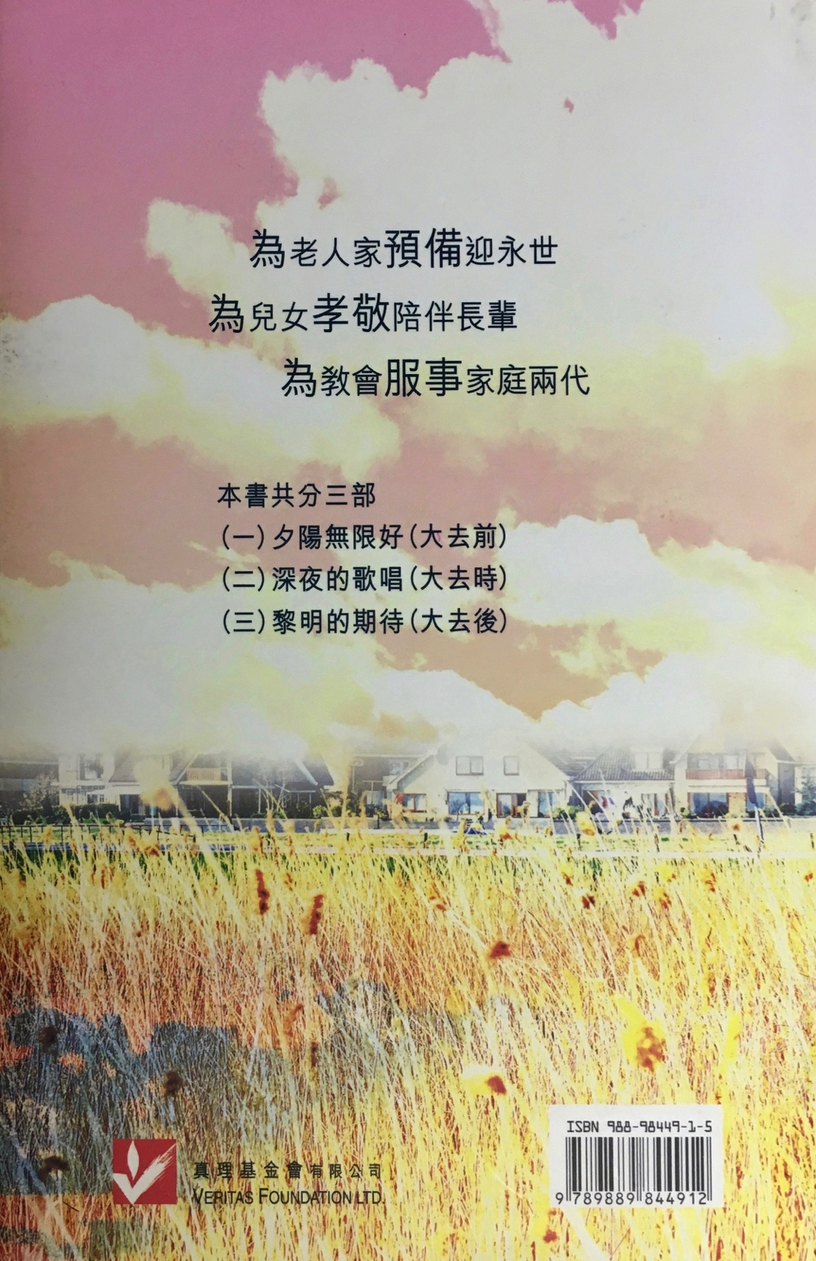
Anticipating Eternity

Slide 11
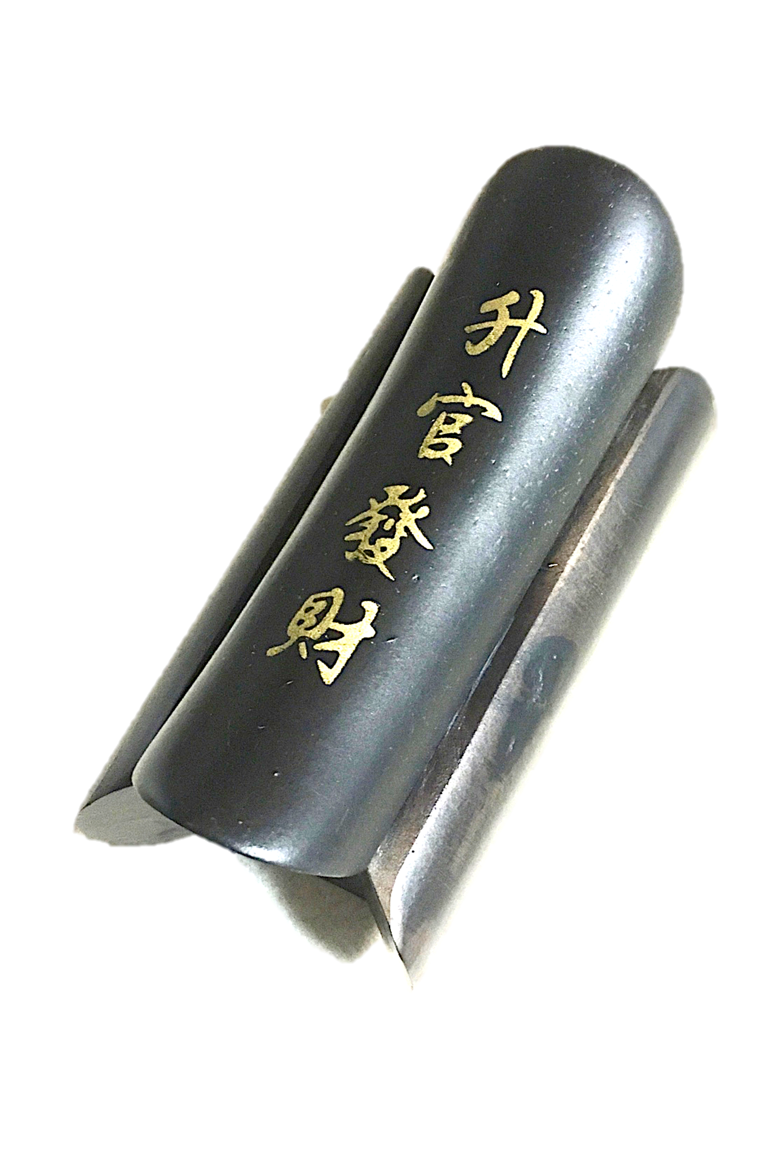
棺材 - 升官發財
Coffin (word play)
- Promotion & Riches
「棺」 Coffin, Chinese word "Guan"
sounds like Government officials, means power and authority.
「材」 Chinese word "Cai"
sounds like money and fortune.

Slide 12
總有一天等到你
I can wait,
one of those days
I will get you.

Slide 13
使徒行傳 2: 25-28
25 大卫指着他说：我看见主常在我眼前，他在我右边，叫我不至于摇动。
26 所以我心里欢喜，我的灵快乐，并且我的肉身要安居在指望中；

Slide 14
使徒行傳 2: 25-28
27 因你必不将我的灵魂撇在阴间，也不叫你的圣者见朽坏。 28 你已将生命的道路指示我，必叫我因见你的面得着满足的快乐。

Slide 15
Acts 2: 25-28
25 David said about him:
“‘I saw the Lord always before me. Because he is at my right hand, I will not be shaken.
26 Therefore my heart is glad and my tongue rejoices; my body also will rest in hope,

Slide 16
Acts 2: 25-28
27 because you will not abandon me to the realm of the dead, you will not let your holy one see decay.
28 You have made known to me the paths of life; you will fill me with joy in your presence.’

Slide 17
使徒行傳 2: 29-33
29 弟兄们，先祖大卫的事，我可以明明地对你们说，他死了，也葬埋了，并且他的坟墓直到今日还在我们这里。 30 大卫既是先知，又晓得神曾向他起誓，要从他的后裔中立一位坐在他的宝座上，

Slide 18
使徒行傳 2: 29-33
31 就预先看明这事，讲论基督复活说：他的灵魂不撇在阴间，他的肉身也不见朽坏。
32 这耶稣，神已经叫他复活了，我们都为这事作见证。

Slide 19
使徒行傳 2: 29-33
33 他既被神的右手高举，又从父受了所应许的圣灵，就把你们所看见、所听见的浇灌下来。

Slide 20
Acts 2: 29-33
29 “Fellow Israelites, I can tell you confidently that the patriarch David died and was buried, and his tomb is here to this day. 30 But he was a prophet and knew that God had promised him on oath that he would place one of his descendants on his throne.

Slide 21
Acts 2: 29-33
31 Seeing what was to come, he spoke of the resurrection of the Messiah, that he was not abandoned to the realm of the dead, nor did his body see decay. 32 God has raised this Jesus to life, and we are all witnesses of it.

Slide 22
Acts 2: 29-33
33 Exalted to the right hand of God, he has received from the Father the promised Holy Spirit and has poured out what you now see and hear.

Slide 23
使徒行傳 2: 32
32 这耶稣，神已经叫他复活了，我们都为这事作见证。
32 God has raised this Jesus to life, and we are all witnesses of it.

Slide 24
愛主更深
Love the Lord deeper
愛人更多
Love more and more people

Slide 25
聽了福音以後，人要做兩件事
2 Things You must Do
after Hearing the Gospel
1：要真心悔改。
Repent Truthfully.
2：要奉主名受洗。
Be Baptized in the Name
of the Lord.

Slide 26
使徒行傳 2: 41-42
41 于是，领受他话的人就受了洗，那一天，门徒约添了三千人；
42 都恒心遵守使徒的教训，彼此交接、掰饼、祈祷。

Slide 27
Acts 2: 41-42
41 Those who accepted his message were baptized, and about three thousand were added to their number that day.
The Fellowship of the Believers

Slide 28
Acts 2: 41-42
42 They devoted themselves to the apostles’ teaching and to fellowship, to the breaking of bread and to prayer.

Slide 29
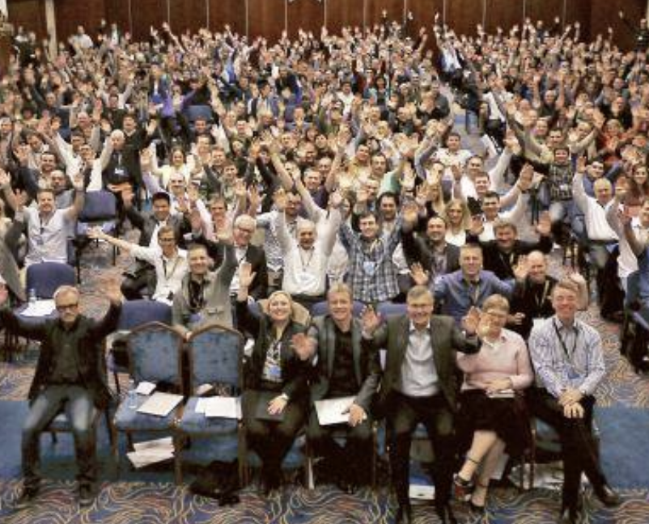
Word of Life: Sweden

Slide 30
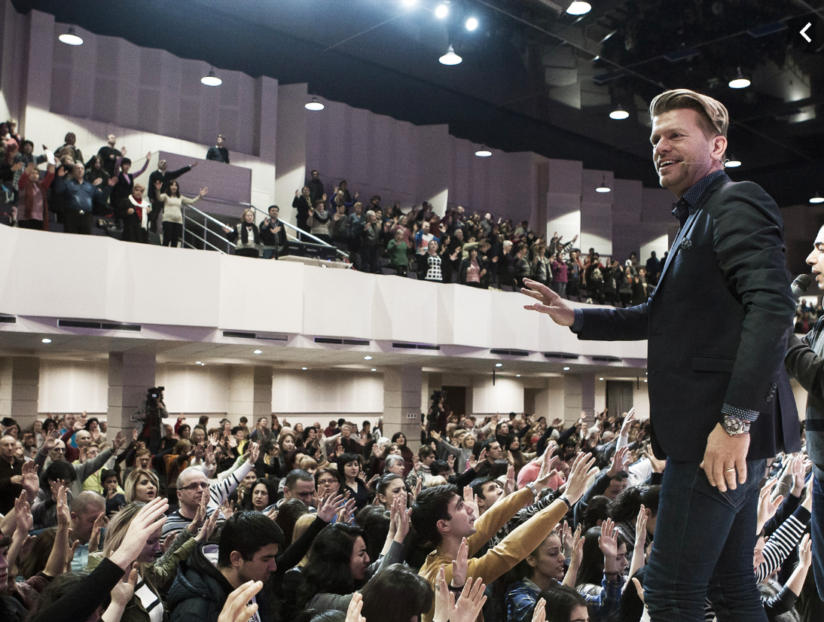
Word of Life: Sweden

Slide 31
使徒行傳 2: 42
42 都恒心遵守使徒的教训，
彼此交接、掰饼、祈祷。
42 They devoted themselves to the apostles’ teaching and to fellowship, to the breaking of bread and to prayer.

Slide 32
震撼人心的信息
What a Shocking Message
to the Heart
1.明白主復活和每人都大有關係？
Understanding what the Resurrection of Jesus Mean to Everyone.

Slide 33
2.我要預備好自己来宣传福音！
I Must Equip Myself to
Share the Gospel!
3.人要悔改，奉主名受洗，做主门徒！
You Must Repent, get Baptize in Jesus’ Name, and become a Disciple of the Lord!

