Slide 1
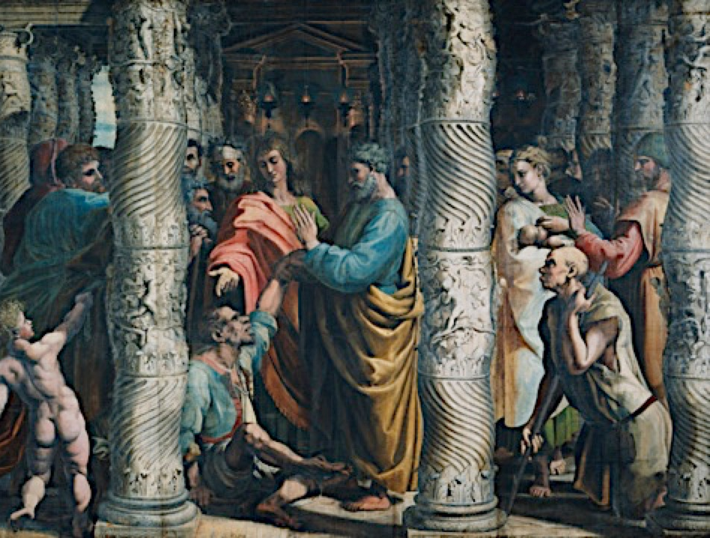
給 你？For You?
房正豪牧師

Slide 2
使徒行傳 3:5-9
5 那人就留意看他们，指望得着什么。
6 彼得说：“金银我都没有，只把我所有的给你：我奉拿撒勒人耶稣基督的名，叫你起来行走！”

Slide 3
7 于是拉着他的右手，扶他起来。他的脚和踝子骨立刻健壮了，
8 就跳起来站着，又行走，同他们进了殿，走着跳着，赞美神。
9 百姓都看见他行走、赞美神，

Slide 4
Acts 3:5-9
5 So the man gave them his attention, expecting to get something from them.
6 Then Peter said, “Silver or gold I do not have, but what I do have I give you. In the name of Jesus Christ of Nazareth, walk.”

Slide 5
7 Taking him by the right hand, he helped him up, and instantly the man’s feet and ankles became strong.
8 He jumped to his feet and began to walk. Then he went with them into the temple courts, walking and jumping, and praising God.

Slide 6
9 When all the people saw him walking and praising God,

Slide 7
對主的信心要大！ Possess Great Faith in the Lord!

Slide 8
主是給人盼望的主！
Our Lord is One who Gives Hope!

Slide 9
我們要常讚美主！
We Must Always Praise the Lord!

Slide 10
诗篇 Psalm 146
2 我一生要赞美耶和华，
我还活的时候要歌颂我的神。
I will praise the Lord all my life;
I will sing praise to my God as long as I live.

Slide 11
诗篇 Psalm 150
6 凡有气息的都要赞美耶和华！你们要赞美耶和华！
Let everything that has breath praise the Lord.
Praise the Lord.

Slide 12
诗篇 Psalm 119
164 我因你公义的典章，
一天七次赞美你。
Seven times a day I praise you
for your righteous laws.

Slide 13
為什麼人要讚美主？ Why Must We Praise the Lord?

Slide 14
給你？
For You?

Slide 15
給你？
For You?
最寶貴的名。
The Most Precious Name.

Slide 16
遠超過世上所有的金銀。
Far More Precious that
All the Gold or Silver.

Slide 17
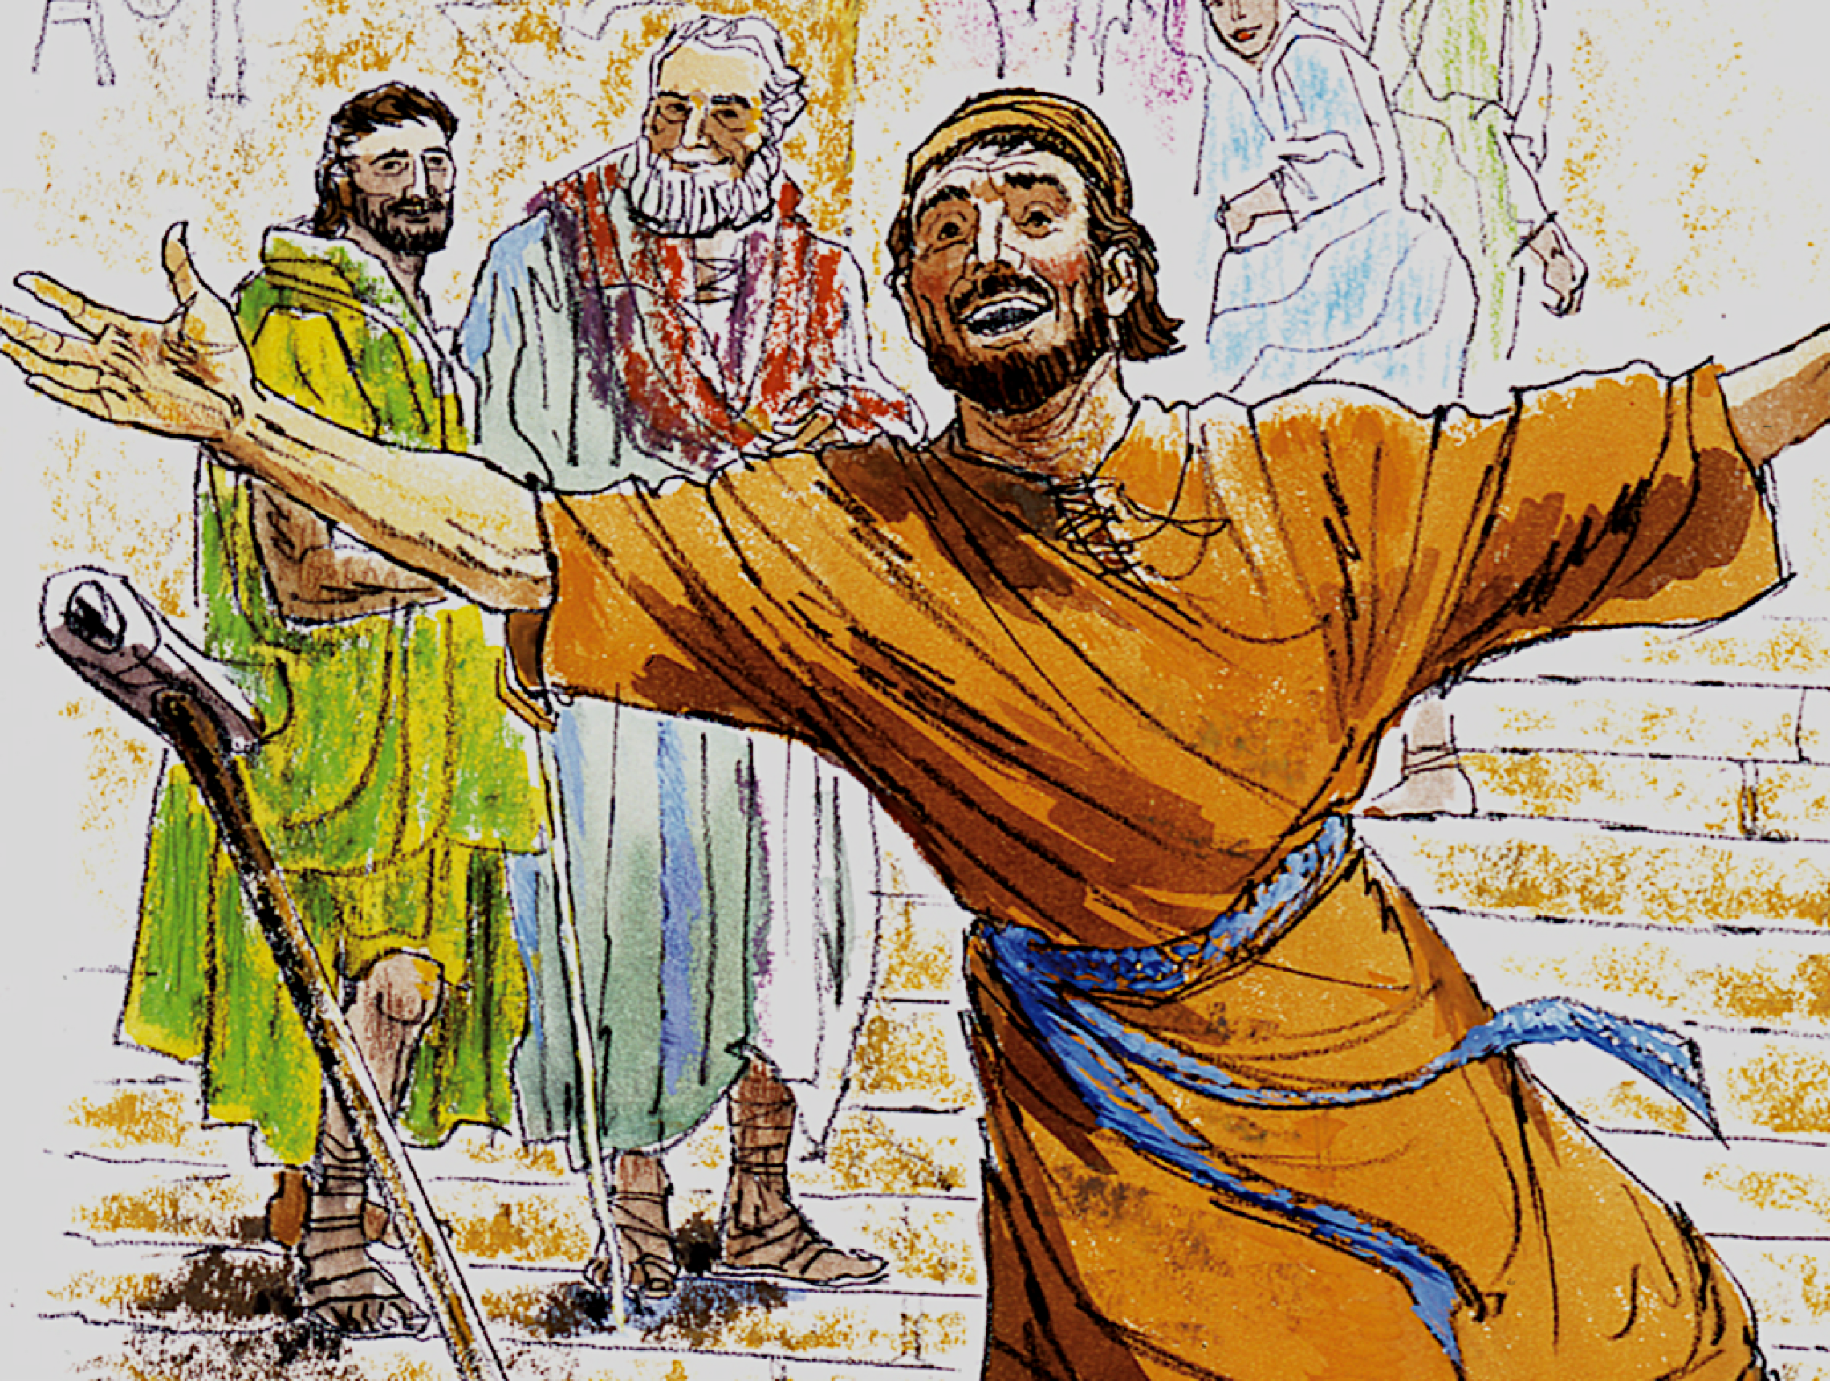
癱子乞丐蒙主醫治的啟示。Revelation Behind the Healing of the Lamed Beggar.

Slide 18
我们对主的信心要大！
主是给人盼望的主！因为他会医治你！
我们要常常赞美主耶稣！

Slide 19
1 We Must Have Strong Faith
in the Lord!
2 Our Lord is One Who Gives
Hope! Because He will Heal You!
3 We Must Praise Our Lord
Jesus Always!

