Slide 1
Who is the Ultimate King?
谁是最终的王？
(Daniel 但以理书 4:24-37, 5:1-30)

Slide 4
Daniel 但以理书 4:24-27
24 This is the interpretation, Your Majesty, and this is the decree the Most High has issued against my lord the king:
24 王啊！梦的意思就是这样：这临到我主我王的事，是至高者的裁决。

Slide 5
25 You will be driven away from people and will live with the wild animals; you will eat grass like the ox and be drenched with the dew of heaven. Seven times will pass by for you until you acknowledge that the Most High is sovereign over all kingdoms on earth and gives them to anyone he wishes.
25 你必被赶逐，离开人群，和野地的走兽同住；你必像牛一样吃草，被天露滴湿，要经过七年的时期；等到你承认至高者在世人的国中掌权，他喜欢把国赐给谁，就赐给谁。

Slide 6
26 The command to leave the stump of the tree with its roots means that your kingdom will be restored to you when you acknowledge that Heaven rules.
26 守望者既然吩咐要留下树根的余干，所以，等到你承认上天的至高者是掌权的，你的国就必再归给你。

Slide 7
27 Therefore, Your Majesty, be pleased to accept my advice: Renounce your sins by doing what is right, and your wickedness by being kind to the oppressed. It may be that then your prosperity will continue.”
27 因此，王啊！请你接纳我的劝告，施行公义，断绝罪过，怜悯受欺压者，断绝罪孽，你的平安或者可以延长。”

Slide 8
Dan 但以理 4:29-30
29 Twelve months later, as the king was walking on the roof of the royal palace of Babylon,
29 过了十二个月，王在巴比伦王宫的平顶上散步的时候，

Slide 9
30 he said, “Is not this the great Babylon I have built as the royal residence, by my mighty power and for the glory of my majesty?”
30 他说：“这大巴比伦城不是我用大能大力建造作我的京都，为显我威严的荣耀吗？”

Slide 11
Dan 但以理书 5:1-4
1 Belshazzar the king held a great feast for a thousand of his nobles, and he was drinking wine in the presence of the thousand.
1 伯沙撒王为他的一千大臣大摆筵席，他和他们一同喝酒。

Slide 12
2 When Belshazzar tasted the wine, he gave orders to bring the gold and silver vessels which Nebuchadnezzar his father had taken out of the temple which was in Jerusalem, so that the king and his nobles, his wives and his concubines might drink from them.
2 伯沙撒喝酒欢畅的时候，下令把他先祖尼布甲尼撒从耶路撒冷圣殿里掠取的金银器皿拿来，好让他和他的大臣、妻妾、妃嫔用这些器皿来喝酒。

Slide 13
3 Then they brought the gold vessels that had been taken out of the temple, the house of God which was in Jerusalem; and the king and his nobles, his wives and his concubines drank from them.
4 They drank the wine and praised the gods of gold and silver, of bronze, iron, wood and stone.
3 于是人把从耶路撒冷圣殿里，就是 神的殿里，掠来的金银器皿拿来；王和他的大臣、妻妾、妃嫔就用这些器皿来喝酒。
4 他们喝酒，赞美那些用金、银、铜、铁、木、石所做的神。

Slide 15
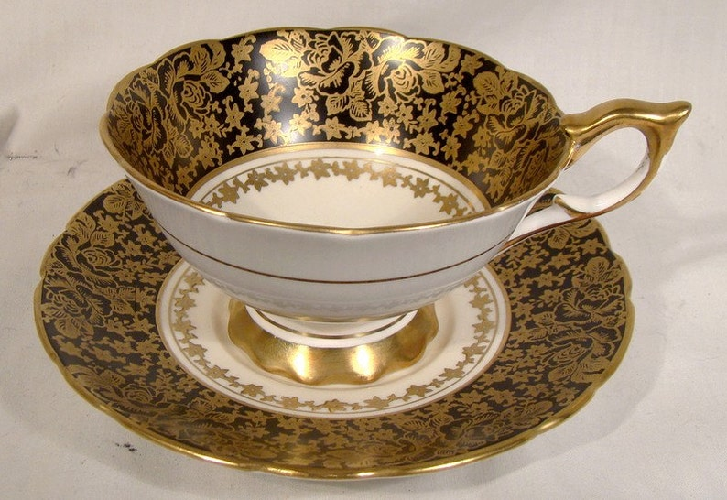

Slide 17
Dan 但以理书 5:22
Yet you, his son, Belshazzar, have not humbled your heart, even though you knew all this,
伯沙撒啊！你是他的子孙，你虽然知道这一切，
你的心仍不谦卑，

Slide 18
Dan 但以理书 5:23a
but you have exalted yourself
against the Lord of heaven;
竟高抬自己，敌对天上的主，

Slide 19
Dan 但以理书 5:23c
But the God in whose hand are your life-breath and all your ways, you have not glorified.
却没有把荣耀归给那手中有你的气息，
和那掌管你一切命途的 神。

Slide 21
Dan 但以理书 4:34b-35a
For His dominion is an everlasting dominion,
And His kingdom endures from generation to generation. “All the inhabitants of the earth are accounted as nothing, But He does according to His will in the host of heaven
赞美尊崇活到永远的 神。他的统治永无穷尽，他的国度直到万代。地上所有的居民，在他来说都是虚无；在天上的万军中，他凭自己的意旨行事

Slide 22
Dan 但以理书 4:35b, 37
35b And among the inhabitants of earth; And no one can ward off His hand Or say to Him, ‘What have You done?’
37 Now I, Nebuchadnezzar, praise, exalt and honor the King of heaven, for all His works are true and His ways just, and He is able to humble those who walk in pride.”
在地上的居民中，也是这样；没有人能拦住他的手，或问他说：‘你作什么？
在我尼布甲尼撒赞美、尊崇、荣耀天上的王，因为他所作的一切都正确，他所行的也都公平；行为骄傲的，他都能贬低。”

Slide 24
Daniel 但以理书 4:36
At that time my reason returned to me. And my majesty and splendor were restored to me for the glory of my kingdom, and my counselors and my nobles began seeking me out; so I was reestablished in my sovereignty, and surpassing greatness was added to me.
那时，我的理智恢复过来后，为着我国的光荣，我的威严和光辉也都恢复过来了。我的谋臣和官员仍来求见我，我的王权重新坚立，我的权势越发增加

Slide 26
1. God is a sovereign King who rules over all people; even appointing leaders whomever he will.
上帝是一位至高无上的君王，祂统治所有人； 甚至随祂任命领导者。
2. He humbles the proud and exalts the humble.
祂降卑自高的人，高举卑微的人。

Slide 27
Application 1
Humble before God,
acknowledging Him as our Lord
在神面前谦卑，承认祂是我们的主

Slide 28
Application 2
Confess our sin of pride before God
在神面前承认我们的高傲

Slide 29
