Slide 1
回 顾 与 前 瞻
Retrospect and Prospect
房正豪牧師
Pastor Fang

Slide 2
回 顾
Retrospect

Slide 3
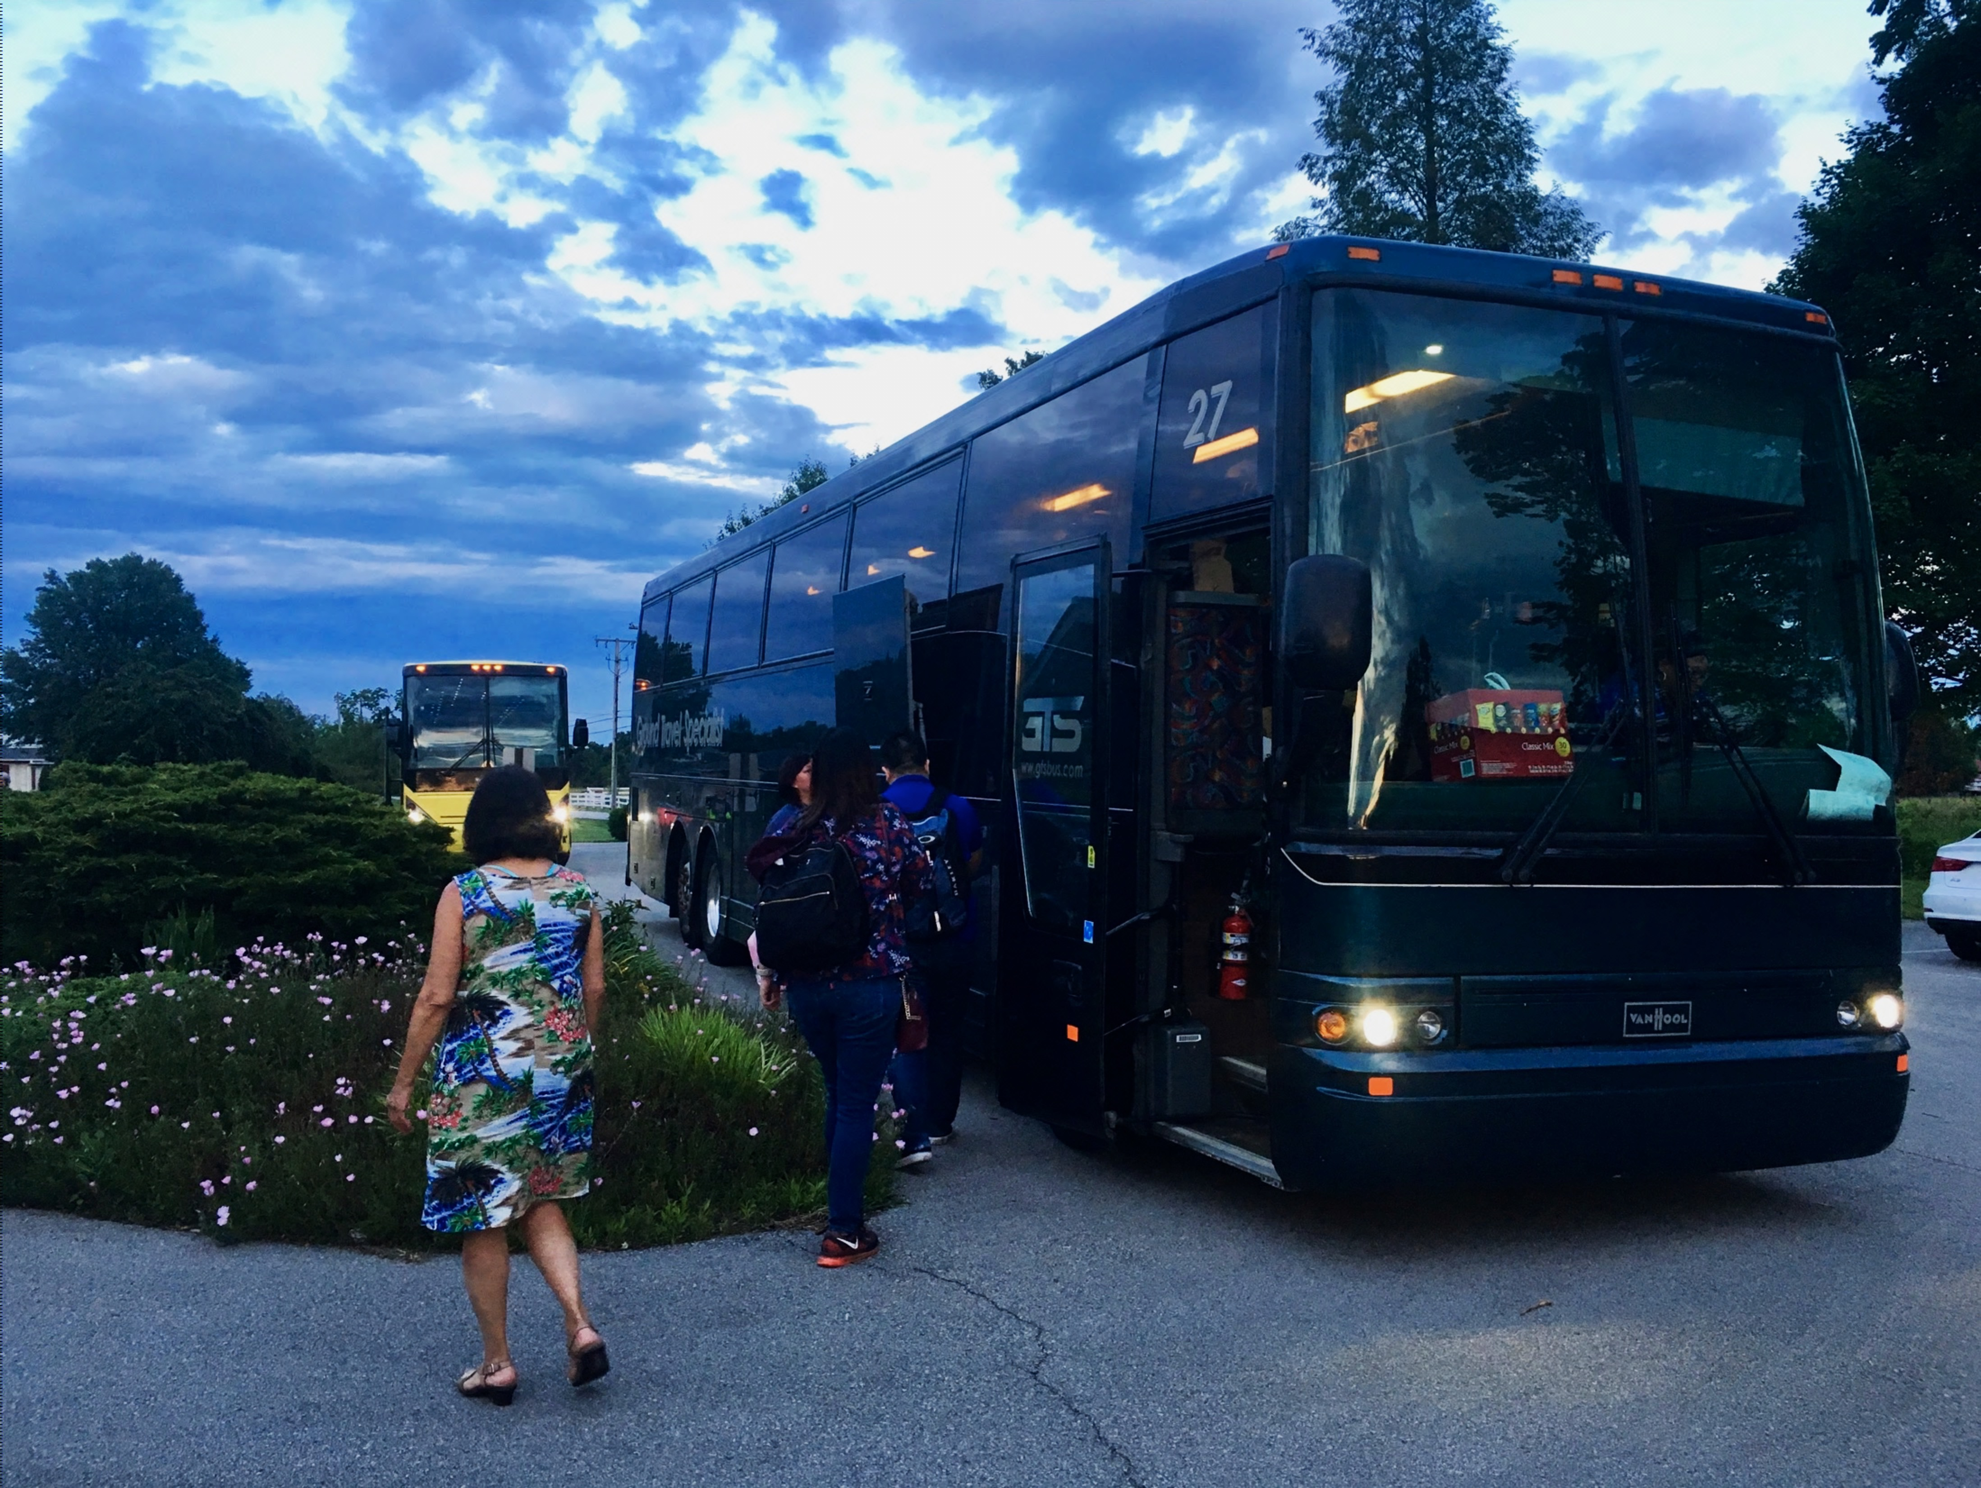
6/12 接待「FECC 蒙愛教會」

Slide 5
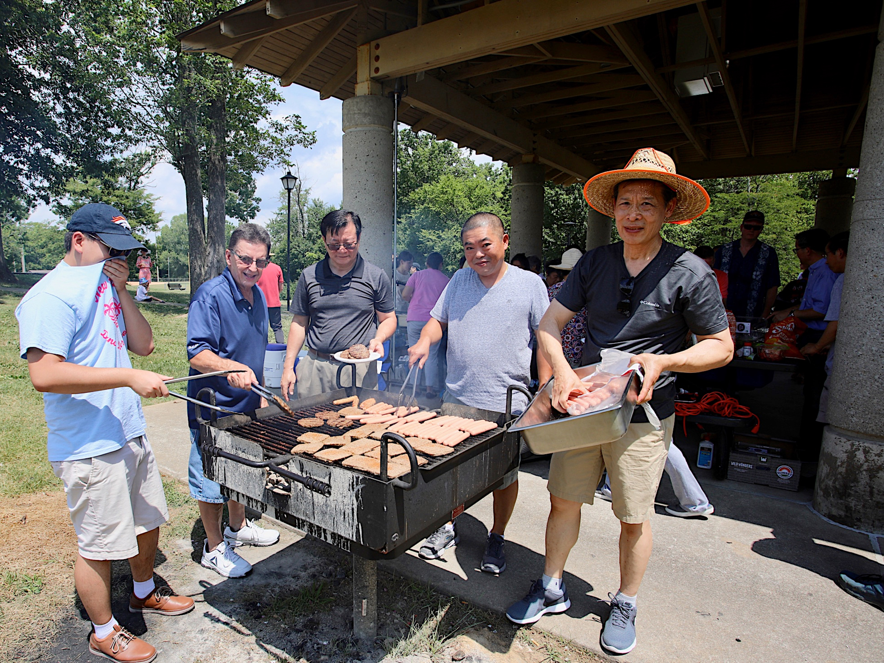
7/21 「主日公園野餐」

Slide 6
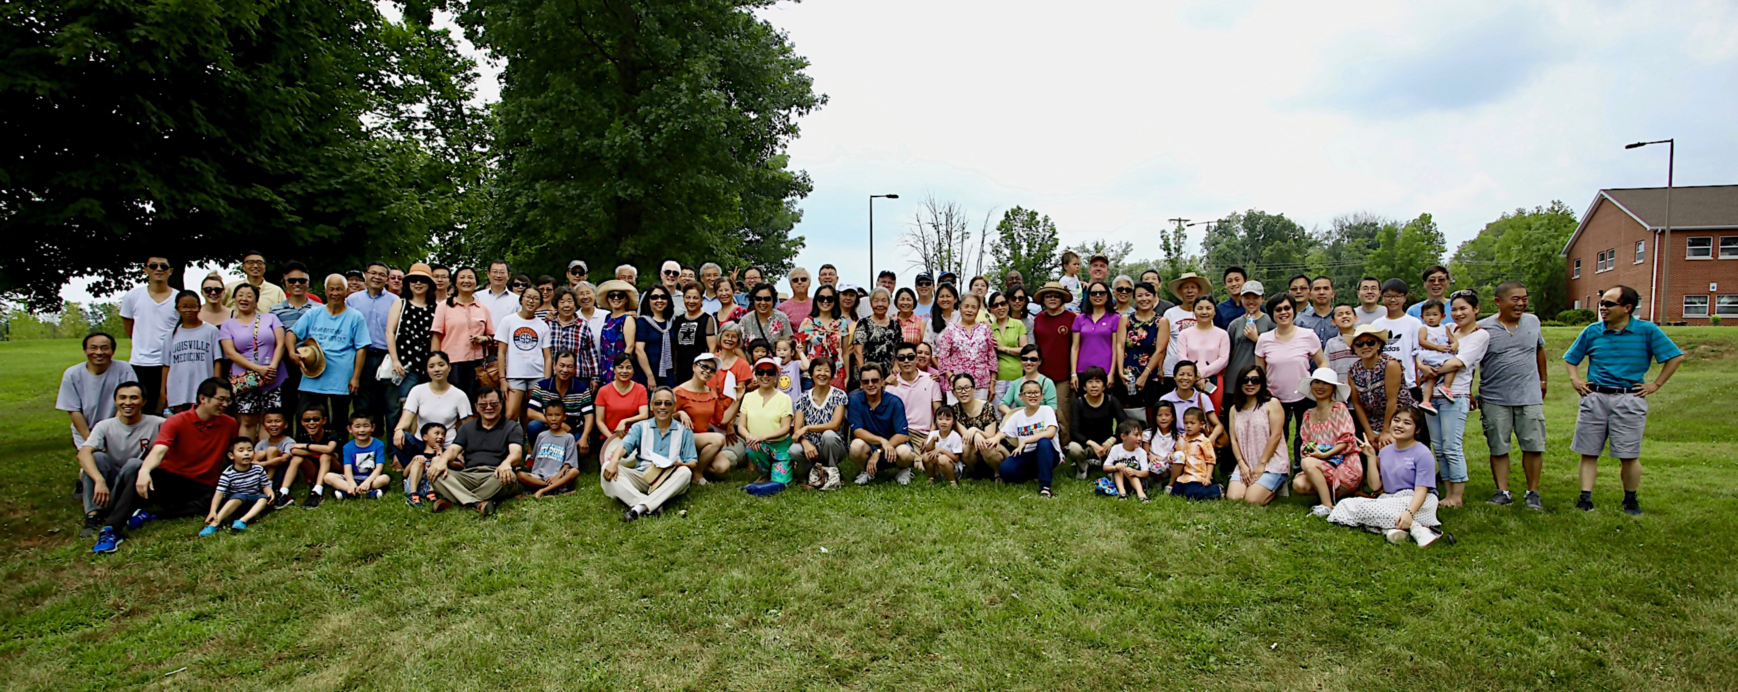

Slide 7
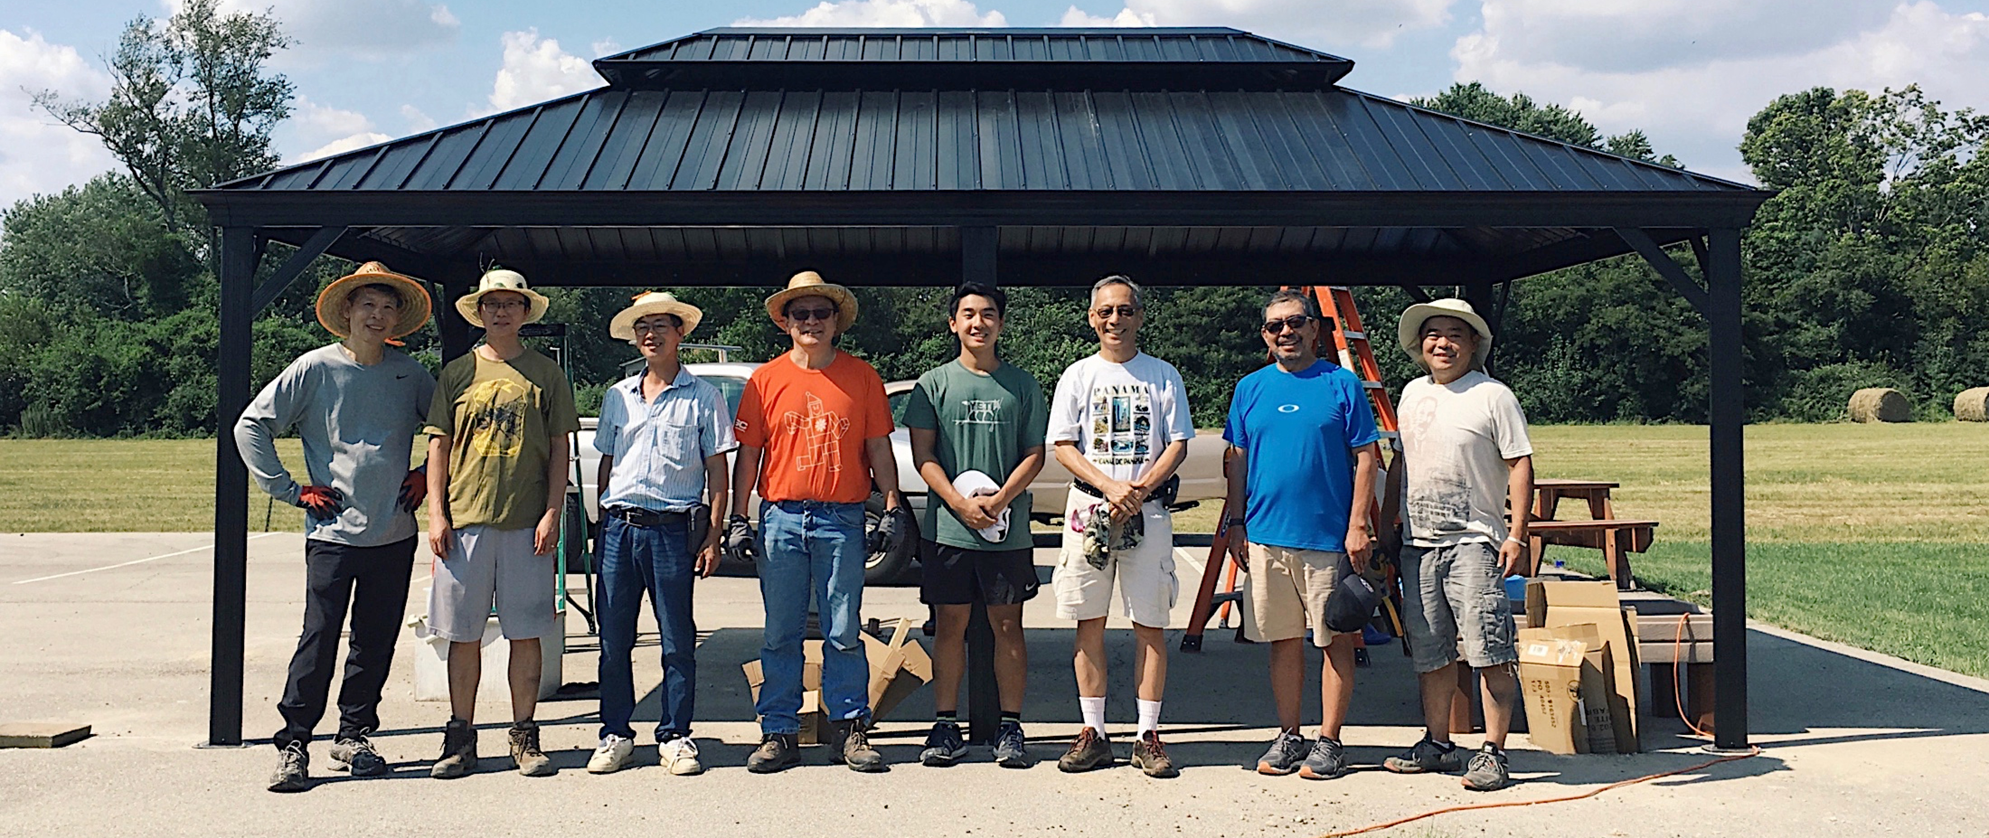
7/27「組裝涼亭 SUN ROOF」

Slide 8
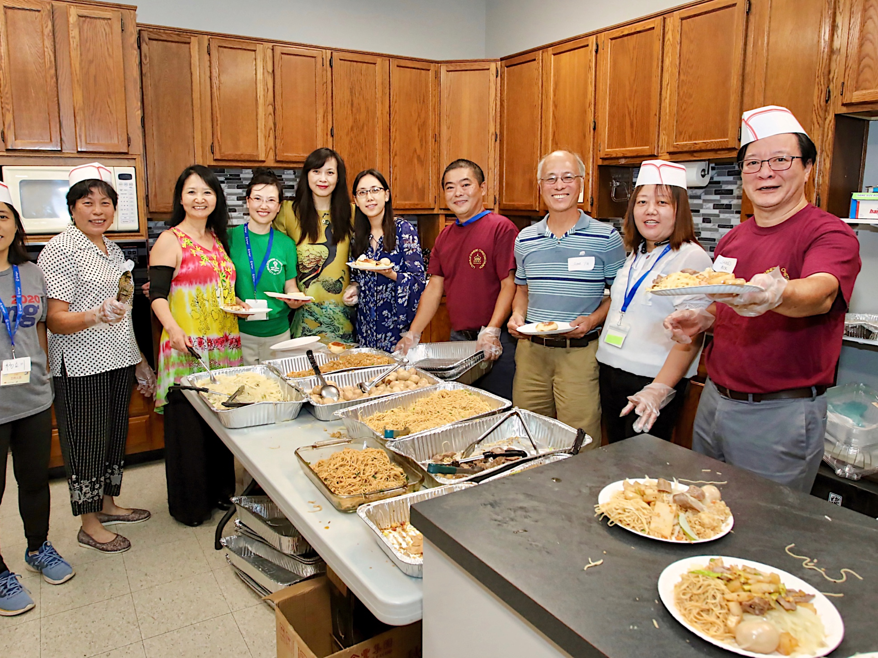
9/14「中秋聯誼活動」

Slide 9
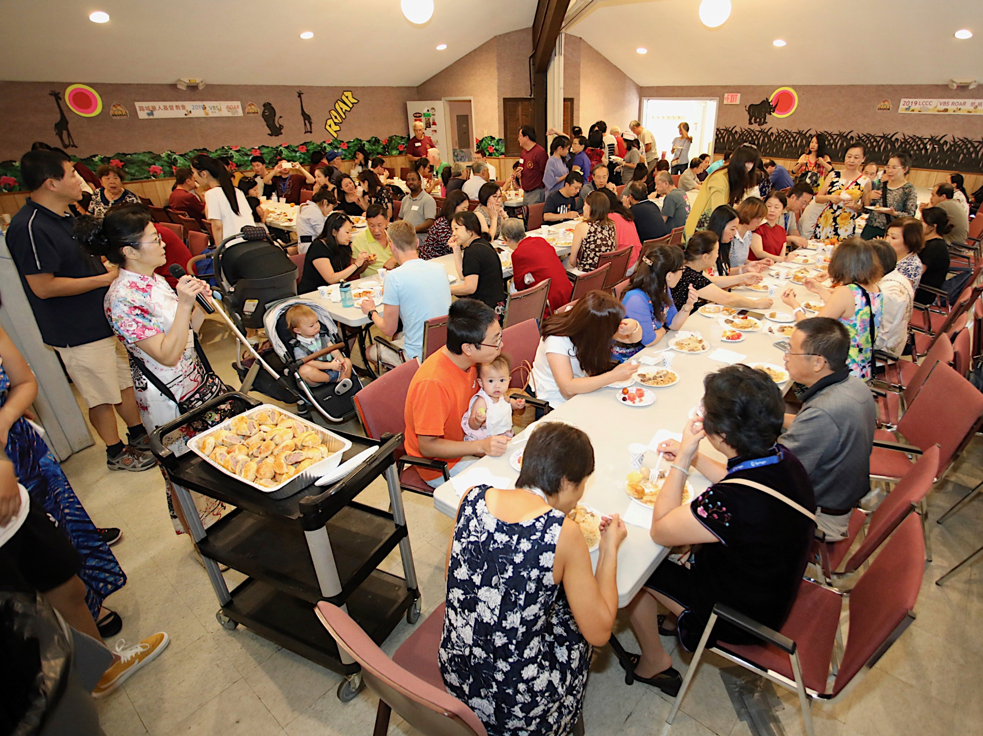

Slide 11
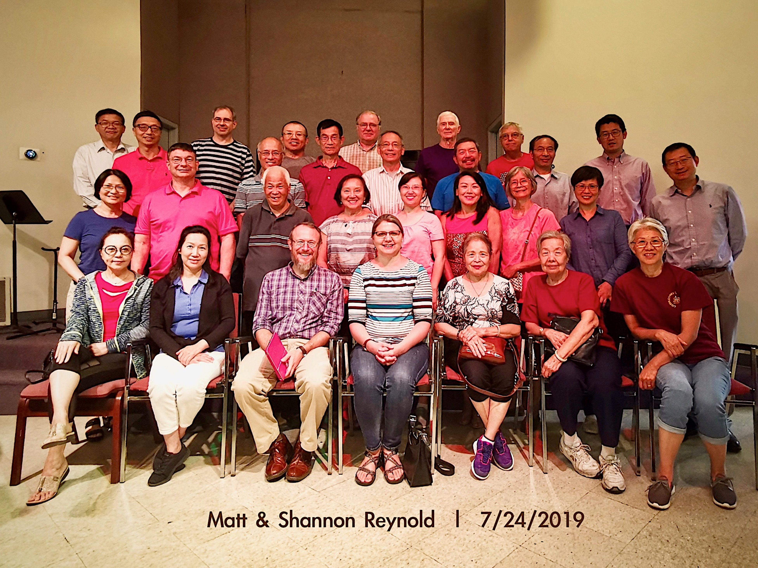

Slide 12
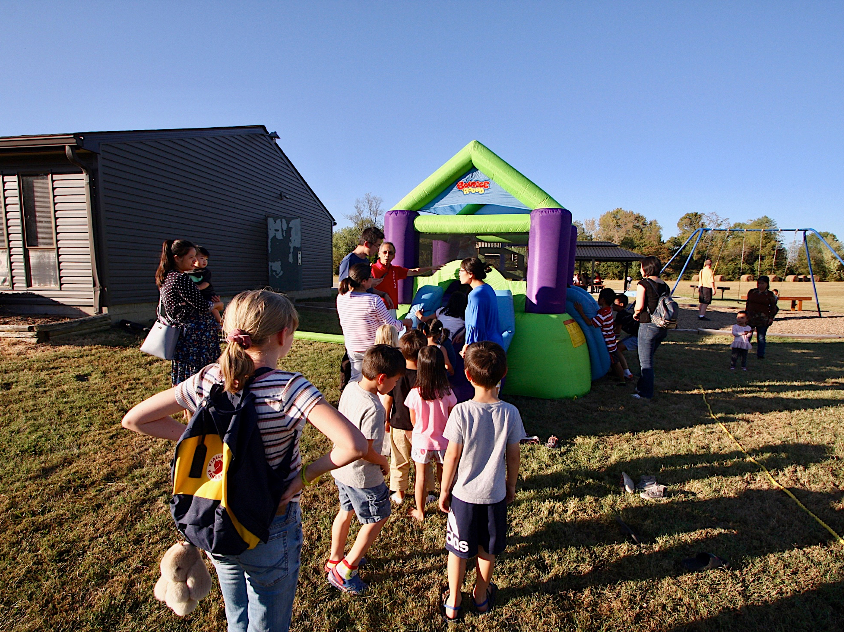
10/05「親子活動」

Slide 13
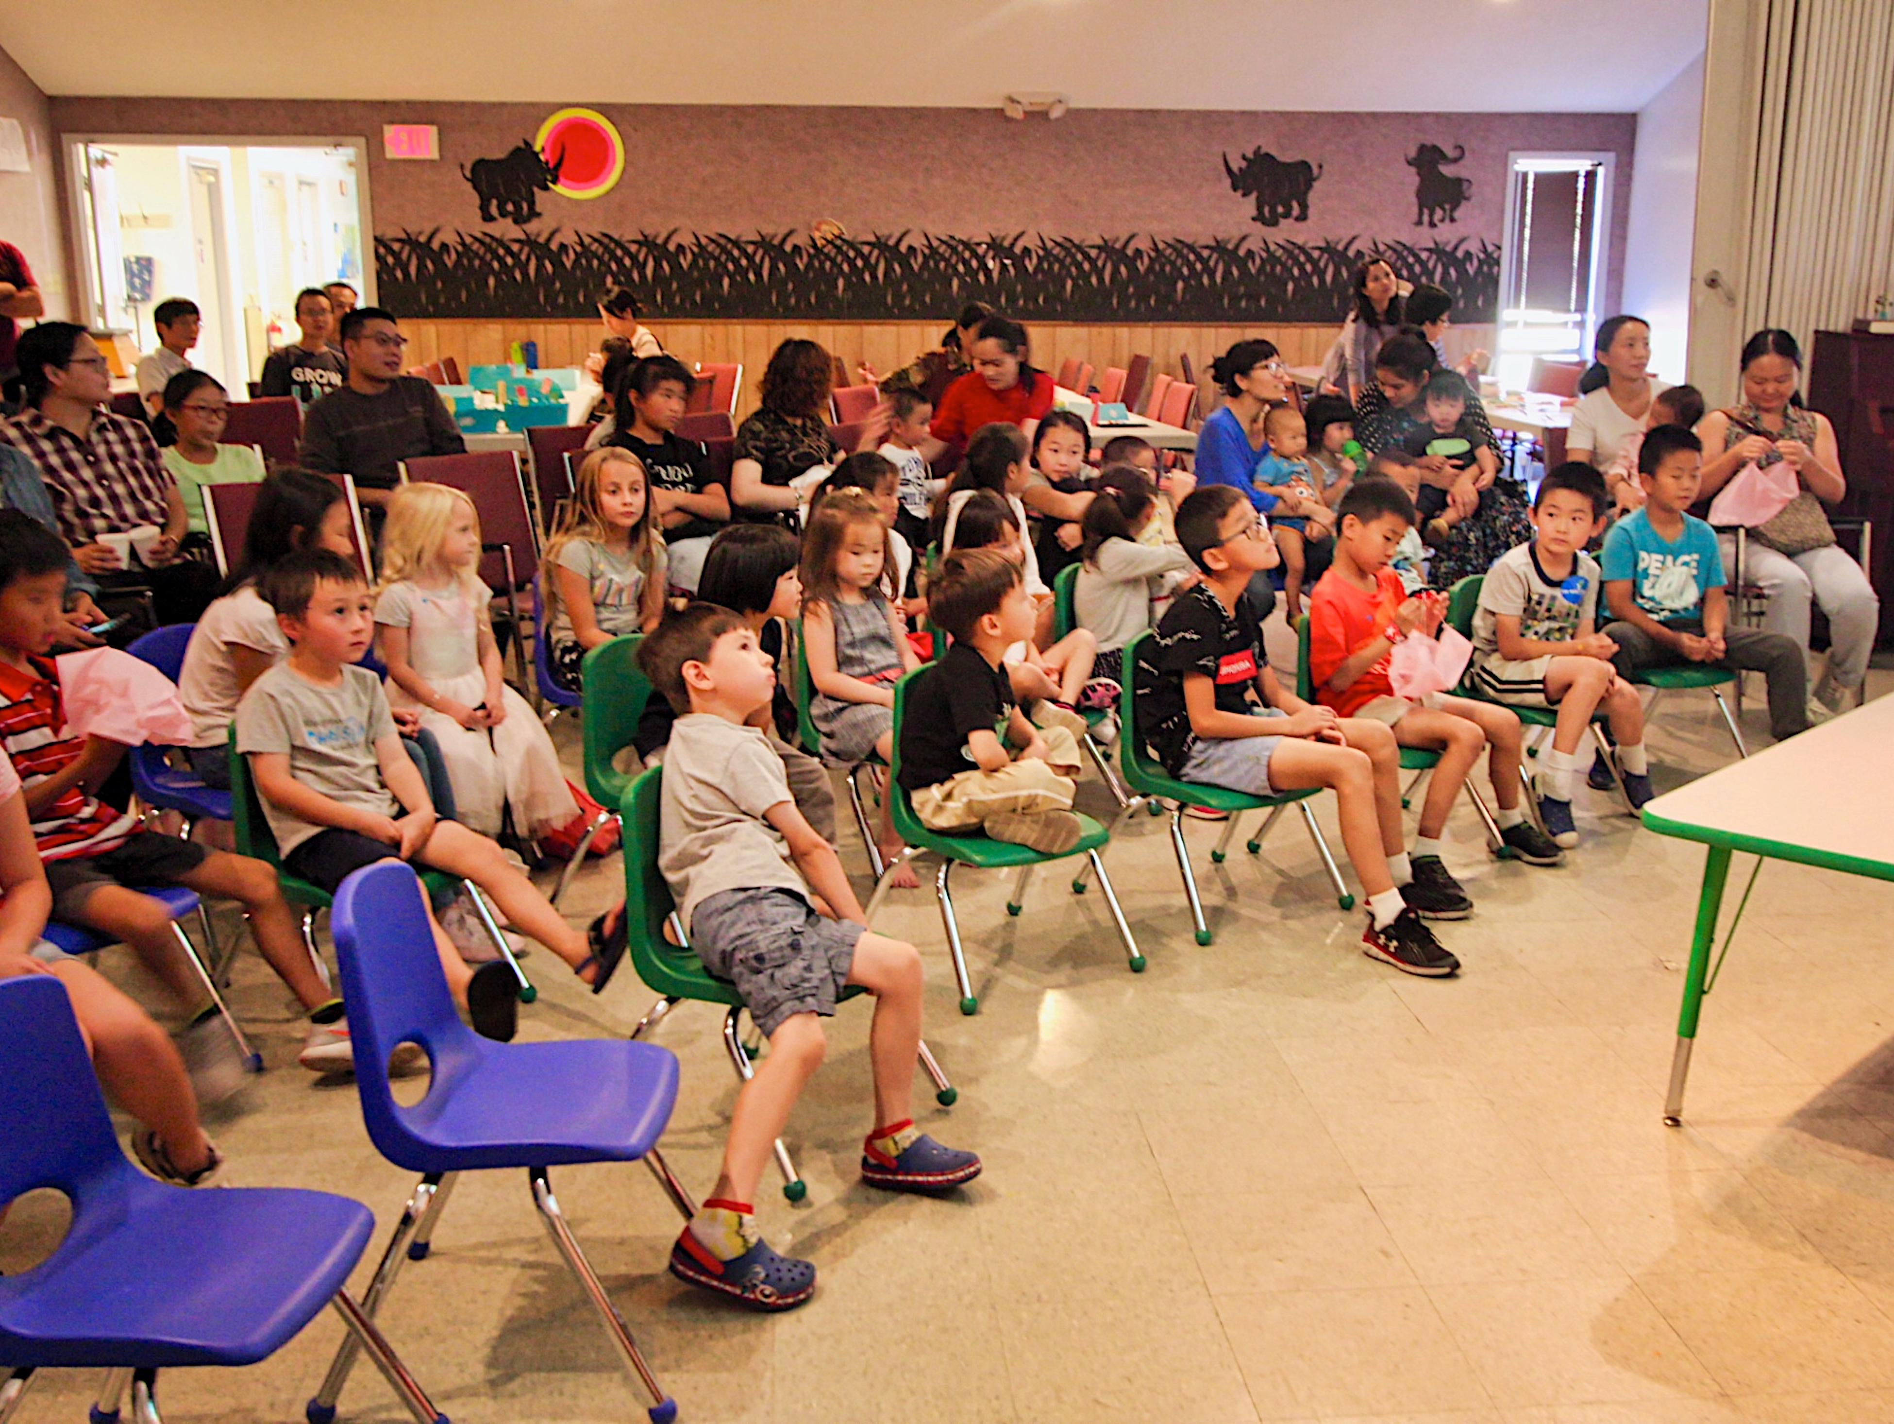

Slide 14
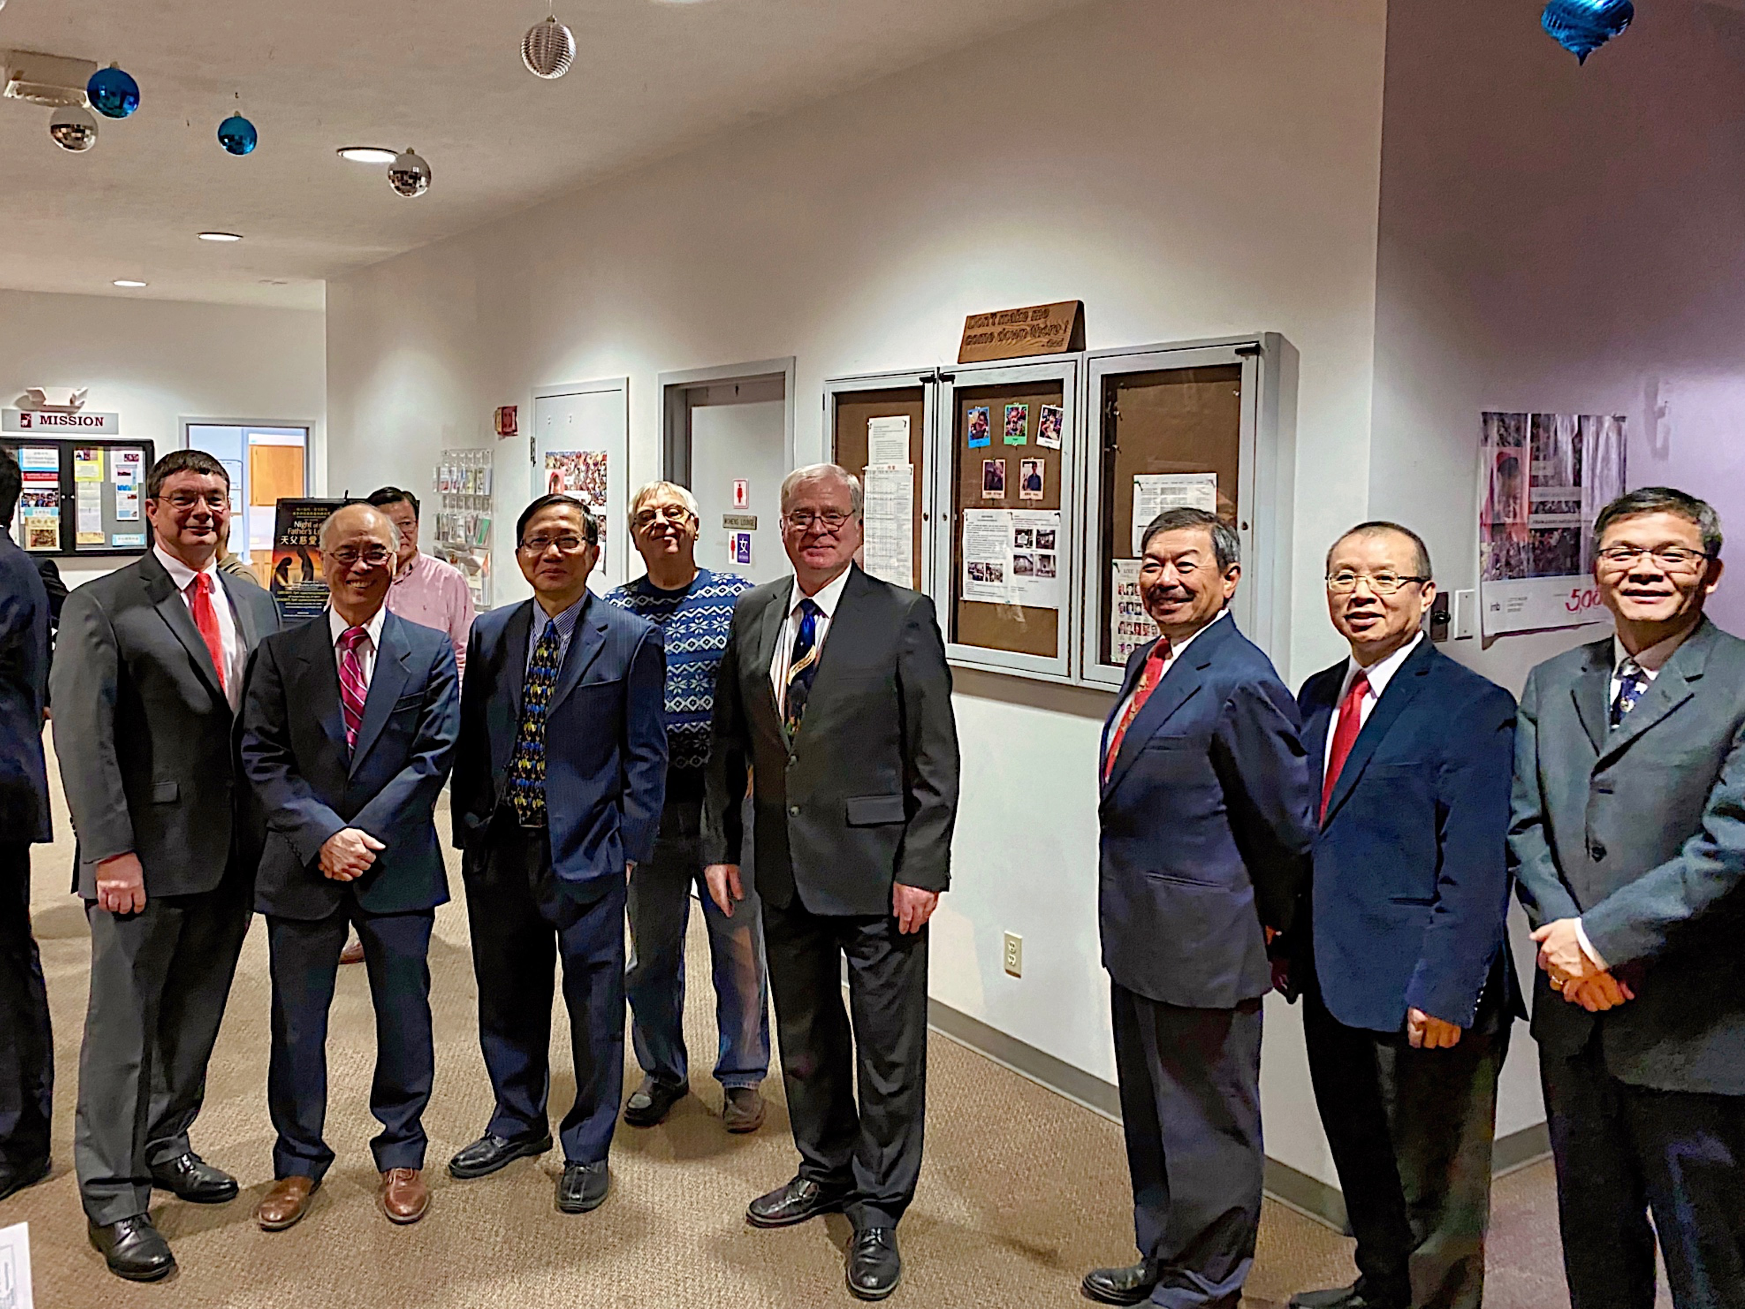
12/07,14「聖誕清唱劇」

Slide 15
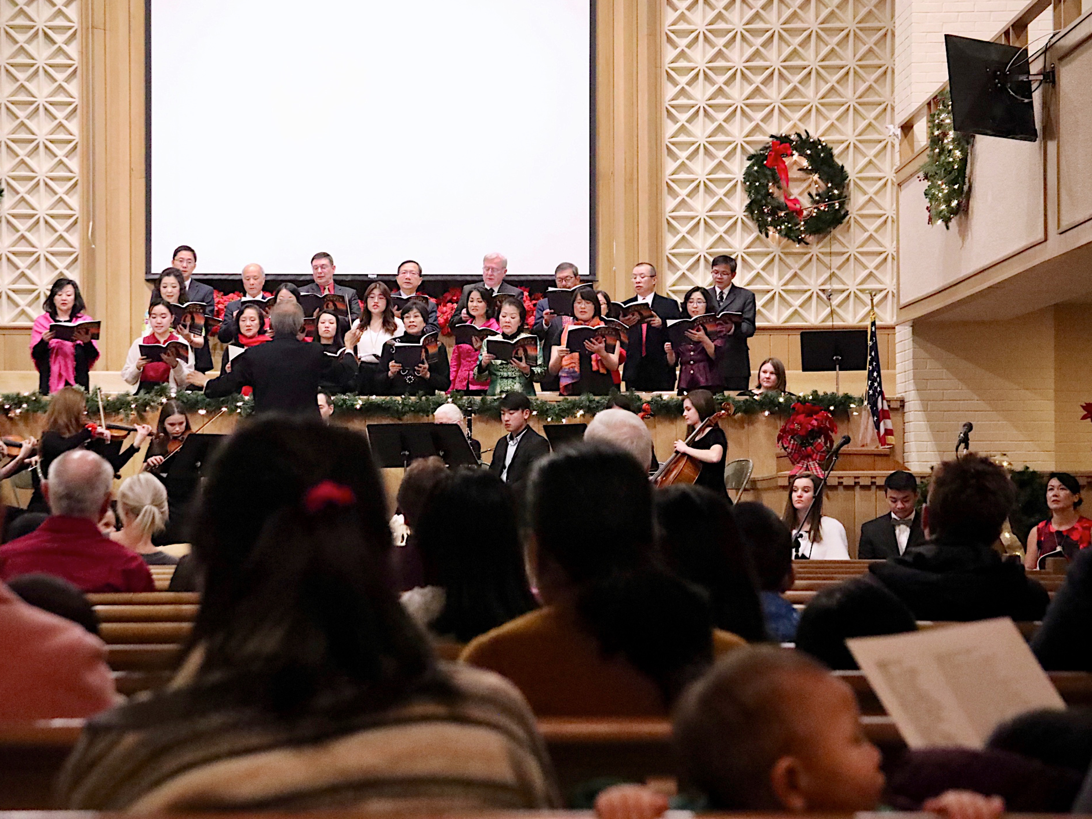

Slide 16
前 瞻
Prospect

Slide 17
我愛我家，同心建造
I love my family. Build up with one mind!
2020

Slide 18
1/1/2020，6:30pm（週三）
教會禱告會
為你的孩子、父母、、、禱告
The first prayer meeting of 2020
6:30pm Wed. 1/1/2020
At church
For your children, for your parent and for others’ needs.

Slide 19
教會是建造 “人的生命”
為優先
The first priority of the church is to build up spiritual life!

Slide 20
四方面操練
1. 心：以基督的心為心。
2. 腦：用思想正面陽光的事。
3. 手：勤勞用手去服務別人。
4. 腳：穿上福音的鞋子。

Slide 21
Four aspects of training
1. Heart: Have the same mindset as Christ
2. Brain: Think positive
3. Hand: Serve others diligently
4. Feet: Put on Gospel shoes

Slide 22
大家要有信心！
Have confidence!
我們要有好的策略！
We need a good strategy!

Slide 23
2020 目標
1. 加强小组的发展，貭与量的提升。
2. 继续扩大儿童事工的增长。
Goals for 2020
1. Strengthen and develop cell groups. Improve both quality and quantity.
2. Continue to expand the growth of children's ministries.

Slide 24
我愛我家，同心建造
I love my family. Build up with one mind!
2020

