Slide 1
English Translation starts NOW
Outside of church
Dial 425-650-1398
Use Conference Code 849387
In House
WI-FI Network = Listen Everywhere
Password: 12345678
Open Listen Everywhere App

Slide 2
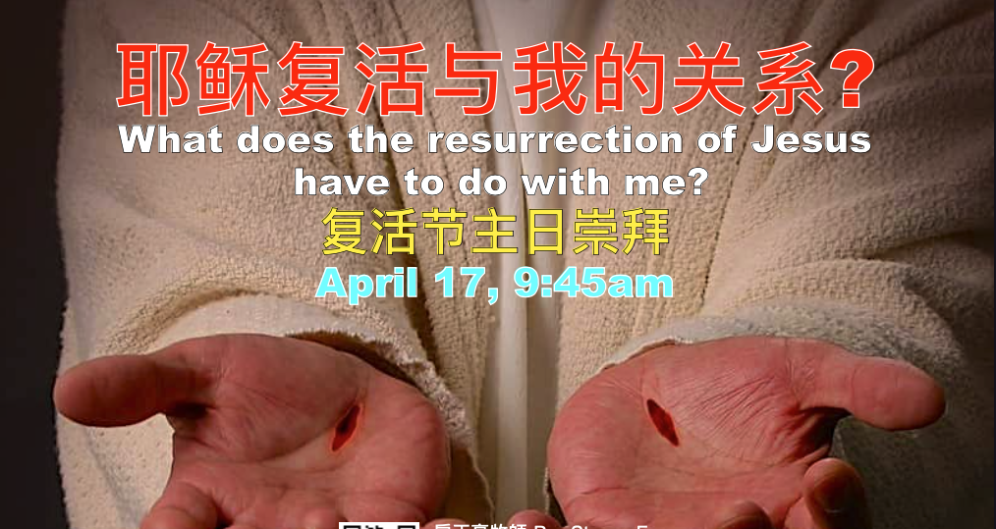
Rev. Steven Fang
房正豪牧师

Slide 3
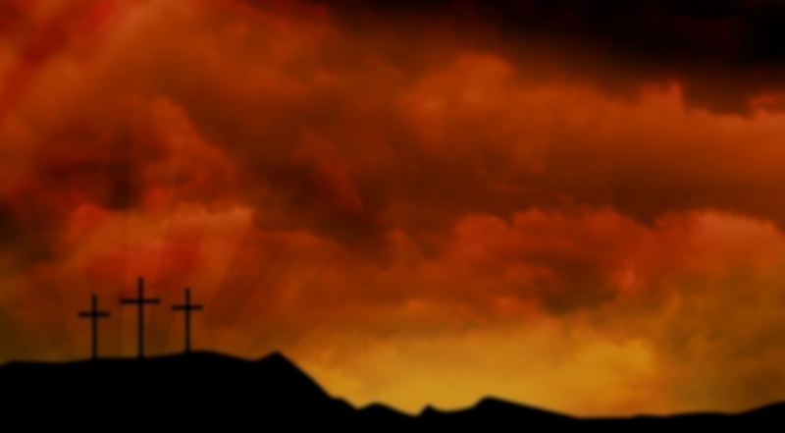
路 加 福 音 Luke 24:25~27
25 耶 稣 对 他 们 说 ： 无 知 的 人 哪 ， 先 知 所 说 的 一 切 话 ， 你 们 的 心 信 得 太 迟 钝 了 。
25 He said to them, “How foolish you are, and how slow to believe all that the prophets have spoken!

Slide 4
26 基 督 这 样 受 害 ， 又 进 入 他 的 荣 耀 ， 岂 不 是 应 当 的 麽 ？
26 Did not the Messiah have to suffer these things and then enter his glory?”
27 於 是 从 摩 西 和 众 先 知 起 ， 凡 经 上 所 指 着 自 己 的 话 都 给 他 们 讲 解 明 白 了 。
27 And beginning with Moses and all the Prophets, he explained to them what was said in all the Scriptures concerning himself.

Slide 5
主说话有两个重点
There are two main points in the Lord's speech.
1. 他们的心，信得太迟钝。
Their hearts are too slow to believe.
2. 主从旧约给他们讲解。
The Lord explained to them from the Old Testament.

Slide 6
路 加 福 音 Luke 24:45~47
45 於 是 耶 稣 开 他 们 的 心 窍 ， 使 他 们 能 明 白 圣 经 ，
45 Then he opened their minds so they could understand the Scriptures.
46 又 对 他 们 说 ： 照 经 上 所 写 的 ， 基 督 必 受 害 ， 第 三 日 从 死 里 复 活 ，
46 He told them, “This is what is written: The Messiah will suffer and rise from the dead on the third day,

Slide 7
47 并 且 人 要 奉 他 的 名 传 悔 改 、 赦 罪 的 道 ， 从 耶 路 撒 冷 起 直 传 到 万 邦 。
47 and repentance and the forgiveness of sins will be preached in his name to all nations, beginning at Jerusalem.

Slide 8
我们要奉主的名
We are in the name of the Lord
传悔改赦罪的道!
Preach the word of repentance and forgiveness of sins!

Slide 9
你有没有傳呢？
Do you preach it?
今天就行动吧？
Do it today?

Slide 10
路 加 福 音 Luke 24:48
你 们 就 是 这 些 事 的 见 证 。
You are witnesses of these things.

Slide 11
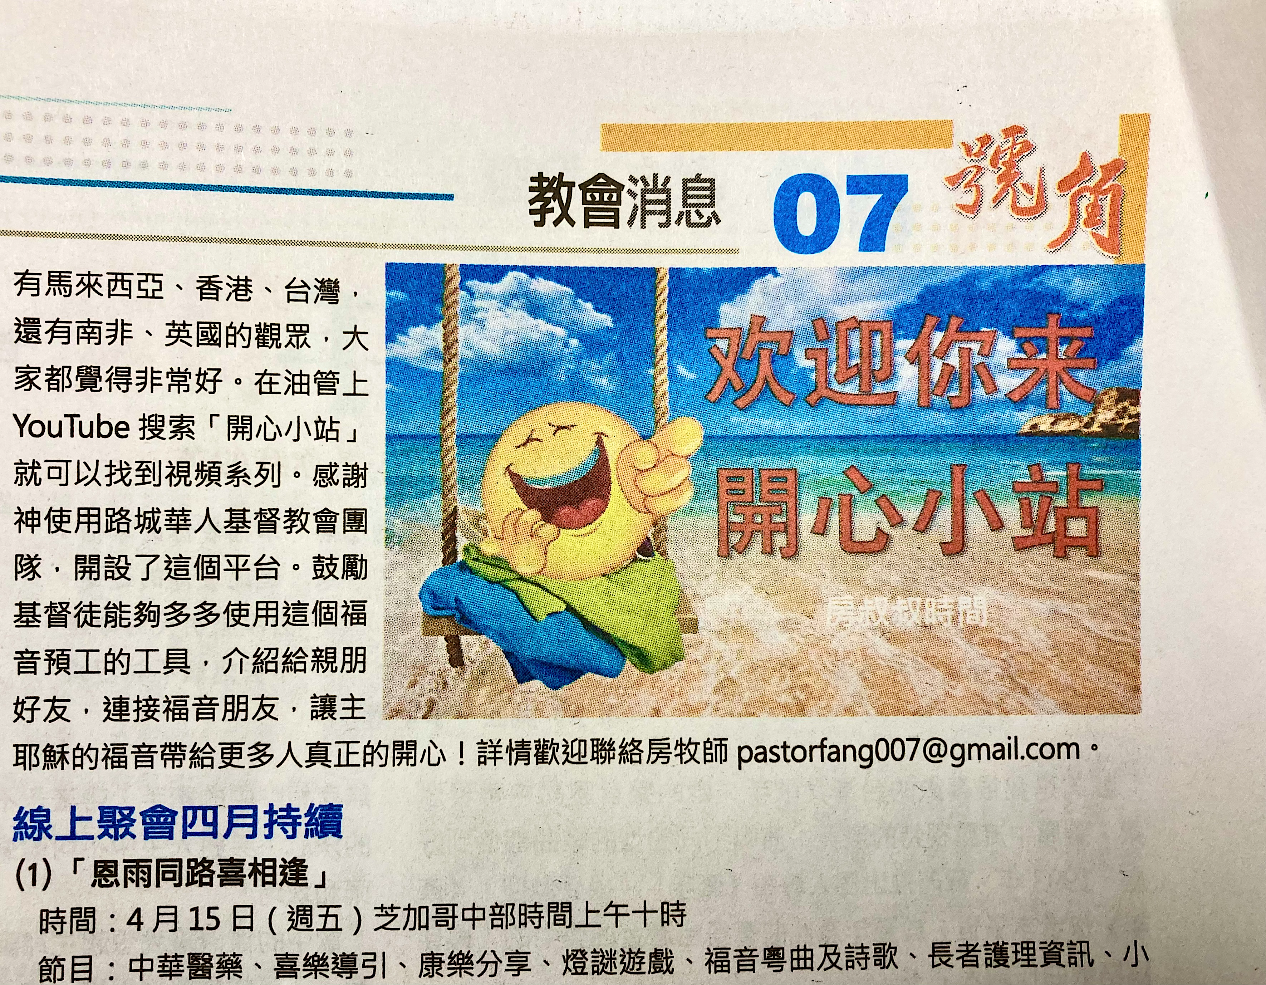

Slide 12
主的复活和我的两大关系
The Resurrection of the Lord has Two Major Relationships with Me
1. 主已得胜死亡，我们也有荣耀的身体！
The Lord has victory over death, and we have glorious bodies!
2. 我们领受圣灵的大能，要做刚强壮胆的门徒！ We receive the power of the Holy Spirit to be strong and brave disciples!

Slide 13
希 伯 來 書 Hebrews 9:27
27 按 着 定 命 ， 人 人 都 有 一 死 ， 死 後 且 有 审 判 。
27 Just as people are destined to die once, and after that to face judgment,

Slide 14
我们不要只是听道
Do not merely listen to the word
更要 “行道”
Do what it says!

Slide 15
求主大大复兴我们教会！
Pray for a great revival of our church!
哈利路亚！
Hallelujah!

Slide 16

见 证
Testimony
（吕绍群 Josh Lu）

Slide 17
大家好，我的名字是 Josh Lu。 我在德克萨斯州的一个基督徒家庭长大，从小就被教导上帝的真理。 上高中后，我开始真正质疑自己的信仰：我怎么能相信神的话？ 上帝真的在那里吗？ 他真的爱我吗？ 我为这些问题挣扎了很长时间，但我决定继续与上帝同行。 随着时间的推移，他向我展示了他是真实的，他爱我，他的话是真实的。 这并不容易，有时我仍然挣扎，但当我这样做时，我会仰望爱我并安息在他的信实中的上帝。

Slide 18
在我认识上帝之前，我是恐惧和不快乐的。 我只考虑自己，以及我能从别人那里得到什么。 这怎么能推进我自己的议程？ 我怎样才能通过这种关系进一步推动自己的学业成功？ 现在我赞美上帝，他带领我把别人放在自己之前，把服务和善良放在自己的利益之前。 我要感谢我的父母一直对我的爱和对我的耐心，以及我的基督徒朋友们不顾自己的支持。

Slide 19
我想鼓励所有怀疑的人仰望上帝在他的话语、他的十字架和他对你的爱中的信实。 他不怕你的问题，他比你所有的恐惧更伟大。 希伯来书 10 章 23 节说：“我们要坚守我们所宣告的盼望，毫不动摇，因为那应许的，是信实的。” 因此，让我们不要害怕为神而活，宣告基督受死和复活的好消息，因为我们的神是他话语的神。

Slide 20
见 证
Testimony
（秦飞 Fei Qin）

Slide 21
Hello, everyone, I am Fei Qin and I came from a small city in China, where almost no one will talk about Jesus Christ. My neighbor is an exception. When I was a kid, each time when I visited this neighbor of mine, he would tell me the stories of Jesus. At that time, I was not interested in those stories. After each story, I gave him a polite smile and left as soon as possible. After moving to the States, I realized that my neighbor was trying to evangelize me. That was the first time when I heard about Jesus.

Slide 22
After moving to the States, I was blessed to meet my girlfriend, Karen. She invited me to join the welcome party hosted by the student fellowship at the Chinese Christian Church of Columbia. I then joined the students fellowship. Almost each week, members with similar age in the student fellowship would gather to enjoy some nice food and have fun. This had made my life more interesting in the States. Also, each Friday, we would read scriptures and share weekly life experience with each other.

Slide 23
At first, like many of you, I had lots of questions for faith. For example, why God chose Israeli instead of Chinese? Many nice people do not have religion, but what would have been their consequences? During this period, I had lots of passion and occasionally considered questions related to God. However, this period did not last long and I lost passion about knowing more about God. Though I continued joining the student fellowship each Friday and attending church occasionally, I had no interest to study scriptures.

Slide 24
When I was listening to the sermon, it went in one ear and out the other. This was my second stage where I had no feeling about bible or religion. I did not reject but I was not willing to know more. To be honest, I could not continue attending church without Karen. This period lasted very long and I could always feel a wall in my heart, blocking me from moving forward. Looking back, this wall was there because I had never experienced God personally.

Slide 25
Furthermore, I cared too much about my parents and friends’ reactions once I become a Christian. I actually expected it might take a few years for me to get through this stage.
This situation continued until I experienced hardship for more than a month ago. I was preparing for my proposal defense. Although I passed my proposal defense, the process did not go very well. In the same week, I received lots of negative comments from my advisor, which made me very frustrated.

Slide 26
I could not drive during those days because my mind was always vacillated by questions, such as, why was my advisor being so harsh on me? Or how could I better complete my assignments? These questions made me sleep poorly at night and I started to experience anxiety. I know I was caring too much about my advisor’s words, but I could not control myself to not think about these. I failed to calm myself down.

Slide 27
I cannot share all my feelings with families or friends as no one can really understand me. This was the first time I felt my weakness and can do nothing to help myself. Thus, I prayed to Jesus. This was the first time I prayed by myself, asking help from the bottom of my heart. I said “God, please save me from my current condition, and help me to obtain the peace of my heart.” I even asked God, “If it’s possible, could You let my advisor give me some positive comments?”

Slide 28
I immediately felt peaceful after the prayer, and a few days later, during our regular meeting, when I was reporting my research progress, my advisor stopped me and praised that I did good job for the manuscript I sent her a few days ago. At that moment, I started to feel much relieved. A few days later, I finally restored to my normal condition. Comparing to the experiences of many brothers and sisters, my experience was not that tough, but this experience left a deep impression on me, as I am the guy who

Slide 29
always take it easy through hard times. Furthermore, I found out the wall in my heart had disappeared, though I did not know when it disappeared. After that experience, together with Karen, we started to read scriptures, do devotions, and discuss how the scriptures connect to our lives. I never imagined that I can now work on these things so naturally, which I used to reject before.

Slide 30
Finally, I want to give thanks. I know lots of people have been praying for my faith, including Karen’s families in Malaysia, brothers and sisters at the Chinese Christian Church of Columbia, and brothers and sisters in our Church. I would like to thank Karen, as I know she sacrificed a lot for our relationship. Most importantly, I want to thank God. Thanks God, for not giving me up.

Slide 31
Thanks God, for helping me to know Him. Thanks God, for letting me experience His power and faithfulness through life. In the end, I want to share a scripture with you about faith, which we memorized in the church last month, Hebews 11:1, “Now faith is confidence in what we hope for and assurance about what we do not see”.

