Slide 1
Participate in the Body of Christ, Practice Your Faith 参与基督的身体， 实践自己的信仰
Bro. Phillip Howard

Slide 2
Google Search Results (Google 搜寻结果)
Church Connects Us with God
(教会使我们与上帝联系 )
Church Gives Us a Chance to Reflect on Gratitude
(教会给我们一个反思感激的机会)

Slide 3
Church Connects Us Socially
(教会在社会上联系我们)
Church Helps Us Better Connect with our Spouse
(教会帮助我们更好地与您的配偶联系)

Slide 4
Church Allows Us to Feel Reverence
(教会让我们感到敬畏)
Church Provides Plenty of Opportunities to Give Back
(教会提供大量回馈的机会)

Slide 5
Church Helps Us “Find the Lesson” in our Trials
(教会在审判中帮助我们“找到教训”)
Church Teaches Us Forgiveness
(教会教导我们宽恕)

Slide 7
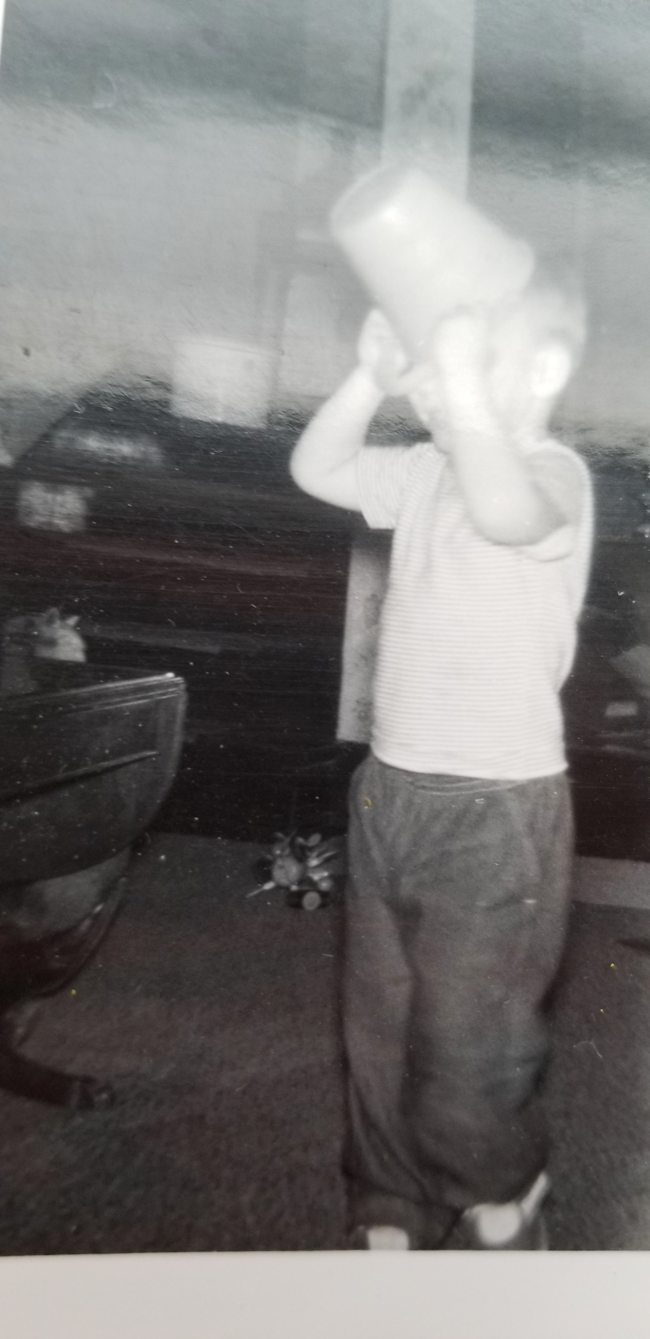

Slide 8
Service is Required
(需要服事 )
2. It is a Difficult Road
(这是一条艰难的道路 )
3. We must be Ready
(我们必须准备好)

Slide 9
Service is Required
(需要服事 )

Slide 10
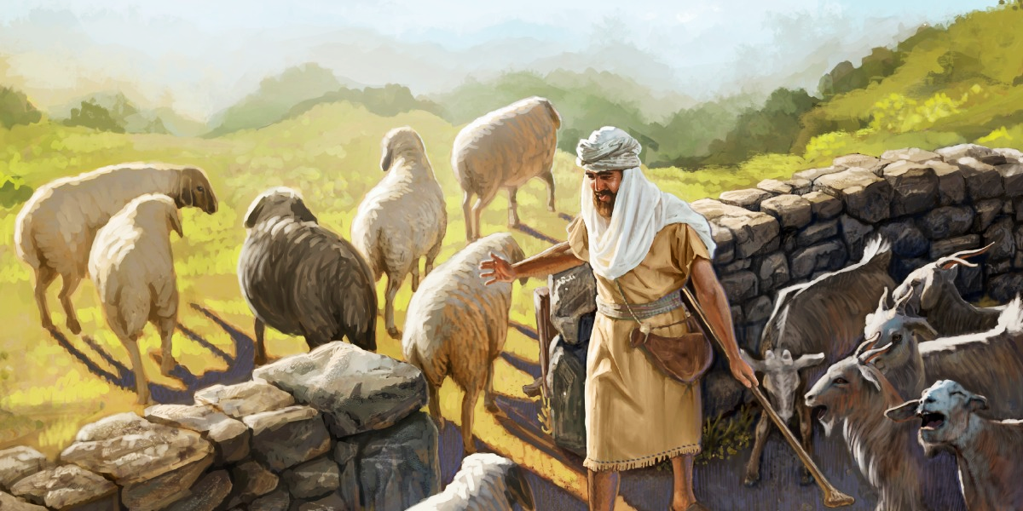

Slide 11
Matthew 马太福音25:45
⁴⁵ “He will reply, ‘Truly I tell you, whatever you did not do for one of the least of these, you did not do for me.’
⁴⁵ 王要回答说：‘我实在告诉你们：这些事你们既不做在我这弟兄中一个最小的身上，就是不做在我身上了。’

Slide 12
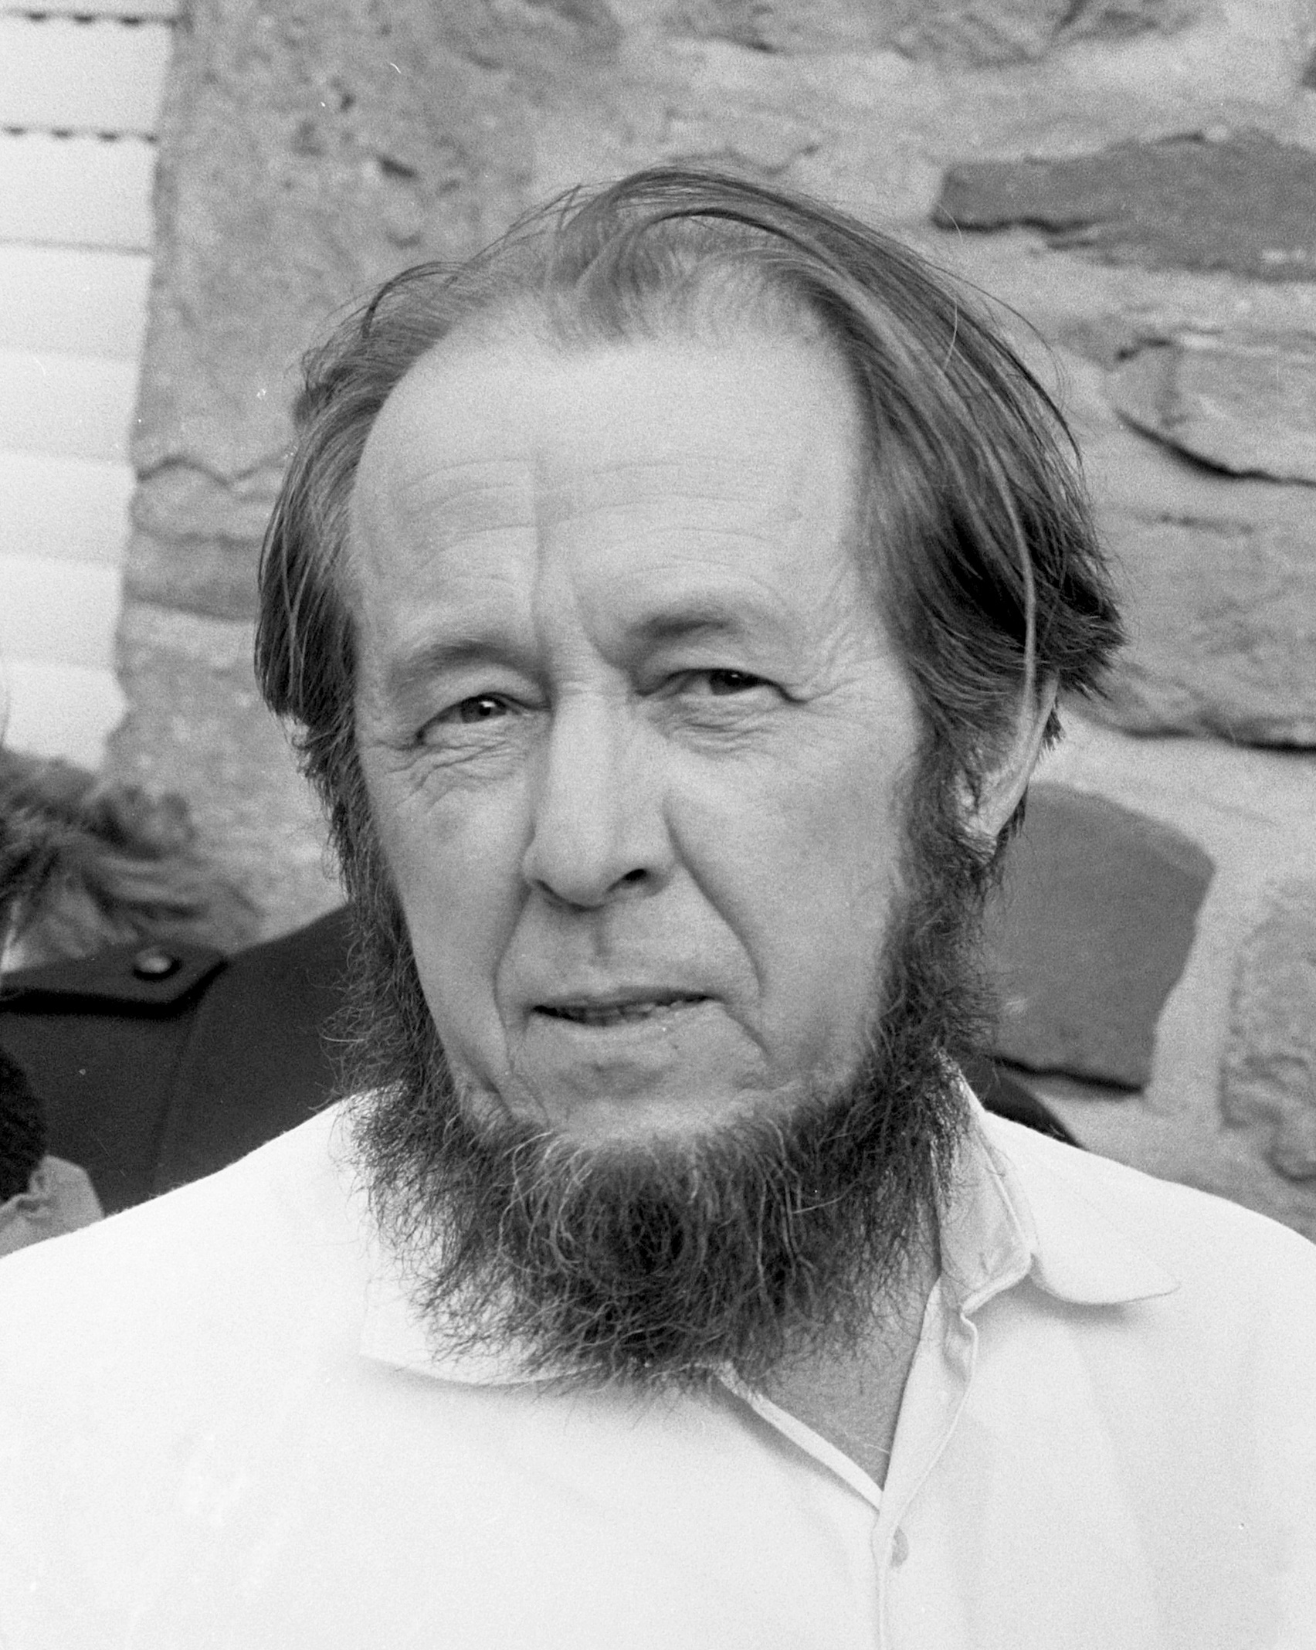
Aleksandr Solzhenitsyn 亚历山大·索尔仁尼琴
the line dividing good and evil cuts through the heart of every human being
善与恶的界限贯穿了每个人的内心

Slide 13
Luke 路加福音 6:45
⁴⁵ A good man brings good things out of the good stored up in his heart, and an evil man brings evil things out of the evil stored up in his heart. For the mouth speaks what the heart is full of.
⁴⁵ 良善的人从心中所存的良善发出良善，邪恶的人从心中所存的邪恶发出邪恶；因为心中所充满的，口里就说出来。

Slide 14
1 Corinthians 哥林多前書 13:3
³ If I give all I possess to the poor and give over my body to hardship that I may boast,^{[a]} but do not have love, I gain nothing.
³ 我若把一切所有的分给人，又舍己身被人焚烧，却没有爱，对我仍然毫无益处

Slide 15
It is a Difficult Road
(这是一条艰难的道路 )

Slide 16
Matthew马太福音 25: 29
²⁹ For whoever has will be given more, and they will have an abundance. Whoever does not have, even what they have will be taken from them.
²⁹ 因为凡是有的，还要赐给他，使他丰足有余；那没有的，连他有的也将从他那里被拿走。

Slide 17
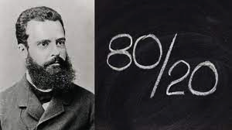

Slide 18
We must be Ready
(我们必须准备好)

Slide 19
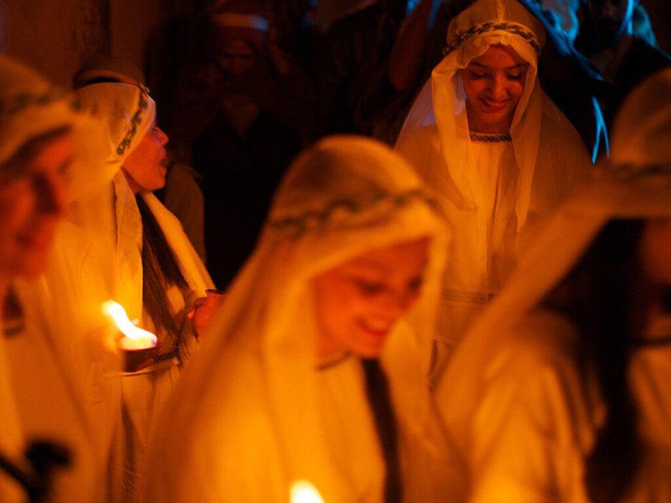
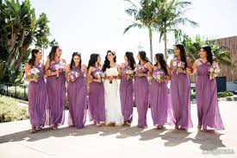
The 10 Bridesmaids 十 个 童 女

Slide 20
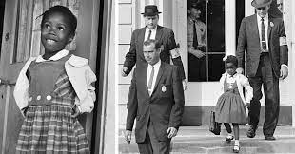

Slide 21
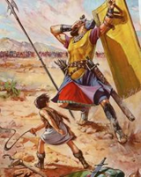

Slide 22
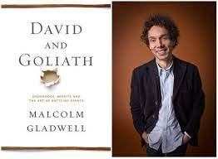
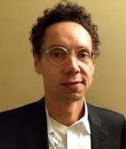

Slide 23
Service is Required
(需要服事 )
2. It is a Difficult Road
(这是一条艰难的道路 )
3. We must be Ready
(我们必须准备好)

Slide 24
Luke 路加福音 18:27
²⁷ Jesus replied, “What is impossible with man is possible with God.”
²⁷ 耶稣说：“在人不可能的事，在神都是可能的。”

Slide 25
Participate in the Body of Christ, Practice Your Faith 参与基督的身体，实践自己的信仰

