Slide 1
Q&A
普通话
广东话
English

Slide 2
How would you define missions?
你会如何定义使命？

Slide 3
What is your role in missions?
你在宣教中的角色是什么？

Slide 4
The Mission of God for all 神对所有人的使命
God’s Mission and its meaning for us
神的使命和它对我们的意义

Slide 5
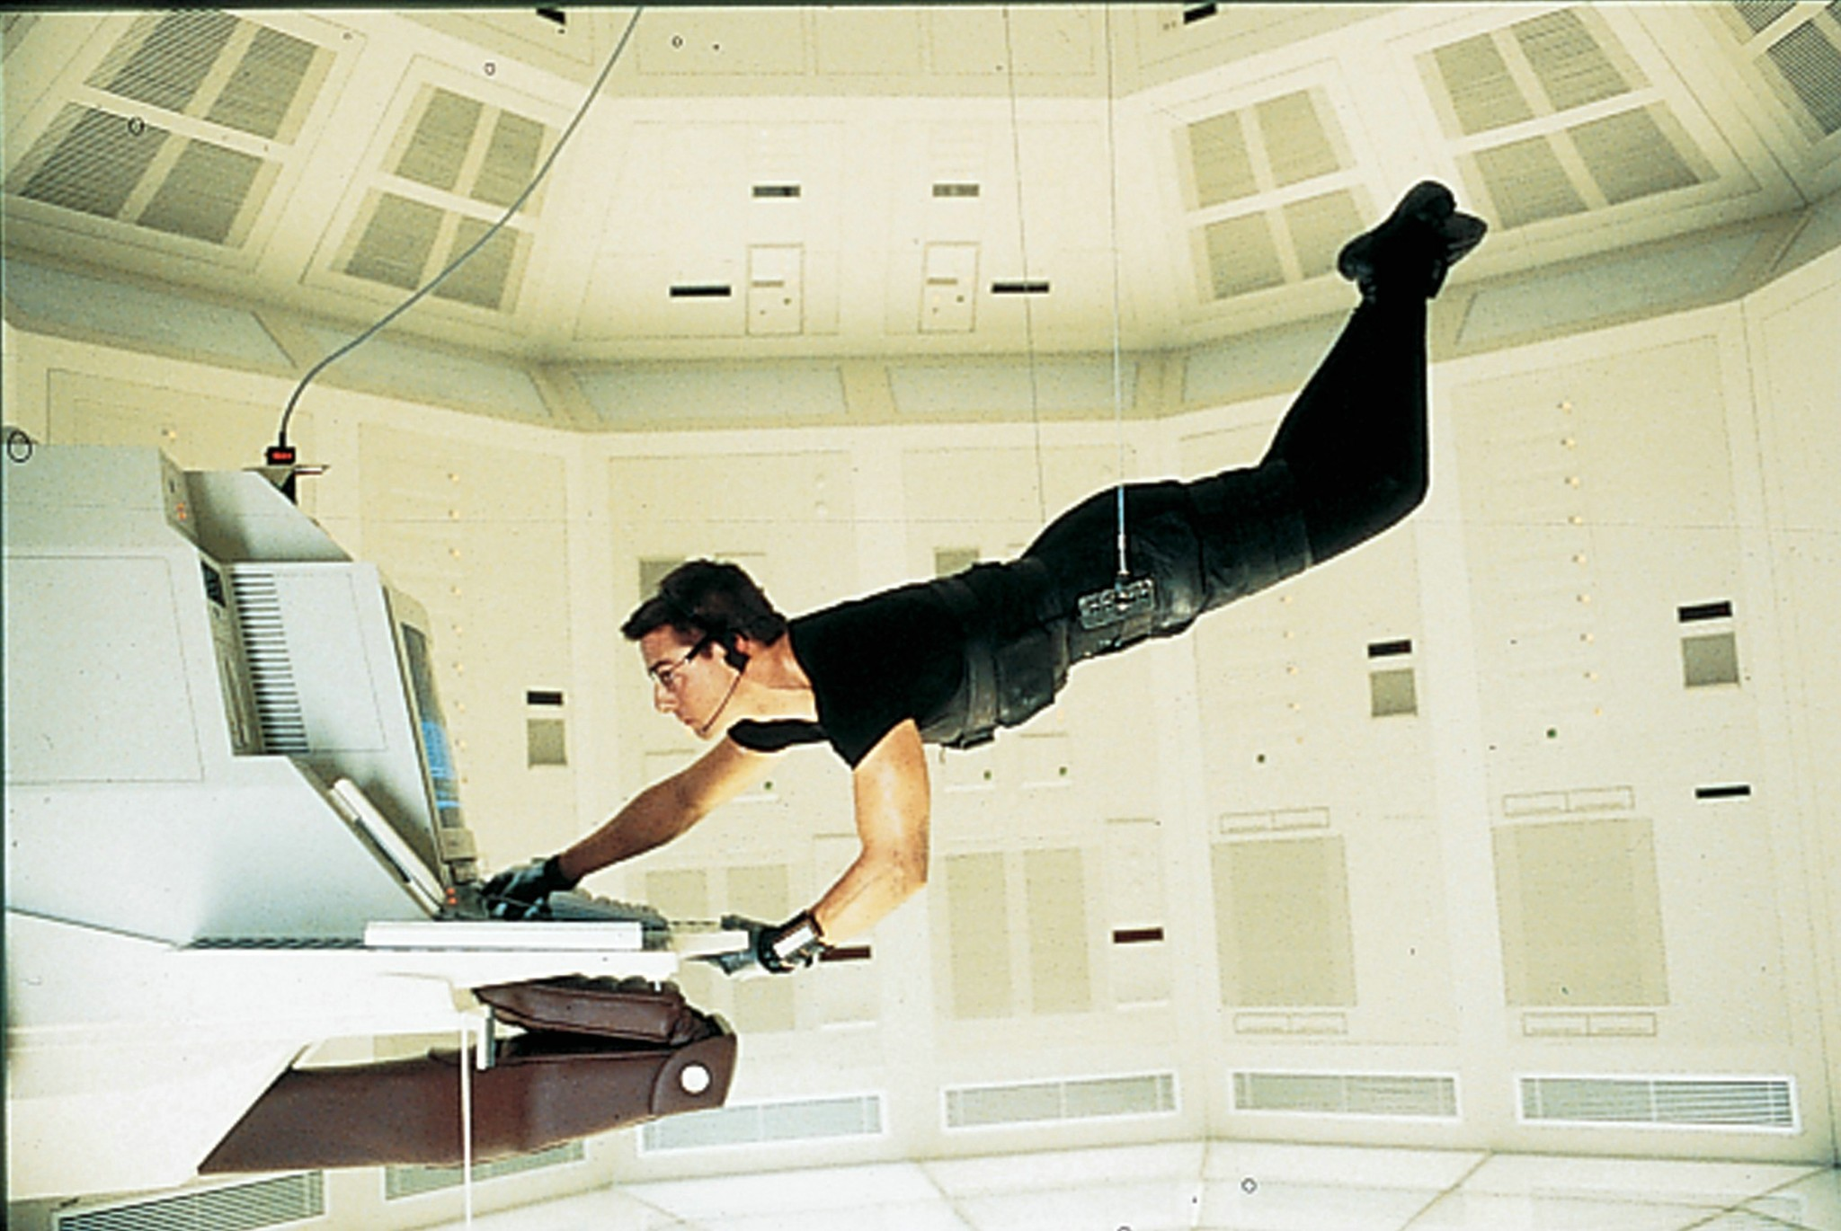

Slide 6
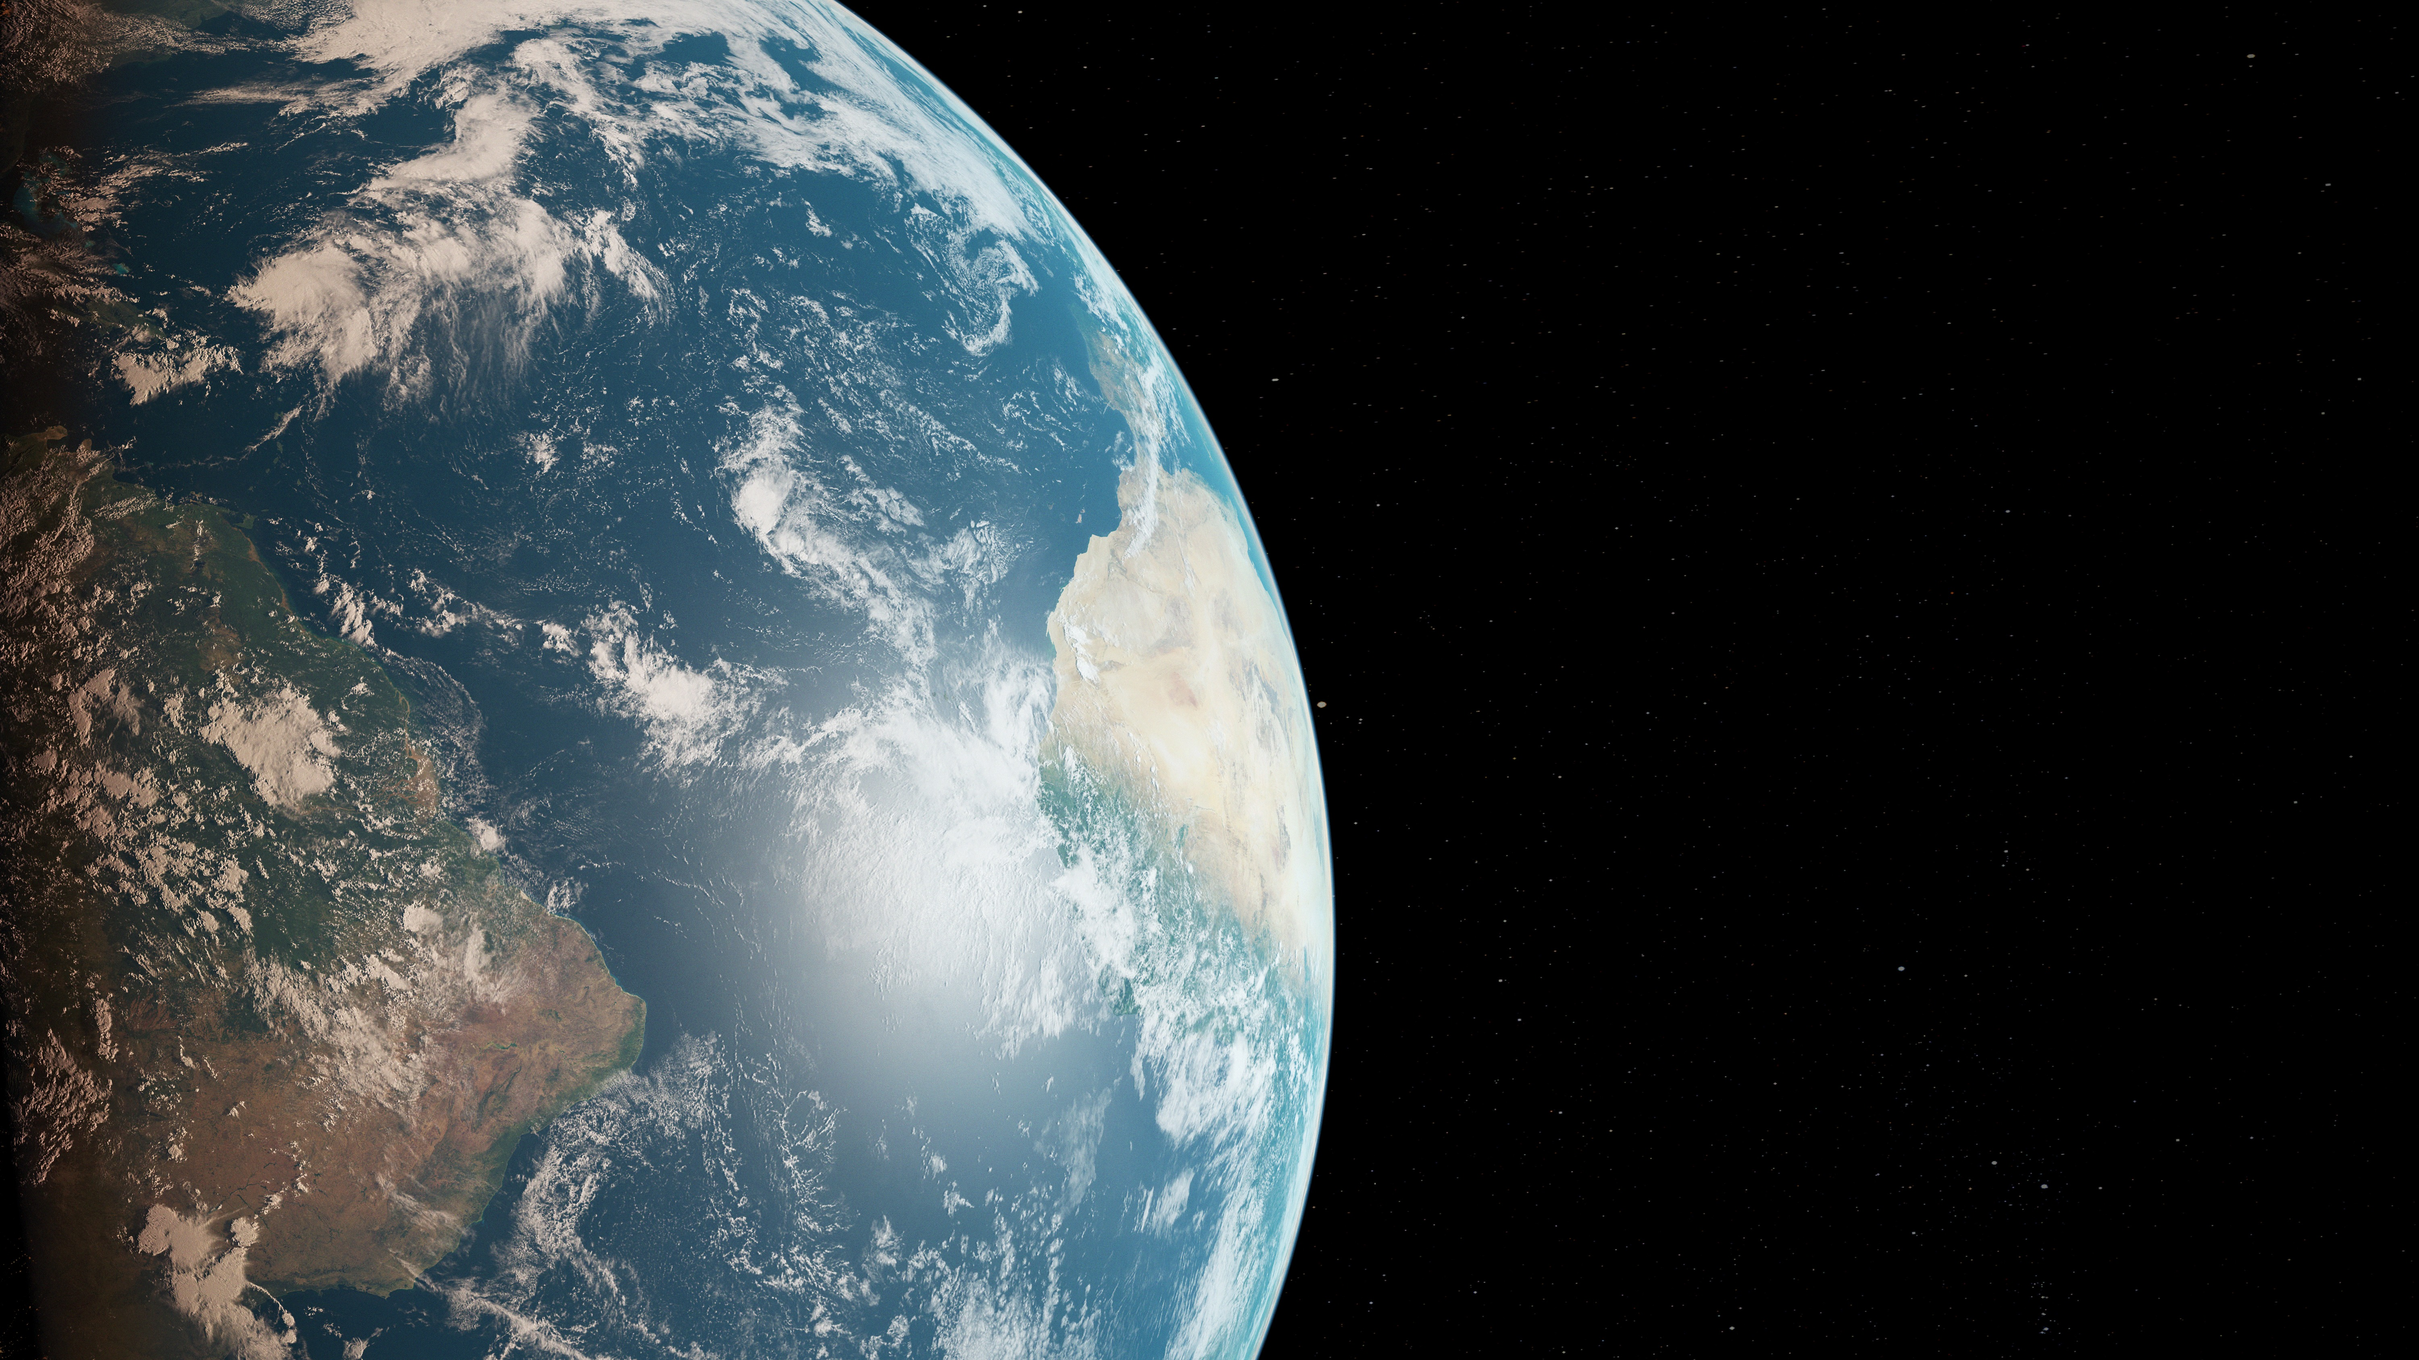
God loves his creation
神爱他的创造

Slide 7
What is god’s mission? 神的使命是什么？

Slide 8
Genesis 创世记 3: 14-15
The Promise to the Serpent 对蛇的承诺
The Lord God said to the serpent, “Because you have done this, cursed are you above all livestock and above all beasts of the field; on your belly you shall go, and dust you shall eat all the days of your life.
耶和华神对蛇说，你既作了这事，就必受咒诅，比一切的牲畜野兽更甚。你必用肚子行走，终身吃土。

Slide 9
I will put enmity between you and the woman, and between your offspring and her offspring; he shall bruise your head, and you shall bruise his heel.
我又要叫你和女人彼此为仇。你的后裔和女人的后裔也彼此为仇。女人的后裔要伤你的头，你要伤他的脚跟。

Slide 10
Genesis 创世记 12: 1-3
The Covenant with Abraham 与亚伯拉罕的约
Now the Lord said to Abram, “Go from your country and your kindred and your father’s house to the land that I will show you. And I will make of you a great nation, and I will bless you and make your name great, so that you will be a blessing.
耶和华对亚伯兰说，你要离开本地，本族，父家，往我所要指示你的地去。我必叫你成为大国，我必赐福给你，叫你的名为大，你也要叫别人得福。

Slide 11
I will bless those who bless you, and him who dishonors you I will curse, and in you all the families of the earth shall be blessed.
为你祝福的，我必赐福与他。那咒诅你的，我必咒诅他，地上的万族都要因你得福。

Slide 12
The Exodus & the Law
出埃及记与律法

Slide 13
The City of Jerusalem
耶路撒冷城

Slide 14
The Prophets’ Foretelling
先知的预言

Slide 15
The Preparation of John the Baptist
施洗约翰的预备

Slide 16
The Coming of Jesus
耶稣的来临

Slide 17
The Death & Resurrection of Jesus
耶稣的死与复活

Slide 18
Matthew 马太福音 28:18-20
The Commissioning of the Apostles 使徒的任命
And Jesus came and said to them, “All authority in heaven and on earth has been given to me. Go therefore and make disciples of all nations, baptizing them in the name of the Father and of the Son and of the Holy Spirit,
耶稣进前来，对他们说，天上，地下所有的权柄，都赐给我了。所以你们要去，使万民作我的门徒，奉父子圣灵的名，给他们施洗。

Slide 19
Matthew 马太福音 28:18-20
The Commissioning of the Apostles 使徒的任命
teaching them to observe all that I have commanded you. And behold, I am with you always, to the end of the age.
凡我所吩咐你们的，都教训他们遵守，我就常与你们同在，直到世界的末了。

Slide 20
The Inclusion of the Gentiles
接纳外邦人

Slide 21
The Gospel to the Ends of the Earth
福音传至地极

Slide 22
The Final Resurrection
最终复活

Slide 23
All of this is God’s Mission
这一切都是神的使命

Slide 24
What does god’s mission mean for us? 神的使命对我们有什么意义？

Slide 25
We have a job to do 我们有工作要做

Slide 26
II Corinthians 歌林多后书 5:18-20
All this is from God, who through Christ reconciled us to himself and gave us the ministry of reconciliation; that is, in Christ God was reconciling the world to himself, not counting their trespasses against them, and entrusting to us the message of reconciliation.
一切都是出于神，他借着基督使我们与他和好，又将劝人与他和好的职分赐给我们。这就是神在基督里叫世人与自己和好，不将他们的过犯归到他们身上。并且将这和好的道理托付了我们。

Slide 27
II Corinthians 歌林多后书 5:18-20 (Continued)
Therefore, we are ambassadors for Christ, God making his appeal through us. We implore you on behalf of Christ, be reconciled to God.
所以我们作基督的使者，就好像神借我们劝你们一般。我们替基督求你们与神和好。

Slide 28
I Peter 彼得前书 2:9
But you are a chosen race, a royal priesthood, a holy nation, a people for his own possession, that you may proclaim the excellencies of him who called you out of darkness into his marvelous light.
惟有你们是被拣选的族类，是有君尊的祭司，是圣洁的国度，是属神的子民，要叫你们宣扬那召你们出黑暗入奇妙光明者的美德。

Slide 29
We need to understand it if we are going to do it 如果我们要这样做， 我们需要了解它

Slide 30
We are not needed 我们不需要

Slide 31
We fulfill the mission together 我们一起完成使命

Slide 32
Matthew 马太福音 5:13-16
You are the salt of the earth, but if salt has lost its taste, how shall its saltiness be restored? It is no longer good for anything except to be thrown out and trampled under people’s feet.
你们是世上的盐。盐若失了味，怎能叫他再咸呢？以后无用，不过丢在外面，被人践踏了。

Slide 33
Matthew 马太福音 5:13-16 (Continued)
You are the light of the world. A city set on a hill cannot be hidden. Nor do people light a lamp and put it under a basket, but on a stand, and it gives light to all in the house. In the same way, let your light shine before others, so that they may see your good works and give glory to your Father who is in heaven.
你们是世上的光。城造在山上，是不能隐藏的。人点灯，不放在斗底下，是放在灯台上，就照亮一家的人。你们的光也当这样照在人前，叫他们看见你们的好行为，便将荣耀归给你们在天上的父。

Slide 34
John 约翰福音 13:35
By this all people will know that you are my disciples, if you have love for one another.
我给你们作了榜样，叫你们照着我向你们所作的去作。

Slide 35
We fulfill the mission individually 我们各自完成使命

Slide 36
Let’s go! 走吧！

