Slide 1
房正豪牧师
Rev. Steven Fang

Slide 2
约翰福音 John 2:1~11 1 第三日，在加利利的迦拿有娶亲的筵席。耶稣的母亲在那里。
2 耶稣和他的门徒也被请去赴席。
3 酒用尽了，耶稣的母亲对他说，他们没有酒了。
1 On the third day a wedding took place at Cana in Galilee. Jesus’ mother was there,
2 and Jesus and his disciples had also been invited to the wedding.
3 When the wine was gone, Jesus’ mother said to him, “They have no more wine.”

Slide 3
4 耶稣说，母亲，（原文作妇人）我与你有什么相干。我的时候还没有到。
5 他母亲对用人说，他告诉你们什么，你们就作什么。
6 照犹太人洁净的规矩，有六口石缸摆在那里，每口可以盛两三桶水。
4 “Woman, why do you involve me?” Jesus replied. “My hour has not yet come.”
5 His mother said to the servants, “Do whatever he tells you.”
6 Nearby stood six stone water jars, the kind used by the Jews for ceremonial washing, each holding from twenty to thirty gallons.

Slide 4
7 耶稣对用人说，把缸倒满了水。他们就倒满了，直到缸口。
8 耶稣又说，现在可以舀出来，送给管筵席的。他们就送了去。
7 Jesus said to the servants, “Fill the jars with water”; so they filled them to the brim.
8 Then he told them, “Now draw some out and take it to the master of the banquet.”
They did so,

Slide 5
9 管筵席的尝了那水变的酒，并不知道是哪里来的，只有舀水的用人知道。管筵席的便叫新郎来。
9 and the master of the banquet tasted the water that had been turned into wine. He did not realize where it had come from, though the servants who had drawn the water knew. Then he called the bridegroom aside

Slide 6
10 对他说，人都是先摆上好酒。等客喝足了，才摆上次的。你倒把好酒留到如今。
11 这是耶稣所行的头一件神迹，是在加利利的迦拿行的，显出他的荣耀来。他的门徒就信他了。
10 and said, “Everyone brings out the choice wine first and then the cheaper wine after the guests have had too much to drink; but you have saved the best till now.”
11 What Jesus did here in Cana of Galilee was the first of the signs through which he revealed his glory; and his disciples believed in him.

Slide 7
约翰福音 John 19:25~27 25 站在耶稣十字架旁边的，有他母亲与他母亲的姊妹，并革罗罢的妻子马利亚，和抹大拉的马利亚。
25 Near the cross of Jesus stood his mother, his mother’s sister, Mary the wife of Clopas, and Mary Magdalene.

Slide 8
26 耶稣见母亲和他所爱的那门徒站在旁边，就对他母亲说，母亲，看你的儿子。
27 又对那门徒说，看你的母亲。从此那门徒就接她到自己家里去了。
26 When Jesus saw his mother there, and the disciple whom he loved standing nearby, he said to her, “Woman,[b] here is your son,”
27 and to the disciple, “Here is your mother.” From that time on, this disciple took her into his home.

Slide 9
马利亚知道耶稣是谁。
Mary knows who Jesus is.
2. 马利亚对耶稣有信心。
Mary had faith in Jesus.

Slide 10
何西阿书 Hosea 6:3 3 我们务要认识耶和华，竭力追求认识他。他出现确如晨光，他必临到我们像甘雨，像滋润田地的春雨。。
3 Let us acknowledge the Lord;
let us press on to acknowledge him.
As surely as the sun rises,
he will appear;
he will come to us like the winter rains,
like the spring rains that water the earth.”

Slide 11
约翰福音 John 2:5~6
5 他母亲对用人说，他告诉你们什么，你们就作什么。
6 照犹太人洁净的规矩，有六口石缸摆在那里，每口可以盛两三桶水。
5 His mother said to the servants, “Do whatever he tells you.”
6 Nearby stood six stone water jars, the kind used by the Jews for ceremonial washing, each holding from twenty to thirty gallons.

Slide 12
主是顾念人的主。
The God is the God takes care of people.
2. 主从不误事。
The God never fails.

Slide 13
约翰福音 John 2:8~10
8 耶稣又说，现在可以舀出来，送给管筵席的。他们就送了去。
9 管筵席的尝了那水变的酒，并不知道是哪里来的，只有舀水的用人知道。管筵席的便叫新郎来。
8 Then he told them, “Now draw some out and take it to the master of the banquet.” They did so,
9 and the master of the banquet tasted the water that had been turned into wine. He did not realize where it had come from, though the servants who had drawn the water knew. Then he called the bridegroom aside

Slide 14
10 对他说，人都是先摆上好酒。等客喝足了，才摆上次的。你倒把好酒留到如今。
11 这是耶稣所行的头一件神迹，是在加利利的迦拿行的，显出他的荣耀来。他的门徒就信他了。
10 and said, “Everyone brings out the choice wine first and then the cheaper wine after the guests have had too much to drink; but you have saved the best till now.”
11 What Jesus did here in Cana of Galilee was the first of the signs through which he revealed his glory; and his disciples believed in him.

Slide 15
彼得前书 1 Peter 5:7
7 你们要将一切的忧虑卸给神，
因为他顾念你们。
7 Cast all your anxiety on him
because he cares for you.

Slide 16
启示录 Revelation 19:7~9
7 我们要欢喜快乐，将荣耀归给他。因为羔羊婚娶的时候到了，新妇也自己预备好了。
8 就蒙恩得穿光明洁白的细麻衣，这细麻衣就是圣徒所行的义。
7 Let us rejoice and be glad and give him glory!
For the wedding of the Lamb has come, and his bride has made herself ready.
8 Fine linen, bright and clean, was given her to wear.”

Slide 17
9 天使吩咐我说，你要写上，凡被请赴羔羊之婚筵的有福了。又对我说，这是神真实的话。
9 Then the angel said to me, “Write this: Blessed are those who are invited to the wedding supper of the Lamb!” And he added, “These are the true words of God.”

Slide 18
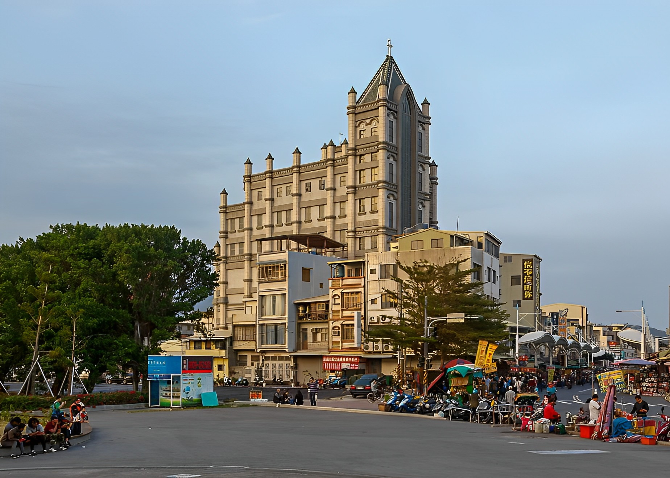
台灣第一間禮拜堂 - 旗後教會 1935 建立
The first chapel in Taiwan - Qihou Church was established in 1935

Slide 19
