Slide 1
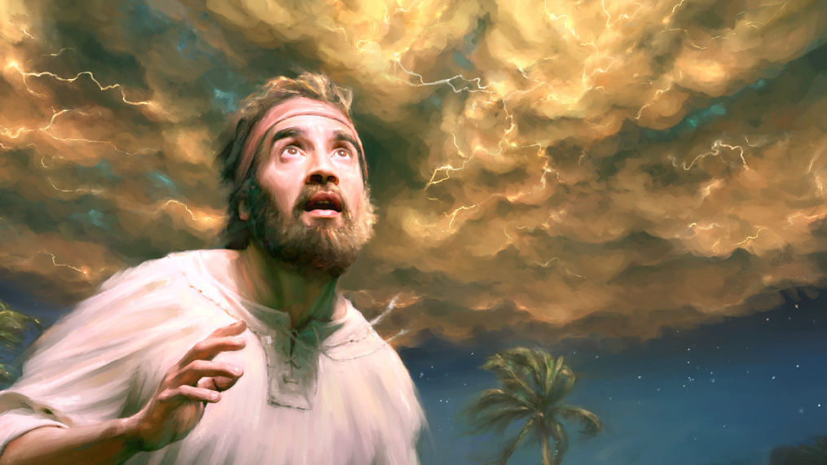
愿顺服！付代价！
Be obedient! Comes with a price!
Rev. Steven Fang
房正豪牧师

Slide 2
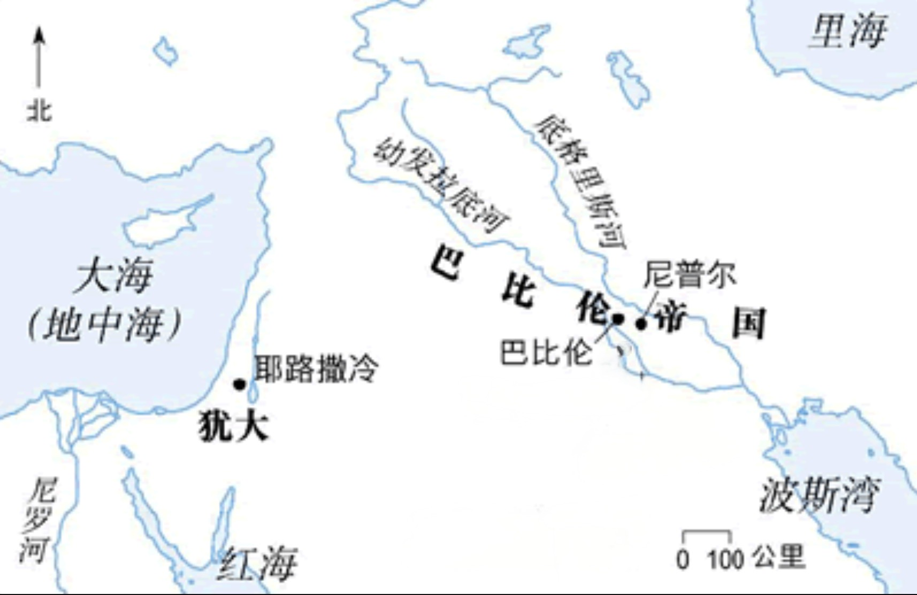
迦巴鲁河

Slide 3
天开了，看见神的荣耀！
Heavens opened
To see God's glory

Slide 4
愿顺服！付代价！
Be obedient! Comes with a price!

Slide 5
以西結書 Ezekiel 2:1-2
1 他对我说，人子啊，你站起来，我要和你说话。
1 He said to me, “Son of man, stand up on your feet and I will speak to you.”
2 他对我说话的时候，灵就进入我里面，使我站起来，我便听见那位对我说话的声音。
2 As he spoke, the Spirit came into me and raised me to my feet, and I heard him speaking to me.

Slide 6
以西結書 Ezekiel 2:3-5
3 他对我说，人子啊，我差你往悖逆的国民以色列人那里去。他们是悖逆我的，他们和他们的列祖违背我，直到今日。
3 He said: “Son of man, I am sending you to the Israelites, to a rebellious nation that has rebelled against me; they and their ancestors have been in revolt against me to this very day.

Slide 7
4 这众子面无羞耻，心里刚硬。我差你往他们那里去，你要对他们说，主耶和华如此说。
4 The people to whom I am sending you are obstinate and stubborn. Say to them, ‘This is what the Sovereign Lord says.’
5 他们或听，或不听，必知道在他们中间有了先知。
5 And whether they listen or fail to listen—for they are a rebellious people—they will know that a prophet has been among them.

Slide 8
以西結書 Ezekiel 2:4
4 这众子面无羞耻，心里刚硬。我差你往他们那里去，你要对他们说，主耶和华如此说。
4 The people to whom I am sending you are obstinate and stubborn. Say to them, ‘This is what the Sovereign Lord says.’

Slide 9
以西結書 Ezekiel 6-7
6 人子啊，虽有荆棘和蒺藜在你那里，你又住在蝎子中间，总不要怕他们，也不要怕他们的话。他们虽是悖逆之家，还不要怕他们的话，也不要因他们的脸色惊惶。
6 And you, son of man, do not be afraid of them or their words. Do not be afraid, though briers and thorns are all around you and you live among scorpions. Do not be afraid of what they say or be terrified by them, though they are a rebellious people.

Slide 10
7 他们或听，或不听，你只管将我的话告诉他们。他们是极其悖逆的。
7 You must speak my words to them, whether they listen or fail to listen, for they are rebellious.

Slide 11
以西結書 Ezekiel 6-7
4 你们要顺从耶和华你们的神，敬畏他，谨守他的诫命，听从他的话，事奉他，专靠他。
4 The people to whom I am sending you are obstinate and stubborn. Say to them, ‘This is what the Sovereign Lord says.’

Slide 12
申命記 Deuteronomy 13:4
4 你们要顺从耶和华你们的神，敬畏他，谨守他的诫命，听从他的话，事奉他，专靠他。
4 It is the Lord your God you must follow, and him you must revere. Keep his commands and obey him; serve him and hold fast to him.

Slide 13
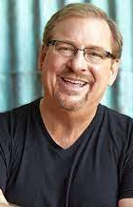
华理克牧师

Slide 14
不只一人顺服，要全体顺服，
来成就主的旨意。 Not just one person submits,
but everyone submits,
to accomplish the Lord's will.

Slide 15
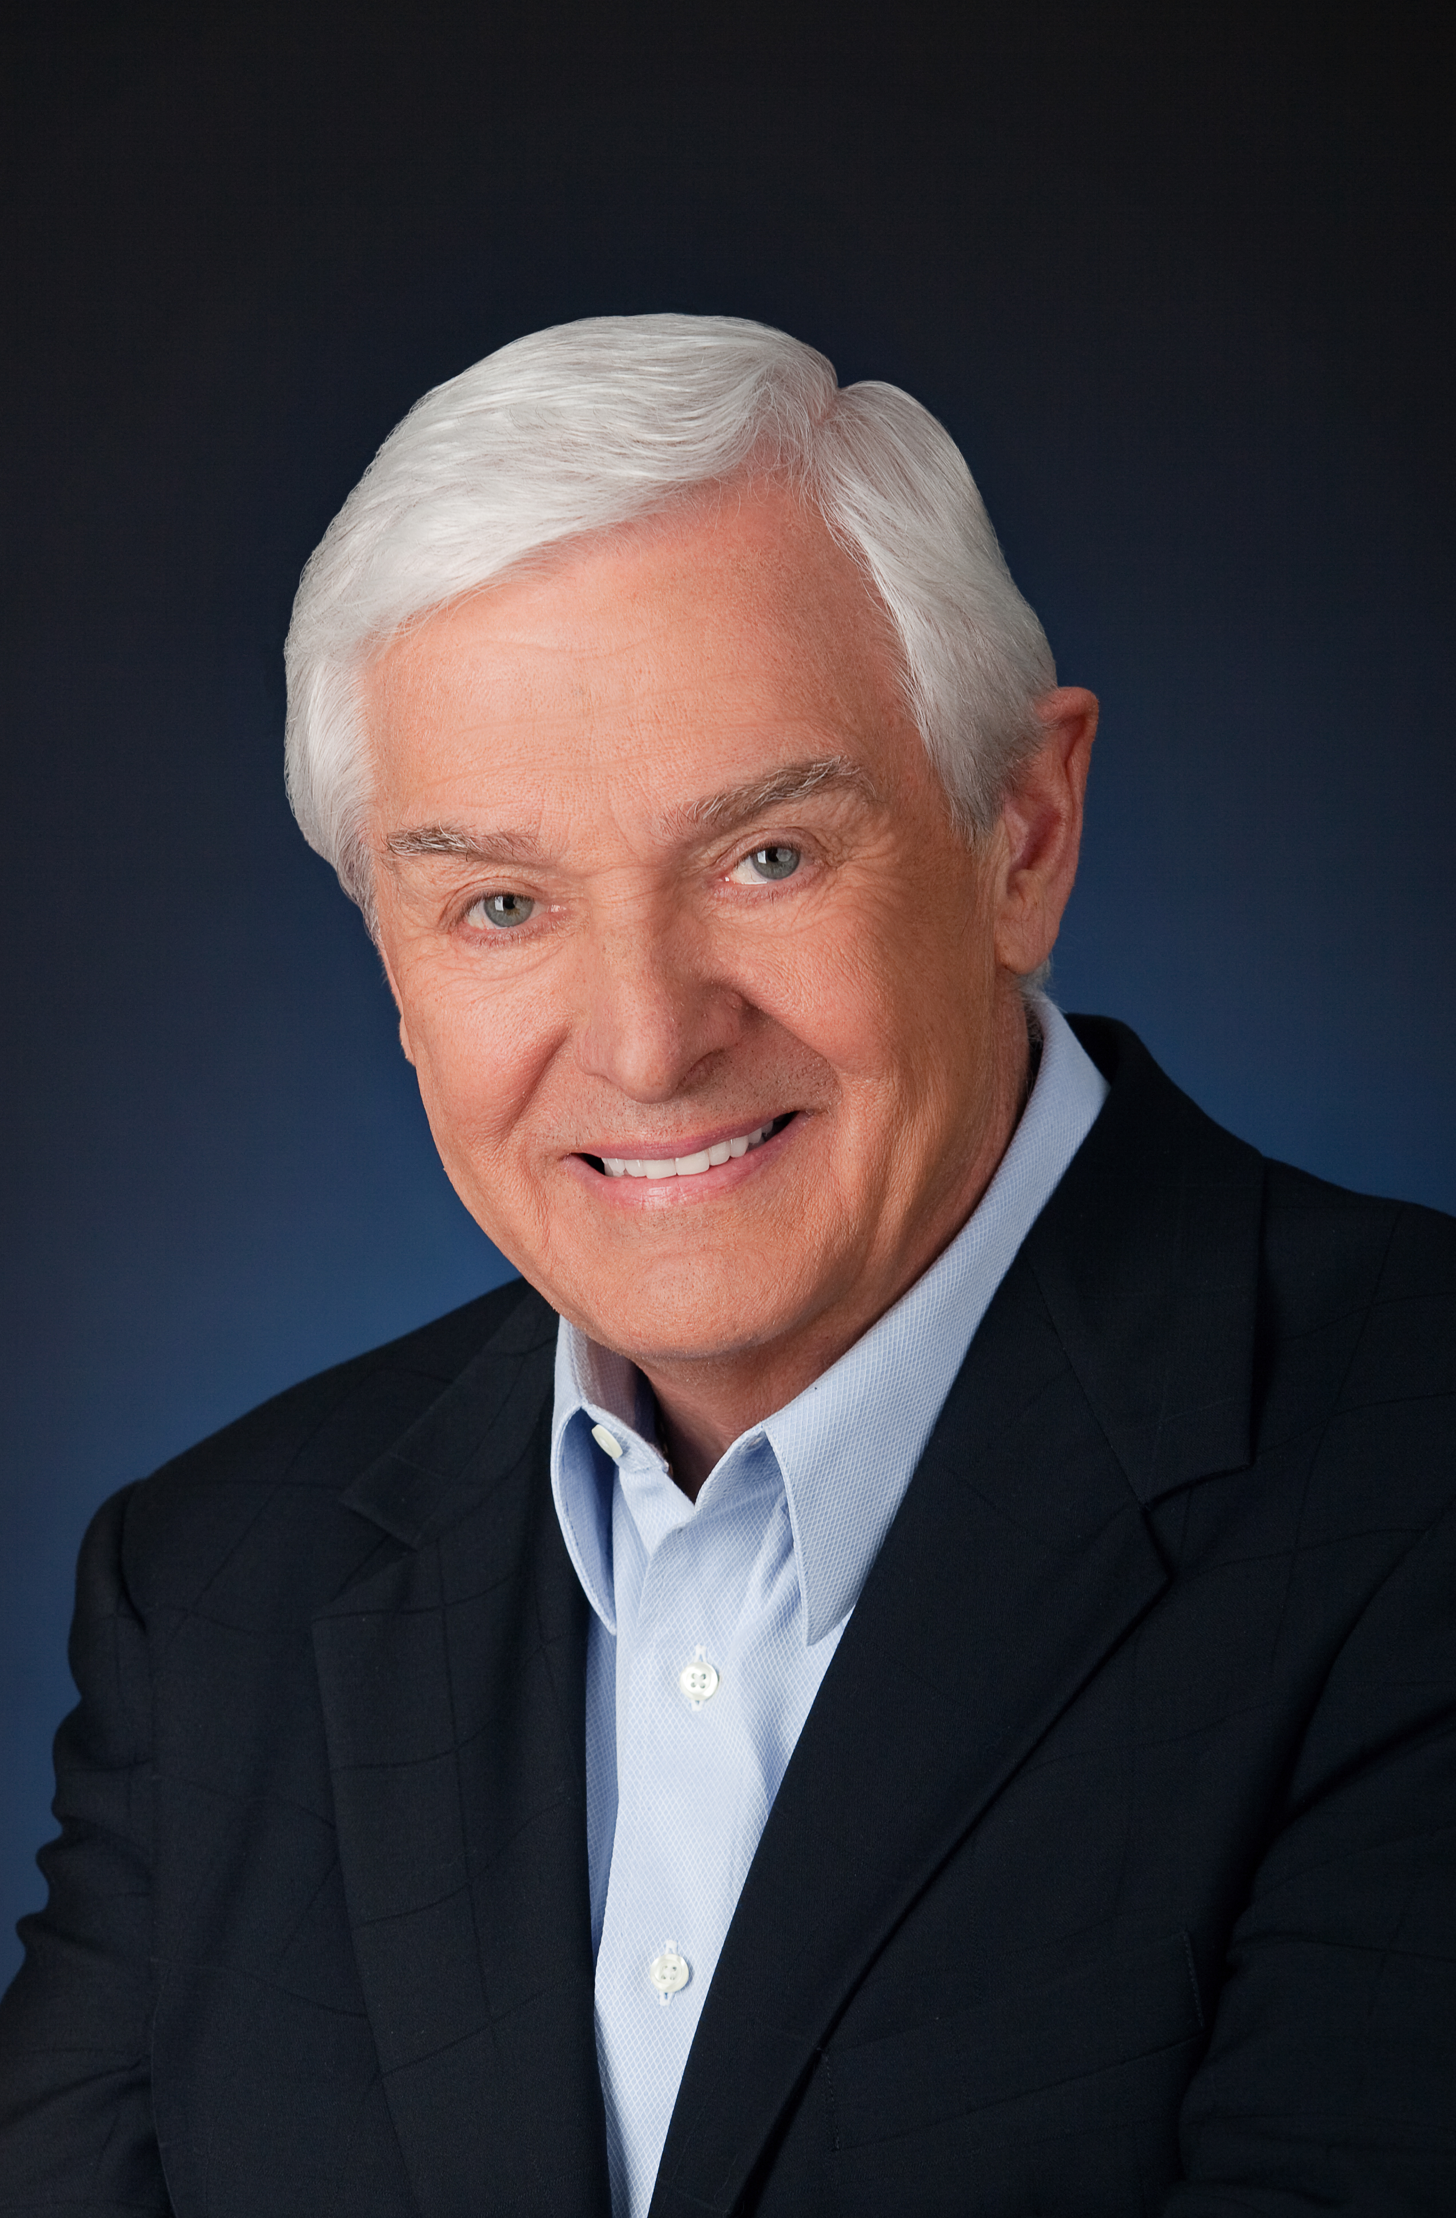
世界的尽头
大卫耶利米

Slide 16
基督精兵需要深度思考！
Soldiers of Christ need deep thinking!

Slide 17
知己知彼「撒但」
百战百胜！
Know yourself and the enemy "Satan"
Win a hundred battles!

Slide 18
真理上装备 生命上装备
Equip the truth
Life equipment

Slide 19
以西結書 Ezekiel 2:8-10
8 人子啊，要听我对你所说的话，不要悖逆像那悖逆之家，你要开口吃我所赐给你的。
8 But you, son of man, listen to what I say to you. Do not rebel like that rebellious people; open your mouth and eat what I give you.”
9 我观看，见有一只手向我伸出来，手中有一书卷。
9 Then I looked, and I saw a hand stretched out to me. In it was a scroll,

Slide 20
10 他将书卷在我面前展开，内外都写着字，其上所写的有哀号，叹息，悲痛的话。
10 which he unrolled before me. On both sides of it were written words of lament and mourning and woe.

Slide 21
以西結書 Ezekiel 3:1-3
1 他对我说，人子啊，要吃你所得的，要吃这书卷，好去对以色列家讲说。
1 And he said to me, “Son of man, eat what is before you, eat this scroll; then go and speak to the people of Israel.”
2 于是我开口，他就使我吃这书卷，
2 So I opened my mouth, and he gave me the scroll to eat.

Slide 22
3 又对我说，人子啊，要吃我所赐给你的这书卷，充满你的肚腹。我就吃了，口中觉得其甜如蜜。
3 Then he said to me, “Son of man, eat this scroll I am giving you and fill your stomach with it.” So I ate it, and it tasted as sweet as honey in my mouth.

Slide 23
愿顺服！付代价！
Be obedient! Comes with a price!

