Slide 1
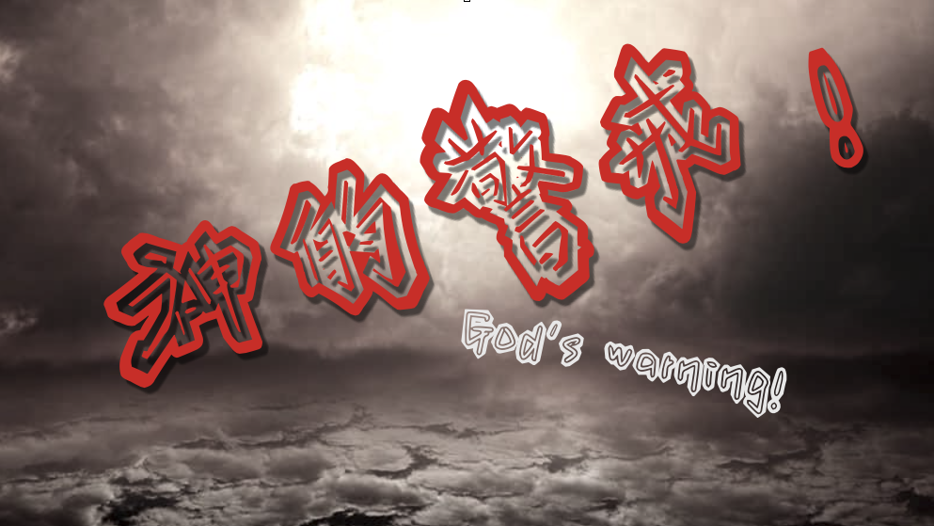
Rev. Steven Fang
房正豪牧师

Slide 2
神的属性 慈爱、公义、圣洁、信实 God's attributes
love, righteousness, holiness, faithfulness

Slide 3
诗篇Psalm 7:11
神是公义的审判者，又是天天向恶人发怒的神。
God is a righteous judge,
a God who displays his wrath every day.

Slide 4
诗篇 Psalm 11:7
因为耶和华是公义的。他喜爱公义。正直人必得见他的面。
For the Lord is righteous,
he loves justice;
the upright will see his face.

Slide 5
以西結書 Ezekiel 2:1-2
1 他对我说，人子啊，你站起来，我要和你说话。
1 He said to me, “Son of man, stand up on your feet and I will speak to you.”
2 他对我说话的时候，灵就进入我里面，使我站起来，我便听见那位对我说话的声音。
2 As he spoke, the Spirit came into me and raised me to my feet, and I heard him speaking to me.

Slide 6
神的警戒（三个层次）
God's Warning (Three Levels) 1. 好言相劝。 Good words to persuade. 2. 严重警告。SERIOUS WARNING. 3. 最后通牒。 Ultimatum.

Slide 7
尊重神的主旨
Respect for God's Purpose 使徒行传 Acts 5:3~5

Slide 8
3 彼得说，亚拿尼亚,为什么撒但充满了你的心，叫你欺哄圣灵，把田地的价银私自留下几分呢？
3 Then Peter said, “Ananias, how is it that Satan has so filled your heart that you have lied to the Holy Spirit and have kept for yourself some of the money you received for the land?

Slide 9
4 田地还没有卖，不是你自己的吗？既卖了，价银不是你作主吗？你怎么心里起这意念呢？你不是欺哄人，是欺哄神了。
4 Didn’t it belong to you before it was sold? And after it was sold, wasn’t the money at your disposal? What made you think of doing such a thing? You have not lied just to human beings but to God.”

Slide 10
5 亚拿尼亚听见这话，就仆倒断了气。听见的人都甚惧怕。
5 When Ananias heard this, he fell down and died. And great fear seized all who heard what had happened.

Slide 11
以西結書 Ezekiel 3:15~17
15 我就来到提勒亚毕，住在迦巴鲁河边被掳的人那里，到他们所住的地方，在他们中间忧忧闷闷地坐了七日。
15 I came to the exiles who lived at Tel Aviv near the Kebar River. And there, where they were living, I sat among them for seven days—deeply distressed.
16 过了七日，耶和华的话临到我说，
16 At the end of seven days the word of the Lord came to me:

Slide 12
17 人子啊，我立你作以色列家守望的人，所以你要听我口中的话，替我警戒他们。
17 “Son of man, I have made you a watchman for the people of Israel; so hear the word I speak and give them warning from me.

Slide 13
以西結書 Ezekiel 3:16~17
16 过了七日，耶和华的话临到我说，
16 At the end of seven days the word of the Lord came to me:
17 人子啊，我立你作以色列家守望的人，所以你要听我口中的话，替我警戒他们。
17 “Son of man, I have made you a watchman for the people of Israel; so hear the word I speak and give them warning from me.

Slide 14
守望人 Watchman 1. 对外：注意外敌入侵。
External: Pay attention
to the invasion of foreign enemies. 2. 对内：注意暴乱、火灾。
2. Internal: Watch out for riots and fires.

Slide 15
以西结是属灵的守望者
Ezekiel is a spiritual watchman 我们也要互相守望、警醒！
We must also watch
and be vigilant to each other!

Slide 16
以西結書 Ezekiel 3:18~19
18 我何时指着恶人说，他必要死。你若不警戒他，也不劝戒他，使他离开恶行，拯救他的性命，这恶人必死在罪孽之中。我却要向你讨他丧命的罪。
18 When I say to a wicked person, ‘You will surely die,’ and you do not warn them or speak out to dissuade them from their evil ways in order to save their life, that wicked person will die for[b] their sin, and I will hold you accountable for their blood.

Slide 17
19 倘若你警戒恶人，他仍不转离罪恶，也不离开恶行，他必死在罪孽之中，你却救自己脱离了罪。
19 But if you do warn the wicked person and they do not turn from their wickedness or from their evil ways, they will die for their sin; but you will have saved yourself.

Slide 18
偷、骗、抢、杀到处都有！ Stealing, cheating, robbing,
and killing are everywhere!

Slide 19
Honesty 诚实
If you search for tenderness
如果你在寻找温柔 It isn't hard to find
不难找到 You can have the love you need to live
你可以生活在温柔的爱中 But if you look for truthfulness
但如果你在寻找诚实 You might just as well be blind
你可能像盲人.... It always seems to be so hard to give
给予... 似乎很难

Slide 20
[副歌]
Honesty is such a lonely word
诚实是如此孤独的字 Everyone is so untrue
每个人都不真实 Honesty is hardly ever heard
诚实很久不曾听闻了 And mostly what I need from you
我希望从你身上得到的

Slide 21
I can alwys find someone to say they sympathize
我总是会遇到某些人说同情我 If I wear my heart out on my sleeve
如果我以真情表白 But I don't want some pretty face to tell me pretty lies
我不要美丽的脸，说着美丽的谎言 All I want is someone to believe
我要的是可以信任的人

Slide 22
I can find a lover 我可以找到情人 I can find a friend 我可以找到朋友 I can have security until the bitter end 我要安全直到所有悲情的结束 Anyone cn comfort me with promises again 任何人都可以用承诺来安慰我

Slide 23
[副歌]
Honesty is such a lonely word 诚实是如此孤独的字 Everyone is so untrue 每个人都不真实 Honesty is hardly ever heard 诚实很久不曾听闻了 And mostly what I need from you 我希望从你身上得到的

Slide 24
以西結書 Ezekiel 3:20~21
20 再者，义人何时离义而犯罪，我将绊脚石放在他面前，他就必死。因你没有警戒他，他必死在罪中，他素来所行的义不被记念。我却要向你讨他丧命的罪。
20 “Again, when a righteous person turns from their righteousness and does evil, and I put a stumbling block before them, they will die. Since you did not warn them, they will die for their sin. The righteous things that person did will not be remembered, and I will hold you accountable for their blood.

Slide 25
21 倘若你警戒义人，使他不犯罪，他就不犯罪。他因受警戒就必存活，你也救自己脱离了罪。
21 But if you do warn the righteous person not to sin and they do not sin, they will surely live because they took warning, and you will have saved yourself.”

Slide 26
傳道書 Ecclesiastes 12:13
13 这些事都已听见了。总意就是敬畏神，
谨守他的诫命，这是人所当尽的本分。
13 Now all has been heard;
here is the conclusion of the matter:
Fear God and keep his commandments,
for this is the duty of all mankind.

