Slide 1
圣灵降临在一切
“听道的人身上”！
The Holy Spirit Rested upon
Those “ who Listen to His Word ” !
房正豪牧師
Pastor Fang

Slide 2
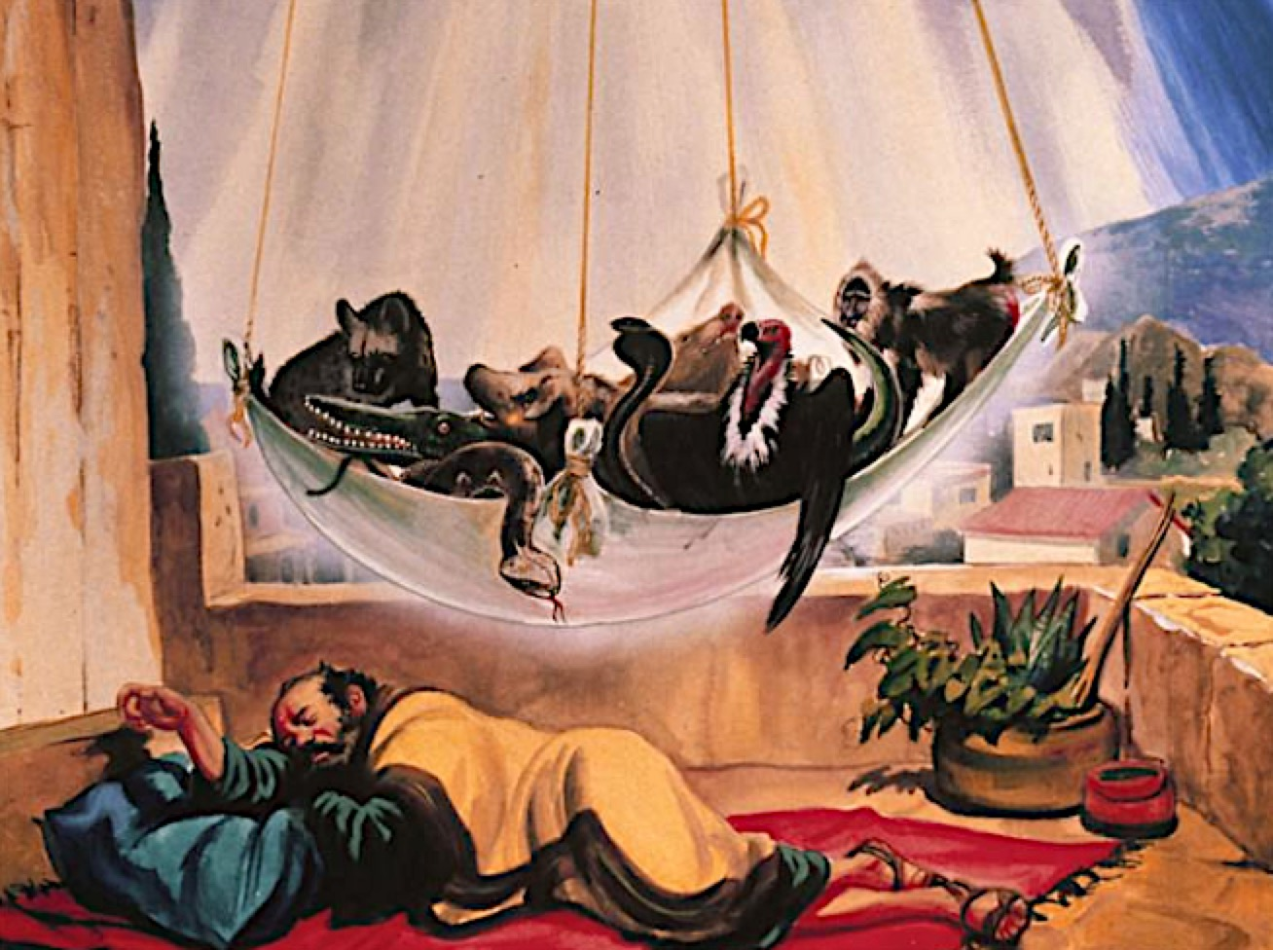

Slide 3
使徒行传 10: 44 - 45
44 彼得还说这话的时候，
圣灵降在一切听道的人身上。
45 那些奉割礼、和彼得同来的信徒，见圣灵的恩赐也浇在外邦人身上，就都稀奇，

Slide 4
Acts 10: 44 - 45
44 While Peter was still speaking these words, the Holy Spirit came on all who heard the message.
45 The circumcised believers who had come with Peter were astonished that the gift of the Holy Spirit had been poured out even on Gentiles.

Slide 5
要有两个条件 On two conditions
1.你要有饥渴慕义的心态！
You must Hunger and Thirst for Righteousness!
2.听道时你是非常专心！
You must be very Focus when Listening to His Teaching!

Slide 6
牧师就像一个邮差一样
按时送“上帝的信给你”！
The Pastor is like a Mail-man who Delivers God’s Message to You !

Slide 7
如果你听道觉得扎心，
因为是圣灵的工作。
If You feel Convicted when Listening to the Message, it is the Work of the Holy Spirit.

Slide 8
信仰分两个层次
1.我的层次（我的需要）
2.神的层次（神要我做什么？）
Two Levels of Faith:
1. Personal Level (my needs)
2.God’s Level
(what does God want me to do ?)

Slide 9
眼界要被神 “打开”
要从永恒看短暂的今生
Allow God to Widen Your Vision.
To see short life from, eternity .

Slide 10
撒迦利亚书 4: 6 b
不是倚靠势力，不是倚靠才能，乃是倚靠我的灵方能成事。Zechariah 4: 6
Not by might nor by power,
but by my Spirit,

Slide 11
圣灵两大工作
1圣灵引导人 “明白真理” ！
2圣灵帮助人 “活出基督” ！
The Two Main Duties of the Holy Spirit
1. It Guides Us in Understanding the Truth !
2. It Assists Us in Living a Christ-like Life !

