Slide 1
事奉和禱告的意義
The Meaning of
Service and Prayer
房正豪牧師

Slide 2
禱告三要點
Three points of prayer
1.禱告要謙卑自己
Pray to humble yourself
2.屬靈戰爭要靠神
Rely on God for spiritual warfare
3.我們能經歷神的作為
Experience the work of God

Slide 3
歌羅西書 Psalm 4:2-6
2 你們要恆切禱告，在此警醒、感恩。
3 也要為我們禱告，求神給我們開傳道的門，能以講基督的奧祕——我為此被捆鎖——
4 叫我按著所該說的話將這奧祕發明出來。

Slide 4
歌羅西書 Psalm 4:2-6
5 你們要愛惜光陰，用智慧與外人交往。
6 你們的言語要常常帶著和氣，好像用鹽調和，就可知道該怎樣回答各人。

Slide 5
歌羅西書 Psalm 4:2-6
2 Devote yourselves to prayer, being watchful and thankful.
3 And pray for us, too, that God may open a door for our message, so that we may proclaim the mystery of Christ, for which I am in chains.
4 Pray that I may proclaim it clearly, as I should.
.

Slide 6
歌羅西書 Psalm 4:2-6
5 Be wise in the way you act toward outsiders; make the most of every opportunity.
6 Let your conversation be always full of grace, seasoned with salt, so that you may know how to answer everyone.

Slide 7
禱告就像屬靈的發電廠
能發出巨大的能量！
Prayer is like a spiritual power plant that can make a huge amount of energy!

Slide 9
歌羅西書 Psalm 3:23-24
23 無論做什麼，都要從心裡做，像是給主做的，不是給人做的。
24 因你們知道，從主那裡必得著基業為賞賜，你們所侍奉的乃是主基督。

Slide 10
歌羅西書 Psalm 3:23-24
23 Whatever you do, work at it with all your heart, as working for the Lord, not for human masters,
24 since you know that you will receive an inheritance from the Lord as a reward. It is the Lord Christ you are serving.

Slide 11
羅馬書 Romans 12:11
殷勤不可懶惰；
要心裡火熱，常常服侍主。
Never be lacking in zeal,
but keep your spiritual fervor, serving the Lord.

Slide 12
服事神三要點
Three points of serving God
1.有忠心 Be faithful
2.有見識 Be knowledgeable
3.有目標 Be goal-oriented

Slide 13
明白我們一起的真理
Understand the truth of being together
1.我們一起學習
We study together
2.我們一起成長
We grow together
3.我們一起服事主
We serve the Lord together

Slide 14
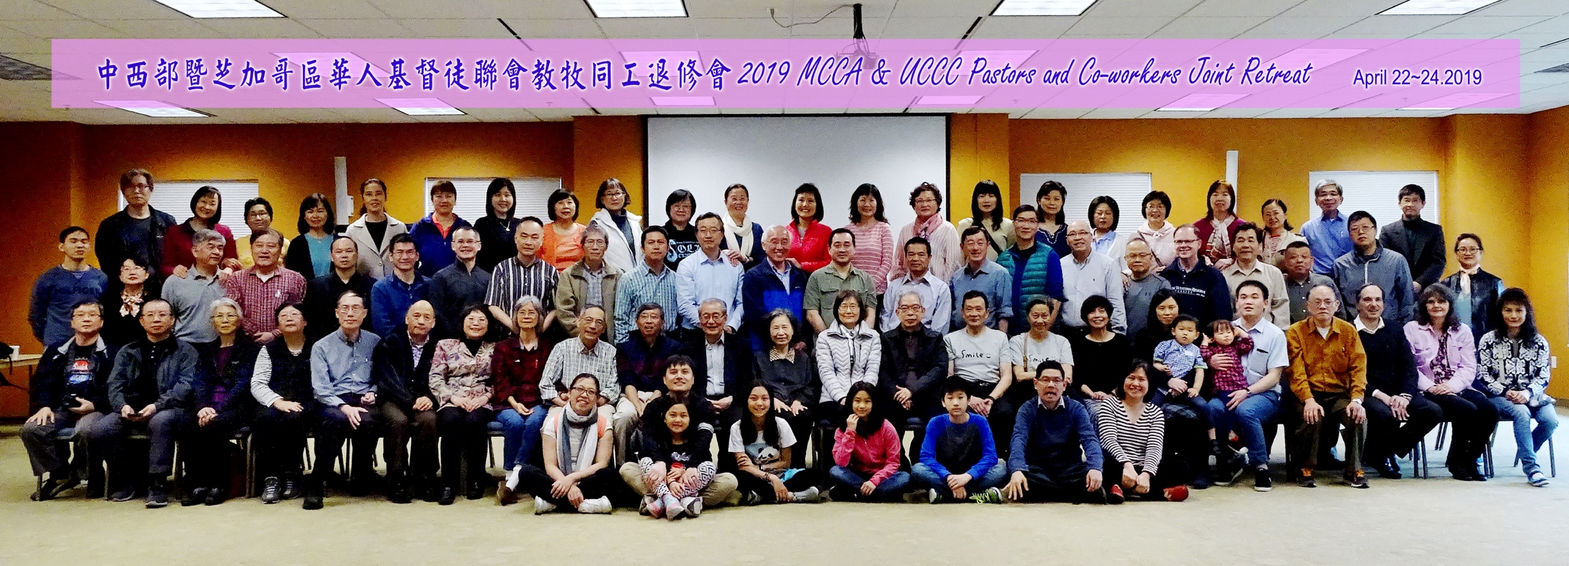
2019中西部＆芝加哥聯會教牧同工退修會
MCCA & UCCC Pastors and Co-workers Joint Retreat

Slide 15
腓立比書 Philippians 1:5
因為從頭一天直到如今，
你們是同心合意地興旺福音。because of your partnership
in the gospel from the first day until now,

Slide 16
教會兩隻手要一起做
The church has to do both hands together.
一手培靈（靈命進深）
One hand spiritual revival
(for spiritual depth)
一手傳福音（小孩、大人）
The other hand Gospel preach
(for children and adults)

Slide 17
培靈裝備三重點
Thee points for spiritual revival
1.在真理上（在聖經中）
In truth (Biblically)
2.在生命上（效法基督）
In life (Follow Jesus)
3.在生活上（多操練求進步）
Life of Christ (Sunday school)

Slide 18
（TEE）Theological Education by Extension

Slide 19
歌羅西書 Colossians 4:2-3
2 你們要恆切禱告，在此警醒、感恩。
3 也要為我們禱告，求神給我們開傳道的門，能以講基督的奧祕——我為此被捆鎖——
2 Devote yourselves to prayer, being watchful and thankful.
3 And pray for us, too, that God may open a door for our message, so that we may proclaim the mystery of Christ, for which I am in chains.

Slide 20
服事神三要點
Three points of serving God
1.有忠心 Be faithful
2.有見識 Be knowledgeable
3.有目標 Be goal-oriented

