Slide 1
How to deal with being neither cold nor hot?
房正豪牧師

Slide 2
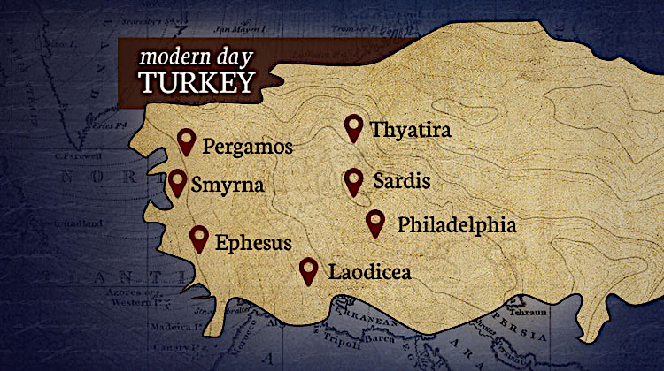
土 耳 其
推雅推喇
別迦摩
士每拿
撒狄
拉菲鐵非
以弗所
老底嘉

Slide 3
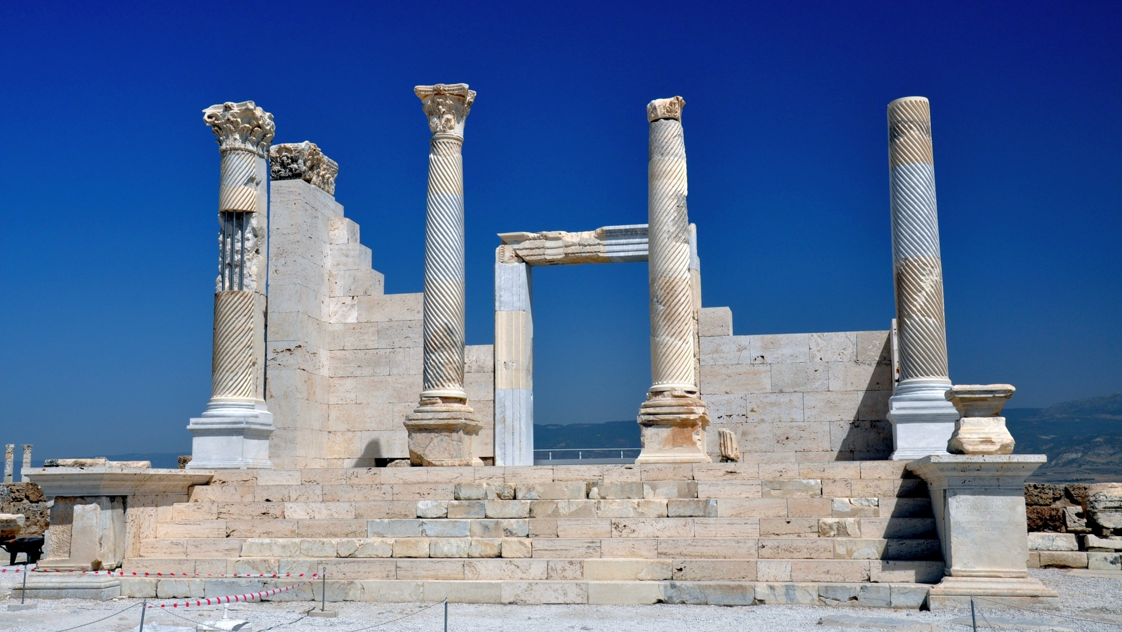
老底嘉（Laodicea）

Slide 4
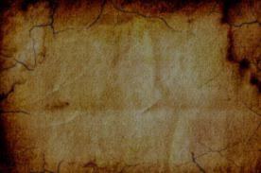
老底嘉城市特点
The characteristics of Laodicea
银行、纺织、医学发达
Banking, textile industry, and medicine were developed.
老底嘉人非常富有
The Laodiceans were very rich.

Slide 5
启示录 Revelation 3:16
你既如温水，也不冷也不热，所以我必从我口中把你吐出去。
Since you are lukewarm and neither hot nor cold, I am going to spit you out of my mouth.

Slide 6
启示录 3:14-17
14 “你要写信给老底嘉教会的使者说：‘那为阿门的，为诚信真实见证的，在神创造万物之上为元首的说：
15 我知道你的行为，你也不冷也不热。我巴不得你或冷或热！

Slide 7
16 你既如温水，也不冷也不热，所以我必从我口中把你吐出去。
17 ‘你说“我是富足，已经发了财，一样都不缺”，却不知道你是那困苦、可怜、贫穷、瞎眼、赤身的。

Slide 8
Revelation 3:14-17
14 “To the messenger of the church in Laodicea, write:
‘The Amen, the witness who is faithful and true, the originator of God’s creation, says this:
15 ‘I know your actions, that you are neither cold nor hot. I wish you were cold or hot.

Slide 9
16 Since you are lukewarm and neither hot nor cold, I am going to spit you out of my mouth.
17 You say, “I am rich. I have become wealthy. I don’t need anything.” Yet you don’t realize that you are miserable, pitiful, poor, blind, and naked.

Slide 10
启示录 3:18
我劝你向我买火炼的金子，叫你富足；又买白衣穿上，叫你赤身的羞耻不露出来；又买眼药擦你的眼睛，使你能看见。

Slide 11
Revelation 3:18
Therefore, I advise you to buy from me gold purified in fire so you may be rich, white clothes to wear so your shameful nakedness won’t show, and ointment to put on your eyes so you may see.

Slide 12
买金子、买白衣、买眼药。Buy gold. Buy white clothes. Buy salve.

Slide 13
马太福音 6:22-23
22 “眼睛就是身上的灯。你的眼睛若了亮，全身就光明；
23 你的眼睛若昏花，全身就黑暗。你里头的光若黑暗了，那黑暗是何等大呢！

Slide 14
Matthew 6:22-23
22 “The eye is the lamp of the body. So if your eye is healthy, your whole body will be full of light.

Slide 15
23 But if your eye is evil, your whole body will be full of darkness. Therefore, if the light within you has turned into darkness, how great is that darkness!”

Slide 16
先要察觉 “目前自己的光景” ？ Start by becoming aware of "where you are".

Slide 17
自己要决心改变！ Be determined to change yourself!

Slide 18
启示录 3:18
我劝你向我买火炼的金子，叫你富足；又买白衣穿上，叫你赤身的羞耻不露出来；又买眼药擦你的眼睛，使你能看见。

Slide 19
Revelation 3:18
Therefore, I advise you to buy from me gold purified in fire so you may be rich, white clothes to wear so your shameful nakedness won’t show, and ointment to put on your eyes so you may see.

Slide 20
金子表示 “信心” 在信上富足。Gold means being rich in faith.

Slide 21
约翰一书 1 John 5:4
因为凡从神生的，就胜过世界。使我们胜了世界的，就是我们的信心。because everyone who is born from God has overcome the world. Our faith is the victory that overcomes the world.

Slide 22
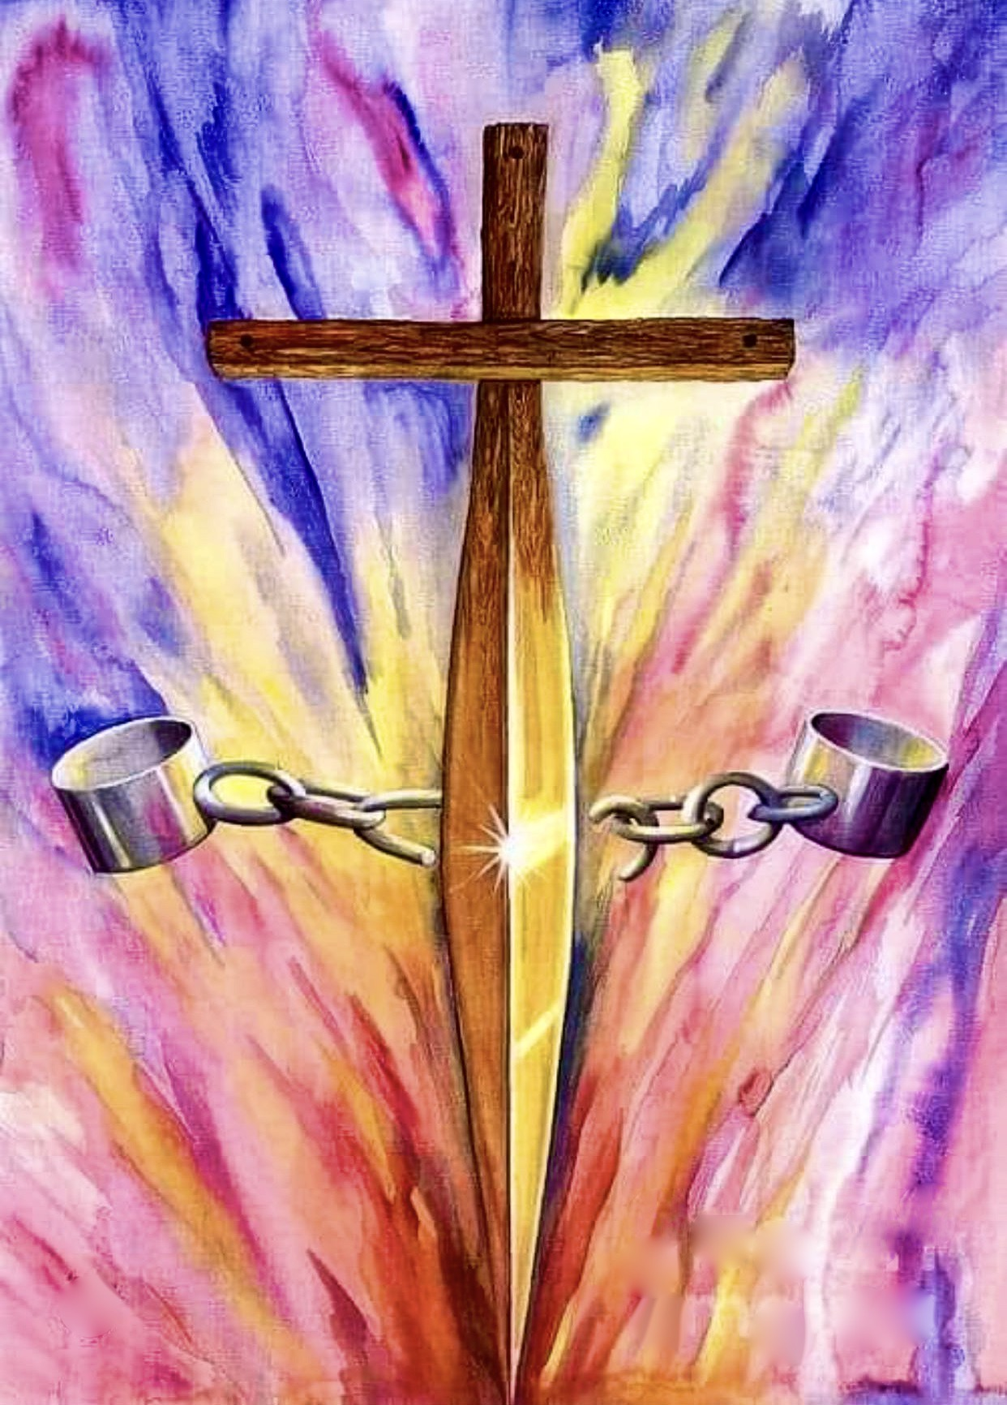

Slide 23
向主买白衣穿上
Buy from the Lord white clothes to wear.
白衣 “公义的袍子”
White clothes represent "the robe of righteousness".

Slide 24
罪人变成义人
The sinner is made righteous.
因信称义
Be justified by faith.

Slide 25
启示录 3:19-22
19 凡我所疼爱的，我就责备管教他，所以你要发热心，也要悔改。
20 看哪，我站在门外叩门；若有听见我声音就开门的，我要进到他那里去，我与他、他与我一同坐席。

Slide 26
21 得胜的，我要赐他在我宝座上与我同坐，就如我得了胜，在我父的宝座上与他同坐一般。
22 圣灵向众教会所说的话，凡有耳的，就应当听！’”

Slide 27
Revelation 3:19-22
19 I correct and discipline those whom I love, so be serious and repent!
20 Look! I am standing at the door and knocking. If anyone listens to my voice and opens the door, I will come in to him and eat with him, and he will eat with me.

Slide 28
21 I will give a place to sit with me on my throne to the one who overcomes, just as I have overcome and have sat down with my Father on his throne.
22 ‘Let everyone[n] listen to what the Spirit says to the churches.’”

Slide 29
启示录 Revelation 3:19
凡我所疼爱的，我就责备管教他，所以你要发热心，也要悔改。
I correct and discipline those whom I love, so be serious and repent!

Slide 30
启示录 Revelation 3:20
看哪，我站在门外叩门；若有听见我声音就开门的，我要进到他那里去，我与他、他与我一同坐席。
Look! I am standing at the door and knocking. If anyone listens to my voice and opens the door, I will come in to him and eat with him, and he will eat with me.

Slide 31
教会的主权本来就是主的！
The sovereignty of the church belongs to the Lord!

Slide 32
坐席 “表明亲密的交流”
Eating at the Lord's table indicates "intimate communication".

Slide 33

How to deal with being neither cold nor hot?
1.向主买眼药！打开属灵的眼睛。
Buy from the Lord salve! To open the spiritual eyes.
2.向主买金子！要在信心上富足。
Buy from the Lord gold! To be rich in faith.
3.向主买白袍！行公义好怜悯，与神同行。
Buy from the Lord white clothes! To act justly and to love mercy and to walk with God.

