Slide 1
房正豪牧师

Slide 2
三个时候 Three Moments
1: 我们还软弱的时候。V6
When was the time we were still weak.
2: 我们还作罪人的时候。V8
When was the time we were still the sinners.
3: 我们作仇敌的时候。V 10
When was the time we were still the enemies.

Slide 3
神给了我们五大保证。
God gives us five major guarantees.
（一）神的大爱永不改变！
1. God's almighty love never changes!

Slide 4
罗马书 Romans 5:7~8
7 为义人死是少有的，为仁人死或者有敢做的；
8 唯有基督在我们还做罪人的时候为我们死，神的爱就在此向我们显明了。

Slide 5
罗马书 Romans 5:7~8
7 For it is rare for anyone to die for a righteous person, though somebody might be brave enough to die for a good person.

Slide 6
8 But God demonstrates his love for us by the fact that the Messiah died for us while we were still sinners.

Slide 7
人原有的情况
The original conditions of human beings
1. 软弱的人: 无心也无力，有心无力。
The weak people who do not have the desire, nor the strength, or even though they have the desire, but no strength.

Slide 8
2. 罪人: 不敬畏神，骄傲自大。
The sinners, who do not worship nor respect God, they are arrogant.
3. 仇敌: 有意的无意的与神为敌。
The enemies, who intentionally or unintentionally are the enemies of God.

Slide 9
（二）神给的平安无人能夺！
No one can take away the peace blessed by God.

Slide 10
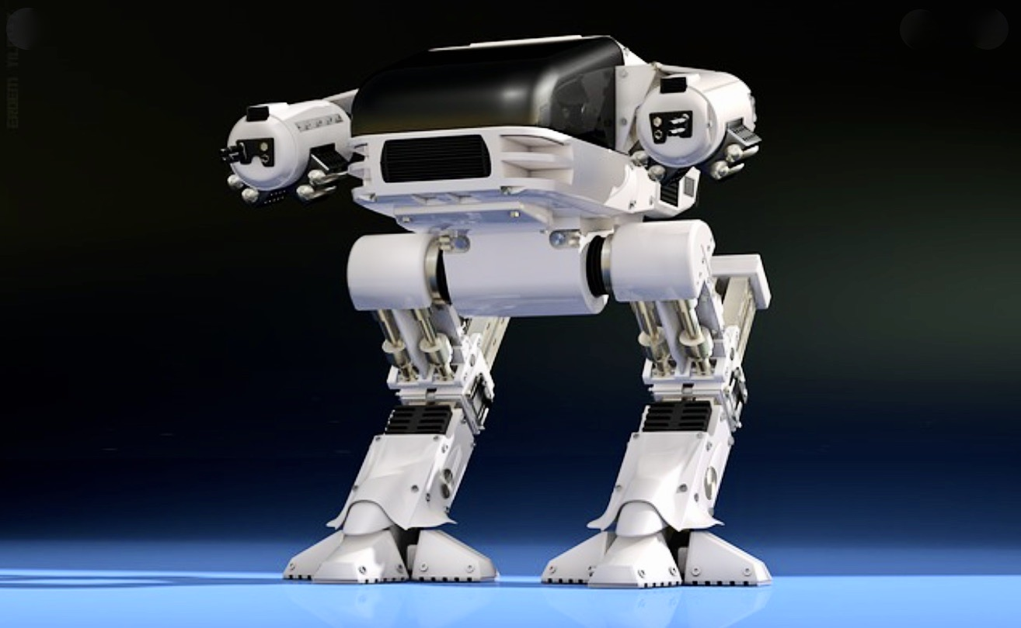

Slide 11
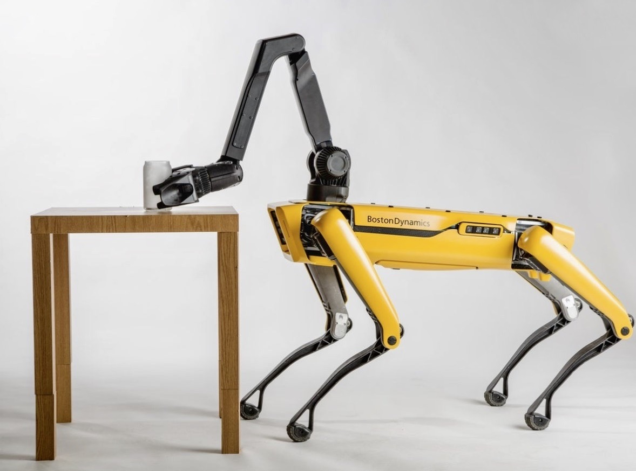

Slide 12
约翰福音 John 14:27
我留下平安给你们，我将我的平安赐给你们。我所赐的不像世人所赐的，你们心里不要忧愁，也不要胆怯。。
I’m leaving you at peace. I’m giving you my own peace. I’m not giving it to you as the world gives. So don’t let your hearts be troubled, and don’t be afraid.

Slide 13
（三）神给的智慧能得胜仇敌！
The wisdom blessed by God can win over the enemy.

Slide 14
三种敌人Three Enemies.
1. 撒旦魔鬼 Satan, Devil
2. 世界的诱惑 The temptation from the world
3. 老我的膨胀Self inflation and arrogant.

Slide 15
箴言 Proverbs 8:32~33
32 “众子啊，现在要听从我，
因为谨守我道的便为有福。
33 要听教训，就得智慧，不可弃绝。
32 “So listen to me, children!
Blessed are those who obey me.
33 Listen to instruction and be wise.
Don’t ignore it.

Slide 16
（四）神就是我的力量，
也是我的喜乐！
God is my strength, God is my joy.

Slide 17
诗篇 Psalm 28:7
7 耶和华是我的力量，是我的盾牌，我心里倚靠他，就得帮助。所以我心中欢乐，我必用诗歌颂赞他。
7 The Lord is my strength and my shield; my heart trusts in him, and I received help. My heart rejoices, and I give thanks to him with my song.

Slide 18
撒迦利亚书 Zechariah 4:6b
不是倚靠势力，不是倚靠才能，乃是倚靠我的灵方能成事。‘Not by valor nor by strength, but only by my Spirit,’ says the Lord of the Heavenly Armies.

Slide 19
（五）第五个保证就是神的同在！
The fifth guarantee is God is with us!

Slide 20
以神为乐五大原因。
Five reasons why God is my JOY.
1. 神的大爱永不改变。
God's Almighty love never changes.
2. 神给的平安， 无人能夺。
No one can take away the peace blessed by God.

Slide 21
3. 神给的智慧， 得胜仇敌。
The wisdom from God can win over the enemy.
4. 神给的力量， 超越环境。
The strength from God is way beyond the environment.

Slide 22
5. 神的同在，表明他的看顾和保守。
God is with us, it shows that God is looking after and protecting us.

