Slide 1
房正豪牧师
Rev. Steven Fang

Slide 2
以西结书 Ezekiel 47：1~5 1 他带我回到殿门，见殿的门槛下有水往东流出）。这水从槛下，由殿的右边，在祭坛的南边往下流
1 The man brought me back to the entrance to the temple, and I saw water coming out from under the threshold of the temple toward the. The water was coming down from under the south side of the temple, south of the altar.

Slide 3
2 他带我出北门，又领我从外边转到朝东的外门，见水从右边流出。
2 He then brought me out through the north gate and led me around the outside to the outer gate facing east, and the water was trickling from the south side.
3 他手拿准绳往东出去的时候，量了一千肘，使我趟过水，水到踝子骨。
3 As the man went eastward with a measuring line in his hand, he measured off a thousand cubits and then led me through water that was ankle-deep.

Slide 4
4 他又量了一千肘，使我趟过水，水就到膝。再量了一千肘，使我趟过水，水便到腰。
4 He measured off another thousand cubits and led me through water that was knee-deep. He measured off another thousand and led me through water that was up to the waist.
5 又量了一千肘，水便成了河，使我不能趟过。因为水势涨起，成为可洑的水，不可趟的河。
5 He measured off another thousand, but now it was a river that I could not cross, because the water had risen and was deep enough to swim in—a river that no one could cross.

Slide 5
以西结书 Ezekiel 47：1 1 他带我回到殿门，见殿的门槛下有水往东流出）。这水从槛下，由殿的右边，在祭坛的南边往下流
1 The man brought me back to the entrance to the temple, and I saw water coming out from under the threshold of the temple toward the. The water was coming down from under the south side of the temple, south of the altar.

Slide 6
以赛亚书 Isaiah 12:3
所以你们必从救恩的泉源欢然取水。
With joy you will draw water
from the wells of salvation.

Slide 7
约翰福音 John 7:38-39 38 信我的人，就如经上所说，从他腹中要流出活水的江河来。
38 Whoever believes in me, as Scripture has said, rivers of living water will flow from within them.”
39 耶稣这话是指着信他之人，要受圣灵说的，那时还没有赐下圣灵来，因为耶稣尚未得着荣耀。
39 By this he meant the Spirit, whom those who believed in him were later to receive. Up to that time the Spirit had not been given, since Jesus had not yet been glorified.

Slide 8
重新建立合乎圣经的三观
Re-establish the three values from the Bible 1.合乎圣经的价值观 Biblical values. 2.合乎圣经的世界观 A Biblical Worldview. 3.合乎圣经的人生观 A biblical view of life.

Slide 9
诗篇 Psalm 1:2
惟喜爱耶和华的律法，
昼夜思想，这人便为有福
but whose delight is in the law of the Lord, and who meditates on his law day and night.

Slide 10
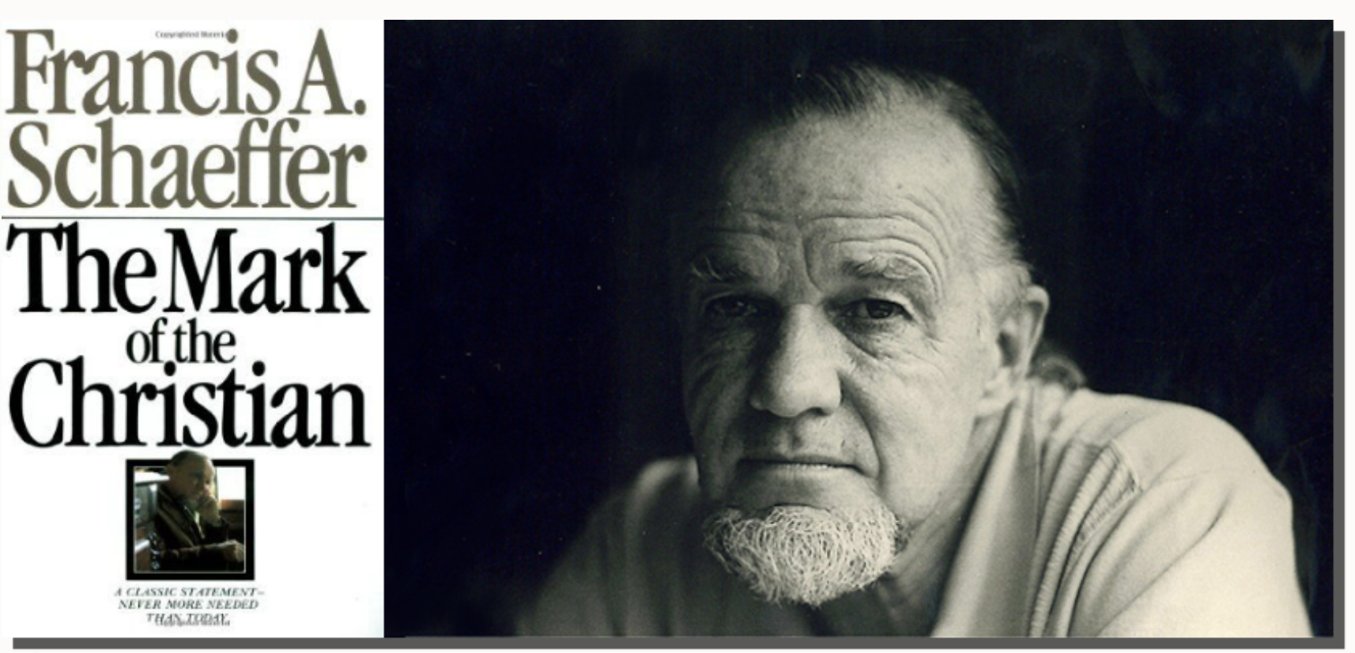
法蘭西斯·薛佛 (Francis Schaeffer)

Slide 11
前车可鉴

Slide 12
歌林多后书 2 Corinthians 10:4-5 4 我们争战的兵器，本不是属血气的，乃是在神面前有能力可以攻破坚固的营垒，
4 The weapons we fight with are not the weapons of the world. On the contrary, they have divine power to demolish strongholds.
5 将各样的计谋，各样拦阻人认识神的那些自高之事，一概攻破了，又将人所有的心意夺回，使他都顺服基督。
5 We demolish arguments and every pretension that sets itself up against the knowledge of God, and we take captive every thought to make it obedient to Christ.

Slide 13
罗马书 Romans 12:1-2 1 所以弟兄们，我以神的慈悲劝你们，将身体献上，当作活祭，是圣洁的，是神所喜悦的。你们如此事奉，乃是理所当然的。
1 Therefore, I urge you, brothers and sisters, in view of God’s mercy, to offer your bodies as a living sacrifice, holy and pleasing to God—this is your true and proper worship.

Slide 14
2 不要效法这个世界。只要心意更新而变化，叫你们察验何为神的善良，纯全可喜悦的旨意。
2 Do not conform to the pattern of this world, but be transformed by the renewing of your mind. Then you will be able to test and approve what God’s will is—his good, pleasing and perfect will.

Slide 15
彼得前书 1 Peter 5:8
务要谨守，儆醒。因为你们的仇敌魔鬼，
如同吼叫的狮子，遍地游行，寻找可吞吃的人。
Be alert and of sober mind. Your enemy the devil prowls around like a roaring lion looking for someone to devour.

Slide 16
约翰福音 John 17:13-17 13 现在我往你那里去。我还在世上说这话，是叫他们心里充满我的喜乐。
13 “I am coming to you now, but I say these things while I am still in the world, so that they may have the full measure of my joy within them.
14 我已将你的道赐给他们。世界又恨他们，因为他们不属世界，正如我不属世界一样。
14 I have given them your word and the world has hated them, for they are not of the world any more than I am of the world.

Slide 17
15 我不求你叫他们离开世界，只求你保守他们脱离那恶者。
15 My prayer is not that you take them out of the world but that you protect them from the evil one.
16 他们不属世界，正如我不属世界一样。
16 They are not of the world, even as I am not of it.
17 求你用真理使他们成圣。你的道就是真理。
17 Sanctify them by the truth; your word is truth.

Slide 18
Dancing with Dementia

Slide 19
申命记 Deuteronomy 6：4~5 4 以色列啊，你要听。耶和华我们神是独一的主。
4 Hear, O Israel: The Lord our God, the Lord is one.
5 你要尽心，尽性，尽力爱耶和华你的神。
5 Love the Lord your God with all your heart and with all your soul and with all your strength.

Slide 20
约翰福音 John 15：12
你们要彼此相爱，像我爱你们一样，
这就是我的命令。
My command is this:
Love each other as I have loved you.

