Slide 1
房正豪牧师
Rev. Steven Fang

Slide 2
但以理书 Daniel 3:1
1 尼布甲尼撒王造了一个金像，高六十肘，宽六肘，立在巴比伦省杜拉平原。
1 King Nebuchadnezzar made an image of gold, sixty cubits high and six cubits wide,[a] and set it up on the plain of Dura in the province of Babylon.

Slide 3
但以理书 Daniel 3:4~7
4 那时传令的大声呼叫说，各方，各国，各族的人哪，有令传与你们，
4 Then the herald loudly proclaimed, “Nations and peoples of every language, this is what you are commanded to do:
5 你们一听见角，笛，琵琶，琴，瑟，笙，和各样乐器的声音，就当俯伏敬拜尼布甲尼撒王所立的金像。
5 As soon as you hear the sound of the horn, flute, zither, lyre, harp, pipe and all kinds of music, you must fall down and worship the image of gold that King Nebuchadnezzar has set up.

Slide 4
但以理书 Daniel 3:4~7
6 凡不俯伏敬拜的，必立时扔在烈火的窑中。
6 Whoever does not fall down and worship will immediately be thrown into a blazing furnace.”
7 因此各方，各国，各族的人民一听见角，笛，琵琶，琴，瑟，和各样乐器的声音，就都俯伏敬拜尼布甲尼撒王所立的金像。
7 Therefore, as soon as they heard the sound of the horn, flute, zither, lyre, harp and all kinds of music, all the nations and peoples of every language fell down and worshiped the image of gold that King Nebuchadnezzar had set up.

Slide 5
但以理书 Daniel 3:8~12
8 那时，有几个迦勒底人进前来控告犹大人。
8 At this time some astrologers[b] came forward and denounced the Jews.
9 他们对尼布甲尼撒王说，愿王万岁。
9 They said to King Nebuchadnezzar, “May the king live forever!
10 王啊，你曾降旨说，凡听见角，笛，琵琶，琴，瑟，笙，和各样乐器声音的都当俯伏敬拜金像。
10 Your Majesty has issued a decree that everyone who hears the sound of the horn, flute, zither, lyre, harp, pipe and all kinds of music must fall down and worship the image of gold,

Slide 6
但以理书 Daniel 3:8~12
11 凡不俯伏敬拜的，必扔在烈火的窑中。
11 and that whoever does not fall down and worship will be thrown into a blazing furnace.
12 现在有几个犹大人，就是王所派管理巴比伦省事务的沙得拉，米煞，亚伯尼歌。王啊，这些人不理你，不事奉你的神，也不敬拜你所立的金像。
12 But there are some Jews whom you have set over the affairs of the province of Babylon—Shadrach, Meshach and Abednego—who pay no attention to you, Your Majesty. They neither serve your gods nor worship the image of gold you have set up.”

Slide 7
但以理书 Daniel 3:12
12 现在有几个犹大人，就是王所派管理巴比伦省事务的沙得拉，米煞，亚伯尼歌。王啊，这些人不理你，不事奉你的神，也不敬拜你所立的金像。
12 But there are some Jews whom you have set over the affairs of the province of Babylon—Shadrach, Meshach and Abednego—who pay no attention to you, Your Majesty. They neither serve your gods nor worship the image of gold you have set up.”

Slide 8
但以理书 Daniel 3:16~18
16 沙得拉，米煞，亚伯尼歌对王说，尼布甲尼撒啊，这件事我们不必回答你。
16 Shadrach, Meshach and Abednego replied to him, “King Nebuchadnezzar, we do not need to defend ourselves before you in this matter.
17 即便如此，我们所事奉的神能将我们从烈火的窑中救出来。王啊，他也必救我们脱离你的手。
17 If we are thrown into the blazing furnace, the God we serve is able to deliver us from it, and he will deliver us[c] from Your Majesty’s hand.

Slide 9
但以理书 Daniel 3:16~18
18 即或不然，王啊，你当知道我们决不事奉你的神，也不敬拜你所立的金像。
18 But even if he does not, we want you to know, Your Majesty, that we will not serve your gods or worship the image of gold you have set up.”

Slide 10
出埃及记 Exodus 20:1~5
1 神吩咐这一切的话说，1 And God spoke all these words:
2 我是耶和华你的神，曾将你从埃及地为奴之家领出来。
2 “I am the Lord your God, who brought you out of Egypt, out of the land of slavery.
3 除了我以外，你不可有别的神。
3 “You shall have no other gods before[a] me.

Slide 11
4 不可为自己雕刻偶像，也不可作什么形像仿佛上天，下地，和地底下，水中的百物。
4 “You shall not make for yourself an image in the form of anything in heaven above or on the earth beneath or in the waters below.
5 不可跪拜那些像，也不可事奉它，因为我耶和华你的神是忌邪的神。恨我的，我必追讨他的罪，自父及子，直到三四代，
5 You shall not bow down to them or worship them; for I, the Lord your God, am a jealous God, punishing the children for the sin of the parents to the third and fourth generation of those who hate me,

Slide 12
1900义和团事件中殉道之宣教士 A List of the Martyred Missionaries During the 1900

Slide 13
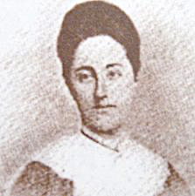
艾渥德师母 Mrs. Elizabeth G. Atwater
我没有后悔来中国，唯一遗憾的是，我只做了这么一点点。 I do not regret coming to China, but I am sorry I have done so little.

Slide 14
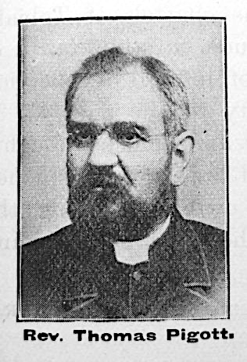
毕翰道牧师 Rev. Thomas W. Pigott
一百年后，我们会怎么样衡量，在这里所投资的生命和劳力呢？ How shall we look on the investment of our lives and labor here, even from the near standpoint of one hundred years hence?

Slide 15
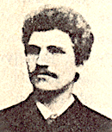
林牧师 Rev. Carl L. Lundberg
我们是为主和中国而活，也为主和中国而死。 We live and die for the Lord and China.

Slide 16
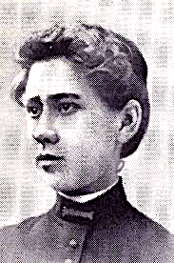
贝如意姑娘 Miss S. Rowena Bird
假如你我從此訣別，請你記住，我沒有後悔到中國來。 If you never see me again, remember I am not sorry I came to China.

Slide 17
但以理书 Daniel 3:24~27
24 那时，尼布甲尼撒王惊奇，急忙起来，对谋士说，我捆起来扔在火里的不是三个人吗？他们回答王说，王啊，是。
24 Then King Nebuchadnezzar leaped to his feet in amazement and asked his advisers, “Weren’t there three men that we tied up and threw into the fire?”
They replied, “Certainly, Your Majesty.”
25 王说，看哪，我见有四个人，并没有捆绑，在火中游行，也没有受伤。那第四个的相貌好像神子。
25 He said, “Look! I see four men walking around in the fire, unbound and unharmed, and the fourth looks like a son of the gods.”

Slide 18
26 于是，尼布甲尼撒就近烈火窑门，说，至高神的仆人沙得拉，米煞，亚伯尼歌出来，上这里来吧。沙得拉，米煞，亚伯尼歌就从火中出来了。
26 Nebuchadnezzar then approached the opening of the blazing furnace and shouted, “Shadrach, Meshach and Abednego, servants of the Most High God, come out! Come here!”
So Shadrach, Meshach and Abednego came out of the fire,

Slide 19
27 那些总督，钦差，巡抚，和王的谋士一同聚集看这三个人，见火无力伤他们的身体，头发也没有烧焦，衣裳也没有变色，并没有火燎的气味。
27 and the satraps, prefects, governors and royal advisers crowded around them. They saw that the fire had not harmed their bodies, nor was a hair of their heads singed; their robes were not scorched, and there was no smell of fire on them.

Slide 20
但以理书 Daniel 3:28~29
28 尼布甲尼撒说，沙得拉，米煞，亚伯尼歌的神是应当称颂的。他差遣使者救护倚靠他的仆人，他们不遵王命，舍去己身，在他们神以外不肯事奉敬拜别神。
28 Then Nebuchadnezzar said, “Praise be to the God of Shadrach, Meshach and Abednego, who has sent his angel and rescued his servants! They trusted in him and defied the king’s command and were willing to give up their lives rather than serve or worship any god except their own God.

Slide 21
29 现在我降旨，无论何方，何国，何族的人，谤讟沙得拉，米煞，亚伯尼歌之神的，必被凌迟，他的房屋必成粪堆，因为没有别神能这样施行拯救。
29 Therefore I decree that the people of any nation or language who say anything against the God of Shadrach, Meshach and Abednego be cut into pieces and their houses be turned into piles of rubble, for no other god can save in this way.”

Slide 22
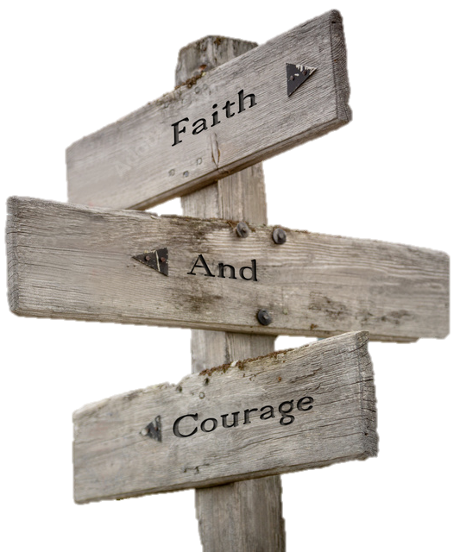
如何得胜？ 信心+勇气 How to Overcome?
Faith + Courage

