Slide 1
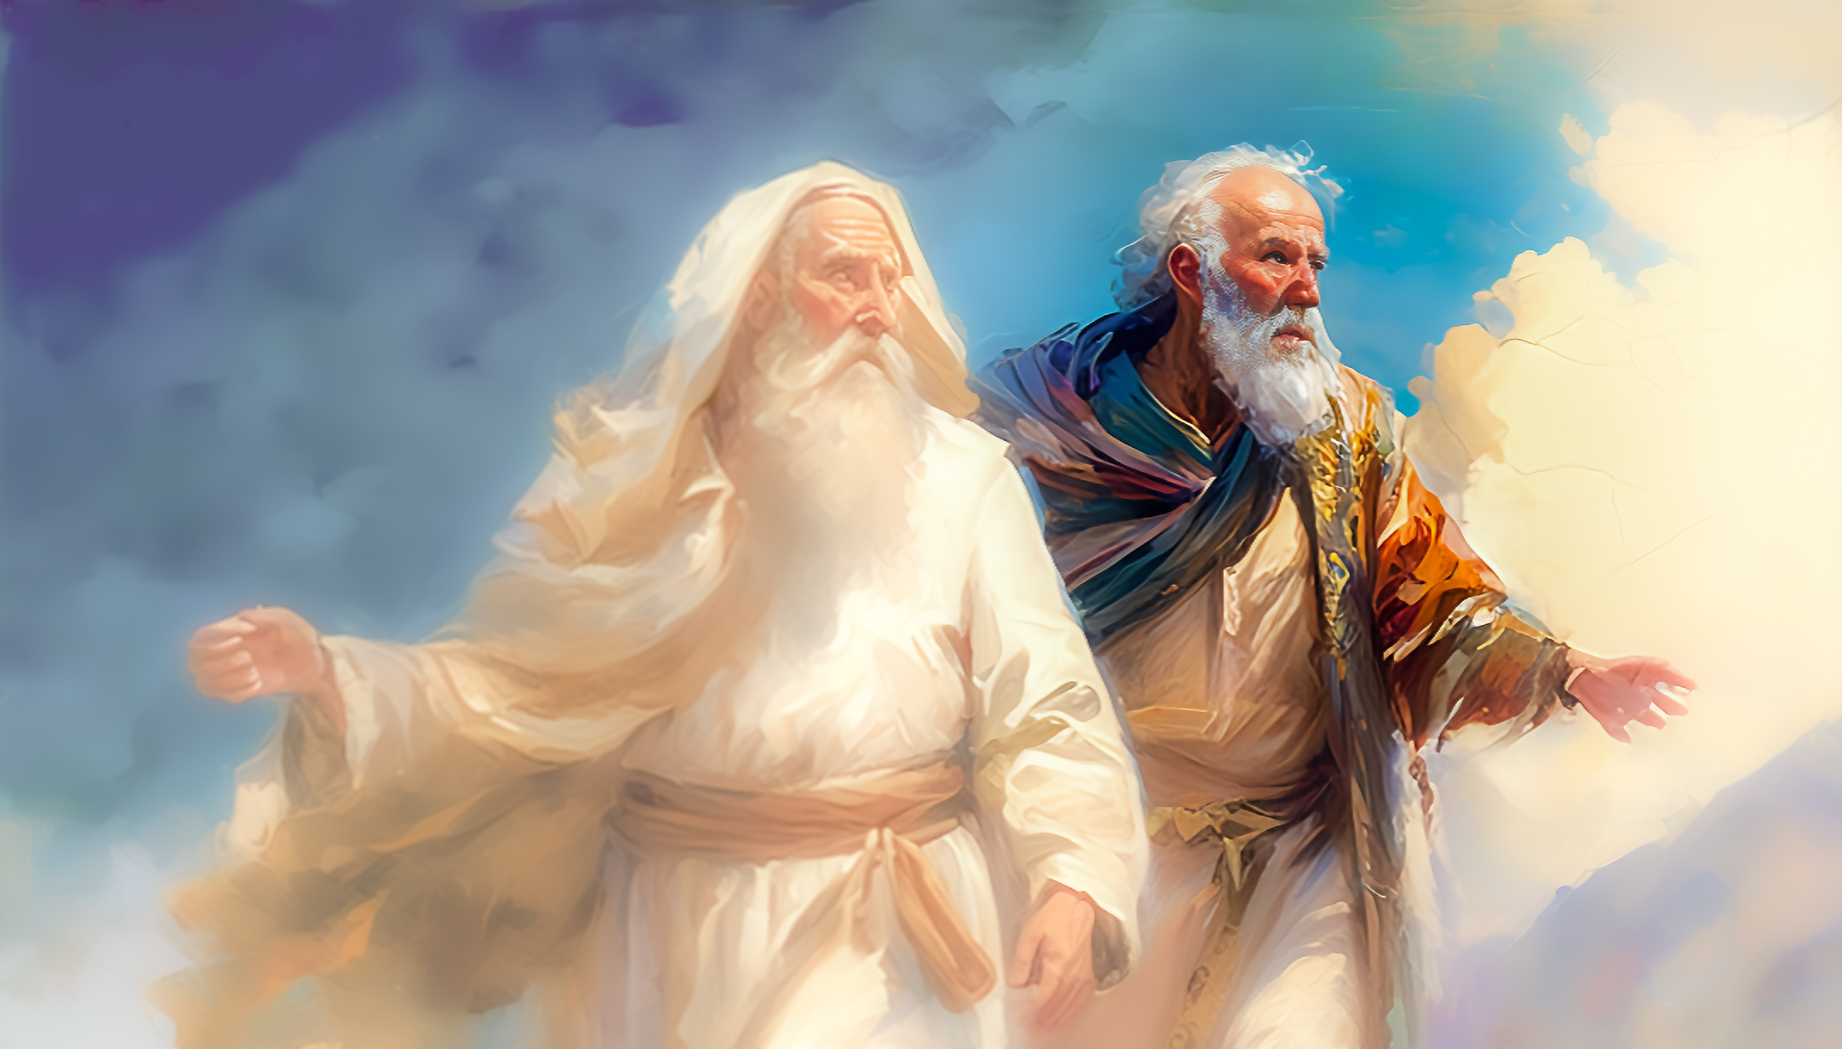
以諾與神同行
Enoch Walked with God
吳文秋牧師
Rev. Timothy Wu

Slide 2
前言 preface
(這是) 亞當的 (家譜) 後代記在下面
(This is) Adam's (genealogical) descendants are listed below
= 這是人類אָדָ֗ם 的故事
= This is the story of human אָדָ֗ם
活了 N 歲，生兒養女，又活 N 歲，就死了!
Live for N years, have sons and daughters, live for N years, and die!

Slide 3
奧古斯丁: 沒有了神， 我們都是走向自身死亡的嚮導!
AUGUSTINE: Without God, we are all guides to our own death!
海德格: SEIN ZUM TOD 人>走向死亡的存在
Heidegger: SEIN ZUM TOD man > being that goes to death
葛理翰: 人類的死亡率 = 百分之百!
Graham: Human Mortality = 100%!

Slide 4
1. 以諾在死亡籠罩的文化中與神同行
Enoch's walk with God
in a death-shrouded culture

Slide 5
（創世紀 Genesis 5:1~5） 亞當的後代記在下面。（當神造人的日子，是照著自己的樣式造的，並且造男造女。在他們被造的日子，神賜福給他們，稱他們為「人」。）
This is the written account of Adam’s family line. When God created mankind, he made them in the likeness of God. He created them male and female and blessed them. And he named them “Mankind” when they were created.

Slide 6
亞當活到 130 歲，生了一個兒子，形像樣式和自己相似，就給他起名叫塞特。亞當生塞特之後，又在世 800 年，並且生兒養女。亞當共活了930 歲就死了。
When Adam had lived 130 years, he had a son in his own likeness, in his own image; and he named him Seth. After Seth was born, Adam lived 800 years and had other sons and daughters. Altogether, Adam lived a total of 930 years, and then he died.

Slide 7
（創世紀 Genesis 2:17） ...你吃的日子必定死!
when you eat from it you will certainly die.”
（創世紀 Genesis 3:4-5）蛇對女人說: 你們不一定死! …
“You will not certainly die,” the serpent said to the woman.

Slide 8
便如神! 心中無神則目中無人，
神的形像越來越扭曲
Just like a god! If there is no god in the heart, there will be no one in the eyes,
and the image of God will become more and more distorted

Slide 9
2. 以諾與神同行三百年
Enoch walked with God
for three hundred years

Slide 10
（創世紀 Genesis 5:21-24）以諾活到六十五歲，生了瑪土撒拉。以諾生瑪土撒拉之後，與神同行三百年，並且生兒養女。以諾共活了三百六十五歲。以諾與神同行，神將他取去，他就不在世了。
When Enoch had lived 65 years, he became the father of Methuselah. After he became the father of Methuselah, Enoch walked faithfully with God 300 years and had other sons and daughters. Altogether, Enoch lived a total of 365 years. Enoch walked faithfully with God; then he was no more, because God took him away.

Slide 11
（弗 Ephesians 2:1）你們死在過犯罪惡之中，祂(耶穌)叫你們活過來。…
you were dead in your transgressions and sins, He (Jesus) made you alive.
（弗 Ephesians 5:11）那暗昧無益的事，不要與人同行，
Have nothing to do with the fruitless deeds of darkness,

Slide 12
（約 John 6:66-67） 他門徒中多有退去的，不再和他同行。
From this time many of his disciples turned back and no longer followed him.
（啟 Revelation 3:4） …他們要穿白衣與我同行，…。
They will walk with me, dressed in white,
大學時代信主的見證:
testimonies of college age:

Slide 13
3. 以諾逃脫了死亡的挾制
Enoch Escapes Death Threat

Slide 14
（來 Hebrews 11:5-6）以諾因著信，被接去，不至於見死，人也找不著他，因為神已經把他接去了；只是他被接去以先，已經得了神喜悅他的明證。
By faith Enoch was taken from this life, so that he did not experience death: “He could not be found, because God had taken him away.” For before he was taken, he was commended as one who pleased God.

Slide 15
人非有信，就不能得神的喜悅；因為到神面前來的人必須信有神，且信祂賞賜那尋求他的人。
And without faith it is impossible to please God, because anyone who comes to him must believe that he exists and that he rewards those who earnestly seek him.

Slide 16
“我不怕死，只不過牠 (死神) 出現的時候，我不想在場罷了!”
“I‘m not afraid of death, I just don’t want to be there when it appears!” -- 伍迪·艾倫 Woody Allen
（羅 Romans 2:7） 凡恆心行善、尋求榮耀、尊貴和不能朽壞之福的，就以永生報應他們；
To those who by persistence in doing good seek glory, honor and immortality, he will give eternal life.

Slide 17
結語 conclusion
（約 John 11:25-26）耶穌對馬大說：「復活在我，生命也在我。信我的人雖然死了，也必復活，凡活著信我的人必永遠不死。你信這話麼？」
Jesus said to Martha, “I am the resurrection and the life. The one who believes in me will live, even though they die; and whoever lives by believing in me will never die. Do you believe this?”

Slide 18
「死的那一天，不是最重要的一天；活著的每一天，才是最重要的一天。」
"The day you die is not the most important day; every day you live is the most important day." ---鄧恩 (John Donne, 英國詩人，1572–1631)
一位老姊妹的見證:
The testimony of an older sister:

