Slide 1

The Citizen Christian
公民基督徒
I Peter 彼得前书 2:12-17

Slide 2
彼得前书 2:12-17
12 你们在外邦人中，应当品行端正，叫那些毁谤你们是作恶的，因看见你们的好行为，便在鉴察的日子，归荣耀给神。
13 你们为主的缘故，要顺服人的一切制度，或是在上的君王，
14 或是君王所派罚恶赏善的臣宰。
15 因为神的旨意原是要你们行善，可以堵住那糊涂无知人的口。
16 你们虽是自由的，却不可借着自由遮盖恶毒，总要作神的仆人。
17 务要尊敬众人。亲爱教中的弟兄。敬畏神。尊敬君王。

Slide 3
I Peter 2:12-17
Keep your conduct among the Gentiles honorable, so that when they speak against you as evildoers, they may see your good deeds and glorify God on the day of visitation. Be subject for the Lord’s sake to every human institution, whether it be to the emperor as supreme, or to governors as sent by him to punish those who do evil and to praise those who do good. For this is the will of God, that by doing good you should put to silence the ignorance of foolish people. Live as people who are free, not using your freedom as a cover-up for evil, but living as servants of God. Honor everyone. Love the brotherhood. Fear God. Honor the emperor.

Slide 4

What kind of citizens should Christians be?
基督徒应该是怎样的公民？？

Slide 5
Christians should be citizens marked by conviction, care, and contentment
基督徒应该是有信念
关心和满足的公民

Slide 6

Should Christians be involved in politics?
基督徒应该参与政治吗？
Jesus cared about physical needs
耶稣关心身体上的需要
Jesus spoke in political terms
耶稣用政治术语说话
Jesus condemned corruption
耶稣谴责腐败
Jesus answered political questions
耶稣回答政治问题

Slide 7
Conviction 信念

Slide 8
Conviction – A firmly held belief or opinion
信念—坚定的信念或观点

Slide 9
We are made in the image of God
我们是按照上帝的形象造的

Slide 10
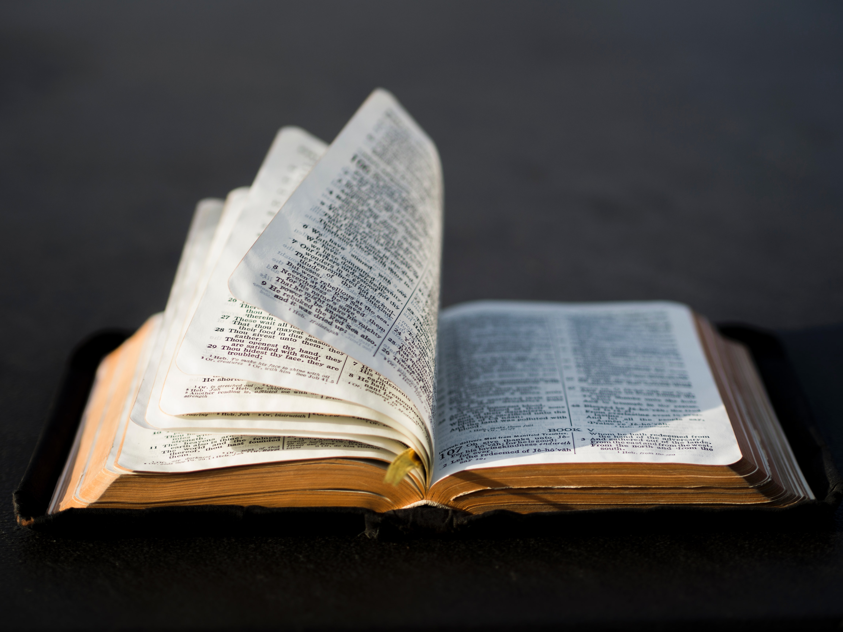
God’s values are a framework within which we act politically
上帝的价值观是我们在其中采取政治行动的框架

Slide 11
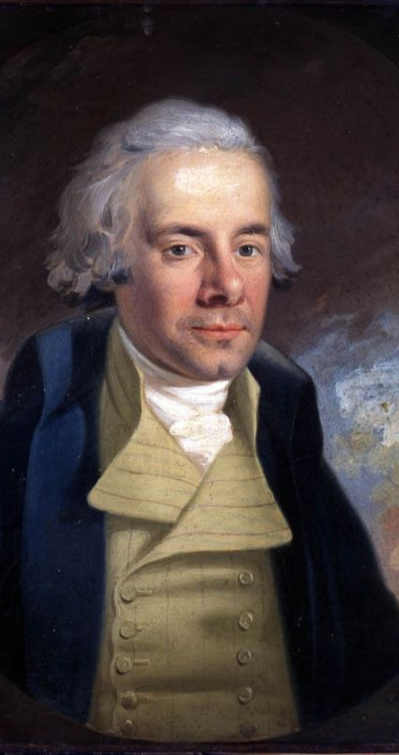
“God Almighty has set before me two great objects: the suppression of the slave trade and the reformation of manners [culture].” “全能的上帝已将两大目标摆在我面前：禁止贩卖奴隶和改革风俗 [文化]。”
-William Wilberforce
威廉·威伯福斯

Slide 12
How do we get conviction? 我们如何获得信念？
Get a deep understanding of Christian principles and teaching
深入了解基督教的原则和教义
Get a deep understanding of the issue at hand
深入了解手头的问题
Think through how to best approach the issue from within Christian principles
思考如何从基督教原则中最好地处理这个问题

Slide 13
Care 关怀

Slide 14

Conviction and Care must go hand-in-hand
定罪和关怀必须
齐头并进

Slide 15
How do we develop a sense of care in our civic life?
我们如何在公民生活中培养关怀意识？
Be humble 要谦虚
See the good in others 看到别人的优点
Recognize our uncertainty
认识到我们的不确定性
Recognize the limits to our understanding
认识到我们理解的局限性
Abstain from involvement when it is best
在最好的时候避免参与
What do they think they are doing?
他们认为他们在做什么？
What problem are they trying to solve?
他们试图解决什么问题？
What are their best points?
他们的最佳点是什么？
Jesus died for them too
耶稣也为他们而死
They are also made in God’s image
它们也是按照上帝的形象造的

Slide 16
Contentment 满意

Slide 17

The results are in God’s hands
结果在上帝手中

