Slide 1
A Win-Win Investment Strategy (Luke 16:1-15)
比胜的投资秘籍 （路 十六1-15）

Slide 2
“For the people of this world are more shrewd in dealing with their own kind than are the people of the light.” (Luke 16:8) “因 为 今 世 之 子 在 世 事 之 上 ， 较 比 光 明 之 子 更 加 聪 明 。” (路十六8)

Slide 3
The meaning of Shrewdness 狡猾还是机智？

Slide 4
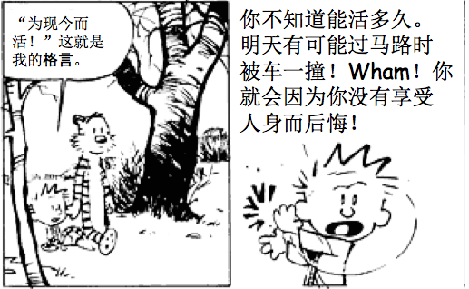
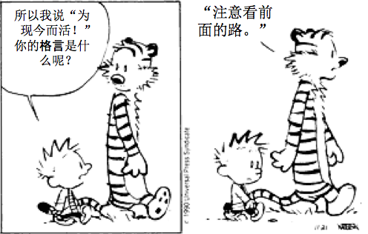

Slide 8
Look down the Road

Slide 9
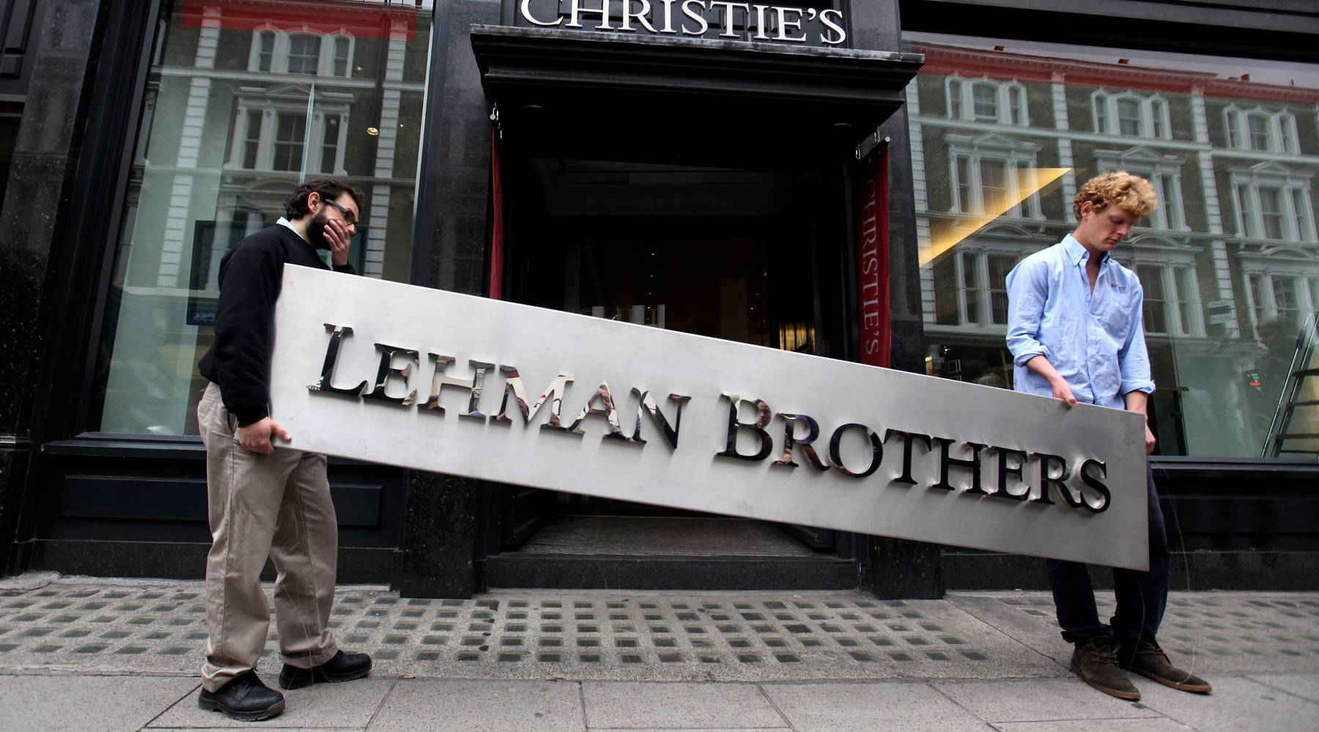

Slide 10
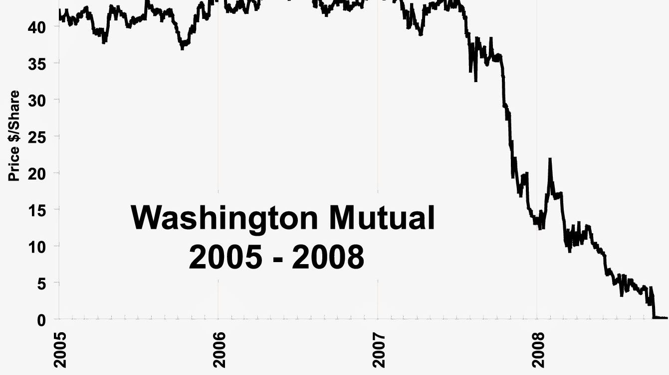

Slide 12
“Use worldly wealth to gain friends for yourselves, so that when it is gone, they will welcome you into heaven.” (Luke 16:9)
“要借着那不义的钱财结交朋友，到了钱财无用的时候，他们可以接你们到永存的帐幕里去.” (路十六9）

Slide 13
“Whoever can be trusted with very little can also be trusted with much, and whoever is dishonest with very little will also be dishonest with much. ¹¹ So if you have not been trustworthy in handling worldly wealth, who will trust you with true riches? ¹² And if you have not been trustworthy with someone else’s property, who will give you property of your own? (Luke 16:10-12)
人在最小的事上忠心，在大事上也忠心；在最小的事上不义，在大事上也不义。
11 倘若你们在不义的钱财上不忠心，谁还把那真实的钱财托付你们呢？
12 倘若你们在别人的东西上不忠心，谁还把你们自己的东西给你们呢？(路十六10-12）

Slide 14
“Every man of ambition has to fight his century with its own weapons. What this century worships is wealth. The God of this century is wealth. To succeed one must have wealth. At all cost one must have wealth.”
— Oscar Wilde

Slide 15
"No servant can serve two masters. Either he will hate the one and love the other, or he will be devoted to the one and despise the other. You cannot serve both God and Money." Luke 16:13
“一个仆人不能事奉两个主；不是恶这个爱那个，就是重这个轻那个。你们不能又事奉 神，又事奉玛门” 路十六13

Slide 16
“The Pharisees, who loved money, heard all this and were sneering at Jesus.” (Luke 16:14)
“法利赛人是贪爱钱财的；他们听见这一切话，就嗤笑耶稣。”路十六14

Slide 17
“You are the ones who justify yourselves in the eyes of men, but God knows your hearts. What is highly valued among men is detestable in God‘s sight.” Luke 16:15
「你们是在人面前自称为义的，你们的心， 神却知道；因为人所尊贵的，是 神看为可憎恶的。” 路十六15

Slide 18
Use worldly wealth to gain friends for yourself so that when it is gone, they will welcome you into heaven.

